Slide 1
DATABASE
CSE 2101
GROUP: Delight Smiles
LCD Dental Database

Slide 2
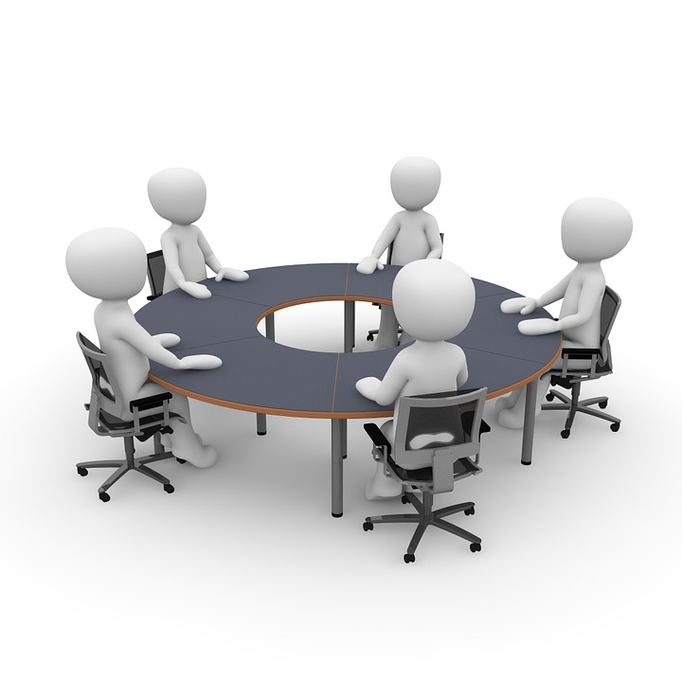
Delight Smiles- Group Members
Group Leader: Amber Beaton
        Ronaldo Springer
        Feliciann Elliot
        Jason Jay Jacobs
        Kim Shing Chong

Slide 3
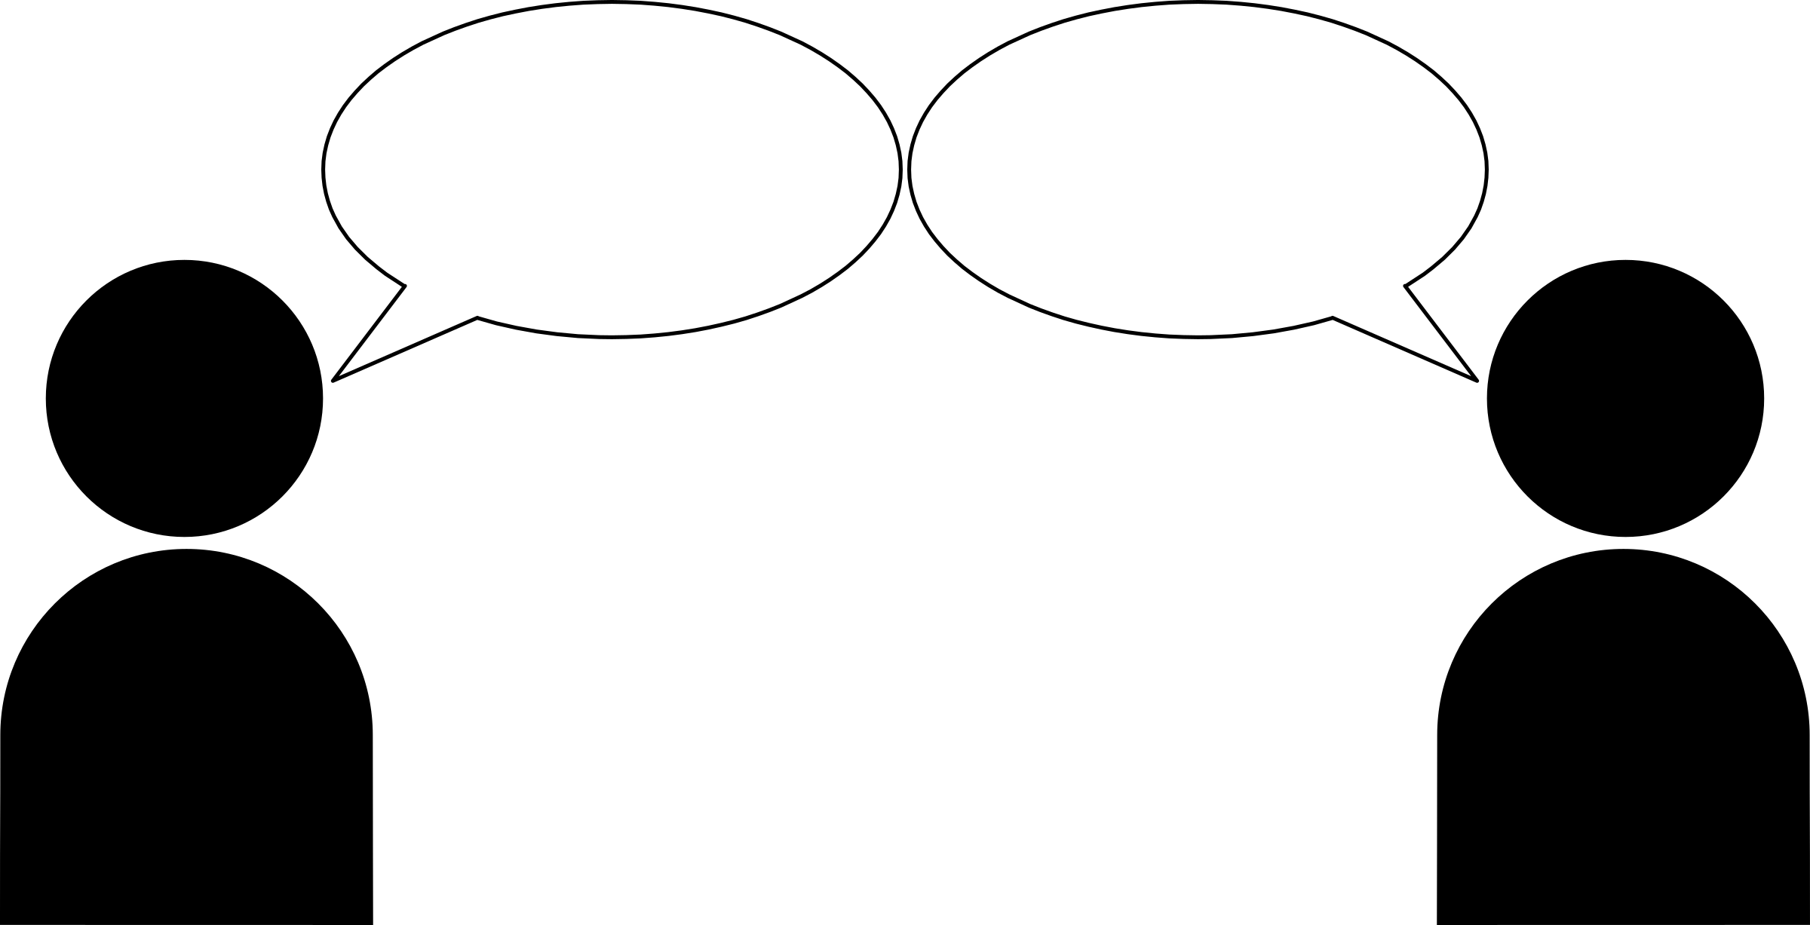
Problem? How can we be of service?
I need your help
Please do tell!

Slide 4
Problem Statement
Shavannie, the manager of the dental department, from the Leonora Diagnostic Centre, has found it very tedious to record and keep track of her patient’s required information. She is currently using manual books to document information needed. This method was working for the past year, however, as more patients are being registered to the dental department, the performance rate has dropped significantly. It is becoming more time-consuming for her to access, edit and even record the patients’ information. Also, the information can be easily breached and used by whoever gets their hands on the book.

Slide 5
Requirements the Client Desire
She would like a database system to be implemented so that she can:
Systematically input patient’s relevant information
Edit the information.
Update or delete records.
Save and store records.
Search and sort records.

Slide 6
System Overview
System Overview | Details
System Name | Leonora Diagnostic Centre Dental Database
System Code | BNG-7H921
System Type | Client Sever Application
System Category | Major Application
Operational Status | Under Development
Database Name | LDC-Dental Record

Slide 7
Points of Contact
Position/Role | Name | Email Address | Contact Number
Client | Shavannie Persaud | Ldc_dental@gmail.com | +592 629-8143
Database Manager | Sakuran Hirman | S_hirman@gmail.com | +592 672-5194

Slide 8
System the will be used
Vendor | Product | Version | Comments
Microsoft | Microsoft SQL server | Standard Edition 2012 | Database Management System

Slide 9
Storage Requirements
Storage Device | Minimum Free Space
Hard disk | 16 GB (more will be required as time progress)

Slide 10
CONCEPTUAL
DATABASE
DESIGN

Slide 11
Conceptual Database Design
ENTITY SET
Patient
Teeth
Dentist

Slide 12
Attributes of Entities
Patient
Patient ID
Teeth Number
First Name
Last Name
DOB
Sex
Address
Note

Slide 13
Attributes of entities cont.
Teeth
Teeth ID
Number of Anesthesia

Slide 14
Attributes of entities cont.
Dentist
First Name
Last Name
Dentist ID
Sex
Note

Slide 15
Relationships between Entities
Relationships
Removes
Visits

Slide 16
Attributes of Relationship
Removes
Date
Remove ID
Patient ID
Dentist ID
Teeth ID

Slide 17
Attributes of Relationship cont.
Visits
Date
Visit ID
Patient ID
Dentist ID

Slide 18
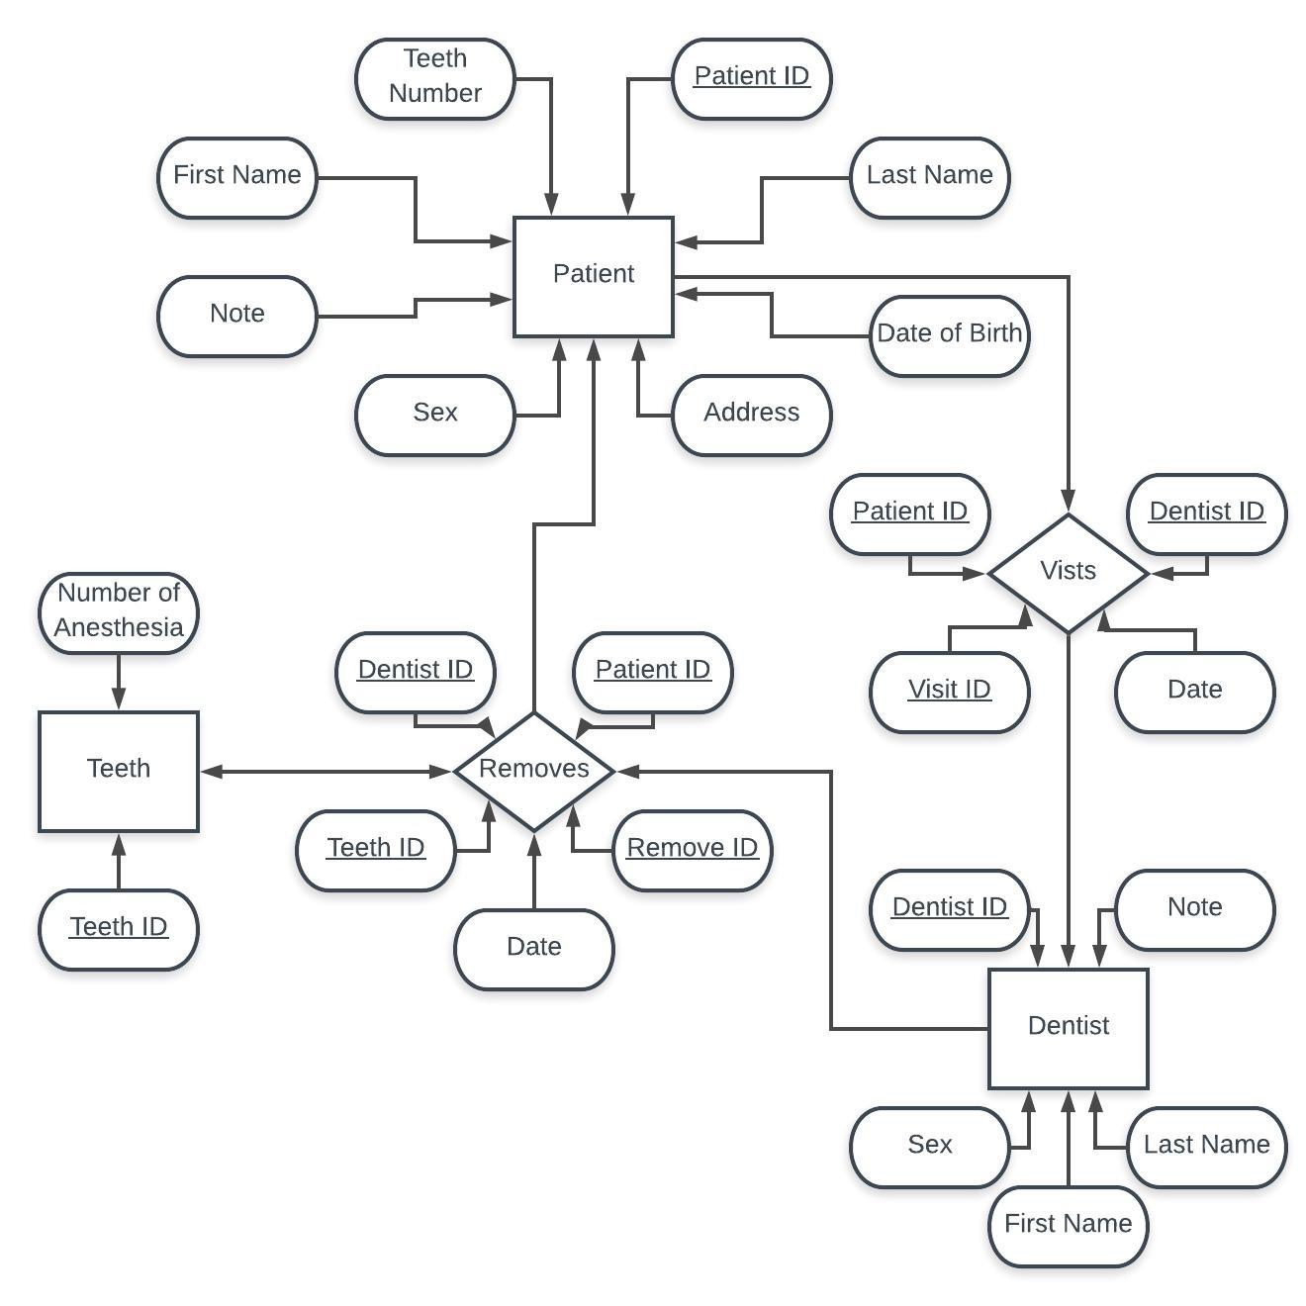
Entity Relationship Diagram

Slide 19
LOGICAL
DATABASE
DESIGN

Slide 20
Logical Database Design
Dentist: ( Dentist ID: INT (7), First Name: VARCHAR (15), Last Name: VARCHAR (15), Sex: CHAR (1), Note: VARCHAR (100) )

Slide 21
Logical Database Design cont.
Removes: ( Remove ID: INT (7), Date: DATE, Dentist ID: INT (7), Teeth ID: INT (7), Patient ID: INT (7) )

Slide 22
Logical Database Design cont.
Teeth: ( Teeth ID: INT (7), Number of Anesthesia: INT (1) )

Slide 23
Logical Database Design cont.
Patient: (Patient ID: INT (7), Teeth Number: INT (7), First Name: VARCHAR (15), Last Name: VARCHAR (15), DOB: DATE, Sex: CHAR (1), Address: VARCHAR (120), Note: VARCHAR (100) ).

Slide 24
Logical Database Design cont.
Visits: ( Date: DATE, Visit ID: INT (7), Patient ID: INT (7), Dentist ID: INT (7) )

Slide 25
