Slide 1
CSE 2102 DATABASE MANAGEMENT – Sir Girendra Persaud.
Done by Delight-Smiles

Slide 2
GROUP MEMBERS OF DELIGHT SMILES
Amber Beaton
Ronaldo Springer
Feliciann Elliot
Kim Shing Chong
Jason Jacobs

Slide 3
Presentation Outline
Problem Statement
Proposed Idea
Purpose
System Overview
Points of Contact
System Using the Database
Schema
ER Diagram
Conceptual Database Design
Logical Database Design
Functional Requirements
Flow Chart Process
Dental Demo
Conclusion

Slide 4
Problem Statement
Miss Shavannie Persaud, the manager of the dental department, from the Leonora Diagnostic Centre, has found it very tedious to record and keep track of her patient’s required information.
She is currently using manual books to document information needed. This method was working for the past year, however, as more patients are being registered to the dental department, the performance rate has dropped significantly.
It is becoming more time-consuming for her to access, edit and even record the patients’ information.
The information can be easily breached and used by whoever gets their hands on the book.

Slide 5
Proposed Idea
She would like a database system to be implemented so that she can systematically record and secure the patients’ information within a database and record the various dentists that does the operation on patients’ teeth.

Slide 6
Purpose
The purpose of this database specification is to employ a more efficient way to securely store valid and mandatory information about patients who visit the Leonora Diagnostic Centre.

Slide 7
System Overview
System Overview | Details
System Name | Leonora Diagnostic Centre Dental Database
System Code | BNG-7H921
System Type | Client Server Application
System Category | Major Application
Operational Status | Under Development
Database Name | LDC-Dental Record

Slide 8
Points of Contact
Position/Role | Name | Email Address | Contact Number
Client | Shavannie Persaud | Ldc_dental@gmail.com | +592 629-8143

Slide 9
System Using The Database
The system that will be using the database is the MySQL server.
Product | Comments
MySQL server | Database Management System

Slide 10
Schema Information
The External Schema - the user of the database may see titles such as: Patient ID, First Name, Last Name, Age, Date of Birth, Address, Teeth Number, Number of Anesthetics etc.
The Conceptual Schema- For the conceptual/ logical schema, it stores data in terms of the data model of the Database Management system (DBMS). It describes all information that is stored in the database.
The Internal Schema-how data is to be represented and stored in secondary storage.

Slide 11
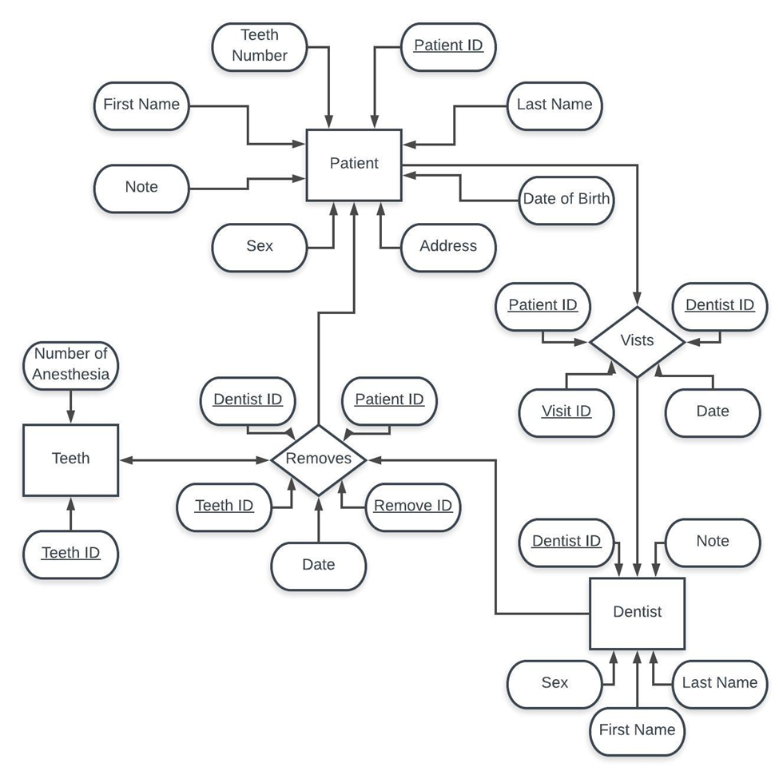
Entity Relationship Diagram

Slide 12
Conceptual Database Design Attributes of Entities-
Patient
Dentist
Teeth
Patient ID
Teeth Number
First Name
Last Name
DOB
Sex
Address
Note
Teeth ID
Number of anesthesia
First Name
Last Name
Dentist ID
Sex
Note

Slide 13
Attributes of Relationships
Removes
Visits
Date
Remove ID
Patient ID
Dentist ID
Teeth ID
Date
Visit ID
Patient ID
Dentist ID

Slide 14
Logical Database Design
Dentist: ( Dentist ID: INT (7), First Name: VARCHAR (15), Last Name: VARCHAR (15), Sex: CHAR (1), Note: VARCHAR (100) )
Patient: (Patient ID: INT (7), Teeth Number: INT (7), First Name: VARCHAR (15), Last Name: VARCHAR (15), DOB: DATE, Sex: CHAR (1), Address: VARCHAR (120), Note: VARCHAR (100) )
Teeth: ( Teeth ID: INT (7), Number of Anesthesia: INT (1) )
Removes: ( Remove ID: INT (7), Date: DATE, Dentist ID: INT (7), Teeth ID: INT (7), Patient ID: INT (7) )
Visits: ( Date: DATE, Visit ID: INT (7), Patient ID: INT (7), Dentist ID: INT (7) )

Slide 15
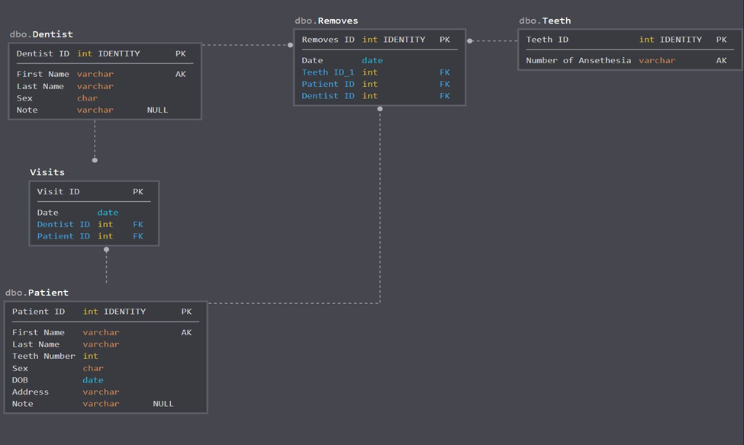

Slide 16
Functional Requirements
Input data or information into database
Edit data or information in the database
Update and delete records in the database
Save and store records in database
Search and sort records in database

Slide 17
Flow Chart Process

Slide 18
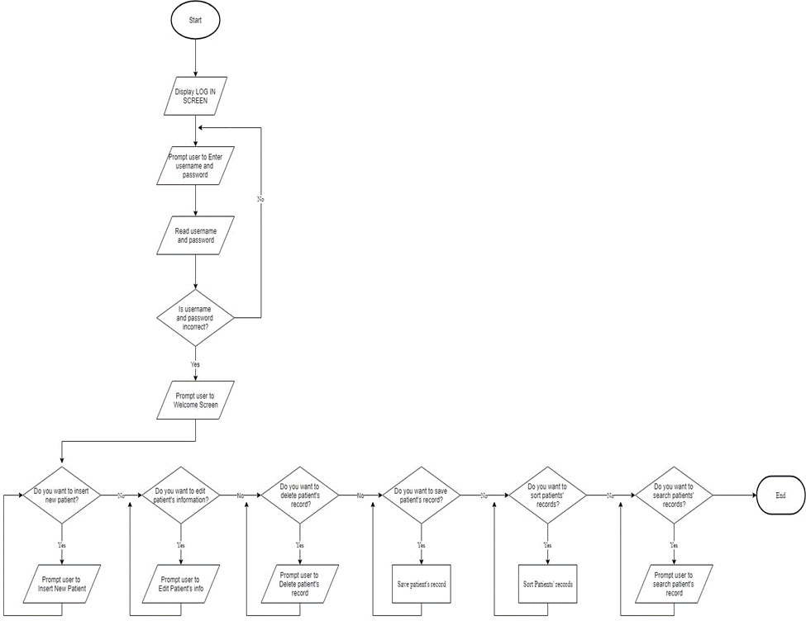

Slide 19
Dental Demo

Slide 20
Conclusion
The Leonora Diagnosis Centre now has a more efficient way to secure and store valid and mandatory information for both patients and Dentists through the implementation of a user friendly database system which systematically log precise information

