Slide 1
Software Quality Assurance Fundamentals:

Slide 2
What is Quality?
Quality is frequently defined as meeting the customer's requirements the first time and every time.
In the American Heritage Dictionary defines quality as “a characteristic or attribute of something”.
IEEE define Software Quality as:-
Conformance to explicitly stated functional and performance requirements, explicitly documented development standards and implicit characteristics that are expected of all professionally developed software.

Slide 3
Testing and quality
Quality is meeting customer's needs and requirements
Testing is finding out gaps between customer’s requirements and system to be delivered
Testing increases software quality
“ Testing identifies faults and whose removal increases software quality by increasing the software’s potential reliability “.
Testing is the measurement of software quality
“ We measure how closely we have achieved quality by testing the relevant factors such as Correctness, Reliability, Usability, Maintainability etc.”

Slide 4
Quality Control Vs Quality Assurance
Quality Control :
“ is the activity performed to ensue that a Product is ‘fit for Purpose’ “.
Quality Assurance:
“is the activity performed to test the process is being followed”
Quality Management:
Responsible choosing the correct process to ensure that the product is ‘fit for purpose’.

Slide 5
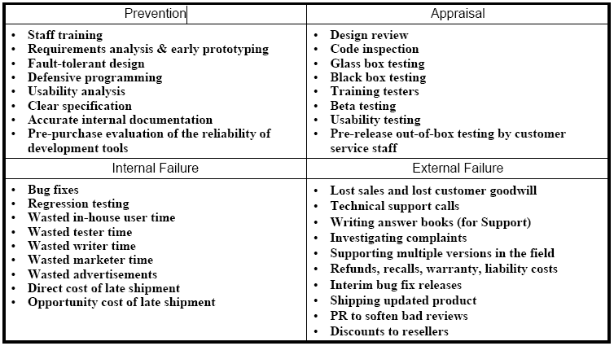
Quality Assurance Vs Quality Control
Quality Assurance | Quality Control
It is an activity that established and evaluate the process that produced product. | It is process by which product quality is compare with application standard
Identifies weaknesses in processes and improves them. | Identifying defects in the actual product produced
Primary purpose is identify weakness in process and improve them | Primary purpose is correcting defect
It is Staff function | It is line function
It gives confidence to customer | It gives confidence to Producer
Activies are – provide data for acquiring or helping install:- Software requirement specification process, development process, maintenance process, testing process. | Activities are inspection , review, testing
Examples Defining Processes Quality Audit Selection of tools Training | Examples Walkthrough Testing Inspection Checkpoint review

Slide 6
Cost Of Quality
Prevention Cost -- Quality Assurance Cost - auditing, process improvement.
Appraisal Cost -- Cost of Finding the defects
Failure Cost --Cost which is incurred and need to be fixed. Fixing the defects.

Slide 7
Cost Of Quality
Prevention Costs: Costs of activities that are specifically designed to prevent poor quality. Examples of "poor quality" include coding errors, design errors, mistakes in the user manuals, as well as badly documented or unmaintainably complex code.
Note that most of the prevention costs don’t fit within the Testing Group’s budget. This money is spent by the programming, design, and marketing staffs.

Slide 8
Cost Of Quality
Appraisal Costs: Costs of activities designed to find quality problems, such as code inspections and any type of testing.
Design reviews are part prevention and part appraisal. To the degree that you’re looking for errors in the proposed design itself when you do the review, you’re doing an appraisal. To the degree that you are looking for ways to strengthen the design, you are doing prevention.
Failure Costs: Costs that result from poor quality, such as the cost of fixing bugs and the cost of dealing with customer complaints.

Slide 9
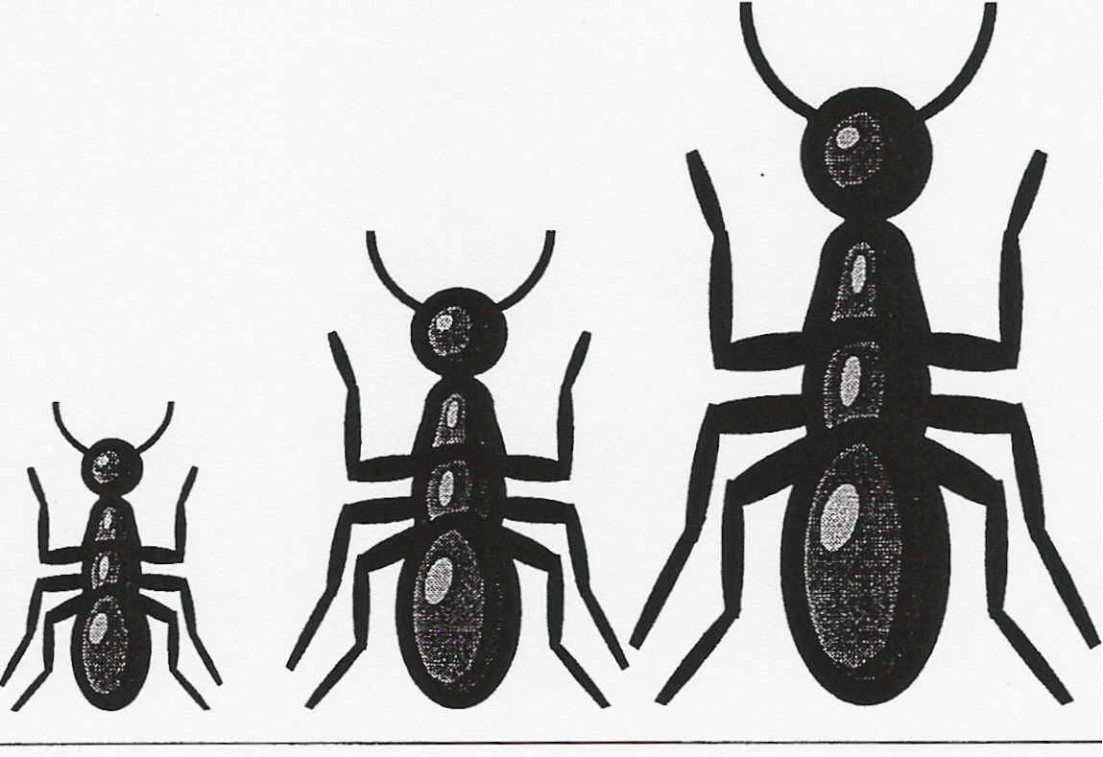
Cost Of bugs
The cost to fix bugs increased dramatically over time
Cost
Specification Design Code
Time When Bug Is Found

Slide 10
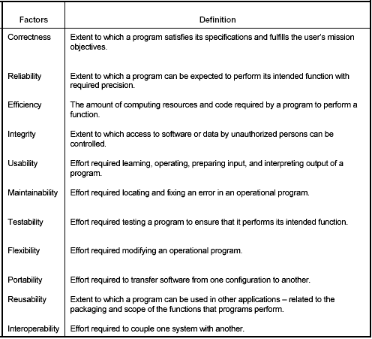
Test / quality factors

Slide 11
McCall’s Quality Factors
Functionality:- The capability to provide functions which meet stated and implied need when the software is used.
Correctness:- Extent to which a program satisfies its specifications and fulfils user’s mission objectives
Reliability:- Extent to which a program can be expected to perform its intended function with required precision.
Efficiency:- The amount of computing resources and code required by a program to perform a function.

Slide 12
McCall’s Quality Factors
Integrity:- Extend to which access to software or data by unauthorized persons can be controlled
Usability:- Effort required learning , operating , preparing input and interpreting output of a program
Maintainability:- Effort required locating and fixing an error in an operational program
Testability:- Effort required testing a program to ensure that it perform its intended function

Slide 13
McCall’s Quality Factors
Flexibility:- Effort required to modify an operational program
Portability:- Effort required to transfer software from one configuration to another
Reusability:- Extent to which a program can be used in other applications- - related to the packaging and scope of function that programs perform
Interpretability:- Effort required to couple one system with another

Slide 14
Thank You

