Slide 1
Driving License Test Using Machine Learning
Team Member:
Prakash Kumar Pachauri
Priyranjan Kumar
Umashankar.M

Slide 2
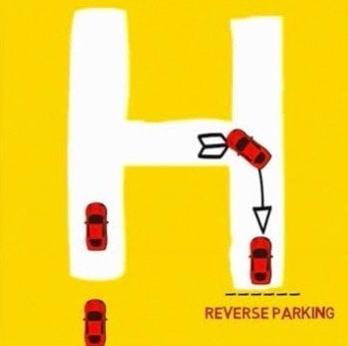

INTRODUCTION TO H-PATTERN DRIVING TEST
The is essential for
evaluating driving skills. This presentation explores how can enhance
the accuracy of such evaluations. By leveraging advanced algorithms, we can provide more objective assessments and
improve driver training outcomes.

Slide 3

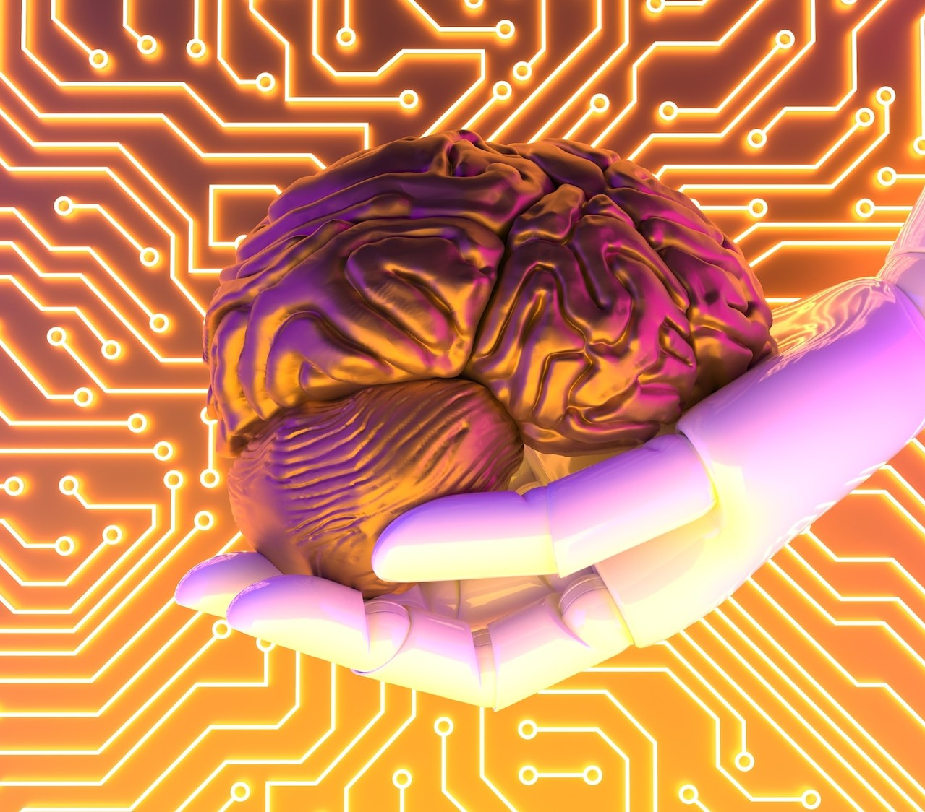
UNDERSTANDING MACHINE LEARNING
involves algorithms that learn from data to make predictions or decisions. In driving test evaluations, it can analyze patterns in driver behavior, helping to identify strengths and weaknesses in driving skills. This technology is revolutionizing how we assess driving proficiency.

Slide 4
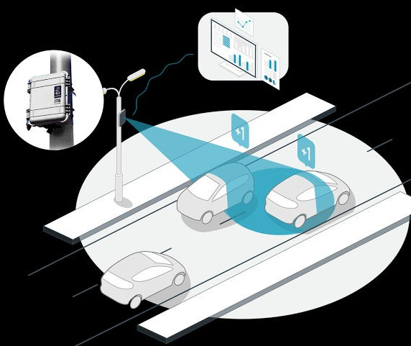


DATA COLLECTION METHODS
To eﬀectively apply relevant data. This includes
, we must gather from vehicles,
video footage of driving tests, and feedback from instructors. Collecting comprehensive data allows for more accurate training of machine learning models, leading to better evaluation outcomes.

Slide 5
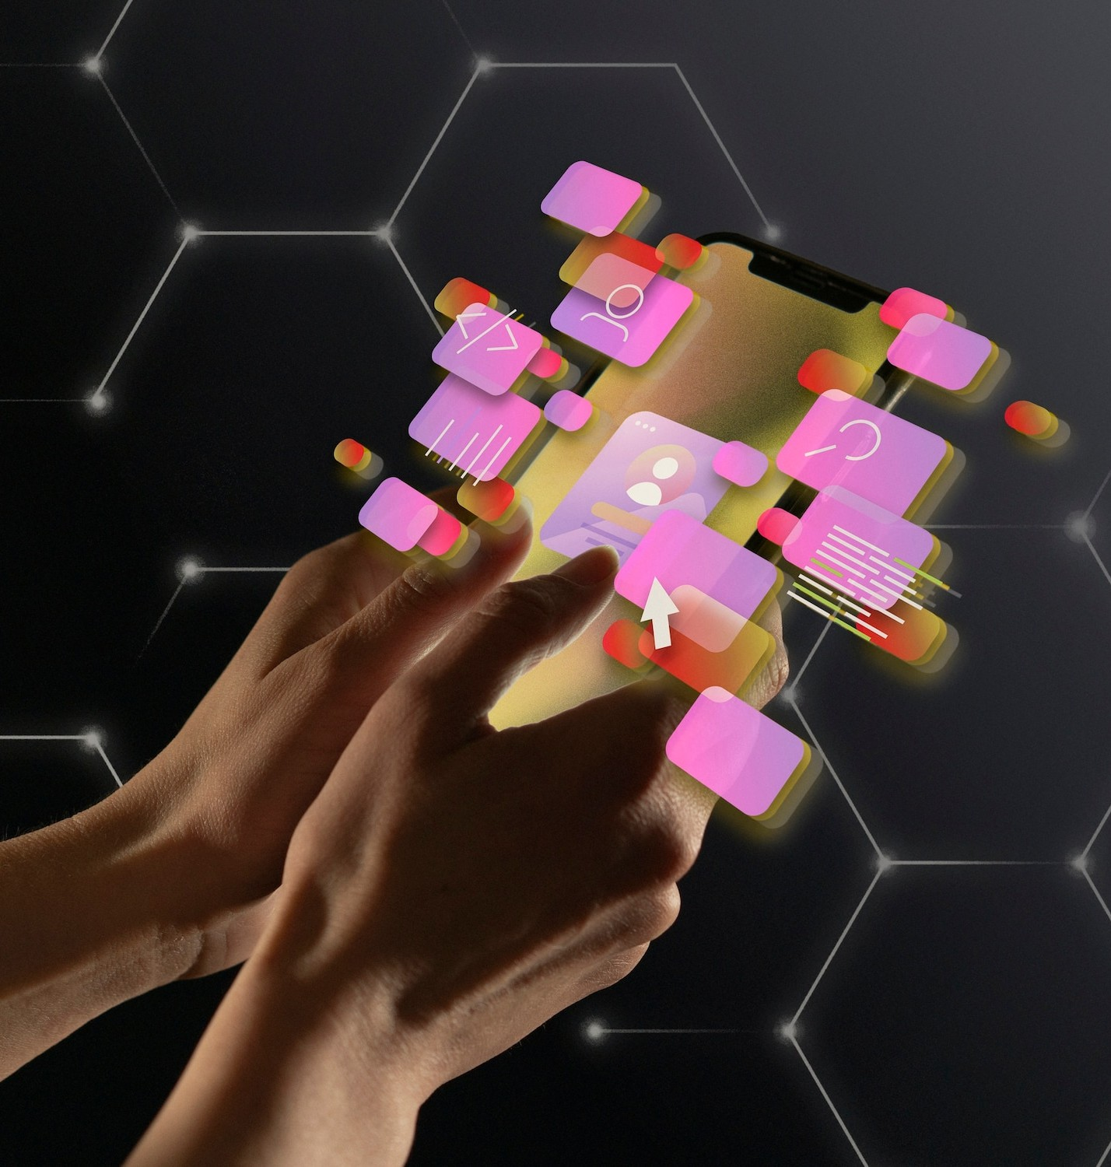
MACHINE LEARNING ALGORITHMS USED
Various machine learning algorithms can be employed in driving test evaluations, including supervised and unsupervised learning.
Techniques like neural networks and decision trees can analyze driving patterns, predict performance, and provide insights for
improvement, enhancing the overall testing process.

Slide 6

BENEFITS OF ENHANCED EVALUATION
Implementing machine learning in driving test evaluations oﬀers numerous benefits. It provides objective assessments, reduces human bias, and identifies specific areas for improvement.
This leads to more eﬀective training programs and ultimately safer drivers on the road.

Slide 7
CONCLUSION AND FUTURE DIRECTIONS
In conclusion, integrating machine learning into H-pattern driving test evaluations significantly enhances accuracy and eﬀectiveness. Future advancements may include real-time feedback systems and personalized training programs, further improving driver competency and safety on the roads.

Slide 8
Thanks!
Do you have any questions?

