Slide 1
HACKATHON 2K25
Personalized Learning Platform
Aanand Ingle
Gayatri Donatkar
Chitra Shinde

Slide 2
Team Details
Team Name: 404 Placement Not Found
Team Members:
Aanand Ingle: Backend Developer
Chitra Shinde: UI Developer
Gayatri Donatkar: UI Developer

Slide 3
Problem Statement
Problem Statement
In today’s digital learning environment, students and professionals often struggle to find relevant and personalized learning resources tailored to their unique needs, preferences, and progress. Traditional learning platforms offer static content without adaptive recommendations, leading to inefficient learning experiences. There is a need for an intelligent platform that dynamically curates learning materials, tracks progress and enhances engagement through quizzes and assessments.
Objective
To develop an AI-powered personalized learning platform that recommends learning resources (videos, articles, courses) based on user preferences, learning history, and progress. The platform will integrate features such as AI-driven content recommendations, real-time progress tracking, and interactive quizzes to optimize user engagement and improve learning outcomes.

Slide 4
Tech Stack
SQLAlchemy & PostgreSQL: For database management, handling queries, and ensuring efficient data storage and retrieval.
Flask: Lightweight Python web framework for building the backend and serving the application.
HTML, CSS: For structuring and styling the front-end interface.
JavaScript: For adding interactivity and handling dynamic data updates in real time.

Slide 5
API Models used
User Authentication API: Handles user registration, login, and authentication.
Resource Recommendation API: Uses AI-based algorithms to suggest learning materials based on user preferences and progress.
Progress Tracking API: Stores and retrieves user progress in courses, quizzes, and activities.
Quiz Management API: Generates and evaluates quizzes to enhance learning.

Slide 6
Features
AI-Powered Learning Recommendations
Provides personalized learning resources (videos, articles, courses) based on user preferences and progress.
Uses AI algorithms to analyze user activity and suggest relevant content.
User Authentication & Profile Management
Secure user registration and login system.
Allows users to manage their profiles and track their learning journey.
Progress Tracking System
Monitors user activity and tracks progress in different courses.
Displays learning milestones and completion status.
Interactive Quizzes & Assessments
Generates quizzes based on the completed topics.
Provides instant feedback and performance analysis.
Dynamic & Responsive UI
Built using HTML, CSS, and JavaScript for a seamless learning experience.
Ensures a smooth and user-friendly interface across devices.
Flask-Based Backend with PostgreSQL Database
Efficiently handles user data, progress tracking, and recommendations.
Uses SQLAlchemy for seamless database operations.

Slide 7
Implementation
Progress:
Partial implementation is available in the GitHub repository.
Flask API created for communication.
Initial tests conducted with sample datasets.
GitHub Repository Link: (Aanand2204/learning_platform: Hackathon2k25)

Slide 8
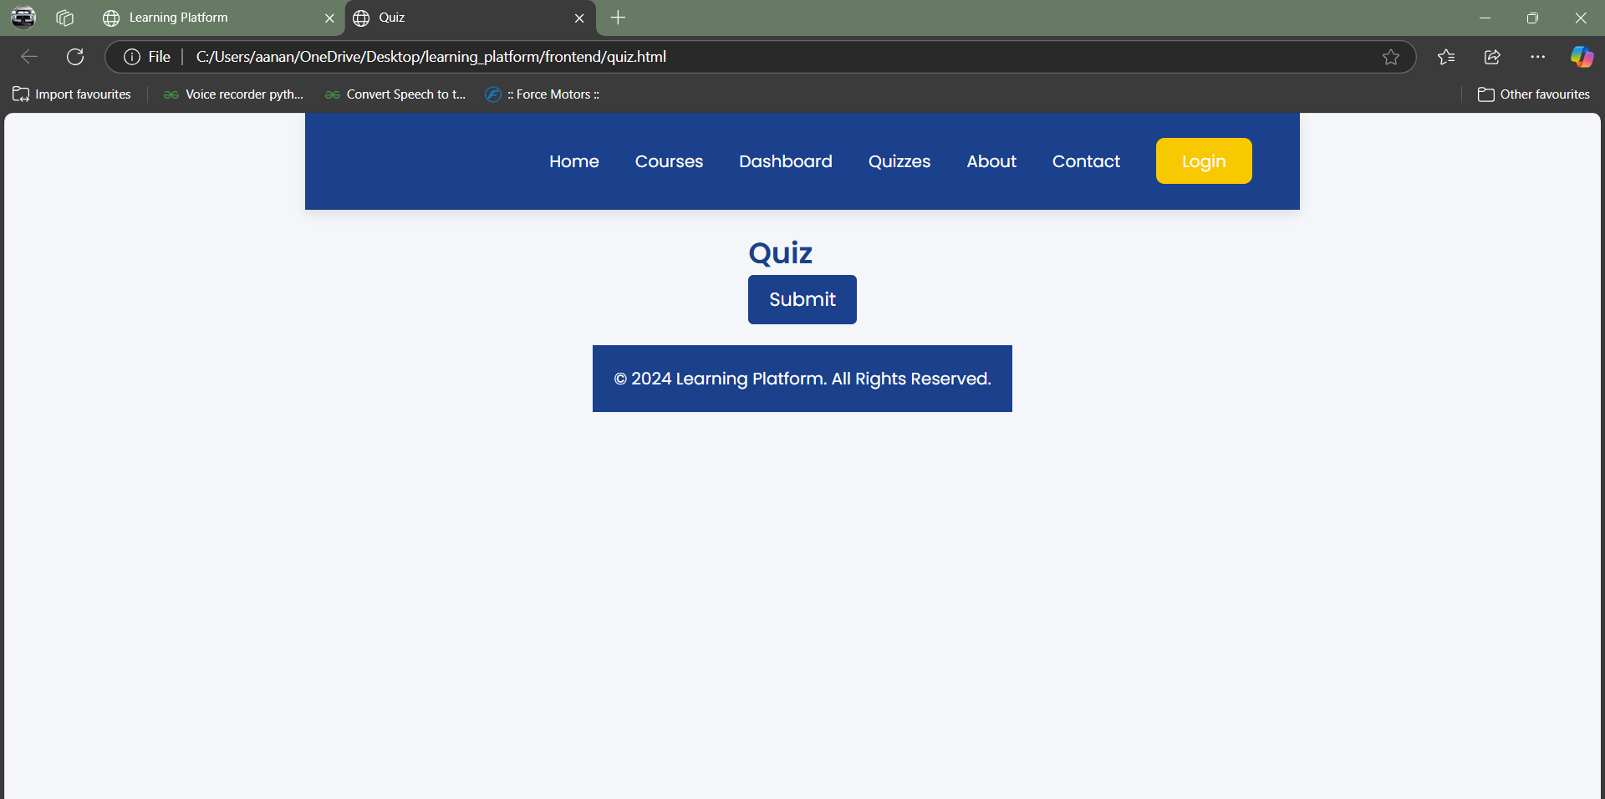
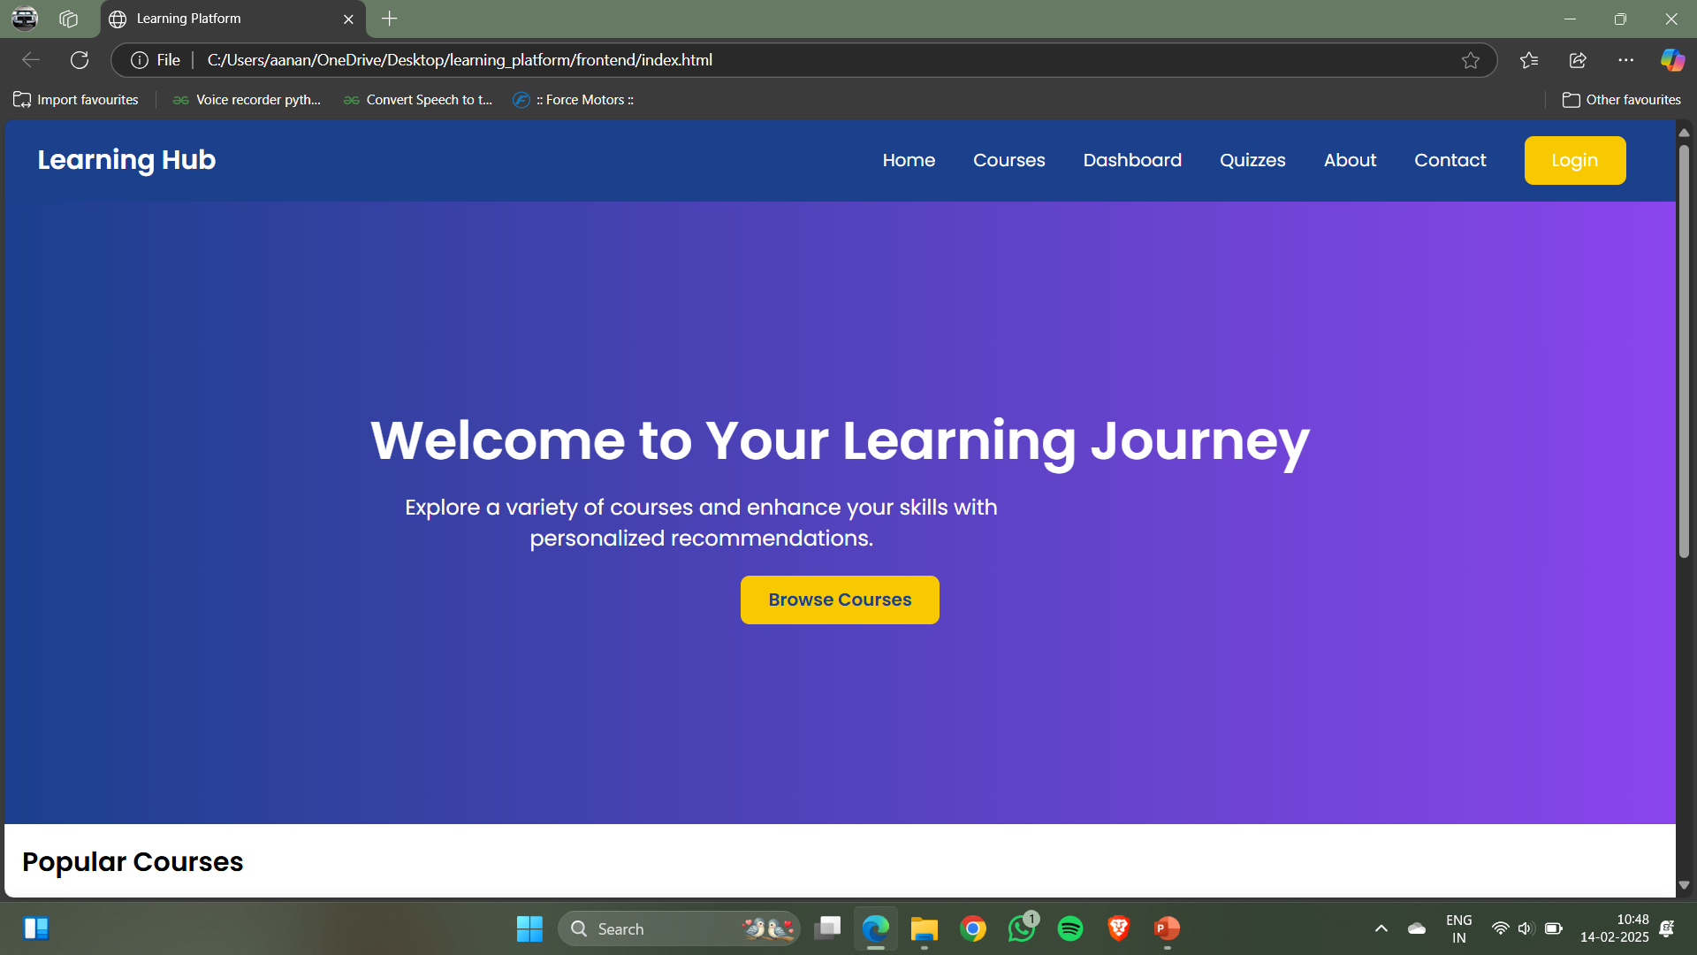
Front End

Slide 9
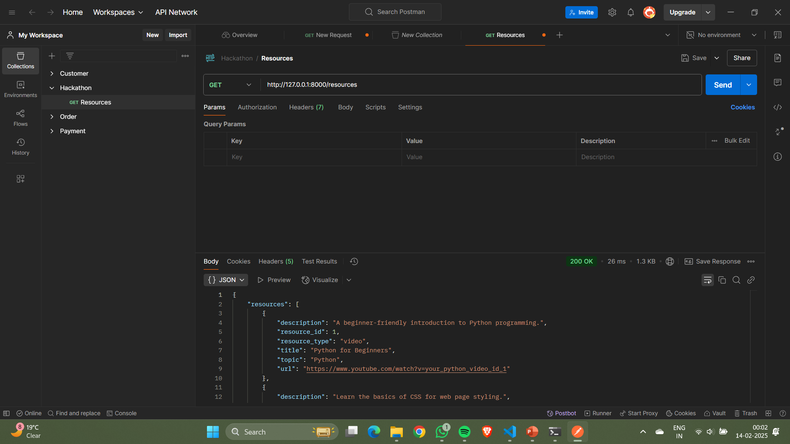
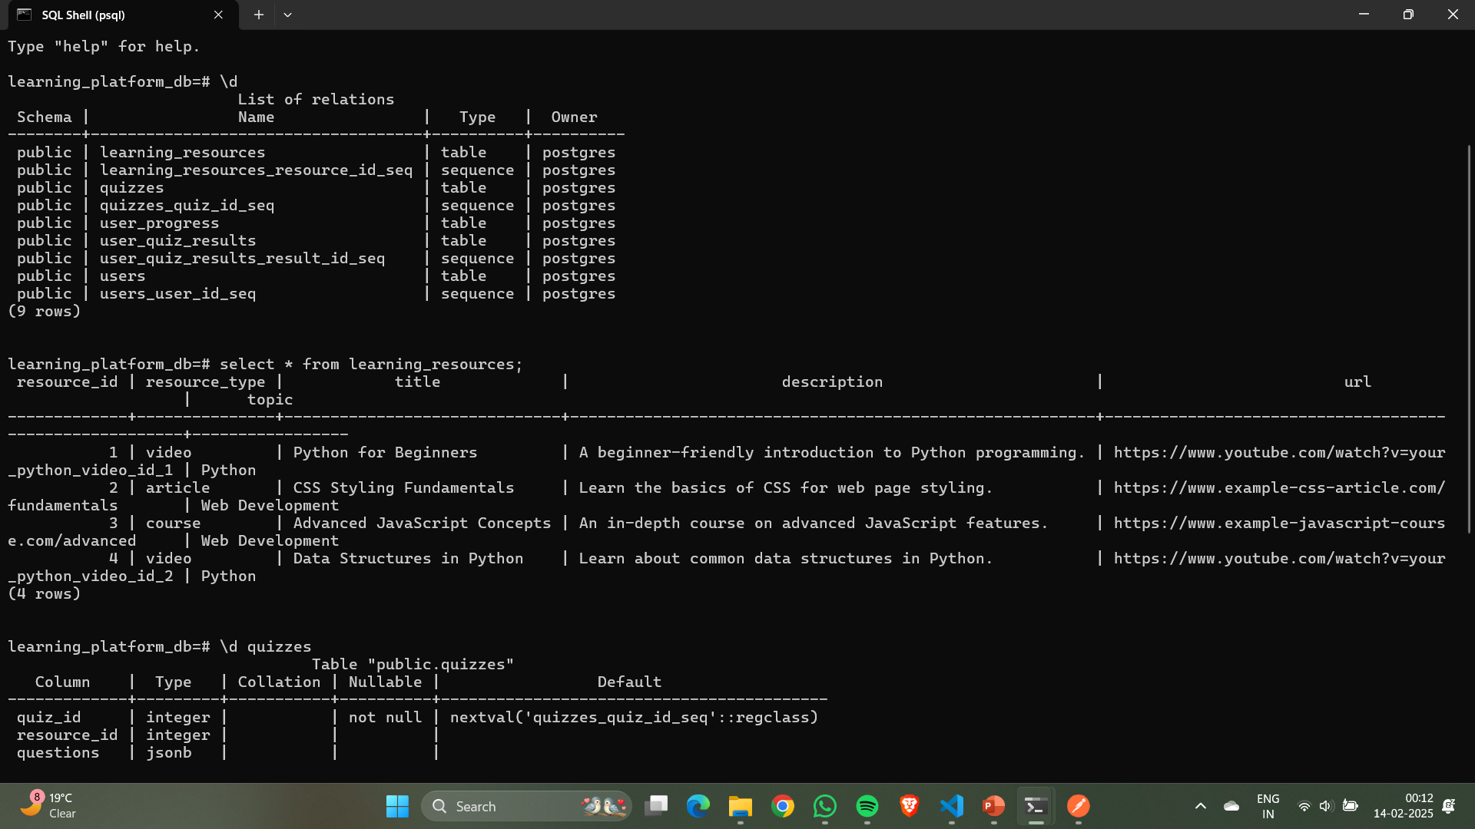
Testing of API’s

Slide 10
Current Status
Completed:
Development of a lightweight API.
2. In Progress:
Complete Implementation with the UI

Slide 11
Thank You

