Slide 1


Problem Statement 3: Real-Time Data Experience with Fluvio GREENHOUSE AGRI FARMING MONITORING
Submitted by (Solo Performer):
AANAND PANDIT
aanandpandit0001@gmail.com
github.com/AanandPandit
HACKHAZARD’S 25
Organized By
THE NAMESPACE COMMUNITY

Slide 2
INTRODUCTION
Introduction: A smart greenhouse system that simulates real-time monitoring and control using IoT, Fluvio, PyQt5, and Flask.
Problem Statement: Traditional greenhouses suffer from inefficient manual monitoring. This project provides a smart system for automated real-time environmental control.
Scope: The system simulates sensor readings for temperature, humidity, CO₂, soil moisture, water level, and rainfall, alongside device controls for lights, fans, pumps, and ACs. The solution is intended for educational, prototype, and simulation purposes and can be extended for real hardware integration.

Slide 3
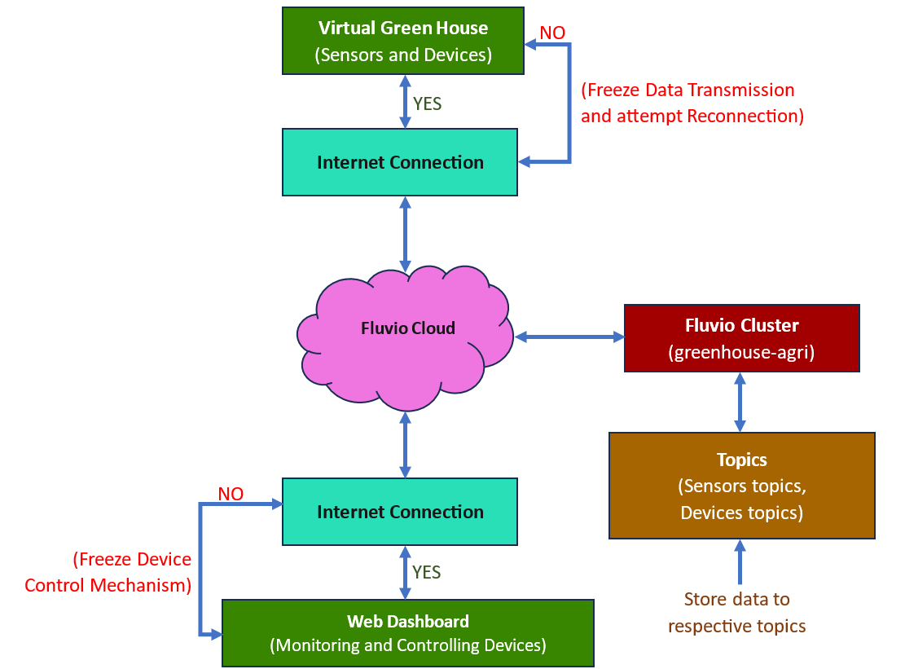
SYSTEM ARCHITECTURE
Technology Stack:
Languages: Python (Flask, PyQt5)
Web: HTML, CSS, JavaScript, Chart.js
Streaming: Fluvio (event-driven messaging and SmartModules)
Others: Threads, Subprocess, Pytz (for timezone handling)
Fig.: High-Level System Architecture

Slide 4
HOW TO RUN THE PROJECT
Requirements:
Linux OS
Python 3.12 or higher
Flask, and necessary library from requirements.txt
sudo pip3 install –r requirements.txt –break-system-packages
Follow the instructions from readme or from the documentation.
Links:
AanandPandit/hackhazards25_green-house-agri-farming
https://youtu.be/ubT7Vlt_fJ4

Slide 5
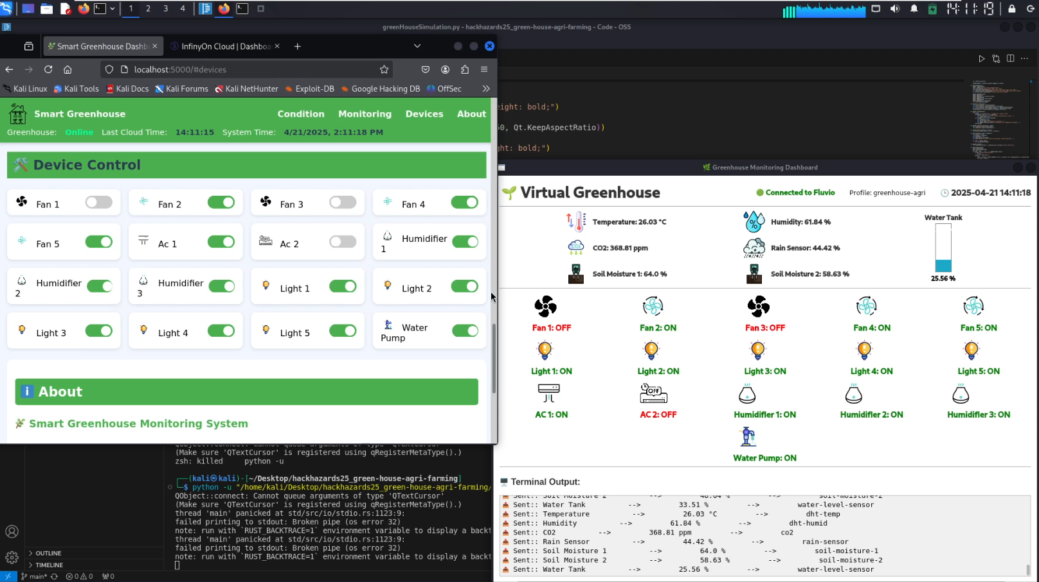
RESULSTS AND OUTPUT

Slide 6
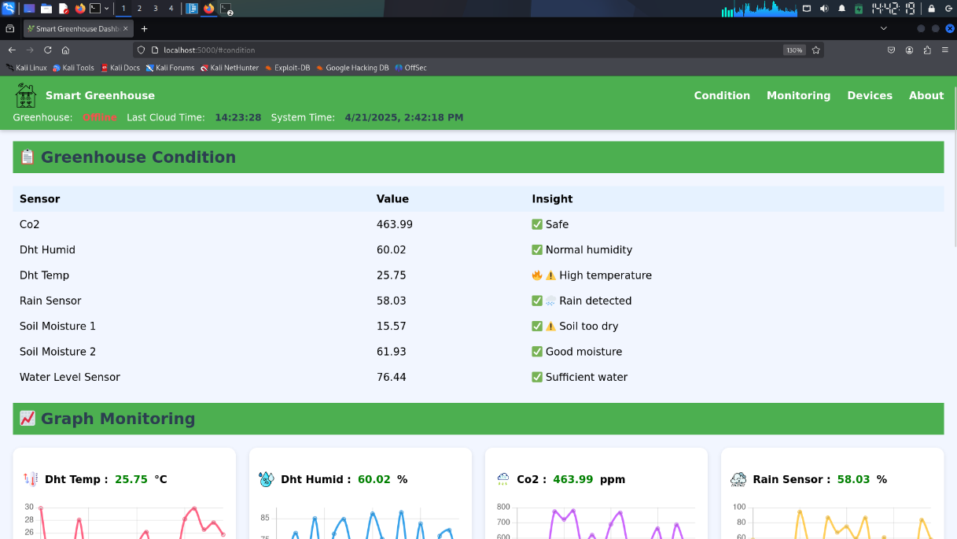
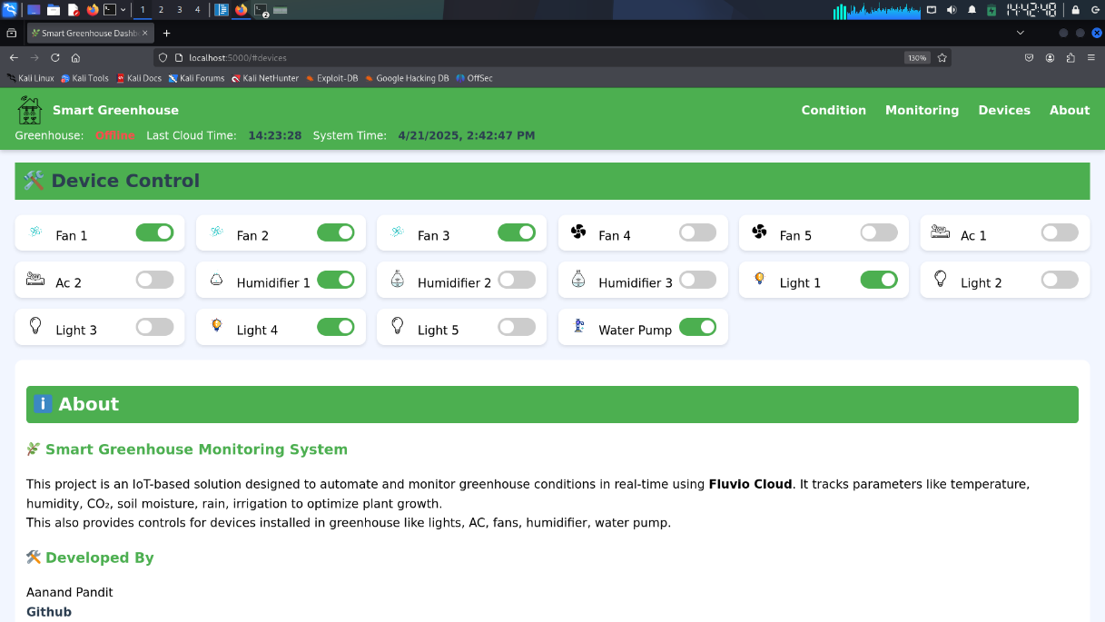
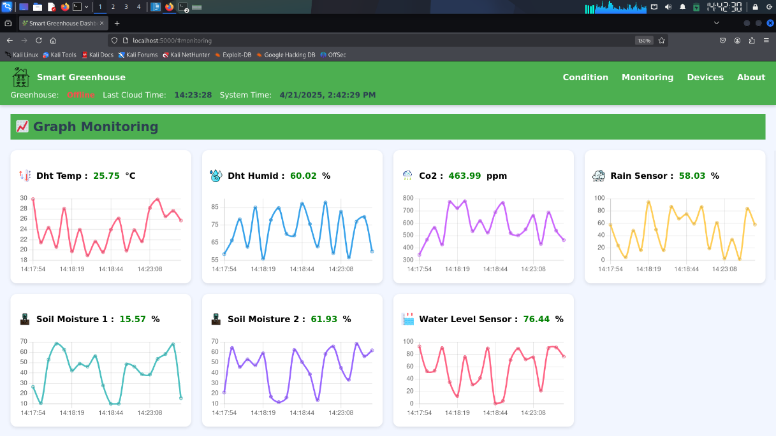
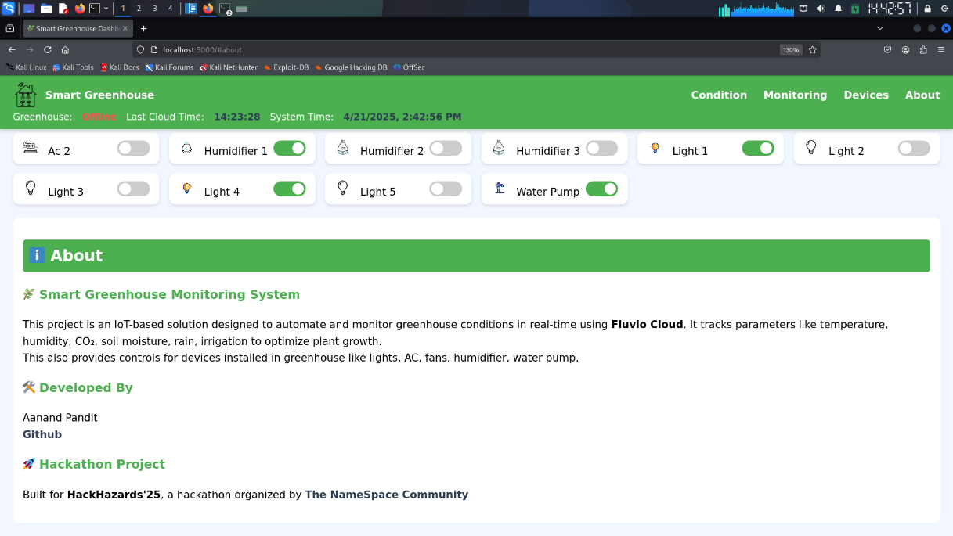
RESULSTS AND OUTPUT

