Slide 1
Employee Data Analysis using Excel
STUDENT NAME: Aanandavarshini R B
REGISTER NO: 312216416
DEPARTMENT: BCOM Computer Applications
COLLEGE: Shri Shankarlal Sundarbai Shasun Jain College for women

Slide 2
PROJECT TITLE
Employee Performance Analysis using Excel

Slide 3


AGENDA
Problem Statement
Project Overview
End Users
Our Solution and Proposition
Dataset Description
Modelling Approach
Results and Discussion
Conclusion
3/21/2024 Annual Review

Slide 4

PROBLEM STATEMENT
The performance of employees within an organization is a critical factor in achieving business objectives and maintaining competitiveness. However, identifying key areas for improvement and assessing individual and team performance can be complex and time-consuming. Without a systematic analysis of employee performance, it is challenging for management to make informed decisions on training, resource allocation, and performance management strategies. This presentation aims to delve into the current challenges faced in evaluating employee performance and proposes a comprehensive analysis framework to enhance performance evaluation processes within the organization.

Slide 5

PROJECT OVERVIEW
.
Employee Performance Analysis addresses the challenges organizations face in evaluating and improving employee performance. The presentation aims to provide a systematic analysis framework to enhance performance evaluation processes, enabling management to make informed decisions on training, resource allocation, and performance management strategies.

Slide 6
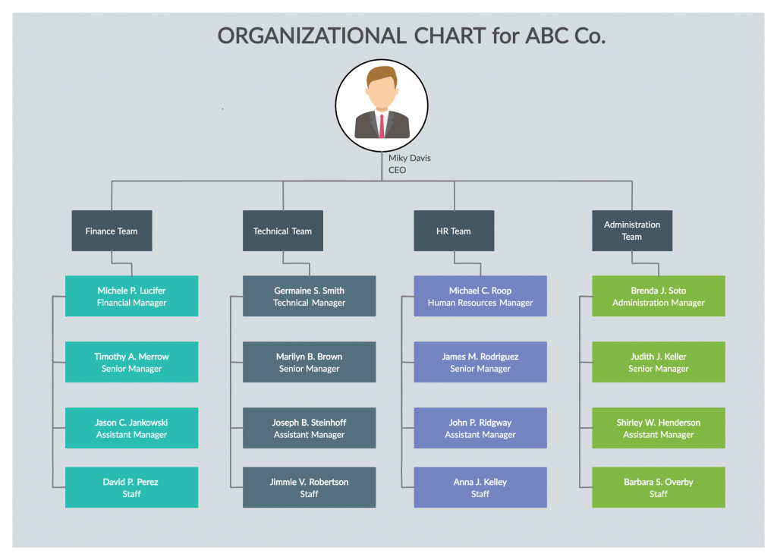

WHO ARE THE END USERS?
Managers
Human Resources Personnel
Team Leader
Other Stakeholders

Slide 7

OUR SOLUTION AND ITS VALUE PROPOSITION
Conditional Formating
Filter – remove
Formula – performance
Pivot – summary
Graph – data visualization

Slide 8
Dataset Description
The dataset for the employee performance analysis includes various parameters related to employee performance, such as employee ID, department, job role, performance ratings, attendance records, training history, project assignments, and any other relevant performance metrics. This dataset is crucial for conducting a comprehensive analysis of individual and team performance, identifying patterns, trends, and areas for improvement within the organization. By analyzing this data, organizations can make data-driven decisions to enhance employee productivity, engagement, and overall performance.

Slide 9

THE "WOW" IN OUR SOLUTION
Performance level =IF(Z8>=5,"EXCELLENT",IF(Z8>=4,"VERY GOOD"))
3/21/2024 Annual Review
9

Slide 10
MODELLING
The modeling approach for employee performance analysis in Excel involves a structured process that begins with the collection and organization of performance data. This data is input into Excel, where it is systematically arranged into tables for clarity. Data validation ensures consistency, and performance metrics are quantified using Excel formulas to derive meaningful indicators. Advanced tools such as PivotTables and statistical functions facilitate detailed analysis, revealing trends and relationships between various performance factors. Visualization techniques, including charts and dashboards, are employed to present the data in an accessible and insightful manner. This comprehensive approach allows for effective evaluation of employee performance, enabling data-driven decisions and enhancing the overall performance assessment process.
10

Slide 11
RESULTS
11

Slide 12
Pie chart

Slide 13
AREA

Slide 14
bar

Slide 15
Line

Slide 16
conclusion
Data analysis of employee performance provides a clear and objective understanding of how well employees achieve organizational goals. By utilizing analytical tools and techniques, organizations can identify performance trends, strengths, and areas for improvement. This approach enhances decision-making, supports targeted development, and improves overall workforce effectiveness by providing actionable insights and clear visualizations of performance data.

