Slide 1

DEPARTMENT OF STATISTICS

Slide 2
RESEARCH PROJECT
Statistical Study on Noise Pollution and Evaluation of Noise Pollution Awareness
Teacher Incharge-
Dr. Charanjeet Kaur
Department of Statistics
Ram Lal Anand College
Delhi University
Performed by-
Aanchal Gupta
Disha Luthra
Priya Gupta

Slide 3
A Note of Thanks
We would like to thank Dr. Rakesh Kumar Gupta, Principal, Ram Lal Anand College, for giving us the opportunity to carry out this project- Research Study on Noise Pollution and Evaluation of Noise Pollution Awareness.
We also wish to express our extreme gratitude to Dr. Charanjeet Kaur, for mentoring and guiding us to the successful completion of the project.
Last but not the least, sincere thanks to all the faculty members of Department of Statistics and our peers, who have supported us throughout the project.

Slide 4
INTRODUCTION
In 1910, a Nobel Prize winning German bacteriologist stated, “A day will come when man will have to fight merciless noise as the worst enemy of health”. According to Dr. Koch, “noise, like smog, is a slow agent of death”. Unfortunately, the forecast provided by Dr. Koch one hundred years ago has come true at the present time.
Review of international literature shows that there are many studies mapping the noise pollution in heavy traffic areas in cities such as airports, train stations, and factories and stating corrective measures to be taken in this matter (Tang & Tong, 2004; Thorsson, Ogren, & Kropp, 2004; Williams & McCrae, 1995).
Noise pollution is generally defined as the unwanted and disturbing sound which is higher than the normal level of sound comfortable to the human ear and has a negative effect on people and society (World Health Organization [WHO], 2001). It is different from other environmental pollutants. Noise pollution is invisible and odorless. It does not have any residuals and does not pollute soil and water. However, its effects take place slightly and in small steps (Lumpur, 1984).
The effects of noise pollution, on human health, can be categorized into three groups: auditory, physiological, and psychological. The causes of the observed noise pollution are many: including but not limited to traffic, overpopulation and failure to use sound absorbing materials. On the other hand, the most important determinant of this noise pollution is the awareness, sensitivity, and consciousness levels of administrators, students, teachers, and families in this matter.

Slide 5
About the Project
Aim: The project aims at studying the level of general awareness on noise pollution amongst college students and analysing the major
sources and effects of noise pollution.
The project was conducted in Ram Lal Anand College, University of Delhi between 20th March and 23rd April, 2019. Students of all years from all branches of study participated in the research project.
The sampling technique used was Proportional Allocation.
No. of students enrolled in college = 2200
Population size considered = 1754 (accounting for absentees)

Slide 6
METHODOLOGY
This study was conducted in Ram Lal Anand College with a population size of 2200 students enrolled in all the courses (of all years).
Broadly courses are divided into 3 categories: Science, Commerce, Arts& Humanities.The proportional allocation sampling method was used for determining the sample size in the study.
Proportional Allocation is defined as a statistical method of drawing representative data by dividing the sample into stratas and maintaining the same proportion of units in all the stratas as there are in the population. 3 course categories, as mentioned above, were taken as stratas and the same proportion as in the population was maintained.
For collecting data, noise pollution questionnaire for students was prepared which contained mostly multiple choice questions capturing the sensitivity and general awareness among the students on noise pollution. The results of the questionnaire were analysed by using descriptive statistics, chi square test and comparative tables.

Slide 7
TOTAL POPULATION OF COLLEGE: 2200
POPULATION SIZE CONSIDERED: 1754 (accounting for absentees)
SAMPLE SIZE: 217
COURSES | POPULATION | SAMPLE
SCIENCE | 458 (26.11 %) | 57
COMMERCE | 373 (21.26%) | 46
ARTS/HUMANITIES | 923 (52.62%) | 114

Slide 8
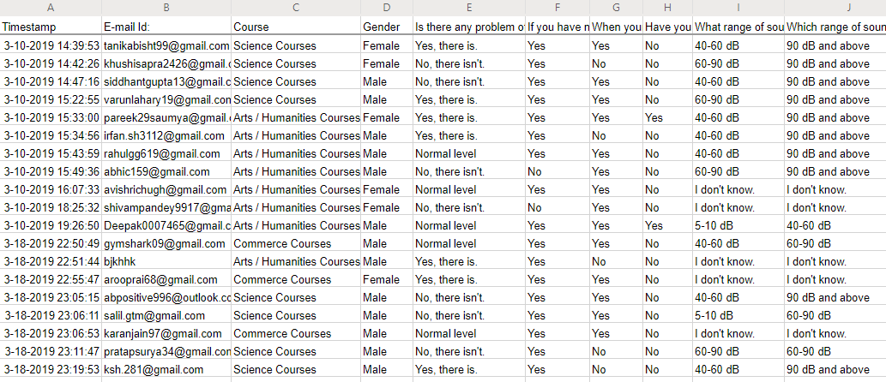
Few Sample Responses

Slide 9
GENDER COMPOSITION OF RESPONDENTS

Slide 10
COURSE

Slide 11
Is there any problem of noise pollution in your area?

Slide 13
SOME GENERAL AWARENESS QUESTIONS

Slide 14
COMPARISON OF CORRECT V/S INCORRECT RESPONSES

Slide 15
Inference: On an average, it is seen that students have little knowledge, understanding, sensitivity and awareness of Noise Pollution.

Slide 16
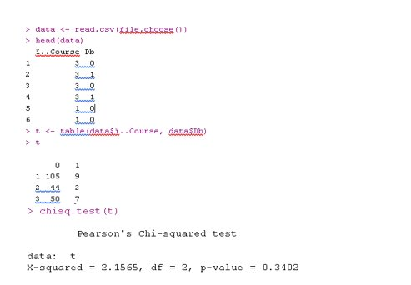
CHI-SQ TEST for
What range of sound intensity can human
ear hear comfortably?
Ans – 60-90 Db (according to course)[3 – sci, 2- comm, 1- arts][1-r, 0-w]
INFERENCE: Since p-value>0.05, we fail to reject null hypothesis. Therefore, there is no relationship between general awareness on noise pollution among individuals and their course.

Slide 17
Based on gender​
> head(d)
Gender Db
1 1 0
2 1 1
3 1 0
4 1 1
5 1 0
6 1 0
> a <- table(d)
> a
Db
Gender 0 1
1 102 13
2 97 5
> chisq.test(a)
Pearson's Chi-squared test with Yates' continuity correction
data: a
X-squared = 2.132, df = 1, p-value = 0.1443
INFERENCE: Since p-value>0.05, we fail to reject null hypothesis. Therefore, there is no relationship between general awareness on noise pollution among individuals and their gender.

Slide 18
What is the time duration in which use of loudspeakers is banned without any official permission?
(BASED ON COURSES)
> t <- table(F)
> t
Time
Course 0 1
1 58 56
2 26 20
3 23 34
> chisq.test(t)
Pearson's Chi-squared test
data: t
X-squared = 2.8996, df = 2, p-value = 0.2346
INFERENCE: Since p-value>0.05, we fail to reject null hypothesis. Therefore, there is no relationship between general awareness on noise pollution among individuals and their course.

Slide 19
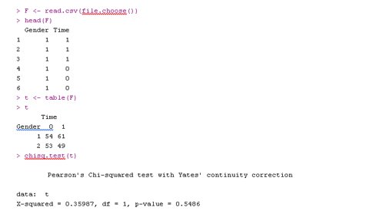
BASED ON GENDER
INFERENCE: Since p-value>0.05, we fail to reject null hypothesis. Therefore, there is no relationship between general awareness on noise
pollution among individuals and
their gender.

Slide 20
Areas under what radius around hospitals, educational institutions and courts have been declared 'silent'? (Based on Course)
> head(F)
Course dist
1 3 0
2 3 1
3 3 0
4 3 0
5 1 0
6 1 0
> t <- table(F)
> t
dist
Course 0 1
1 99 15
2 43 3
3 44 13
> chisq.test(t)
Pearson's Chi-squared test
data: t
X-squared = 5.763, df = 2, p-value = 0.05605
INFERENCE: Since p-value>0.05, we fail to reject null hypothesis. Therefore, there is no relationship between general awareness on noise pollution among individuals and their course.

Slide 21
Based on Gender
> head(x)
Gender dist
1 1 0
2 1 1
3 1 0
4 1 0
5 1 0
6 1 0
> t <- table(x)
> t
dist
Gender 0 1
1 94 21
2 92 10
> chisq.test(t)
Pearson's Chi-squared test with Yates' continuity correction
data: t
X-squared = 2.5044, df = 1, p-value = 0.1135
INFERENCE: Since p-value>0.05, we fail to reject null hypothesis. Therefore, there is no relationship between general awareness on noise pollution among individuals and their gender.

Slide 22
On combining these inferences:
1. Some people might believe that Awareness on Noise Pollution will be found more in Science Students when compared to Commerce and Arts students but the previous results have shown that this is as a 'Myth' and we can say that the General Awareness is independent of the academic course you study.
2. Also, it can be concluded that General Awareness is also independent of Gender.

Slide 23
CAUSES OF NOISE POLLUTION
Inference: From the above graph, it is clear that people believe Traffic to be the major cause of noise pollution nowadays.

Slide 24
Effects of Noise pollution
Inference: We observe here that majority of people nowadays are actually experiencing the effects of noise pollution even if it is in the form of general irritation or headache.

Slide 25
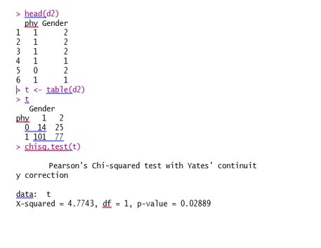
Physiological Effects of Noise Pollution (Based on Gender)
INFERENCE: Since p-value<0.05, we reject null hypothesis. Therefore, physi-ological effects of noise pollution has association with the gender of the person.

Slide 26
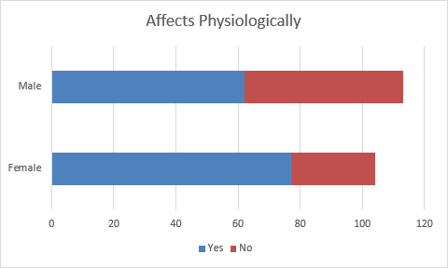

Slide 27
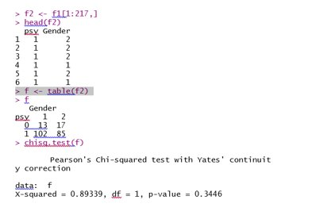
Psychological Effects of Noise Pollution (Based on Gender)
INFERENCE: Since p-value>0.05, we fail to reject null hypothesis. Therefore, there is no relationship between psychological effects of noise pollution on individuals and their gender.

Slide 28
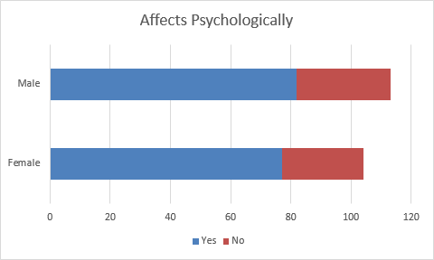

Slide 29
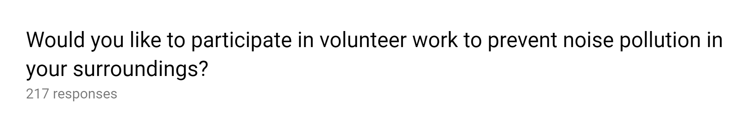
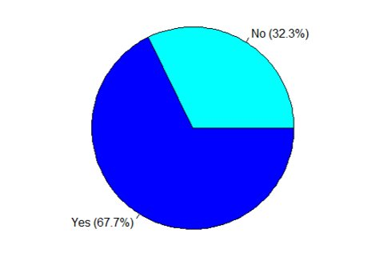
HOW WELL DO YOU HAVE KNOWLEDGE OF WORKING ON INTERNET?

Slide 30
CONCLUSION
Majority of students have the perception that the noise pollution around them is at normal level.
But, 80% of the people admitting having noise pollution around them feel that it is annoying.
The data indicated poor levels of general awareness among the students.
The general awareness on noise pollution was found to be independent of the course of study and gender.
Among the causes of noise pollution, Transportation is observed as the major one.

Slide 31
Majority of people nowadays are experiencing effects of noise pollution (mainly in the form of irritation and headache).
Physiological effects of noise pollution are gender dependent and are seen more in females.
There’s not much evidence for saying that psychological effects of noise pollution are gender dependent. A marginal difference is observed that males are getting affected psychologically a little more than females.
Lastly, a good percentage of students i.e. 67% are willing to participate in volunteer work to control and prevent noise pollution in their surroundings.

Slide 32
Future Scope Of The Project
The project can be extended further by taking new data points within the college, or expanding the project to university level from college level. This will help in drawing broader conclusions.
Noise level awareness and Sensitivity training can be given to the students and data on awareness can again be collected to check any increase in the level of general awareness.
The project can also be extended further by checking the noise pollution levels in and around the campus and comparing them with the permissible upper limits to conclude if there is a high noise pollution level or not.

