Slide 1
CSS - Training

Slide 2
CSS Basic Selectors
A CSS selector selects the HTML element(s) which we want to style
Types of Selectors:
CSS element Selector or type selector
CSS id Selector
CSS class Selector
CSS Universal Selector
CSS Grouping Selector

Slide 3
CSS Selectors
CSS element Selector: - The element selector selects HTML elements based on the element name
CSS id Selector - id selector uses the id attribute of an HTML element to select a specific element
CSS class Selector - Class selector selects HTML elements with a specific class attribute
p { text-align: center;
color: red; }
#textBoxName{ text-align: center; color: red; }
.portal { text-align: center; color: black; }

Slide 4
CSS Selectors
CSS Universal Selector: - CSS rule below will affect every HTML element on the page
CSS Grouping Selector
* { text-align: center; color: blue; }
h1 { text-align: center; color: red; } h2 { text-align: center; color: red; } p { text-align: center; color: red; }
h1, h2, p { text-align: center; color: red; }

Slide 5
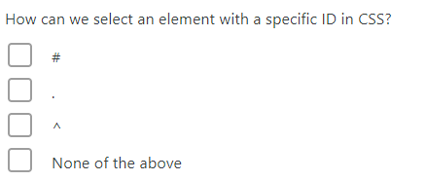
Question

Slide 6
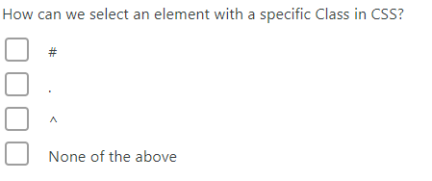
Question

Slide 7
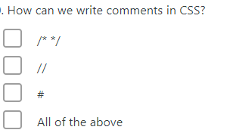
Question

Slide 8
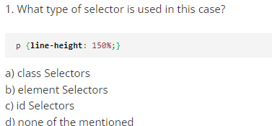
Question

Slide 9
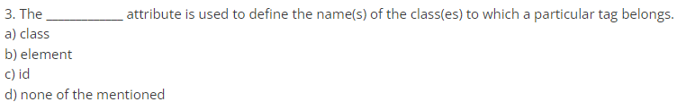
Question

Slide 10
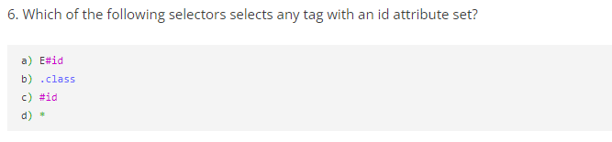
Question

Slide 11
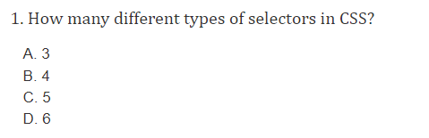
Question

Slide 12
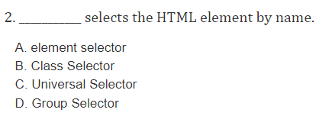
Question

Slide 13
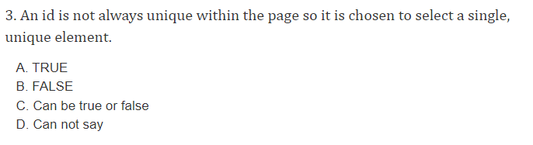
Question

Slide 14
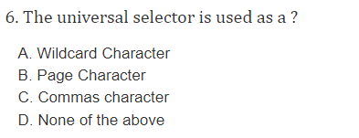
Question

