Slide 1
CSS - Training

Slide 2
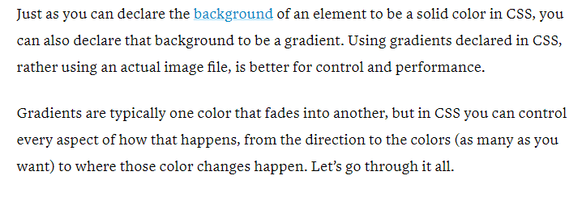
Gradient

Slide 3
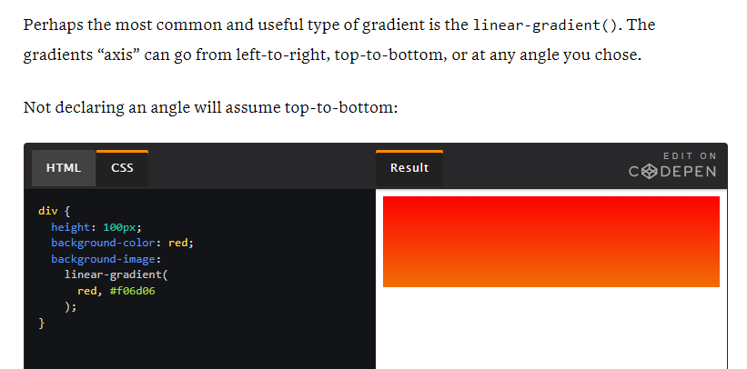
Linear Gradient

Slide 4
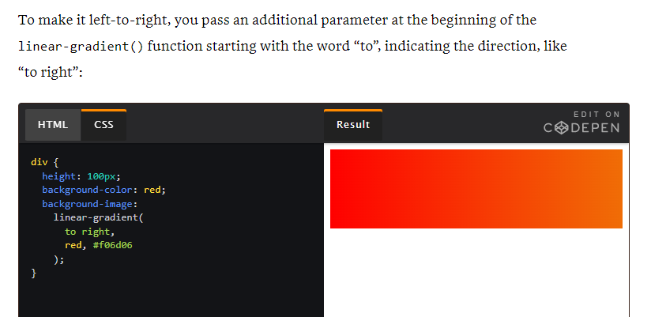
Linear Gradient – to - right

Slide 5
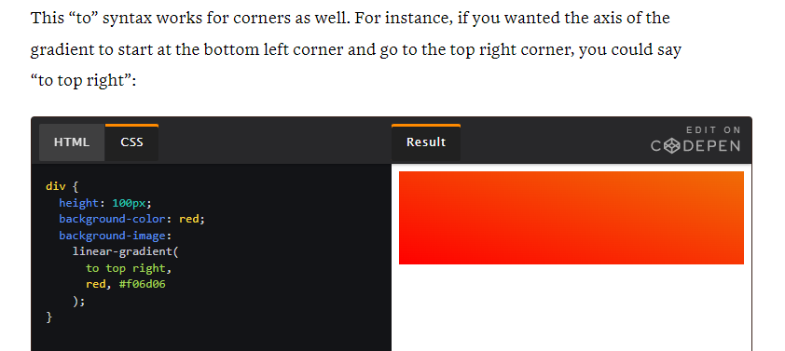
Linear Gradient – top - right

Slide 6
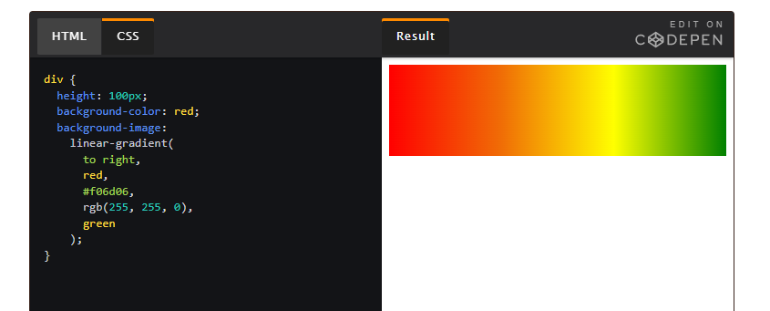
Linear Gradient – multiple color

Slide 7

Radial Gradient

Slide 8

Radial Gradient

Slide 9

Radial Gradient

Slide 10

Repeating-radial-gradient

Slide 11

Repeating-linear-gradient

Slide 12
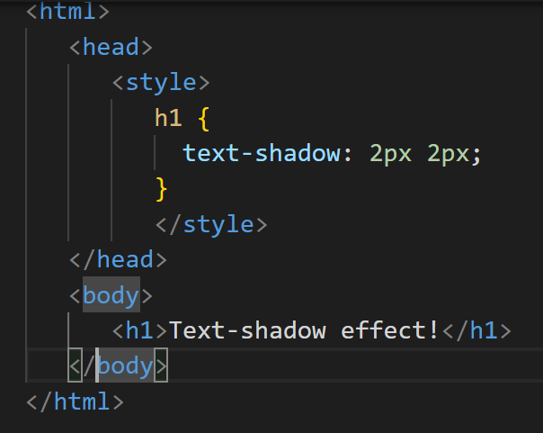
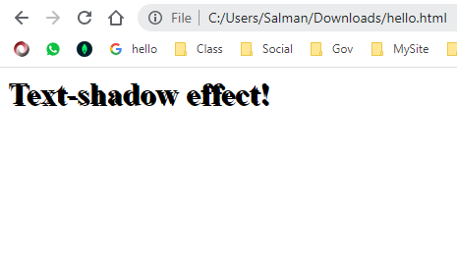
Text-shadow - you only specify the horizontal shadow (2px) and the vertical shadow (2px)

Slide 13
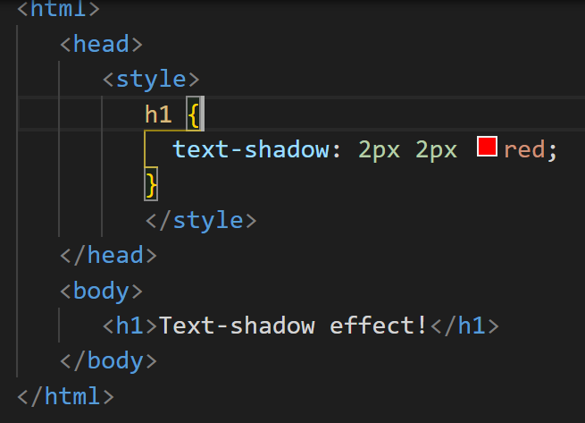
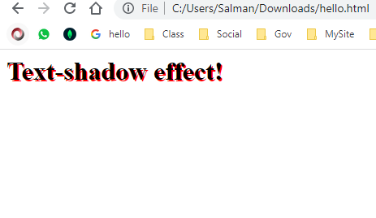
Text-shadow - add a color to the shadow

Slide 14
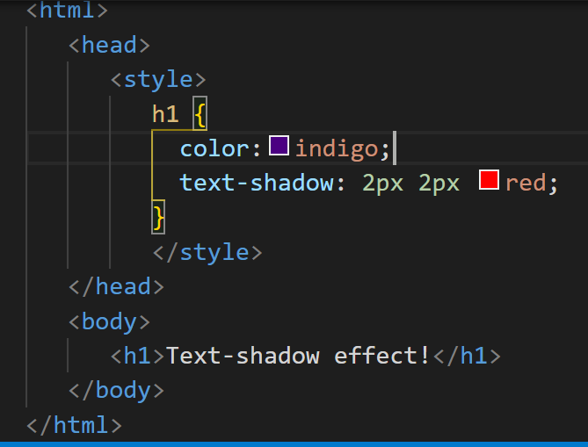
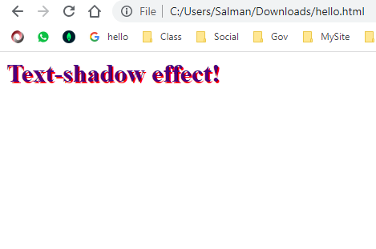
Text-shadow – with color text

Slide 15
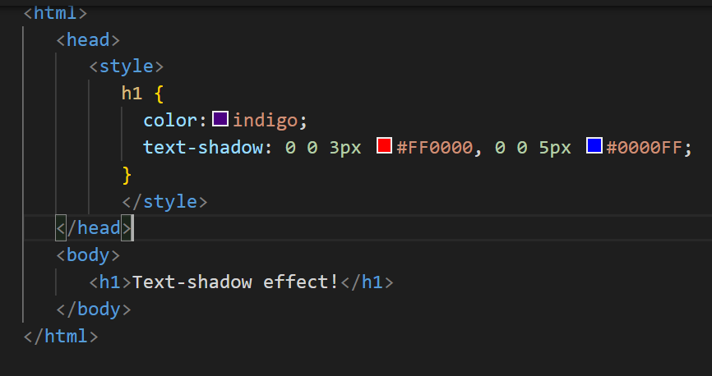
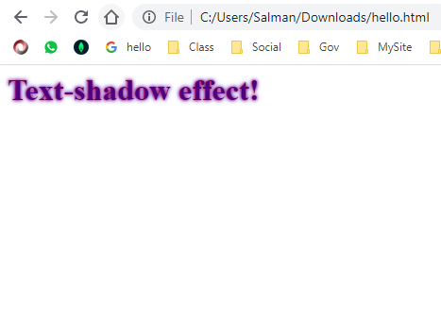
Text-shadow-multiple-shadow

Slide 16
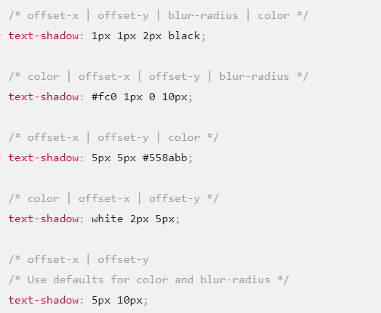
Text-shadow

Slide 17
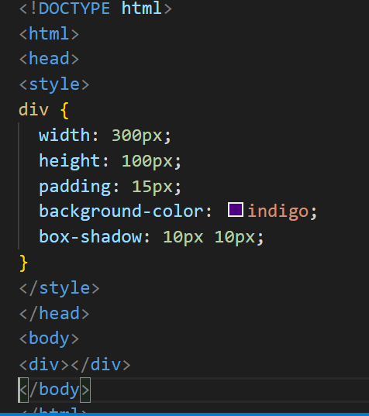
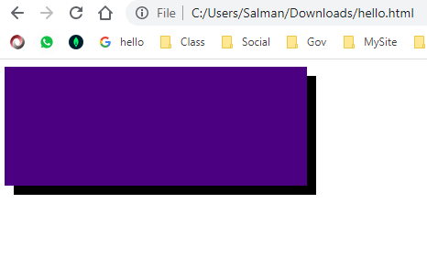
Box-shadow

Slide 18
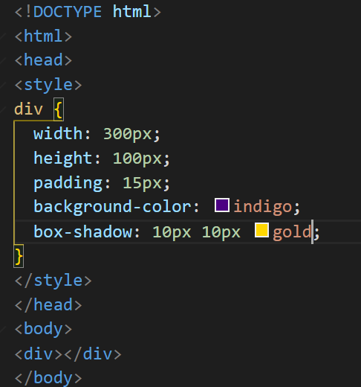
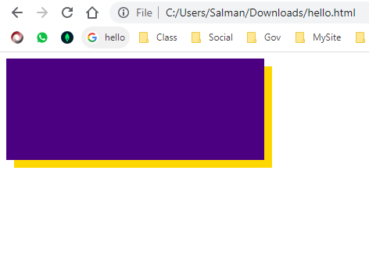
Box-shadow with color

Slide 19
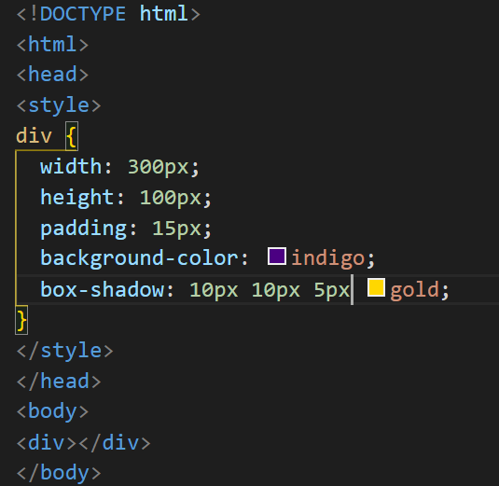
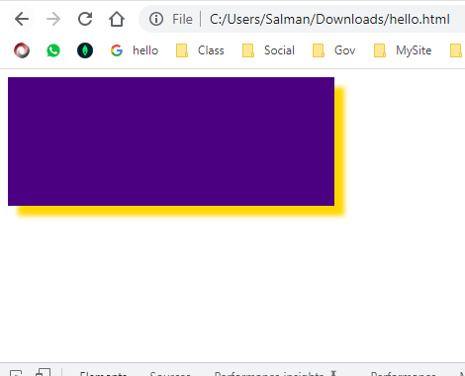
Box-shadow – blur effect

Slide 20
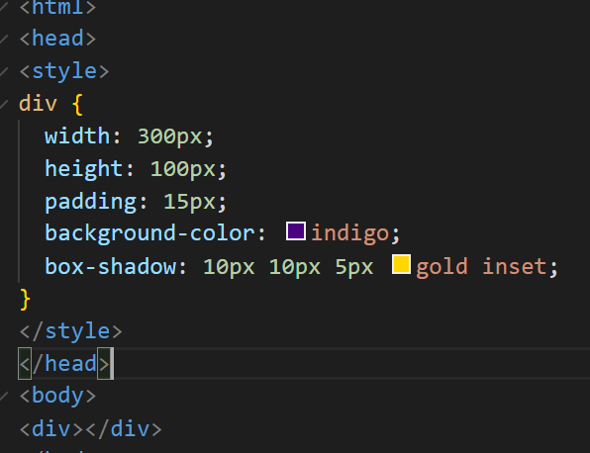
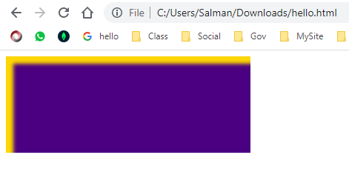
Box-shadow- The inset parameter changes the shadow from an outer shadow (outset) to an inner shadow

Slide 21
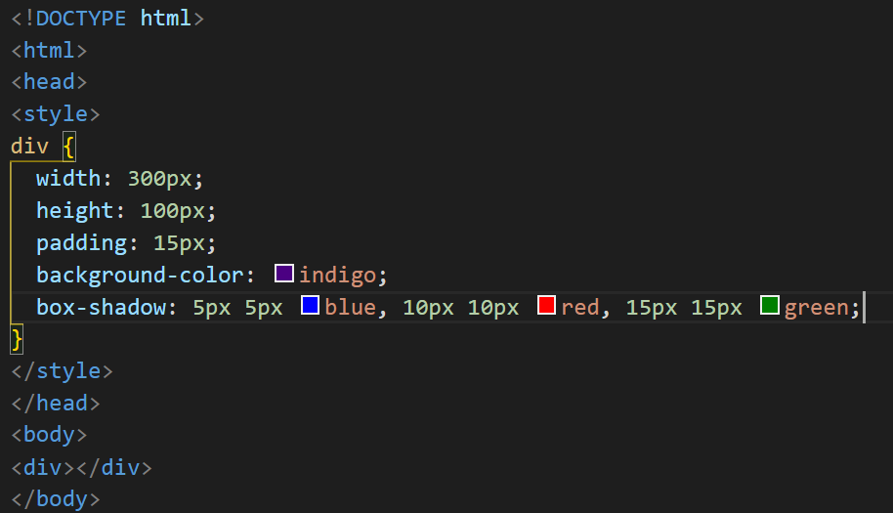
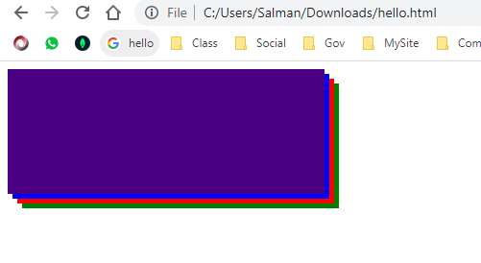
Box-shadow-multiple shadows

Slide 22

Animation

Slide 23

@keyframes

Slide 24
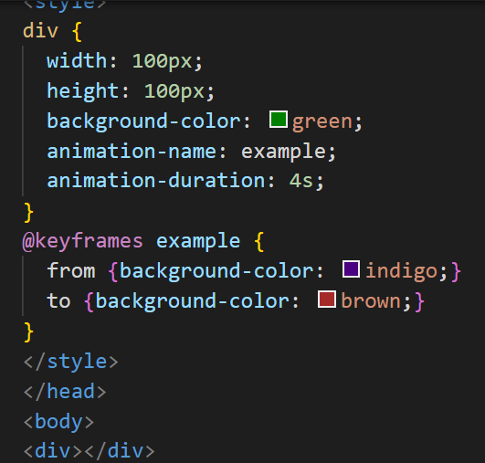

@keyframes

Slide 25

@keyframes

Slide 26

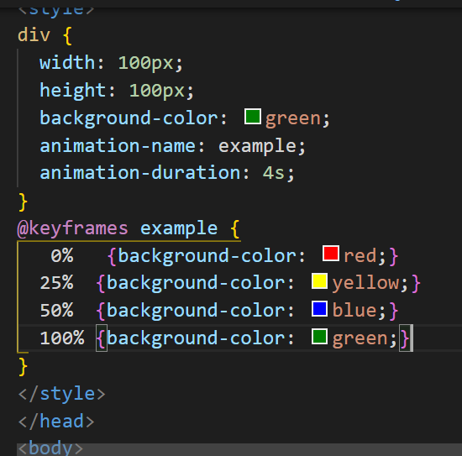
@keyframes

Slide 27
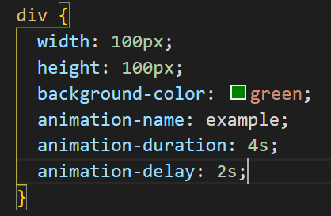
Delay an Animation

Slide 28
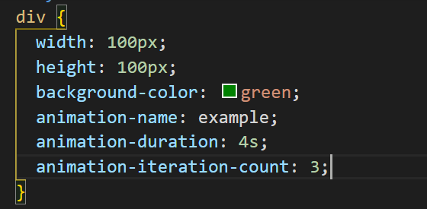
Set How Many Times an Animation Should Run

Slide 29
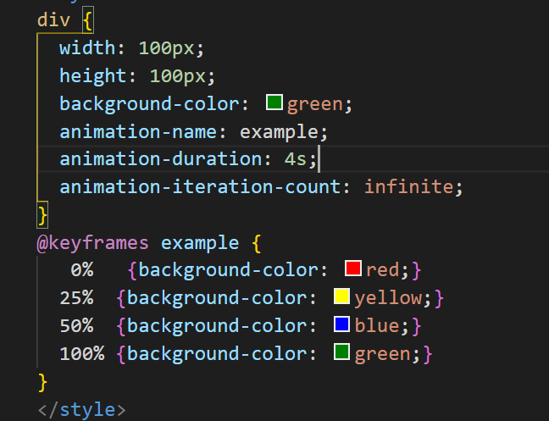
Animation infinite

Slide 30

Animation Direction

Slide 31
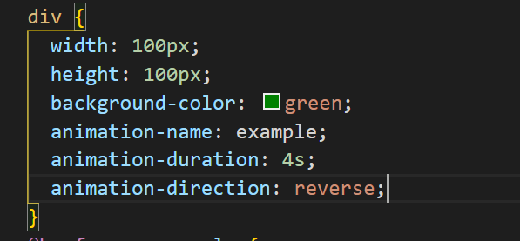
Animation Direction

Slide 32

Animation speed Curve

Slide 33
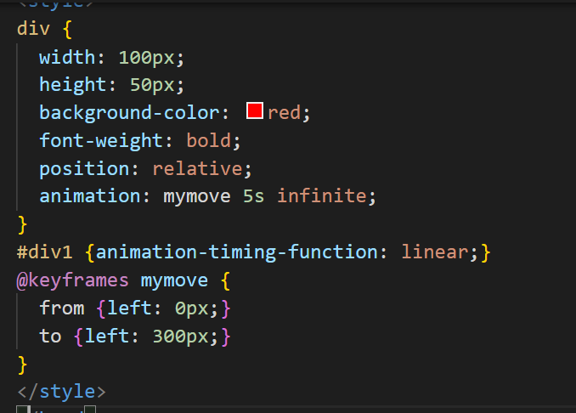
Animation speed curve

