Slide 1
CSS - Training

Slide 2
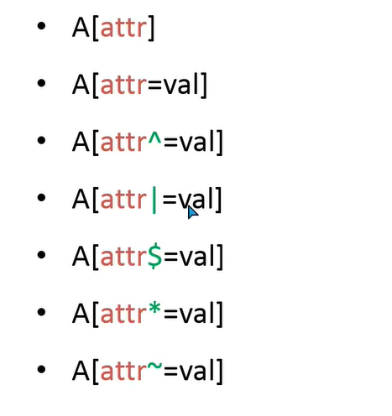
Advanced CSS Selector
Attribute Selectors

Slide 3
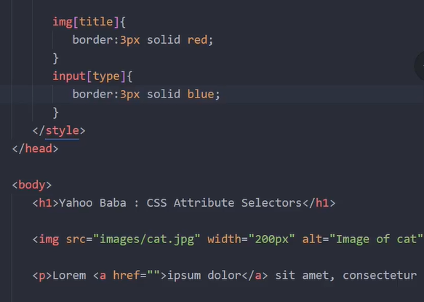
A[attr] – targeting attribute

Slide 4
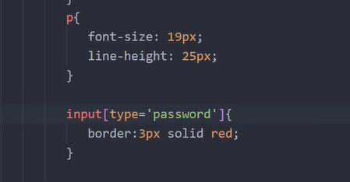
A[attr=val] – matching value

Slide 5
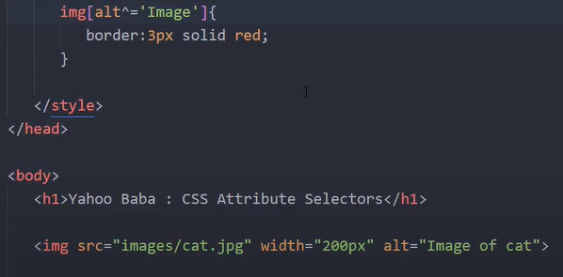
A[attr=^val] – should start with this value

Slide 6
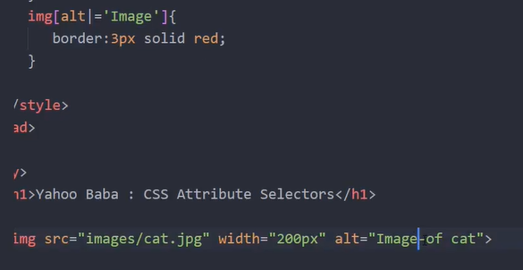
A[attr=|val] – value should have hypen after that

Slide 7
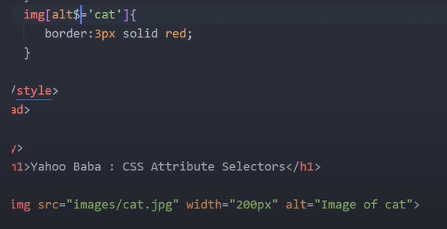
A[attr=$val] – value end with this value

Slide 8
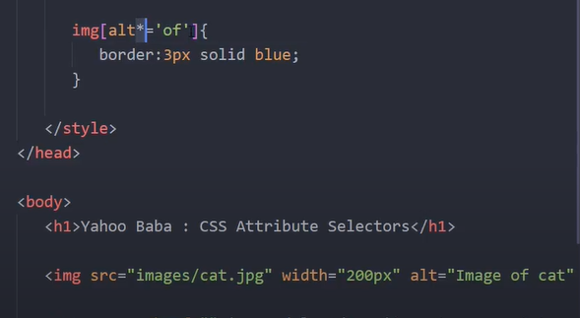
A[attr=*val] – match with value anywhere

Slide 9
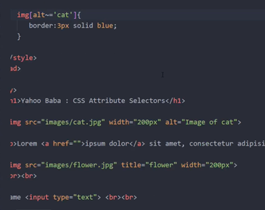
A[attr=~val] – similar like * but space should be there between word

Slide 10
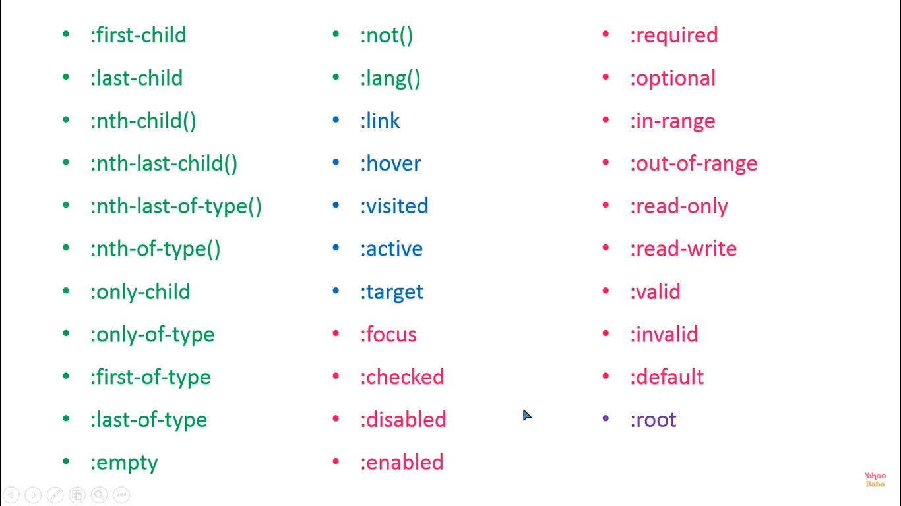
Pseudo Classes

Slide 11
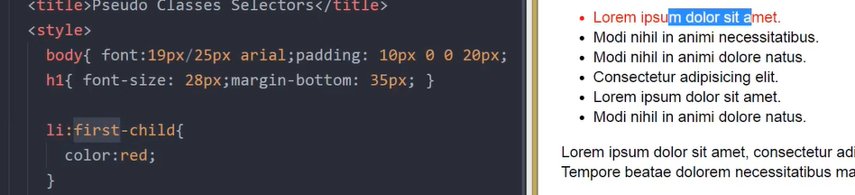
PseudoClass:first-child

Slide 12
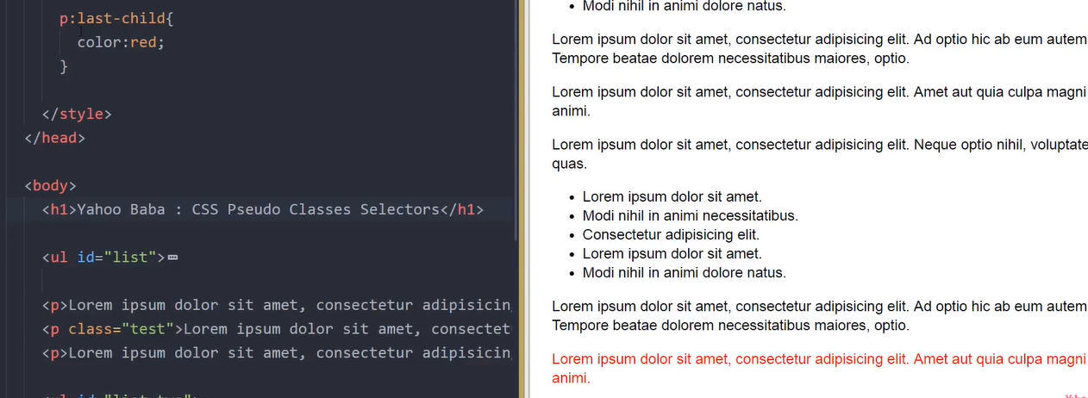
PseudoClass:last-child

Slide 13
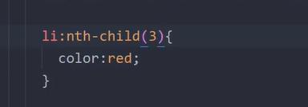
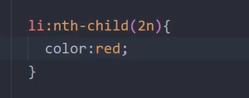
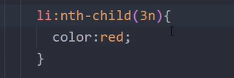
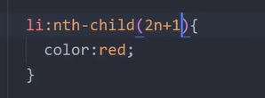
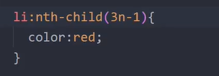
PseudoClass:nth-child()-to target element in sequence

Slide 14
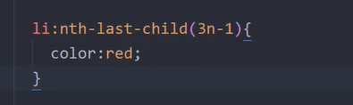

PseudoClass:nth-last-child()-to target element from last in sequence

Slide 15
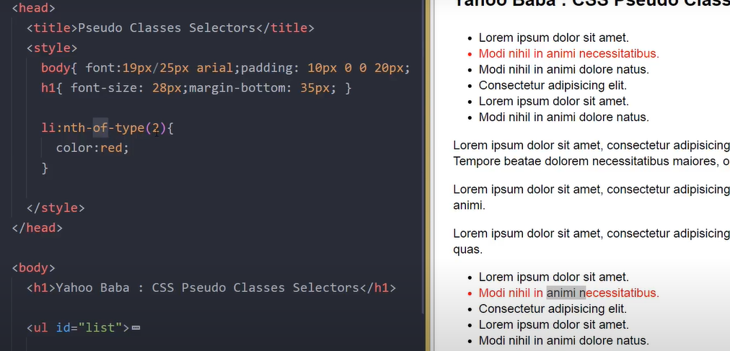
PseudoClass: nth-of-type() – any type but it will concentrate on particular element

Slide 16
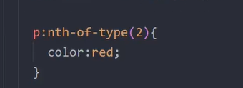
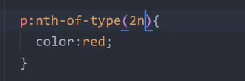
PseudoClass: nth-of-type() – without child as well it will target

Slide 17
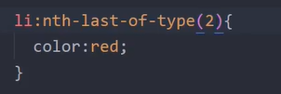
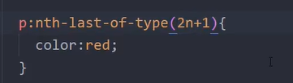
PseudoClass: nth-last-of-type() – without child as well it will target

Slide 18
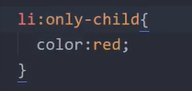
PseudoClass: only-child() - only that particular child only (only one child)

Slide 19
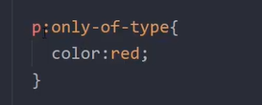
PseudoClass: only-of-type()- only that particular tag one time is there but other tag we can have it

Slide 20

PseudoClass: first-of-type()-it will select first element with or without parent

Slide 21

PseudoClass: last-of-type()-it will select last element with or without parent

Slide 22
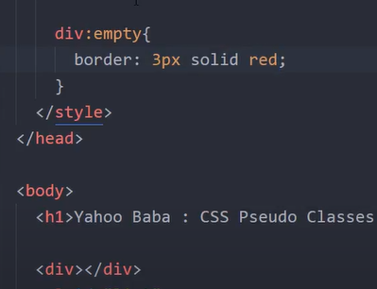
PseudoClass: empty – any empty tag without content without white space

Slide 23

PseudoClass: not()- excepting that paritcular element

Slide 24
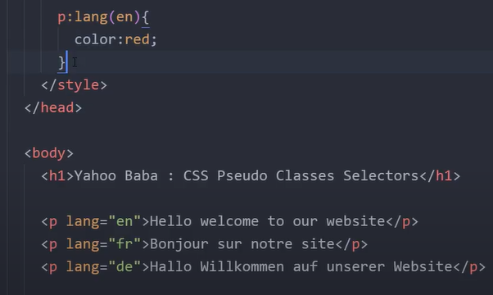
PseudoClass: lang()-targeting particular language

Slide 25
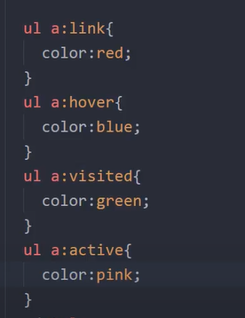
PseudoClass: link(),hover(),active(),visited() – used for anchor tag

Slide 26

PseudoClass: target() – used for anchor

Slide 27
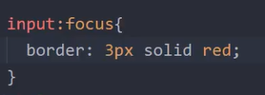
PseudoClass: focus() – forms

Slide 28



PseudoClass:checked() – forms

Slide 29
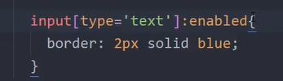


PseudoClass: – enable() and disabled() forms

Slide 30
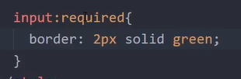
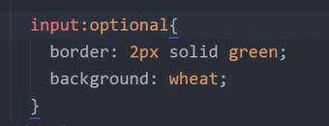
PseudoClass: – required() and optional() forms

Slide 31

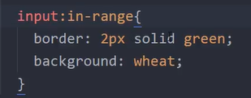
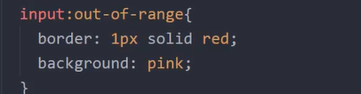
PseudoClass: – in-range() and out-of-range() forms

Slide 32
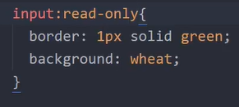
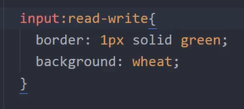
PseudoClass: – read-only() and read-write() forms

Slide 33
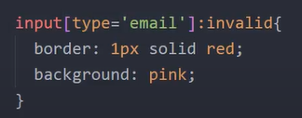
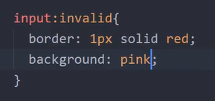
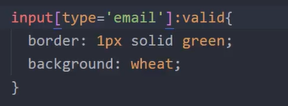
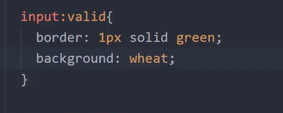
PseudoClass: – valid() and invalid() forms

Slide 34

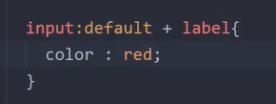
PseudoClass: – default() forms – checkbox,radio,select

Slide 35
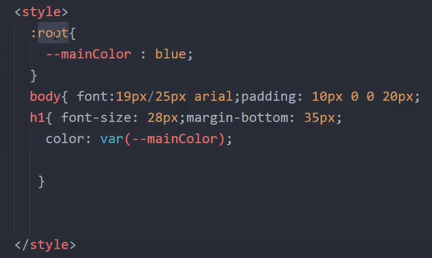
PseudoClass: – root()

Slide 36
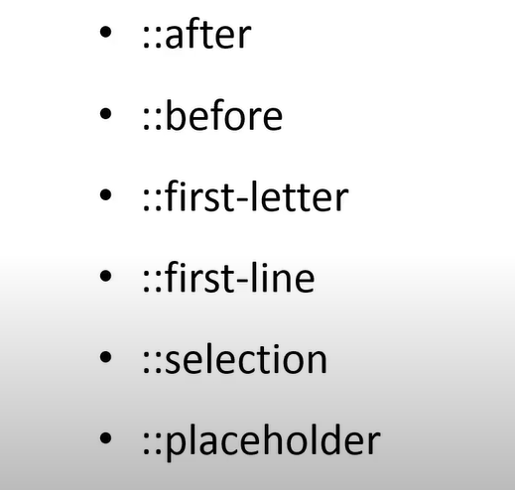
Pseudo -Elements

Slide 37
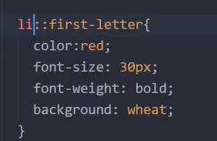
Pseudo –Elements – first-letter()

Slide 38
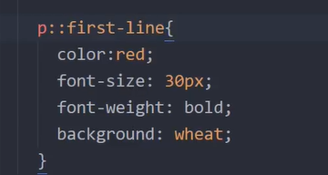
Pseudo –Elements – first-line()

Slide 39
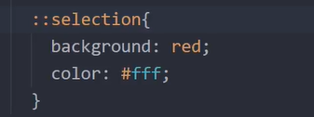
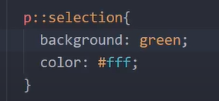
Pseudo –Elements – selection()

Slide 40
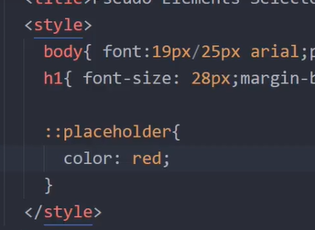
Pseudo –Elements – selection()

