Slide 1
HTML – Meta tag ,img tag,anchor tag,semantic element,entities,attibutes

Slide 2
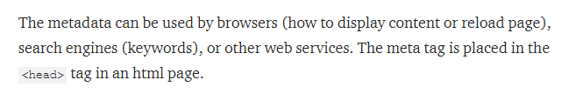

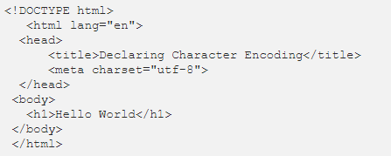

What is meta tag

Slide 3


Meta tag

Slide 4
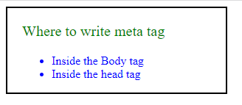
QUESTION?

Slide 5
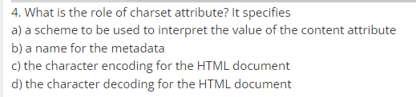
QUESTION

Slide 6
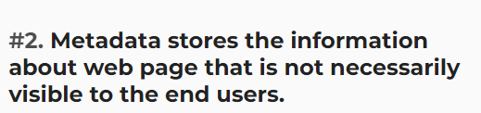
QUESTION

Slide 7
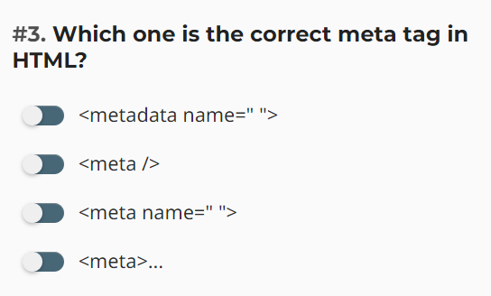
QUESTION

Slide 8
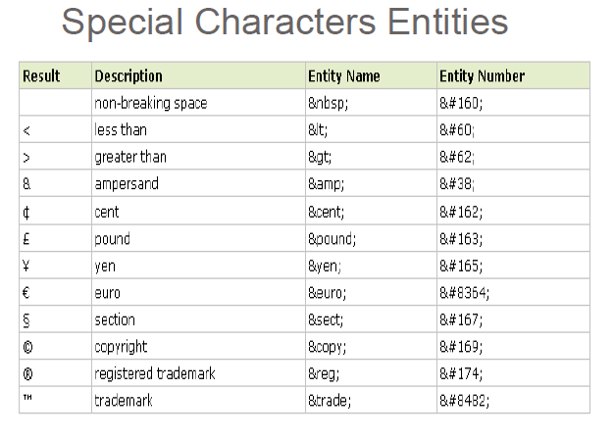


Slide 9
QUESTION

Slide 10

QUESTION

Slide 11

QUESTION

Slide 12

QUESTION

Slide 13
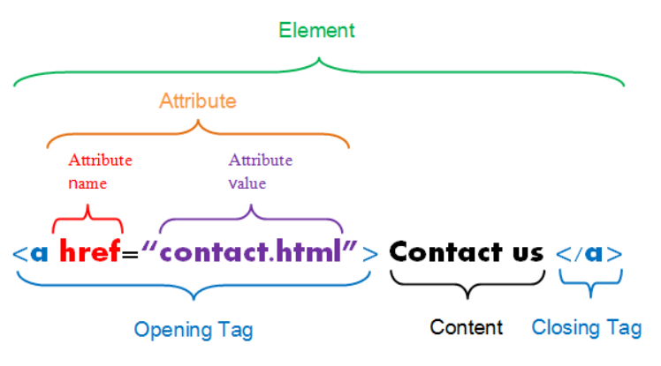
HTML ATTRIBUTE

Slide 14

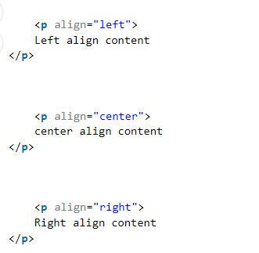



Types of attributes

Slide 15
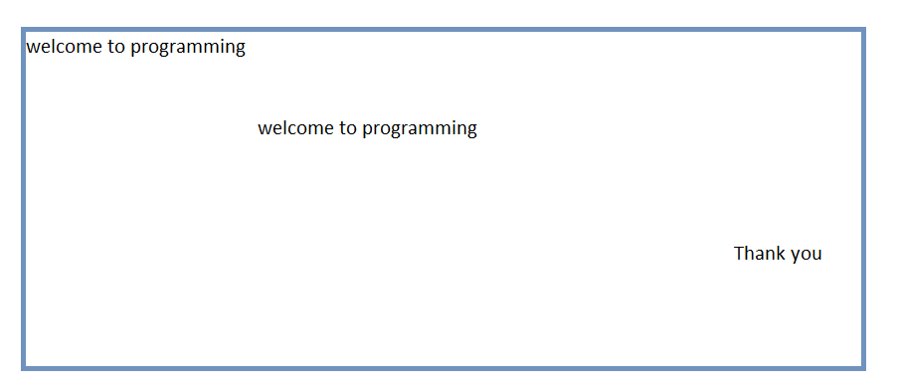
QUESTION – Attribute?

Slide 16
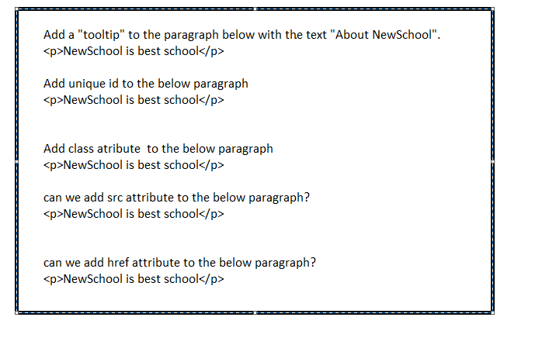
QUESTION HTML ATTRIBUTE

Slide 17
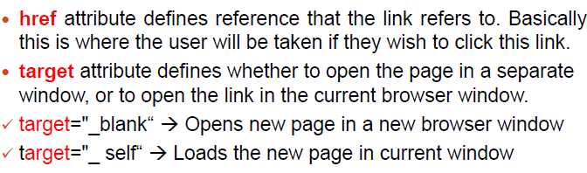
HTML Elements continue..
HTML Links
Use the <a> element to define a link
Use the href attribute to define the link address
Use the target attribute to define where to open the linked document
Use the <img> element (inside <a>) to use an image as a link
15hrs
<a href="https://www.credosystemz.com">This is a link</a>

Slide 18
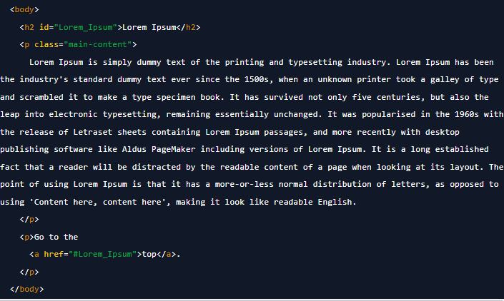
Anchor tag spcific part of the page

Slide 19
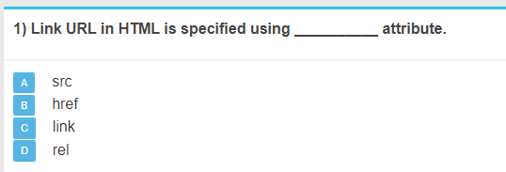
QUESTION

Slide 20
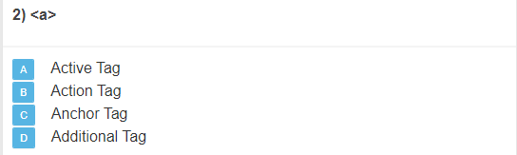
QUESTION

Slide 21
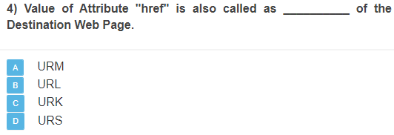
QUESTION

Slide 22
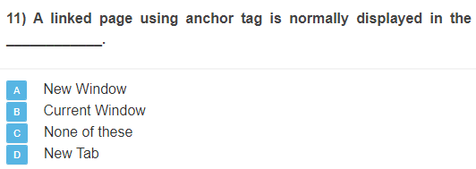
QUESTION

Slide 23
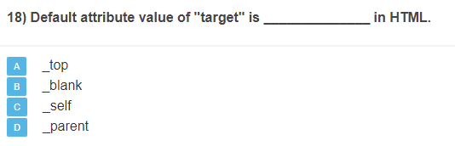
QUESTION

Slide 24
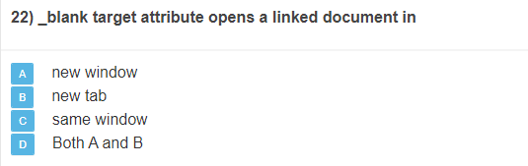
QUESTION

Slide 25
Image
HTML Images
Use the HTML <img> element to define an image.
Use the HTML src attribute to define the URL of the image.
Use the HTML alt attribute to define an alternate text for an image, if it cannot be displayed.
Use the HTML width and height attributes to define the size of the image

Slide 26
Image continue
<img src="credologo.jpg" alt="credosystemz.com" width="104" height="142">

Slide 27
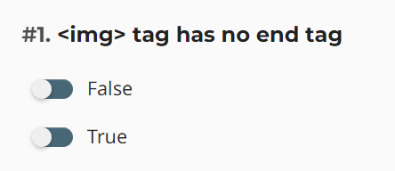
Question

Slide 28
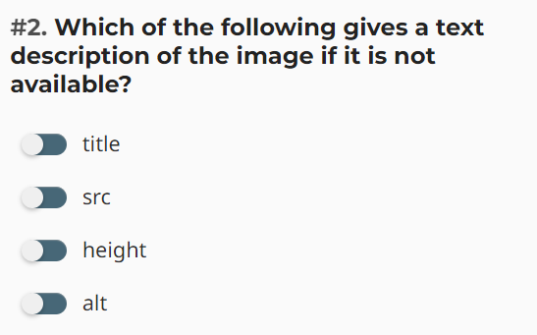
Question

Slide 29
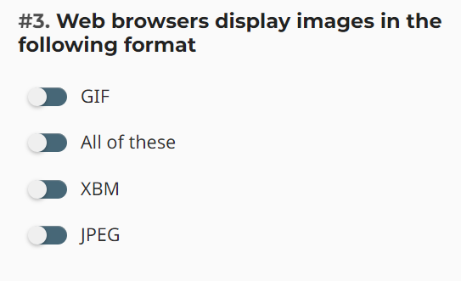
Question

Slide 30
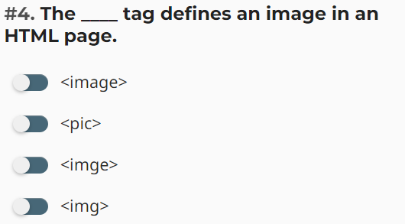
Question

Slide 31
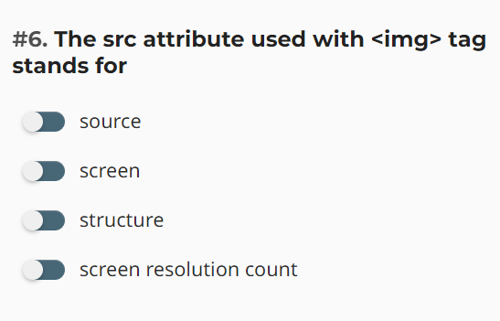
Question

Slide 32
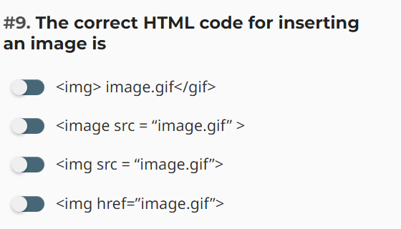
Question

Slide 33
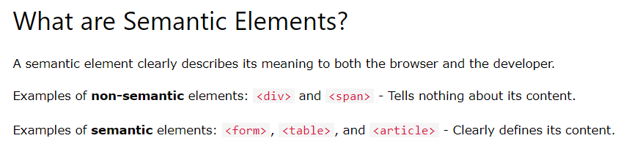
SEMANTIC ELEMENTS

Slide 34
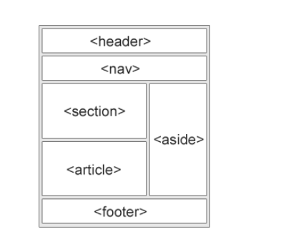
Semantic elements

Slide 35


SECTION

Slide 36
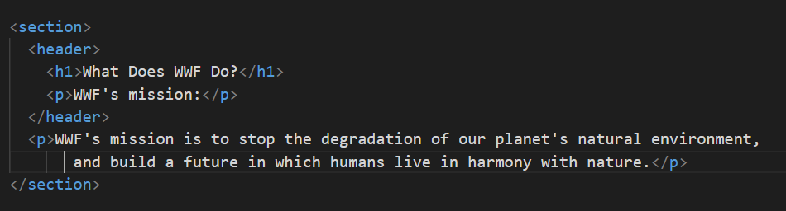
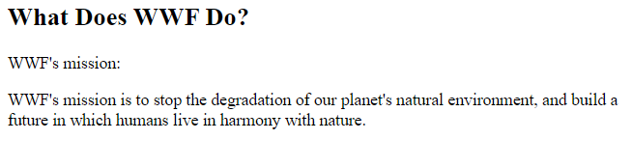
HEADER

Slide 37
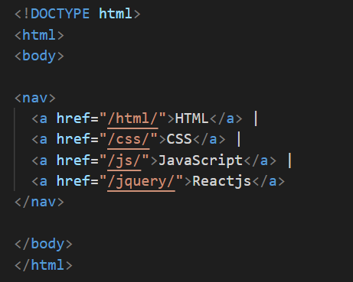

NAV

Slide 38
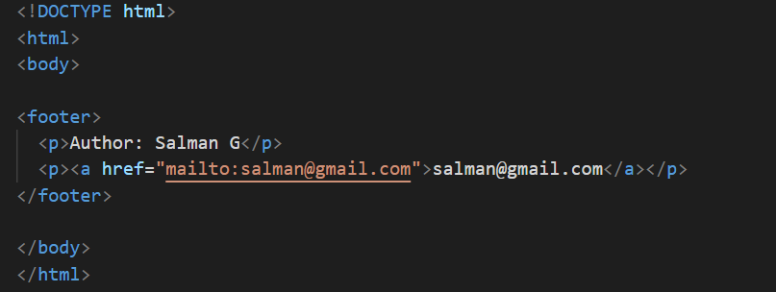
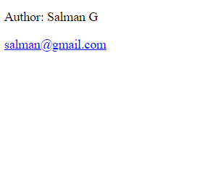
FOOTER

Slide 39

Sidebar menu

Slide 40
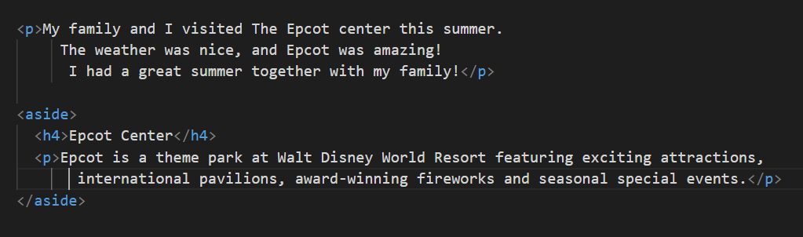
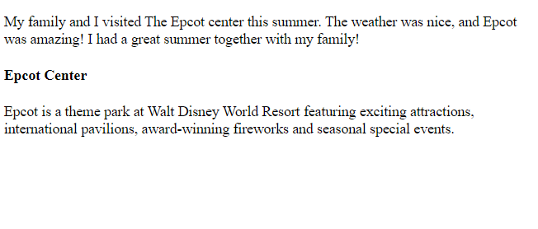
ASIDE

Slide 41
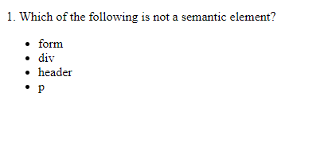
Question

Slide 42
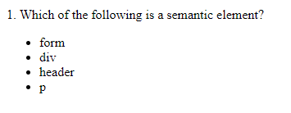
Question

Slide 43

Question

Slide 44
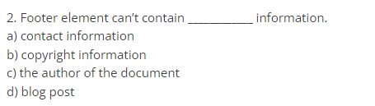
Question

Slide 45
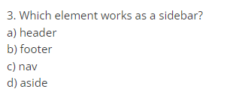
Question

