Slide 1
CSS - Training

Slide 2
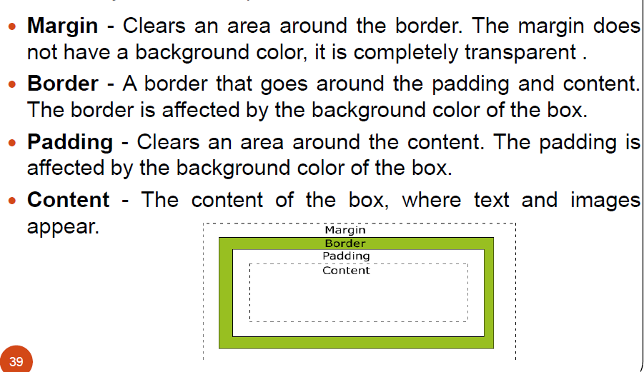
Box Modal

Slide 3
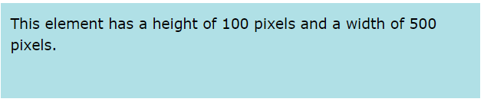
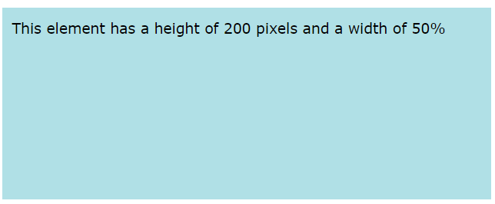
CSS Property – Height & Width
Height and Width - The CSS height and width properties are used to set the height and width of an element.
Individual Sides
div { height: 100px; width: 500px; background-color: powderblue; }
div { height: 200px; width: 50%; background-color: powderblue; }

Slide 4
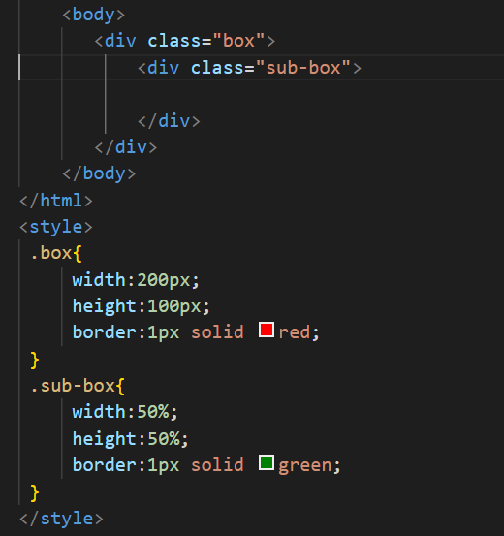
Width and height

Slide 5
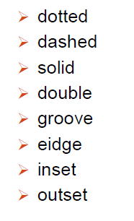
CSS Property - Border
Borders - The CSS border properties allow you to specify the style, width, and color of an element's border
Border Style – dotted, dashed, solid, double -
Border Width -
Border Color –
Border Sides
Shorthand Border Property -
Rounded Borders -
p {border-style: solid;}
p {border-width: 5px;}
p {border-color: red;}
p { border-top-style: dotted; border-right-style: solid; border-bottom-style: dotted; border-left-style: solid; }
p {border: 5px solid red;}
p {border-radius: 5px;}

Slide 6
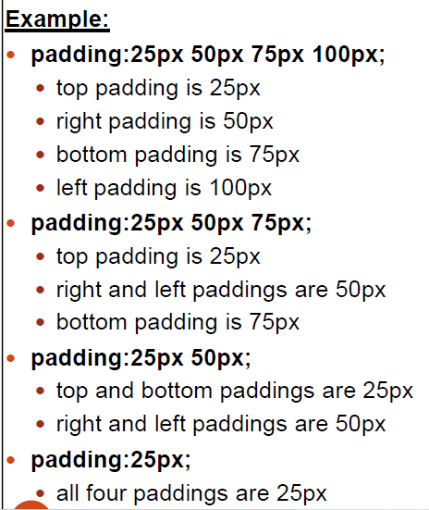
CSS Property - Padding
Padding - Padding is used to create space around an element's content, inside of any defined borders
Individual Sides
Shorthand Property -
div { padding-top: 50px; padding-right: 30px; padding-bottom: 50px; padding-left: 80px; }
p { padding: 25px 50px 75px 100px; }
div{padding: 25px 50px;}
div {padding: 25px;}

Slide 7
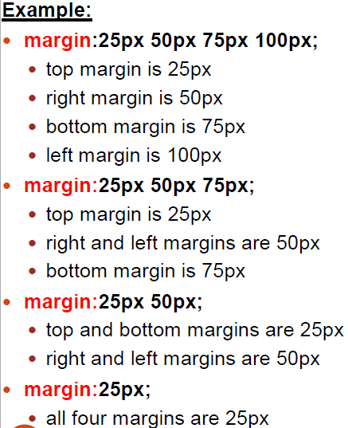
CSS Property - Margin
Margins - Margins are used to create space around elements, outside of any defined borders
Individual Sides
Shorthand Property -
auto Value - set the margin property to auto to horizontally
center the element within its container
p { margin-top: 100px; margin-bottom: 100px; margin-right: 150px; margin-left: 80px; }
p {margin: 25px 50px 75px 100px;}
div { width: 300px; margin: auto; border: 1px solid red; }

