Slide 1
CSS - Training

Slide 2
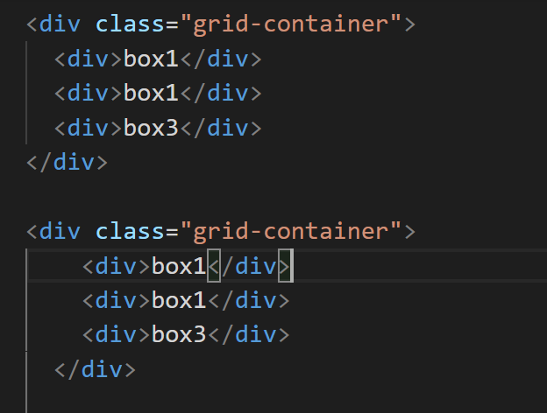
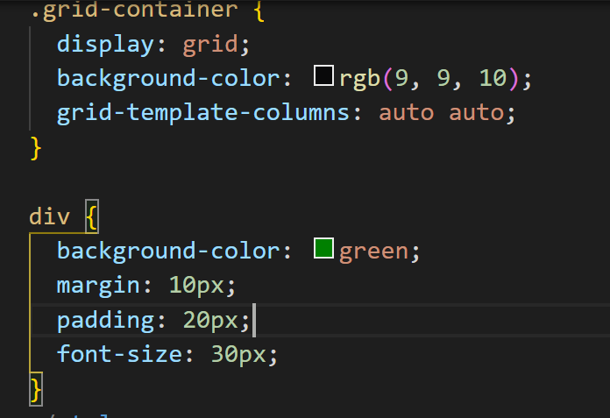
Grid

Slide 3
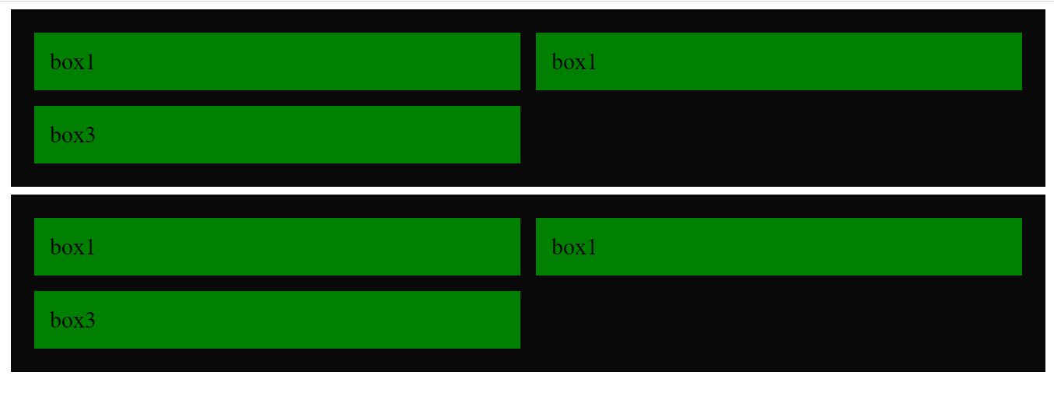
Grid

Slide 4
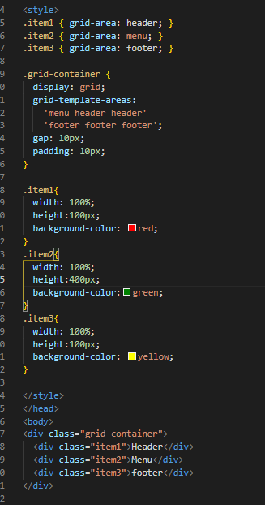
Grid layout 1

Slide 5

Output

Slide 6
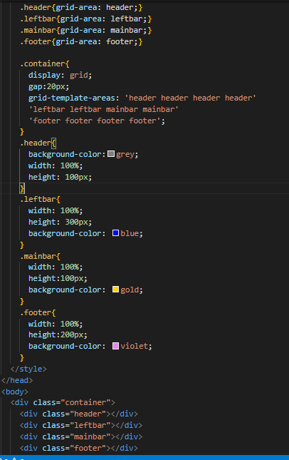
Grid Layout 2

Slide 7

Output

Slide 8
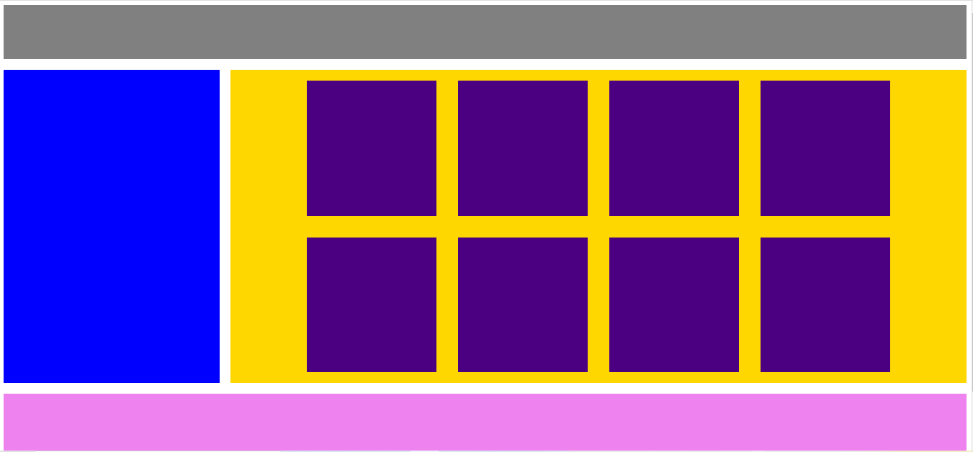
Flex+Grid

Slide 9
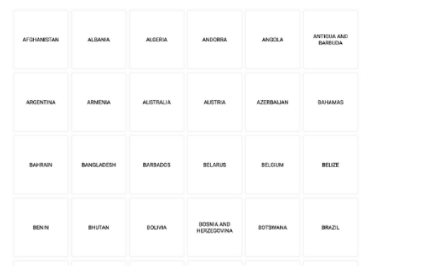

Slide 10
