Slide 1
CSS - Training

Slide 2
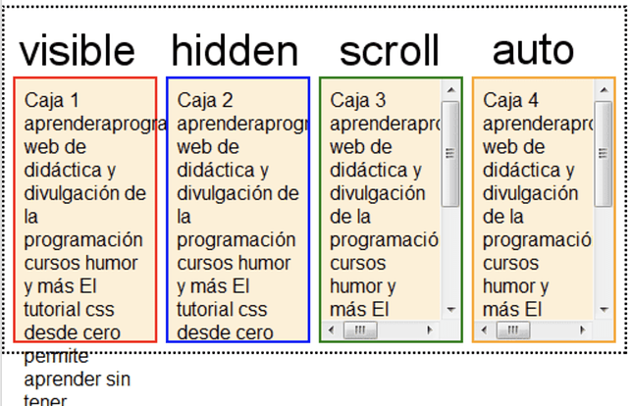
CSS Property – Text overflow

Slide 3
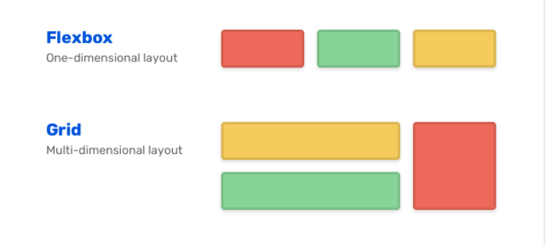
Flex box and grid

Slide 4
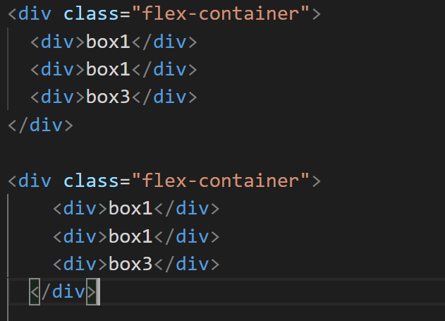
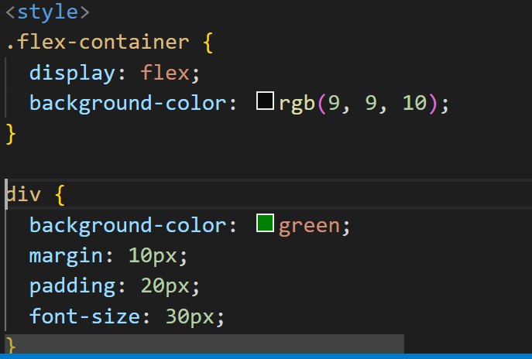
flexbox

Slide 5

FlexBoX

Slide 6
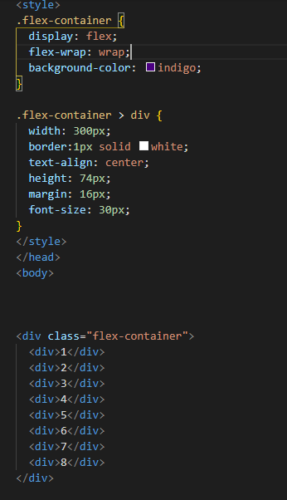

Flexbox

