Slide 1
Git And Github

Slide 2
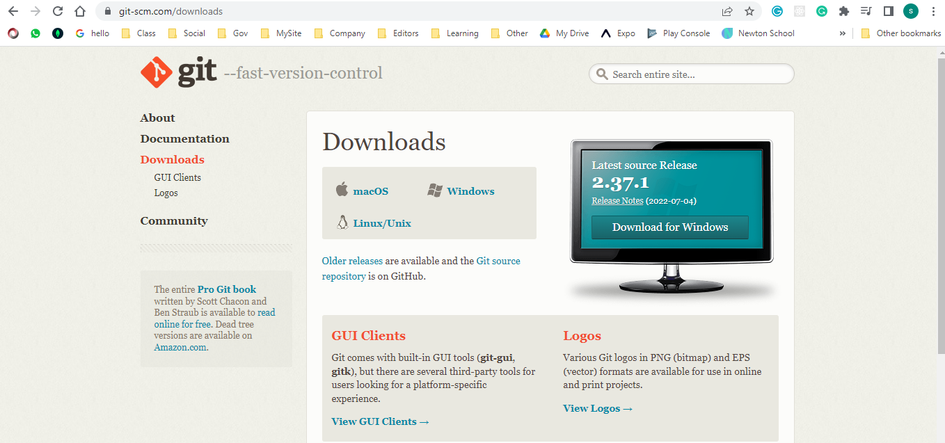
Step1: installing git

Slide 3
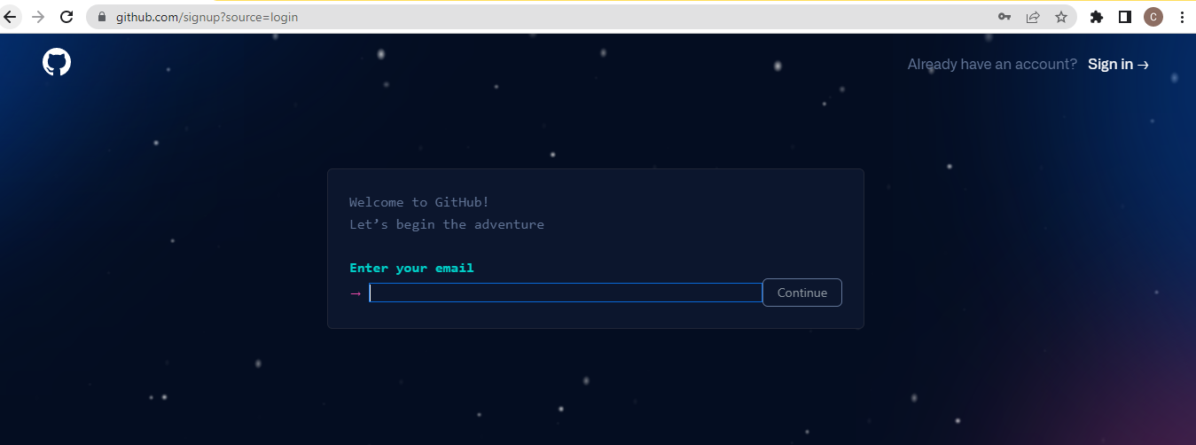
Step 2: Github account

Slide 4
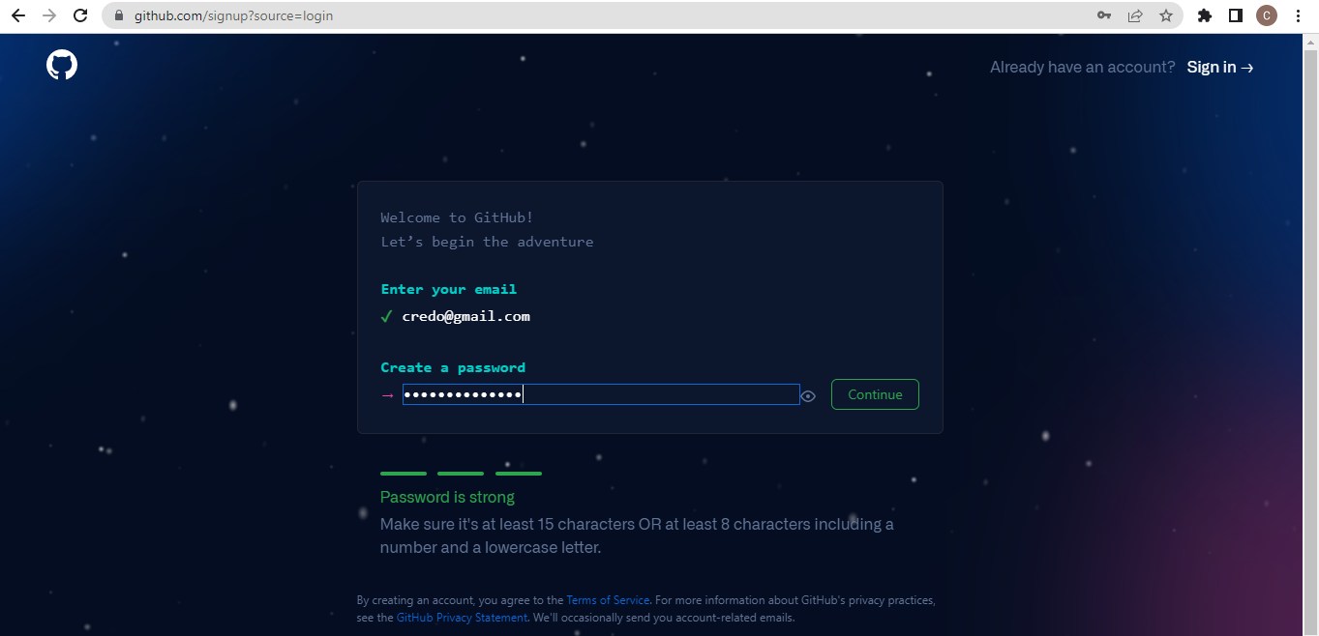
Step 3: Github account

Slide 5
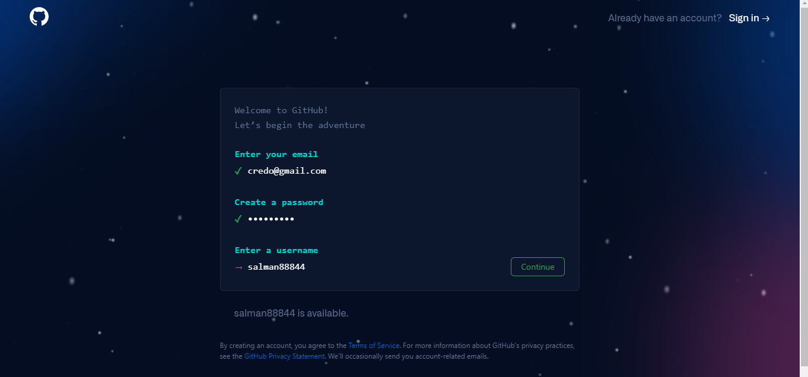
Step4 : Github account

Slide 6
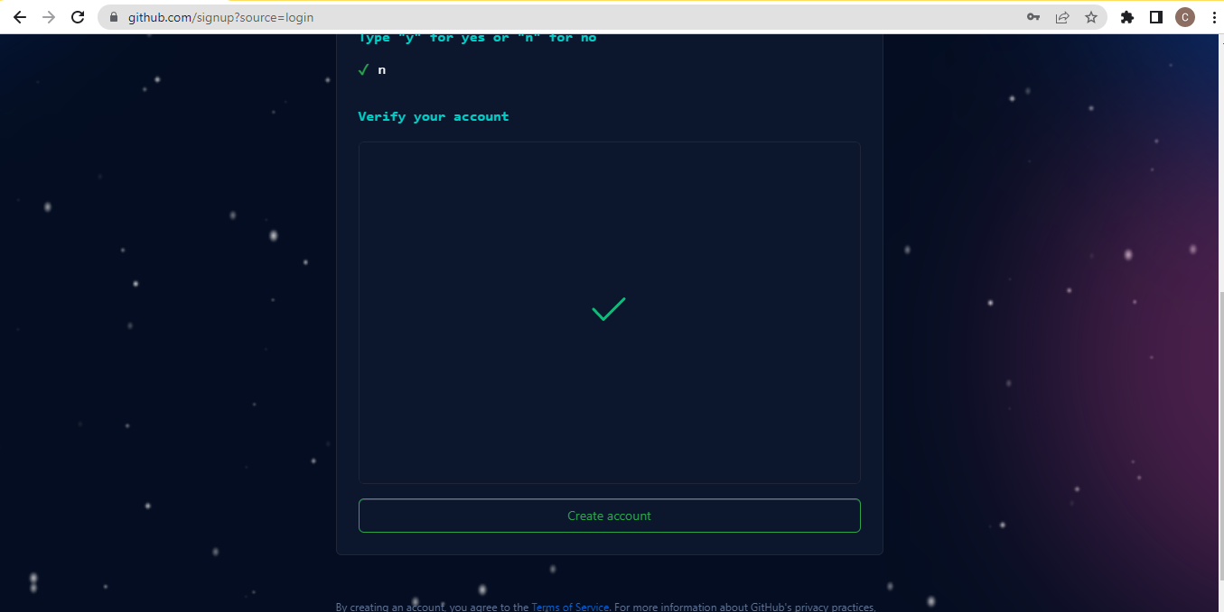
Step 5: Github account

Slide 7
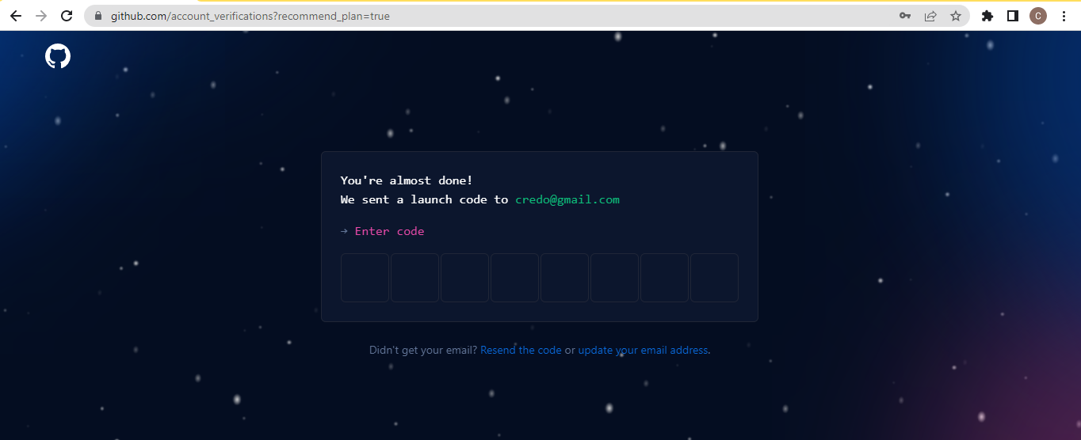
Step 6: Github account

Slide 8
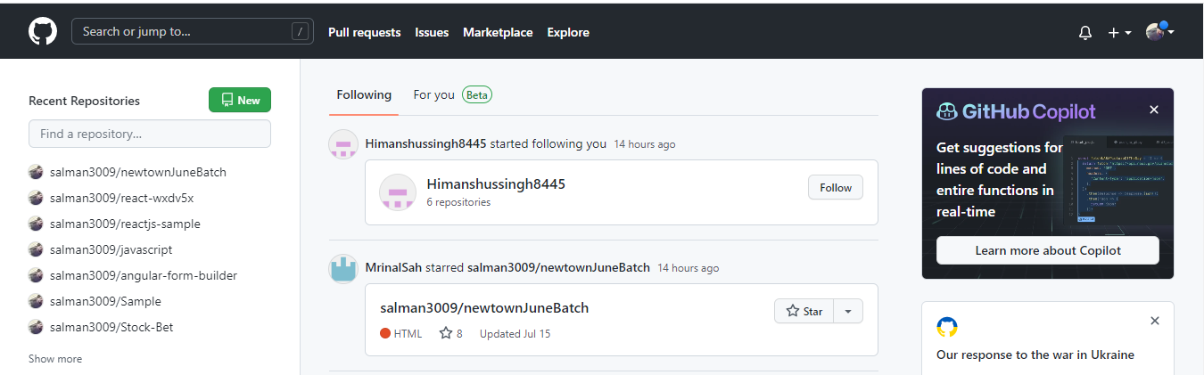
Step 7: Github Page

Slide 9
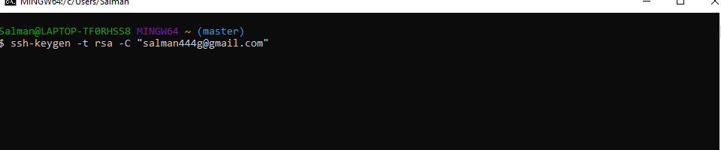
Step 8: Open Git
ssh-keygen -t rsa -C "your_email@example.com"

Slide 10
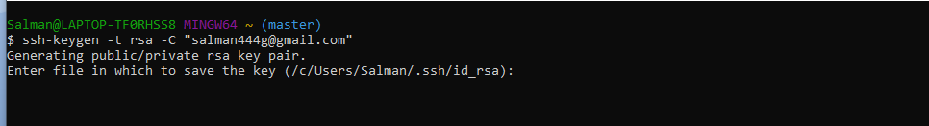
Step 9 : Open Git

Slide 11
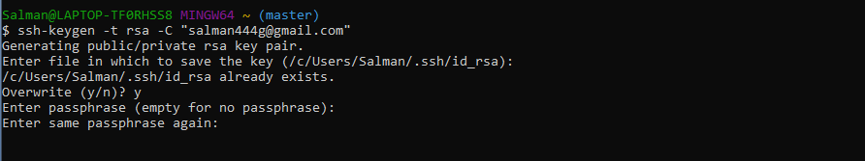
Step 10: open Git

Slide 12

Step 11 : Open Git

Slide 13
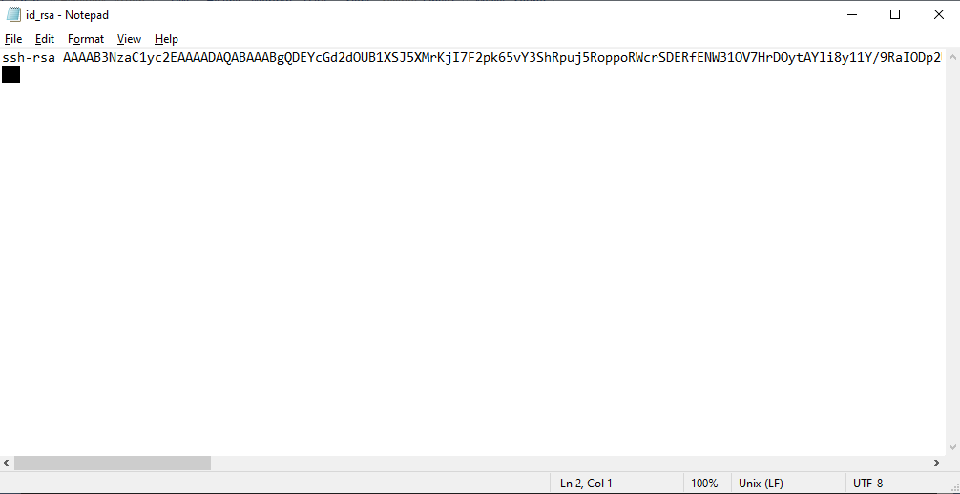
Step 12 : Open Git

Slide 14
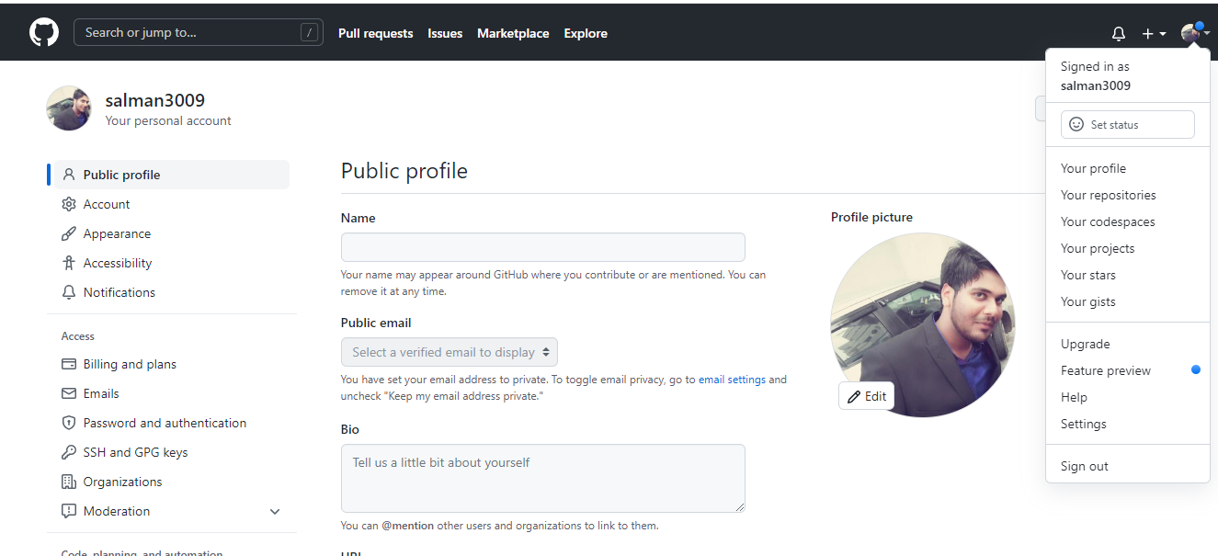
Step 13 : Open github

Slide 15
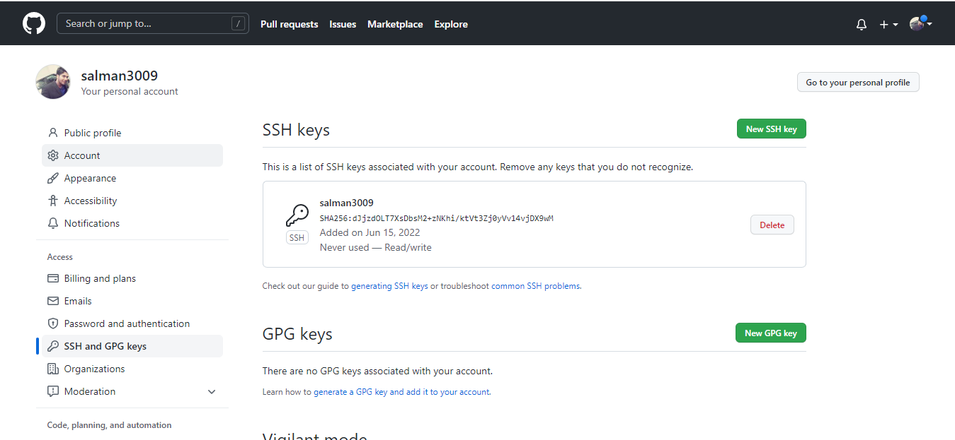
Step 14 : Github

Slide 16
Step 15: Github

Slide 17
Step 16: Github Repository

Slide 18
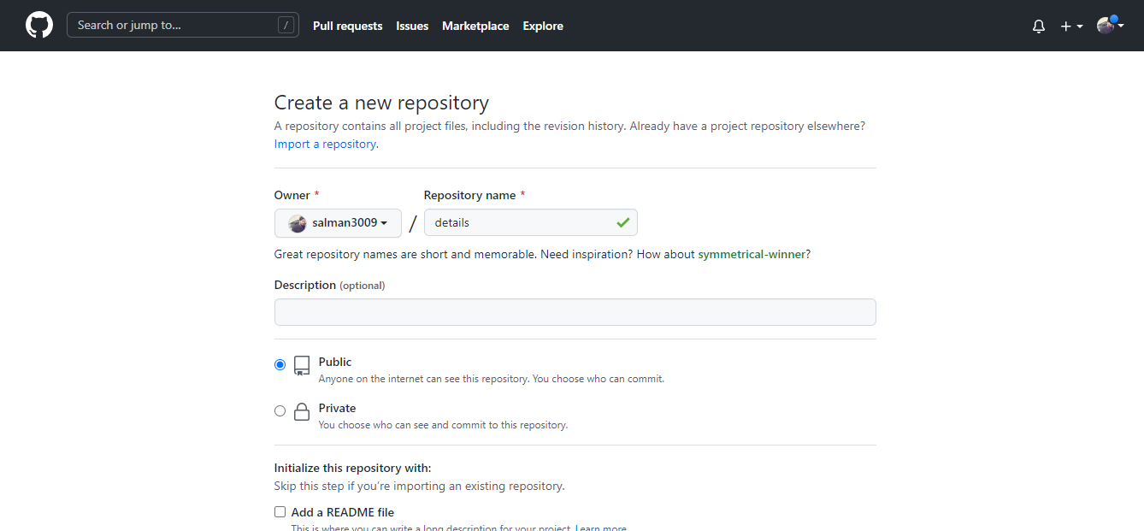
Step 17: Github repository

Slide 19
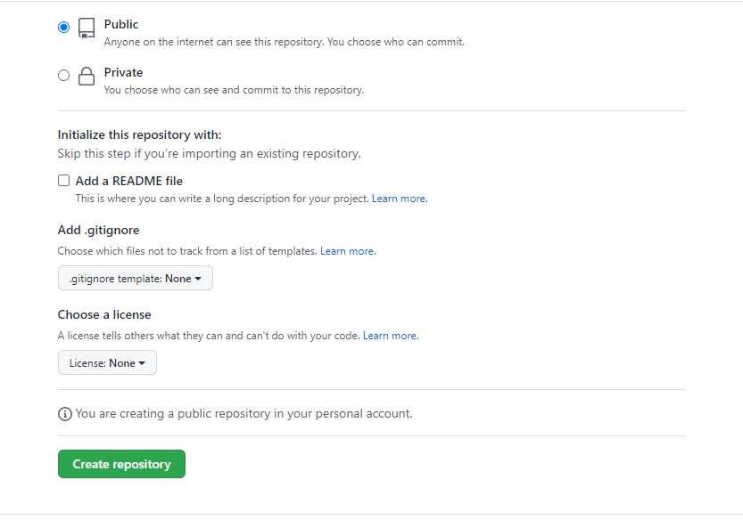
Step 18: Github repository

Slide 20
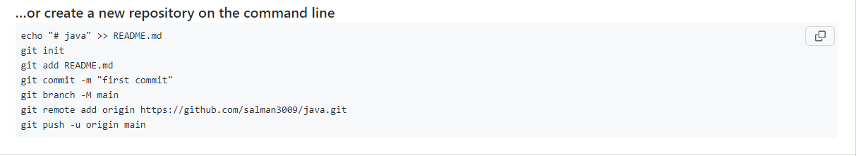
Step 19: Git command

Slide 21
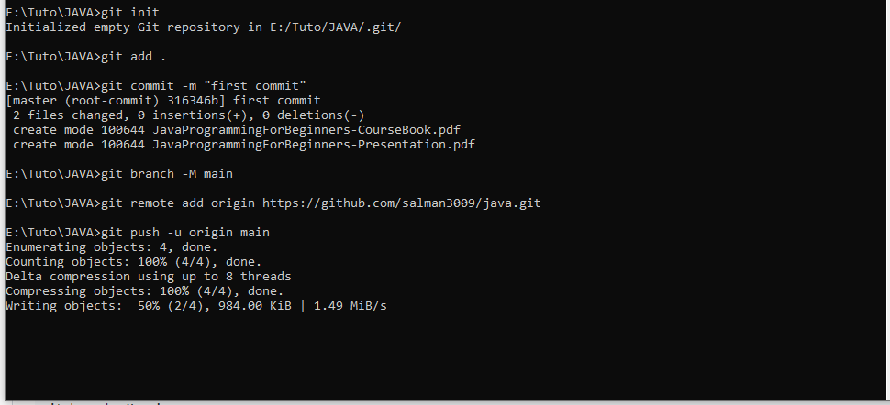
Step 20 : Git command

Slide 22
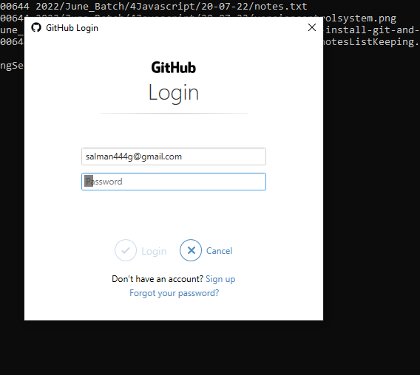
Authentication:

Slide 23
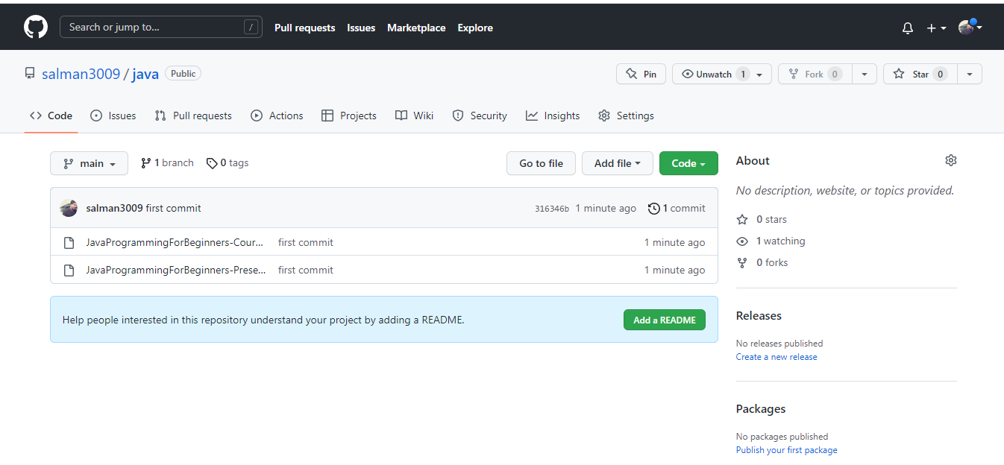
Step 21 : Github repository

Slide 24
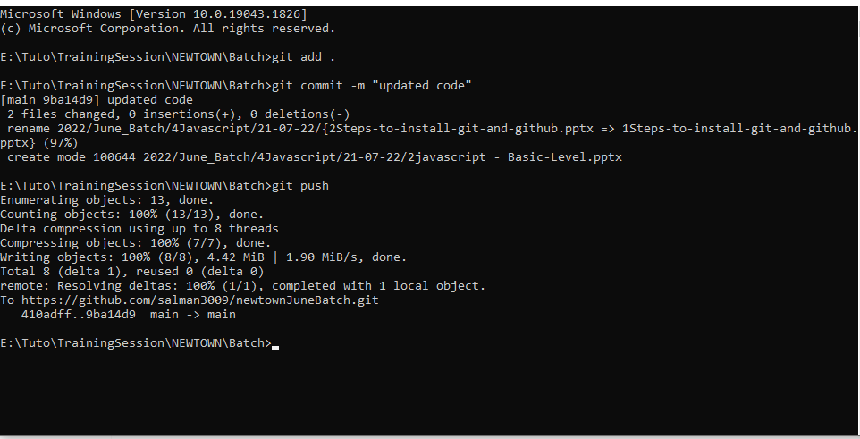
Step22:Repeat the step

Slide 25
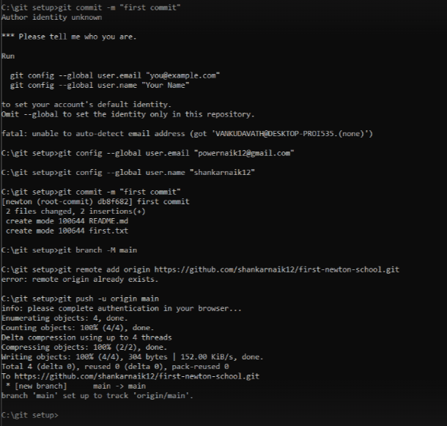
Other type of Errors

