Slide 1
HTML – img tag,formatting tag,semantic,list

Slide 2
Image
HTML Images
Use the HTML <img> element to define an image.
Use the HTML src attribute to define the URL of the image.
Use the HTML alt attribute to define an alternate text for an image, if it cannot be displayed.
Use the HTML width and height attributes to define the size of the image

Slide 3
Image continue
<img src="credologo.jpg" alt="credosystemz.com" width="104" height="142">

Slide 4
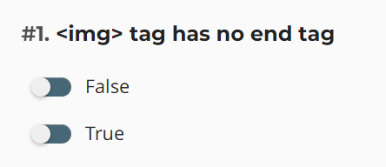
Question

Slide 5
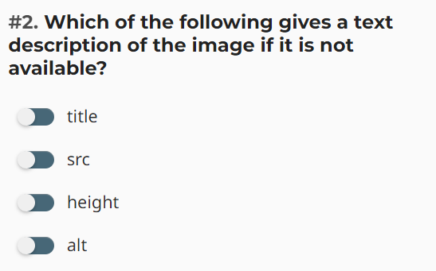
Question

Slide 6
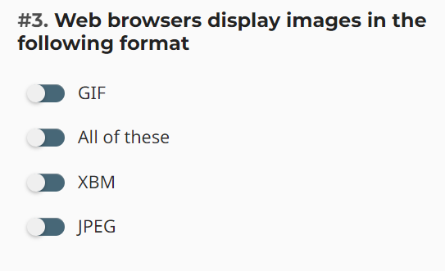
Question

Slide 7
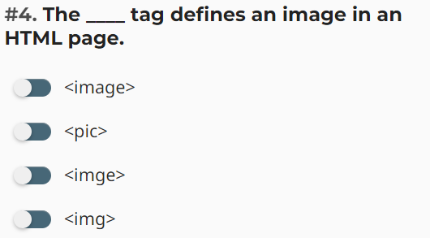
Question

Slide 8
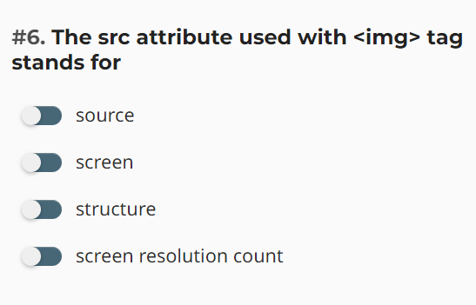
Question

Slide 9
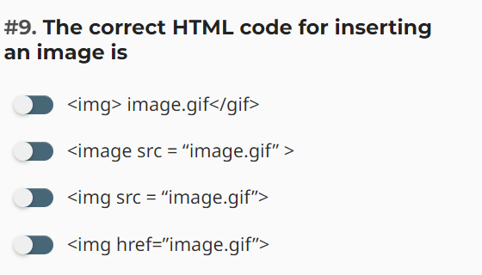
Question

Slide 10
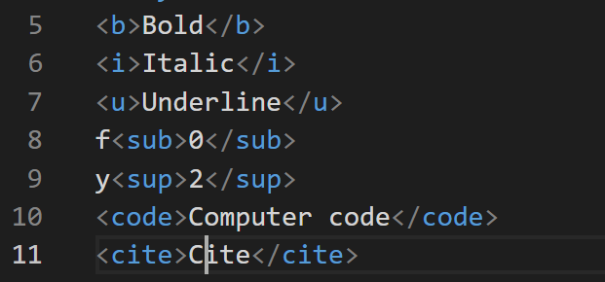
Formatting Tags

Slide 11

Question

Slide 12
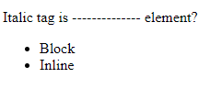
Question

Slide 13
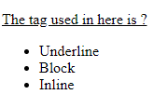
Question

Slide 14
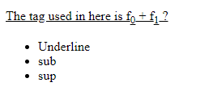
Question

Slide 15
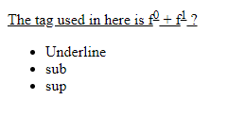
Question

Slide 16
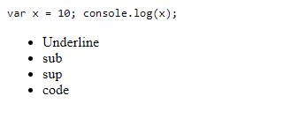
Question

Slide 17
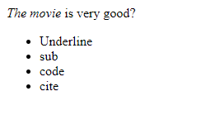
Question

Slide 18
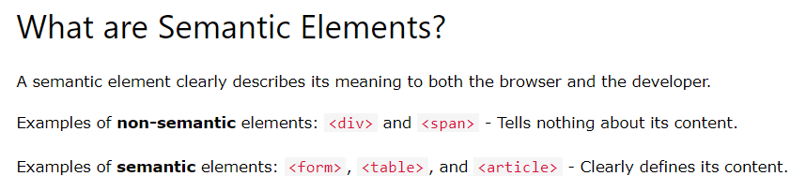
SEMANTIC ELEMENTS

Slide 19
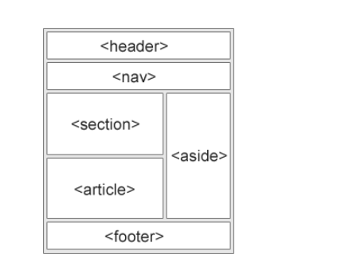
Semantic elements

Slide 20

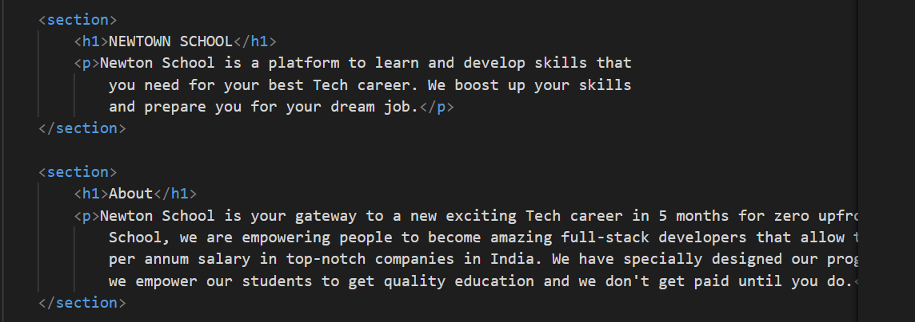
SECTION

Slide 21
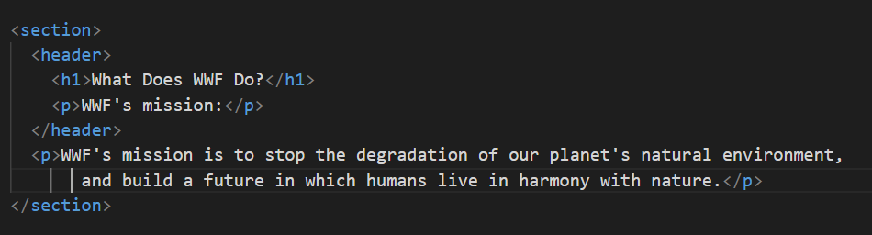
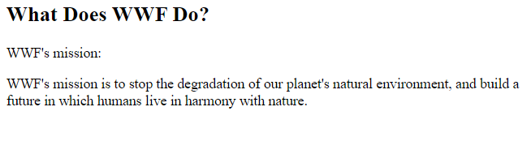
HEADER

Slide 22
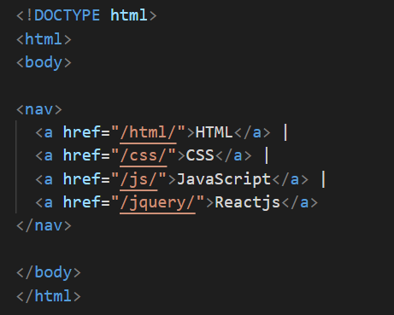

NAV

Slide 23
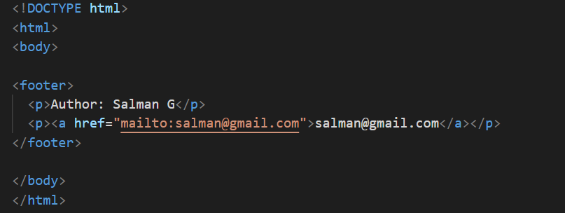
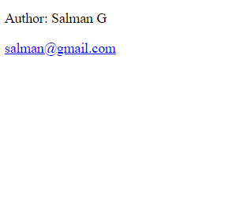
FOOTER

Slide 24

Sidebar menu

Slide 25
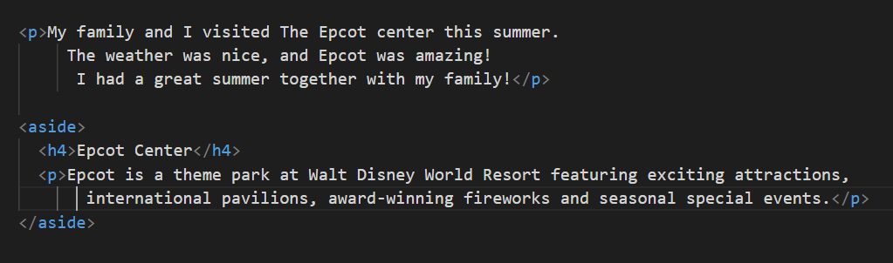
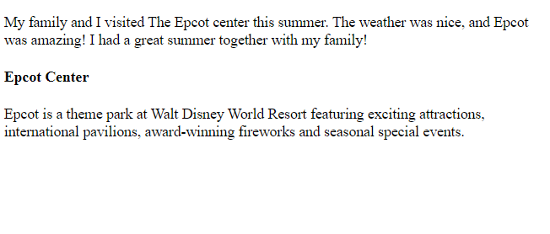
ASIDE

Slide 26
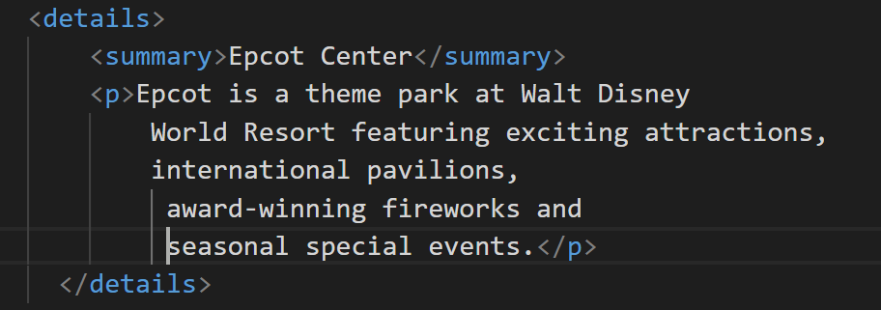

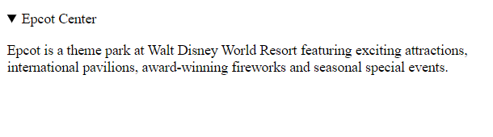

Slide 27
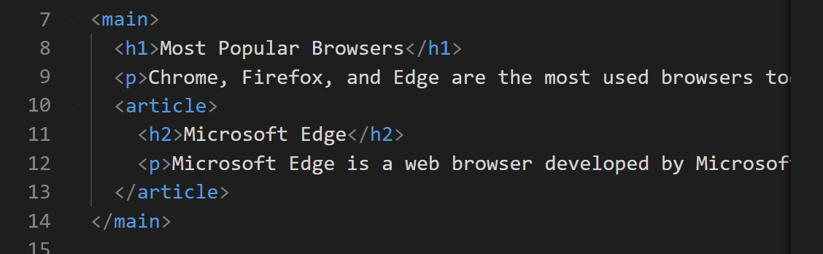
Main tag

Slide 28
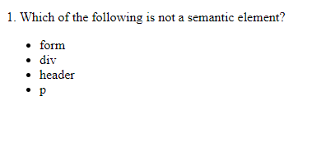
Question

Slide 29
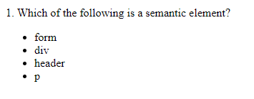
Question

Slide 30

Question

Slide 31
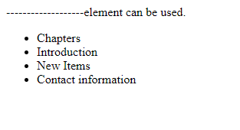
Question

Slide 32
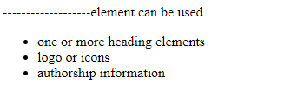
Question

Slide 33
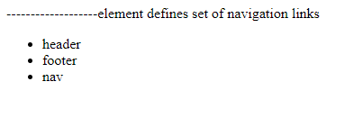
Question

Slide 34
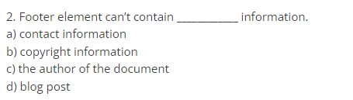
Question

Slide 35
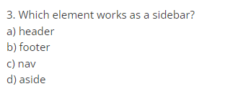
Question

Slide 36
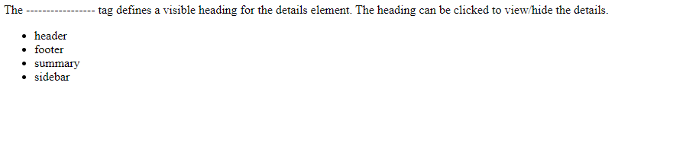
Question

Slide 37
HTML Elements continue..
HTML Lists
HTML lists are defined with the <ul> (unordered/bullet list) or the <ol> (ordered/numbered list) tag, followed by <li> tags (list items):
<ul> <li>Coffee</li> <li>Tea</li> <li>Milk</li> </ul>
<ol> <li>Coffee</li> <li>Tea</li> <li>Milk</li> </ol>

Slide 38
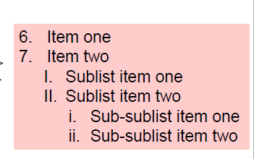
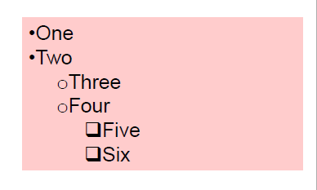
List

Slide 39
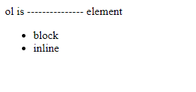
Question

Slide 40
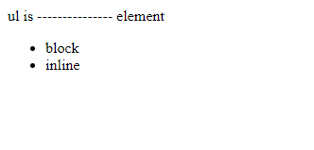
Question

Slide 41

Question

Slide 42

Question

Slide 43

Question

Slide 44
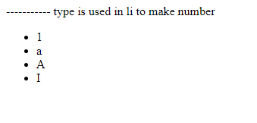
Question

Slide 45
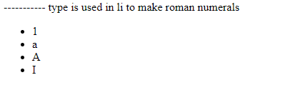
Question

Slide 46
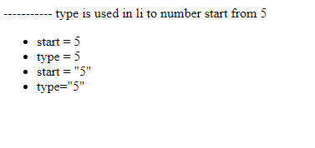
Question

