Slide 1
CSS - Training

Slide 2
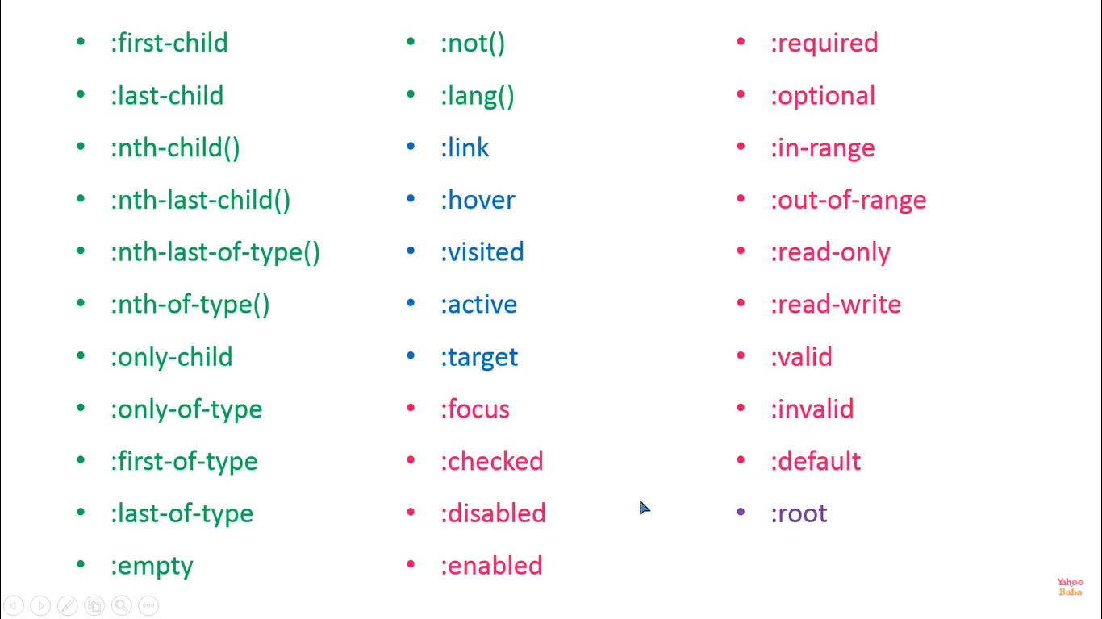
Pseudo Classes
32

Slide 3
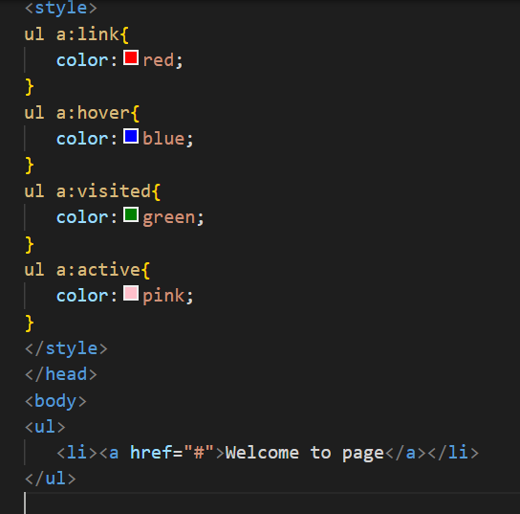
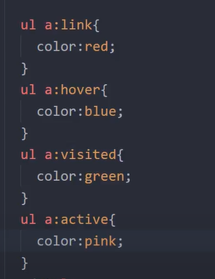
PseudoClass: link(),hover(),active(),visited() – used for anchor tag

Slide 4
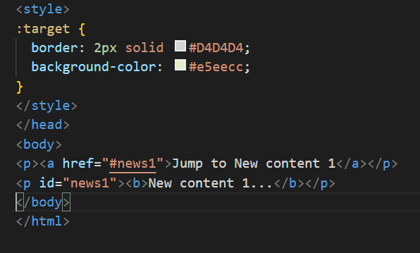

PseudoClass: target() – used for anchor

