Slide 1
CSS - Training

Slide 2
Advanced CSS Selector
Combinators Selector
Descendant Selector
Direct Child Selector
Adjacent sibling Selector
General sibling Selectors

Slide 3
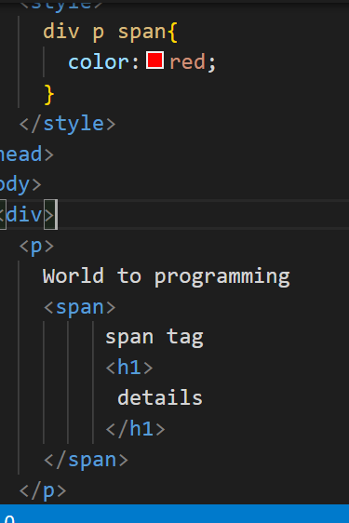
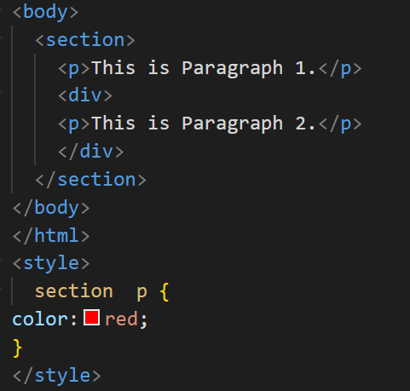
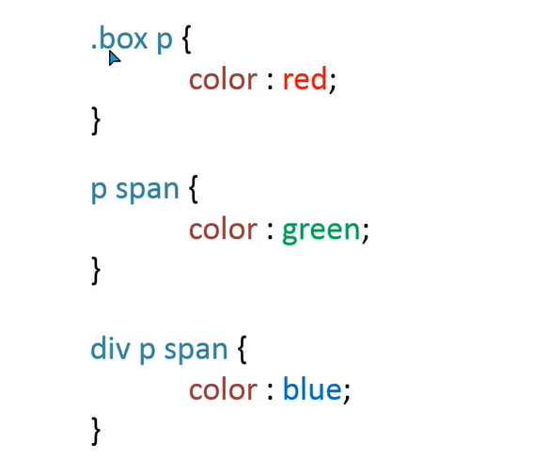
Combinators – Descendant Selector

Slide 4
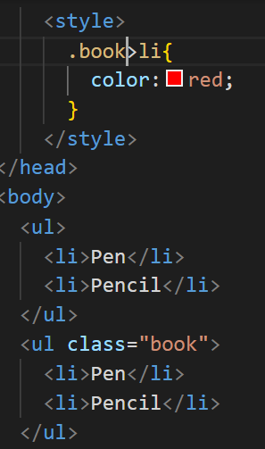
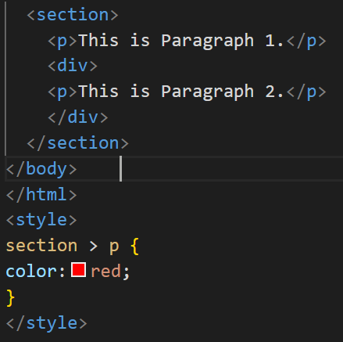
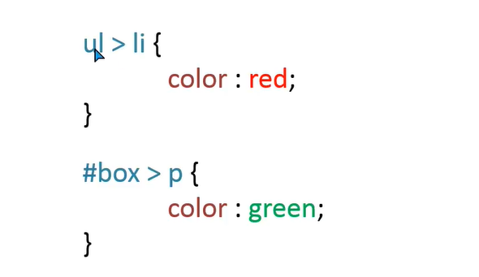
Combinators – Direct Child Selector

Slide 5
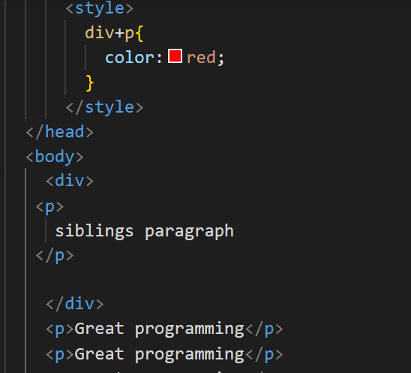
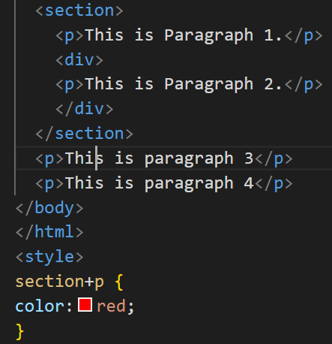
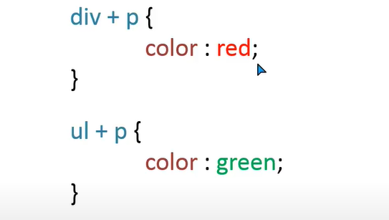
Combinators – Adjacent Sibling Selector

Slide 6
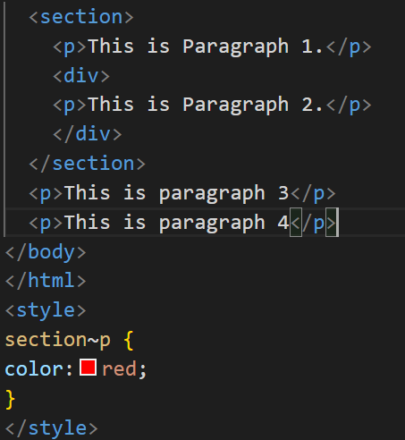
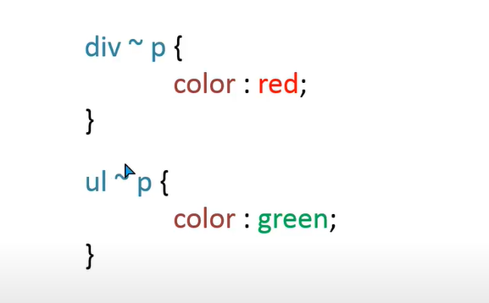
Combinators – General Sibling Selectors

Slide 7

Question

Slide 8

Question

Slide 9

Question

Slide 10

Question

