Slide 1
CSS - Training

Slide 2
Agenda
CSS Introduction
CSS Syntax understanding
CSS Selectors
Different Ways of Applying CSS in HTML
CSS Properties – Deep Dive
Building Various Navigation List
Styling HTML Forms

Slide 3
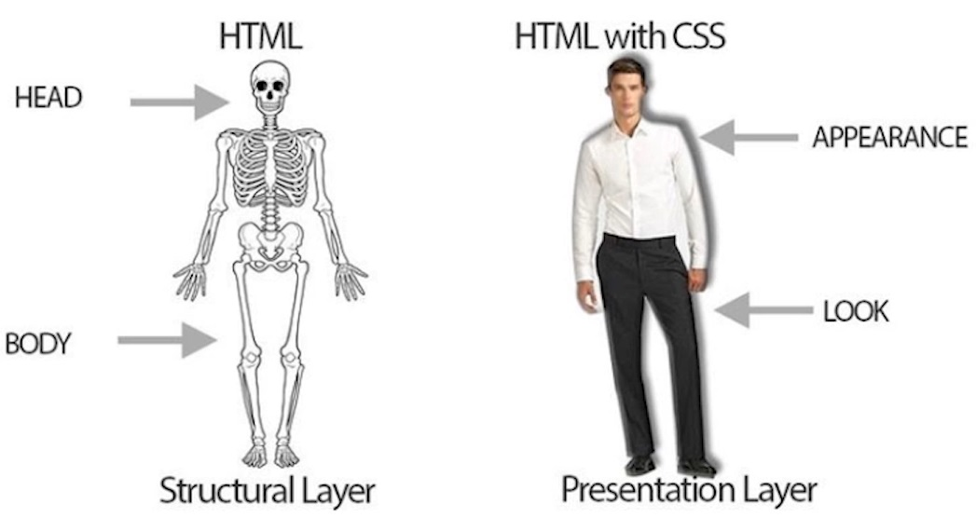
What is CSS?
CSS stands for Cascading Style Sheets.
It is used to style HTML documents to make it good looking.
Turn ordinary black & white page into colorful one.
Can make webpage as a Responsive one.

Slide 4
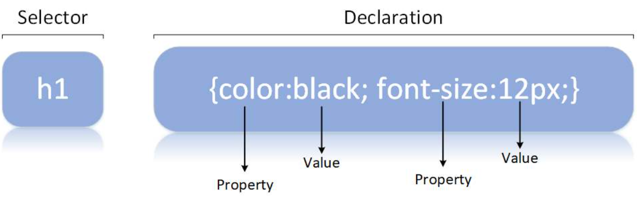
CSS Syntax
A CSS rule consists of a selector and a declaration block.
The selector points to the HTML element you want to style.
The declaration block contains one or more declarations separated by semicolons.

Slide 5
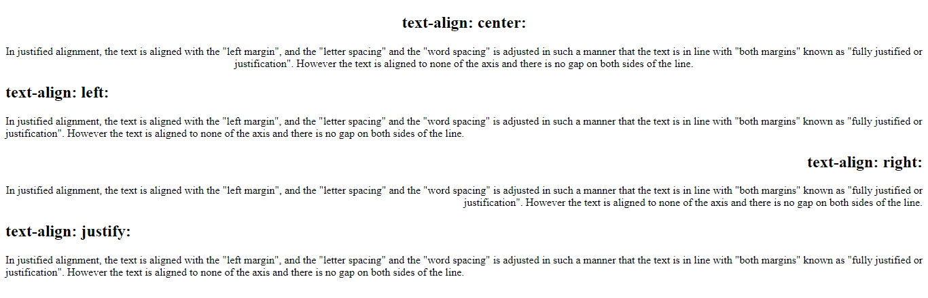
Text-align

Slide 6
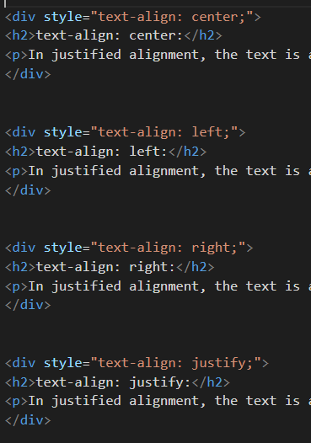

Text-align

Slide 7
CSS Properties
Colors - Colors are specified using predefined color names, or RGB, HEX, HSL, RGBA, HSLA values.
Text Color
Border Color
Background Color
Color Values - In CSS, colors can also be specified using RGB values, HEX values, HSL values:
<h1 style="color:blue;">Hello World</h1>
<h1 style="border:2px solid Tomato;">Hello World</h1>
<h1 style="background-color:DodgerBlue;">Hello World</h1>
Tomato
rgb(255, 99, 71)
#ff6347
hsl(9, 100%, 64%)

Slide 8
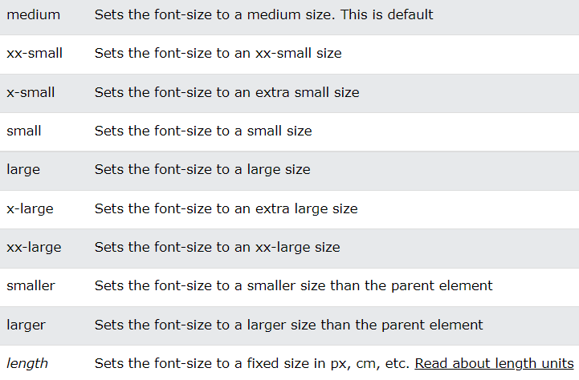
Font-size

Slide 9
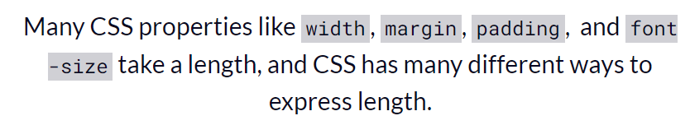
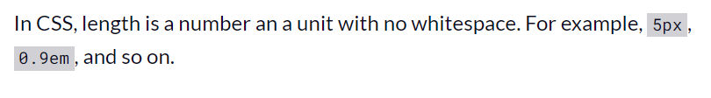
CSS Unit

Slide 10
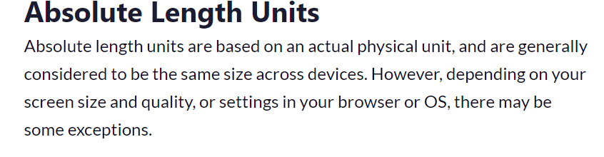
There are two general kinds of units used for length and size in CSS: absolute and relative.

Slide 11
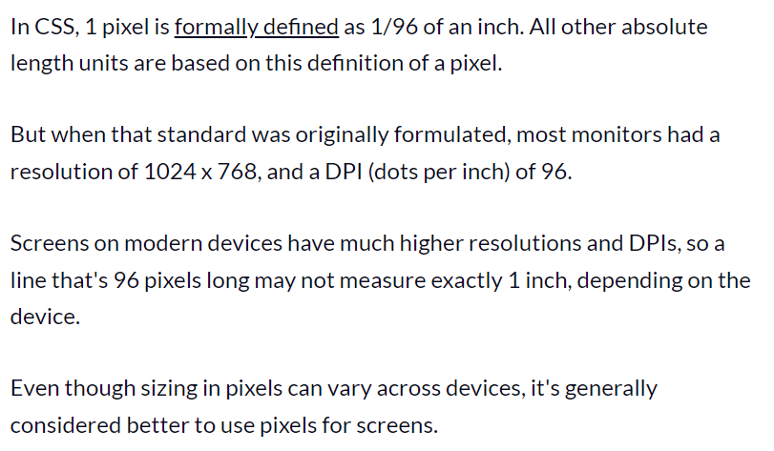
Absolute Length Units

Slide 12
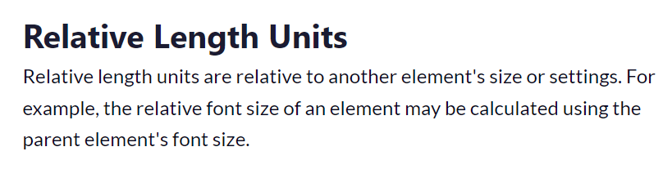
Relative Length Units

Slide 13
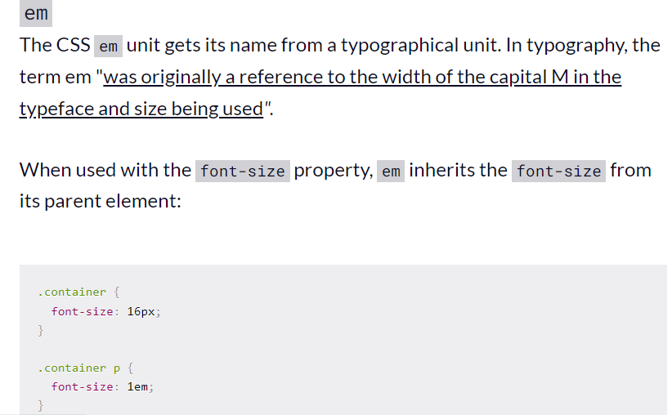
Relative Length Units

Slide 14
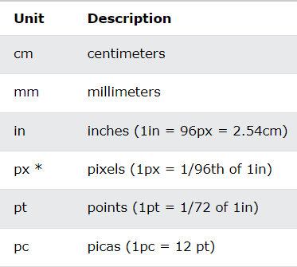
Other example of absolute Units

Slide 15
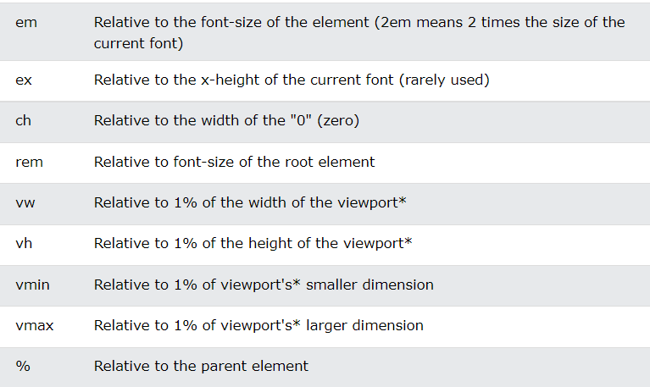
Other example of relative Units

Slide 16
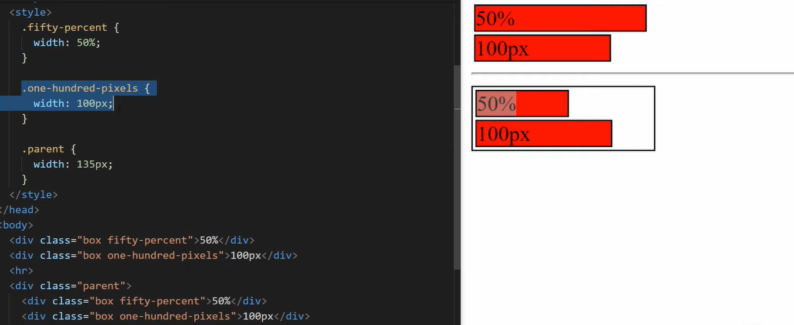
Other example of relative and absolute % related to parent

Slide 17
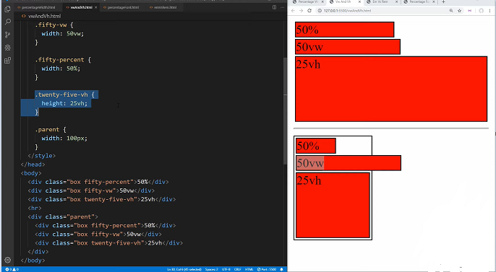
Other example of relative and absolute vw and vh related to screen size

Slide 18
Different Ways of Adding CSS
There are three ways of inserting a style sheet:
External CSS (in the head section)
Internal CSS (in the head section)
Inline CSS (inside an HTML element)
External CSS :
With an external style sheet, you can change the look of an entire website by changing just one file
<!DOCTYPE html> <html> <head> <link rel="stylesheet" href="mystyle.css"> </head> <body> </body> </html>

Slide 19
Different Ways of Adding CSS
Intenal CSS :
An internal style sheet may be used if one single HTML page has a unique style.
The internal style is defined inside the <style> element, inside the head section.
<html> <head> <style> body { background-color: linen; } h1 { color: maroon; margin-left: 40px; } </style> </head> <body> <h1>This is a heading</h1> <p>This is a paragraph.</p> </body> </html>

Slide 20
Different Ways of Adding CSS
Inline CSS :
An inline style may be used to apply a unique style for a single element, to use inline styles, add the style attribute to the relevant element.
<!DOCTYPE html> <html> <body> <h1 style="color:blue;text-align:center;">This is a heading</h1> <p style="color:red;">This is a paragraph.</p> </body> </html>

Slide 21
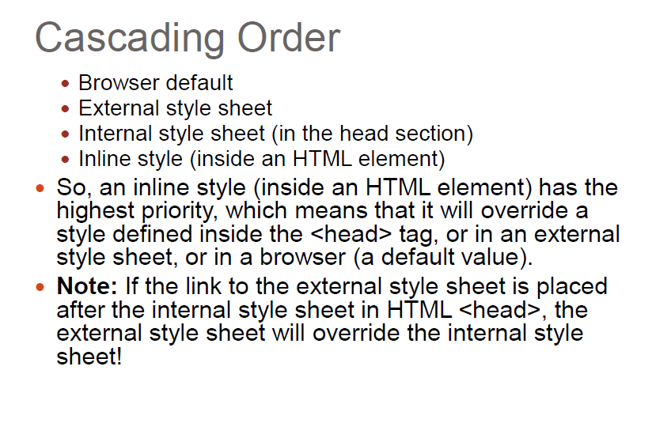
CSS Order

Slide 22
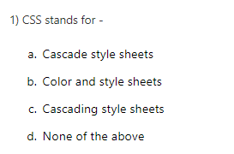
Question

Slide 23
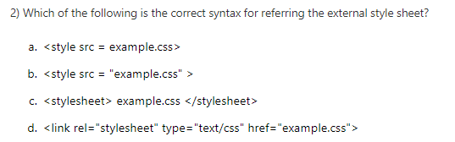
Question

Slide 24
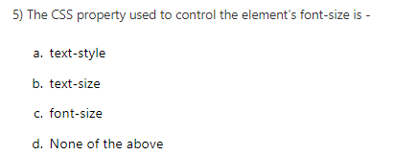
Question

Slide 25
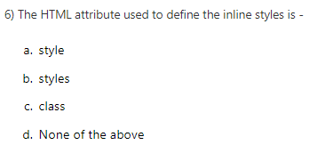
Question

Slide 26
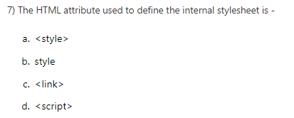
Question

Slide 27
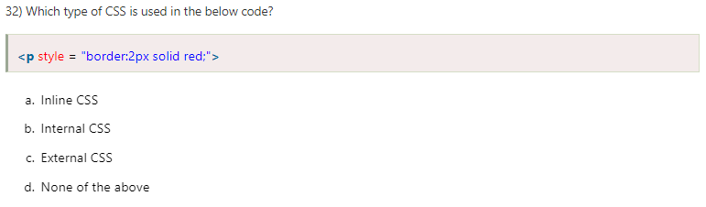
Question

Slide 28
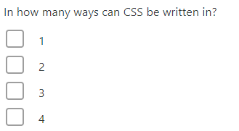
Question

Slide 29
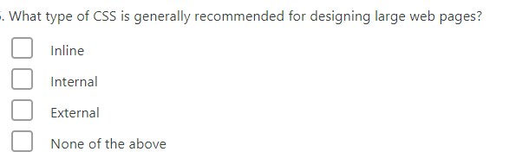
Question

Slide 30
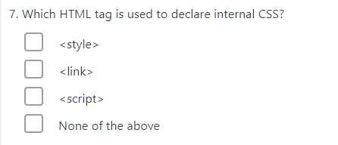
Question

Slide 31
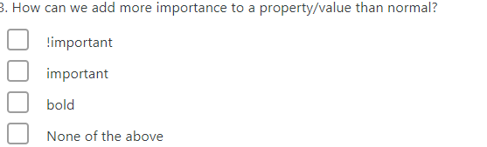
Question

Slide 32
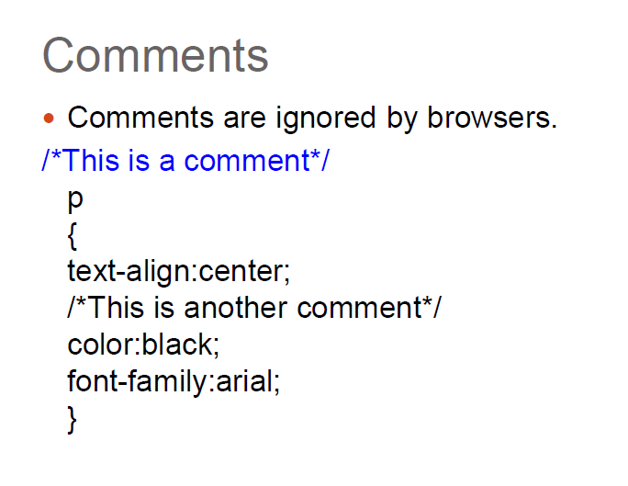
CSS Comment

Slide 33
CSS Basic Selectors
A CSS selector selects the HTML element(s) which we want to style
Types of Selectors:
CSS element Selector
CSS id Selector
CSS class Selector
CSS Universal Selector
CSS Grouping Selector

Slide 34
CSS Selectors
CSS element Selector: - The element selector selects HTML elements based on the element name
CSS id Selector - id selector uses the id attribute of an HTML element to select a specific element
CSS class Selector - Class selector selects HTML elements with a specific class attribute
p { text-align: center;
color: red; }
#textBoxName{ text-align: center; color: red; }
.portal { text-align: center; color: black; }

Slide 35
CSS Selectors
CSS Universal Selector: - CSS rule below will affect every HTML element on the page
CSS Grouping Selector
* { text-align: center; color: blue; }
h1 { text-align: center; color: red; } h2 { text-align: center; color: red; } p { text-align: center; color: red; }
h1, h2, p { text-align: center; color: red; }

Slide 36
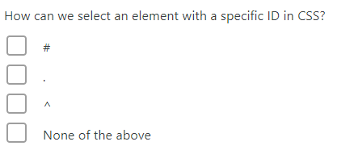
Question

Slide 37
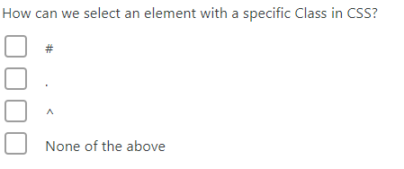
Question

Slide 38
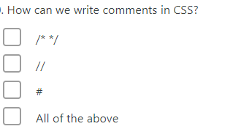
Question

Slide 39
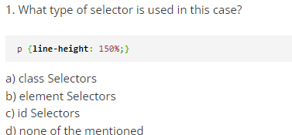
Question

Slide 40
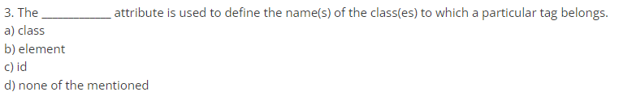
Question

Slide 41
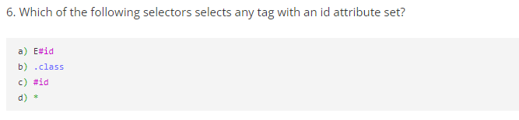
Question

Slide 42
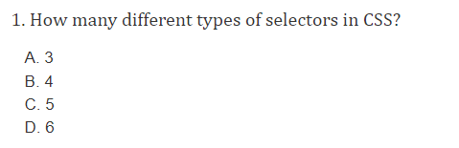
Question

Slide 43
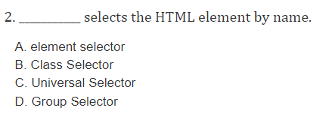
Question

Slide 44
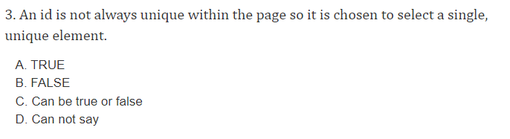
Question

Slide 45
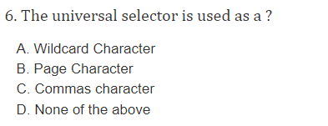
Question

