Slide 1
HTML 5 - Training

Slide 2
HTML Elements continue..
HTML Links
Use the <a> element to define a link
Use the href attribute to define the link address
Use the target attribute to define where to open the linked document
Use the <img> element (inside <a>) to use an image as a link
HTML Images
Use the HTML <img> element to define an image.
Use the HTML src attribute to define the URL of the image.
Use the HTML alt attribute to define an alternate text for an image, if it cannot be displayed.
Use the HTML width and height attributes to define the size of the image
15hrs
<a href="https://www.credosystemz.com">This is a link</a>
<img src="credologo.jpg" alt="credosystemz.com" width="104" height="142">

Slide 3
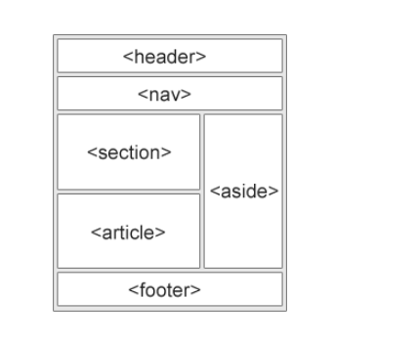
Semantic elements

Slide 4

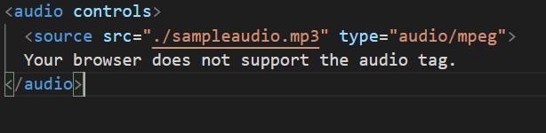
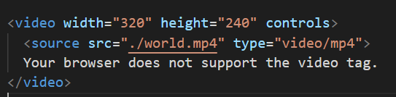
Media tag

