Slide 1
CSS - Training

Slide 2
Agenda
CSS Introduction
CSS Syntax understanding
CSS Selectors
Different Ways of Applying CSS in HTML
CSS Properties – Deep Dive
Building Various Navigation List
Styling HTML Forms

Slide 3
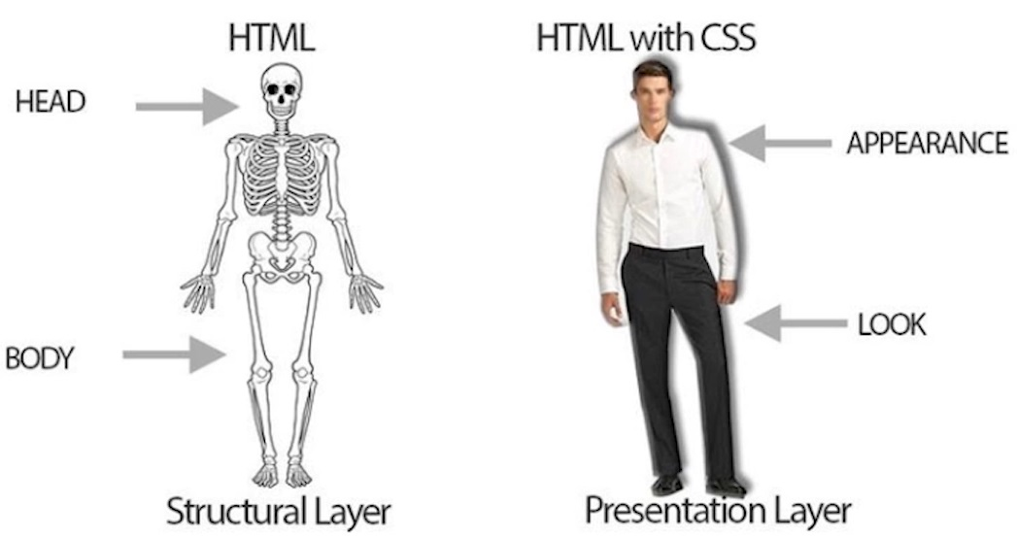
What is CSS?
CSS stands for Cascading Style Sheets.
It is used to style HTML documents to make it good looking.
Turn ordinary black & white page into colorful one.
Can make webpage as a Responsive one.

Slide 4
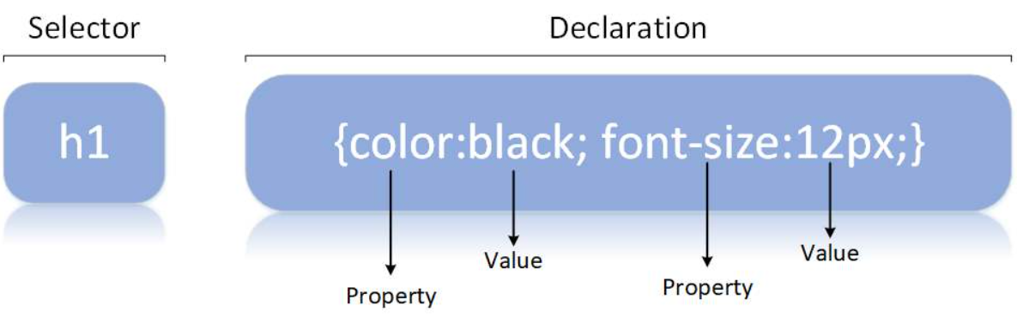
CSS Syntax
A CSS rule consists of a selector and a declaration block.
The selector points to the HTML element you want to style.
The declaration block contains one or more declarations separated by semicolons.

Slide 5
Different Ways of Adding CSS
There are three ways of inserting a style sheet:
External CSS (in the head section)
Internal CSS (in the head section)
Inline CSS (inside an HTML element)
External CSS :
With an external style sheet, you can change the look of an entire website by changing just one file
<!DOCTYPE html> <html> <head> <link rel="stylesheet" href="mystyle.css"> </head> <body> </body> </html>

Slide 6
Different Ways of Adding CSS
Intenal CSS :
An internal style sheet may be used if one single HTML page has a unique style.
The internal style is defined inside the <style> element, inside the head section.
<html> <head> <style> body { background-color: linen; } h1 { color: maroon; margin-left: 40px; } </style> </head> <body> <h1>This is a heading</h1> <p>This is a paragraph.</p> </body> </html>

Slide 7
Different Ways of Adding CSS
Inline CSS :
An inline style may be used to apply a unique style for a single element, to use inline styles, add the style attribute to the relevant element.
<!DOCTYPE html> <html> <body> <h1 style="color:blue;text-align:center;">This is a heading</h1> <p style="color:red;">This is a paragraph.</p> </body> </html>

Slide 8
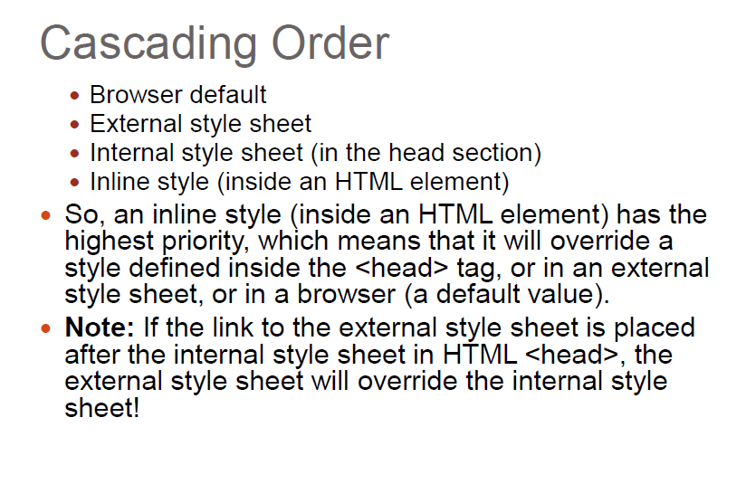
CSS Order

Slide 9
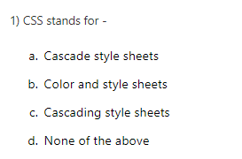
Question

Slide 10
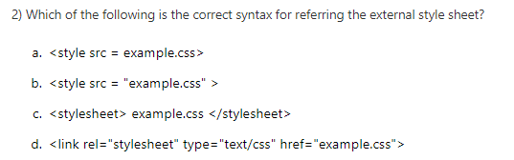
Question

Slide 11
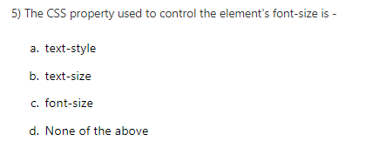
Question

Slide 12
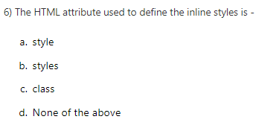
Question

Slide 13
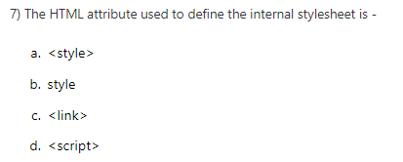
Question

Slide 14
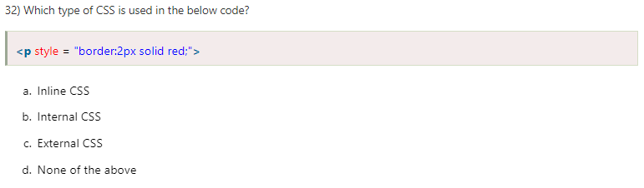
Question

Slide 15
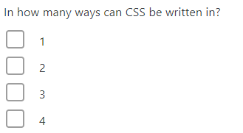
Question

Slide 16
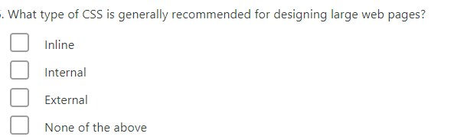
Question

Slide 17
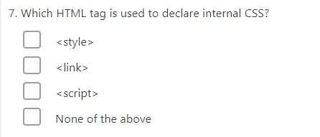
Question

Slide 18
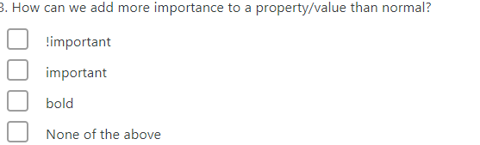
Question

Slide 19
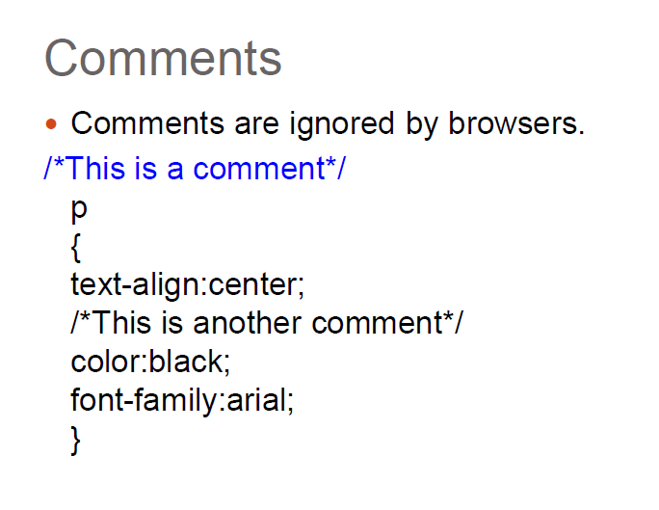
CSS Comment

Slide 20
CSS Basic Selectors
A CSS selector selects the HTML element(s) which we want to style
Types of Selectors:
CSS element Selector
CSS id Selector
CSS class Selector
CSS Universal Selector
CSS Grouping Selector

Slide 21
CSS Selectors
CSS element Selector: - The element selector selects HTML elements based on the element name
CSS id Selector - id selector uses the id attribute of an HTML element to select a specific element
CSS class Selector - Class selector selects HTML elements with a specific class attribute
p { text-align: center;
color: red; }
#textBoxName{ text-align: center; color: red; }
.portal { text-align: center; color: black; }

Slide 22
CSS Selectors
CSS Universal Selector: - CSS rule below will affect every HTML element on the page
CSS Grouping Selector
* { text-align: center; color: blue; }
h1 { text-align: center; color: red; } h2 { text-align: center; color: red; } p { text-align: center; color: red; }
h1, h2, p { text-align: center; color: red; }

Slide 23
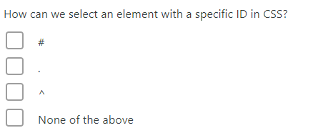
Question

Slide 24
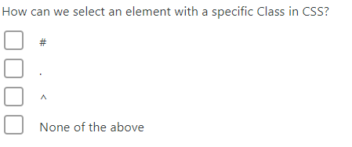
Question

Slide 25
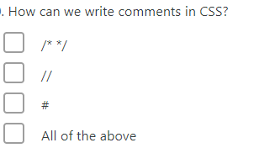
Question

Slide 26
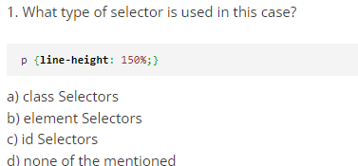
Question

Slide 27
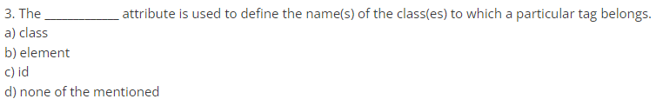
Question

Slide 28
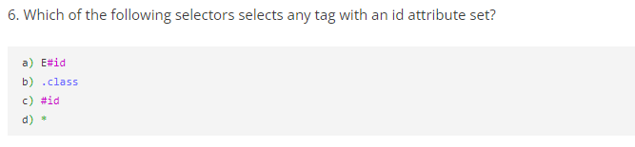
Question

Slide 29
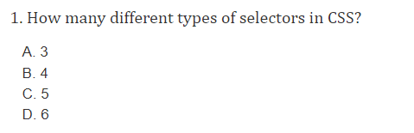
Question

Slide 30
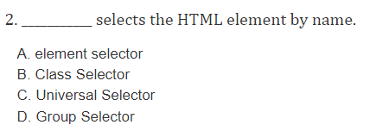
Question

Slide 31
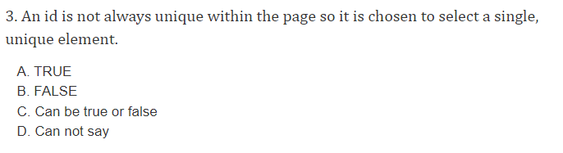
Question

Slide 32
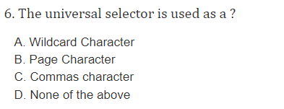
Question

