Slide 1
CSS - Training

Slide 2
CSS Basic Selectors
A CSS selector selects the HTML element(s) which we want to style
Types of Selectors:
CSS element Selector
CSS id Selector
CSS class Selector
CSS Universal Selector
CSS Grouping Selector

Slide 3
CSS Selectors
CSS element Selector: - The element selector selects HTML elements based on the element name
CSS id Selector - id selector uses the id attribute of an HTML element to select a specific element
CSS class Selector - Class selector selects HTML elements with a specific class attribute
p { text-align: center;
color: red; }
#textBoxName{ text-align: center; color: red; }
.portal { text-align: center; color: black; }

Slide 4
CSS Selectors
CSS Universal Selector: - CSS rule below will affect every HTML element on the page
CSS Grouping Selector
* { text-align: center; color: blue; }
h1 { text-align: center; color: red; } h2 { text-align: center; color: red; } p { text-align: center; color: red; }
h1, h2, p { text-align: center; color: red; }

Slide 5
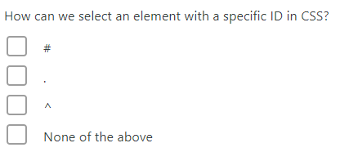
Question

Slide 6
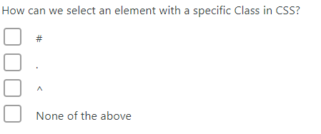
Question

Slide 7
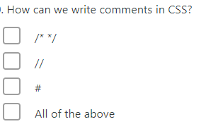
Question

Slide 8
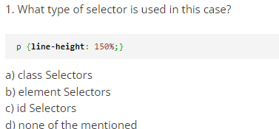
Question

Slide 9
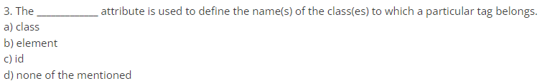
Question

Slide 10
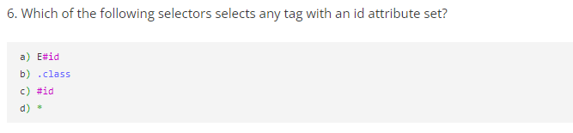
Question

Slide 11
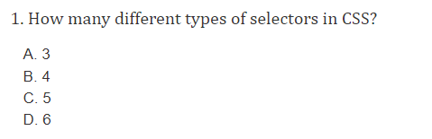
Question

Slide 12
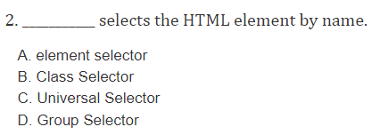
Question

Slide 13
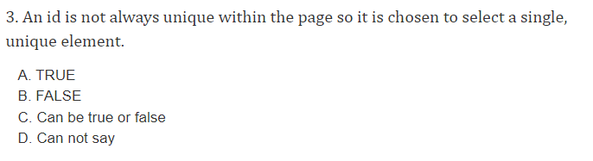
Question

Slide 14
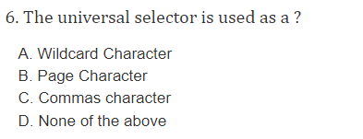
Question

Slide 15
Advanced CSS Selector
Combinators Selector
Descendant Selector
Direct Child Selector
Adjacent sibling Selector
General sibling Selectors

Slide 16
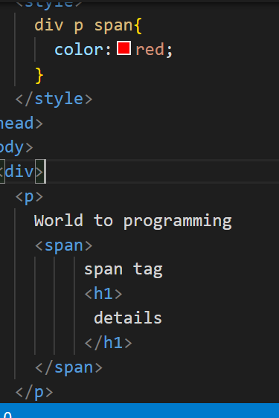
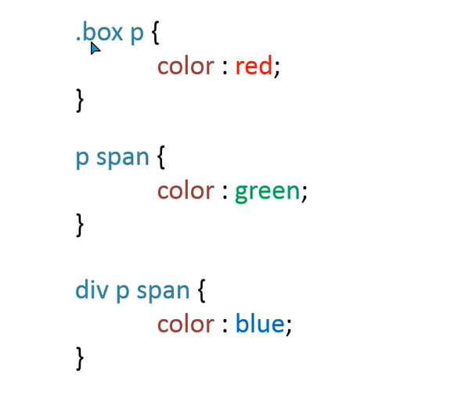
Combinators – Descendant Selector

Slide 17
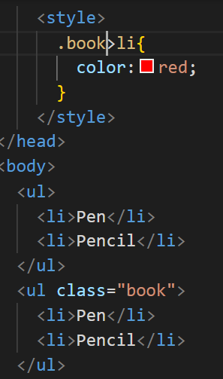
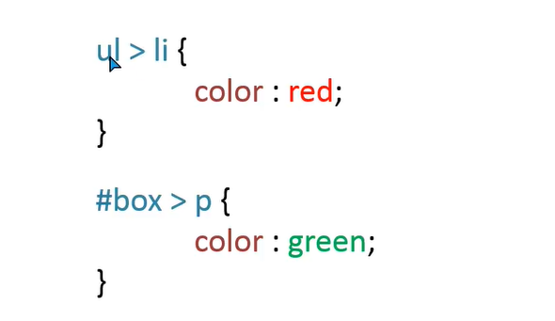
Combinators – Direct Child Selector

Slide 18
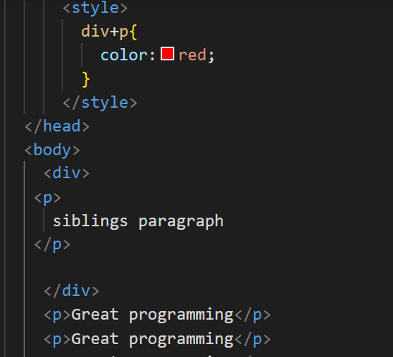
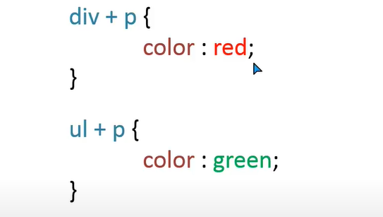
Combinators – Adjacent Sibling Selector

Slide 19
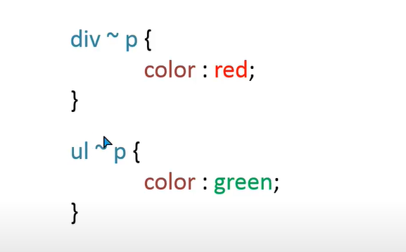
Combinators – General Sibling Selectors

Slide 20
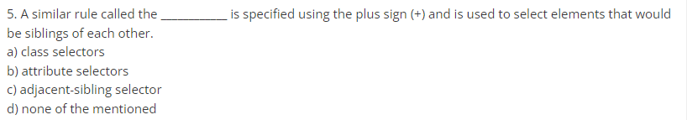
Question

Slide 21
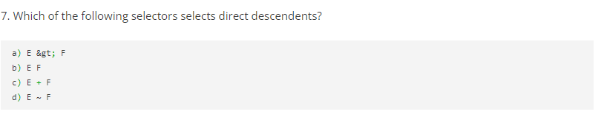
Question

Slide 22
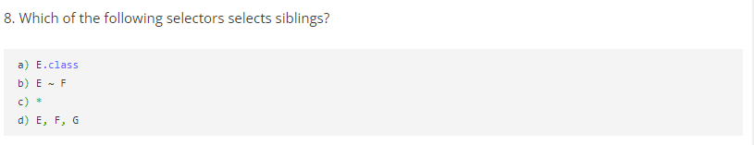
Question

Slide 23
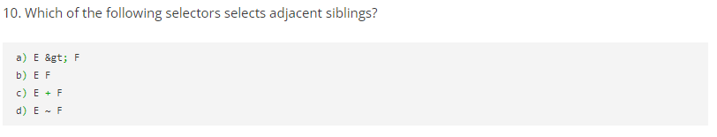
Question

