Slide 1
Baseline Experiments and Initial Failure Analysis
Progress update toward Week 7: synthetic task baselines, validation results, and next steps
Length generalisation in Transformer sequence models

Slide 2
We have completed the first baseline pass
The project is now between baseline experiments and failure analysis
What is done
What is learned
What is not ready
Four synthetic tasks are implemented, generated, trained, and evaluated with a learned-position baseline.
Delayed copy and reverse show clean train-short/test-long failure. Addition needs shorter training length.
Associative recall remains weak even after easier diagnostics, so it should not be scaled yet.
• This is progress toward Week 7, not the final Week 7 experiment matrix.
• The next stage is positional encoding comparison on validated tasks.
2 / 8

Slide 3
The current task set covers memory, order, arithmetic, and retrieval
All tasks follow the train-short/test-long protocol up to 1024
Delayed copy
Reverse
Addition
Associative recall
Recall an earlier sequence after a separator.
Output tokens in the opposite order.
Digit-wise arithmetic with carry propagation.
Retrieve a value paired with a queried key.
Baseline setup
• Transformer encoder baseline with learned absolute positional embeddings
• Primary maximum test length: 1024
• Metrics: token accuracy and exact-match accuracy
3 / 8

Slide 4
Two tasks show clean length-generalisation failure
The model solves the training length, then collapses on longer unseen lengths
Task
Train
Test 128
Test 256
Test 1024
Interpretation
Delayed copy
128
100% exact
0% exact
0% exact
Learns short length; fails extrapolation
Reverse
128
100% exact
0% exact
0% exact
Learns short length; fails extrapolation
Main takeaway
Delayed copy and reverse are ready for positional-encoding comparison because the baseline has learned the training distribution but fails beyond it.
4 / 8

Slide 5
Addition works only after reducing the training length
This separates task learnability from length extrapolation
Setup
Train length
Exact@train
Exact@next
Token@1024
Meaning
Initial
128
0%
0%
10.1%
Too hard at 128
Validation
16
94.6%
0%
10.1%
Learns short length; fails longer
• For addition, train length 16 is the validated baseline for PE comparison.
• Train length 128 is useful evidence of training-length difficulty, not extrapolation.
5 / 8

Slide 6
Associative recall is still a task-design issue
The model remains near random after small-vocabulary and shorter-length diagnostics
Diagnostic
Train length
Exact@train
Exact@longest
Conclusion
Original
128
0%
0.1%
Not learned
Small vocab
16
2.3%
0.3%
Still near random
Debug
8
9.3%
0.4%
Weak learning only
Decision
Do not spend AWS budget scaling associative recall yet. Keep it as a diagnostic task while positional encoding comparisons start on validated tasks.
6 / 8

Slide 7
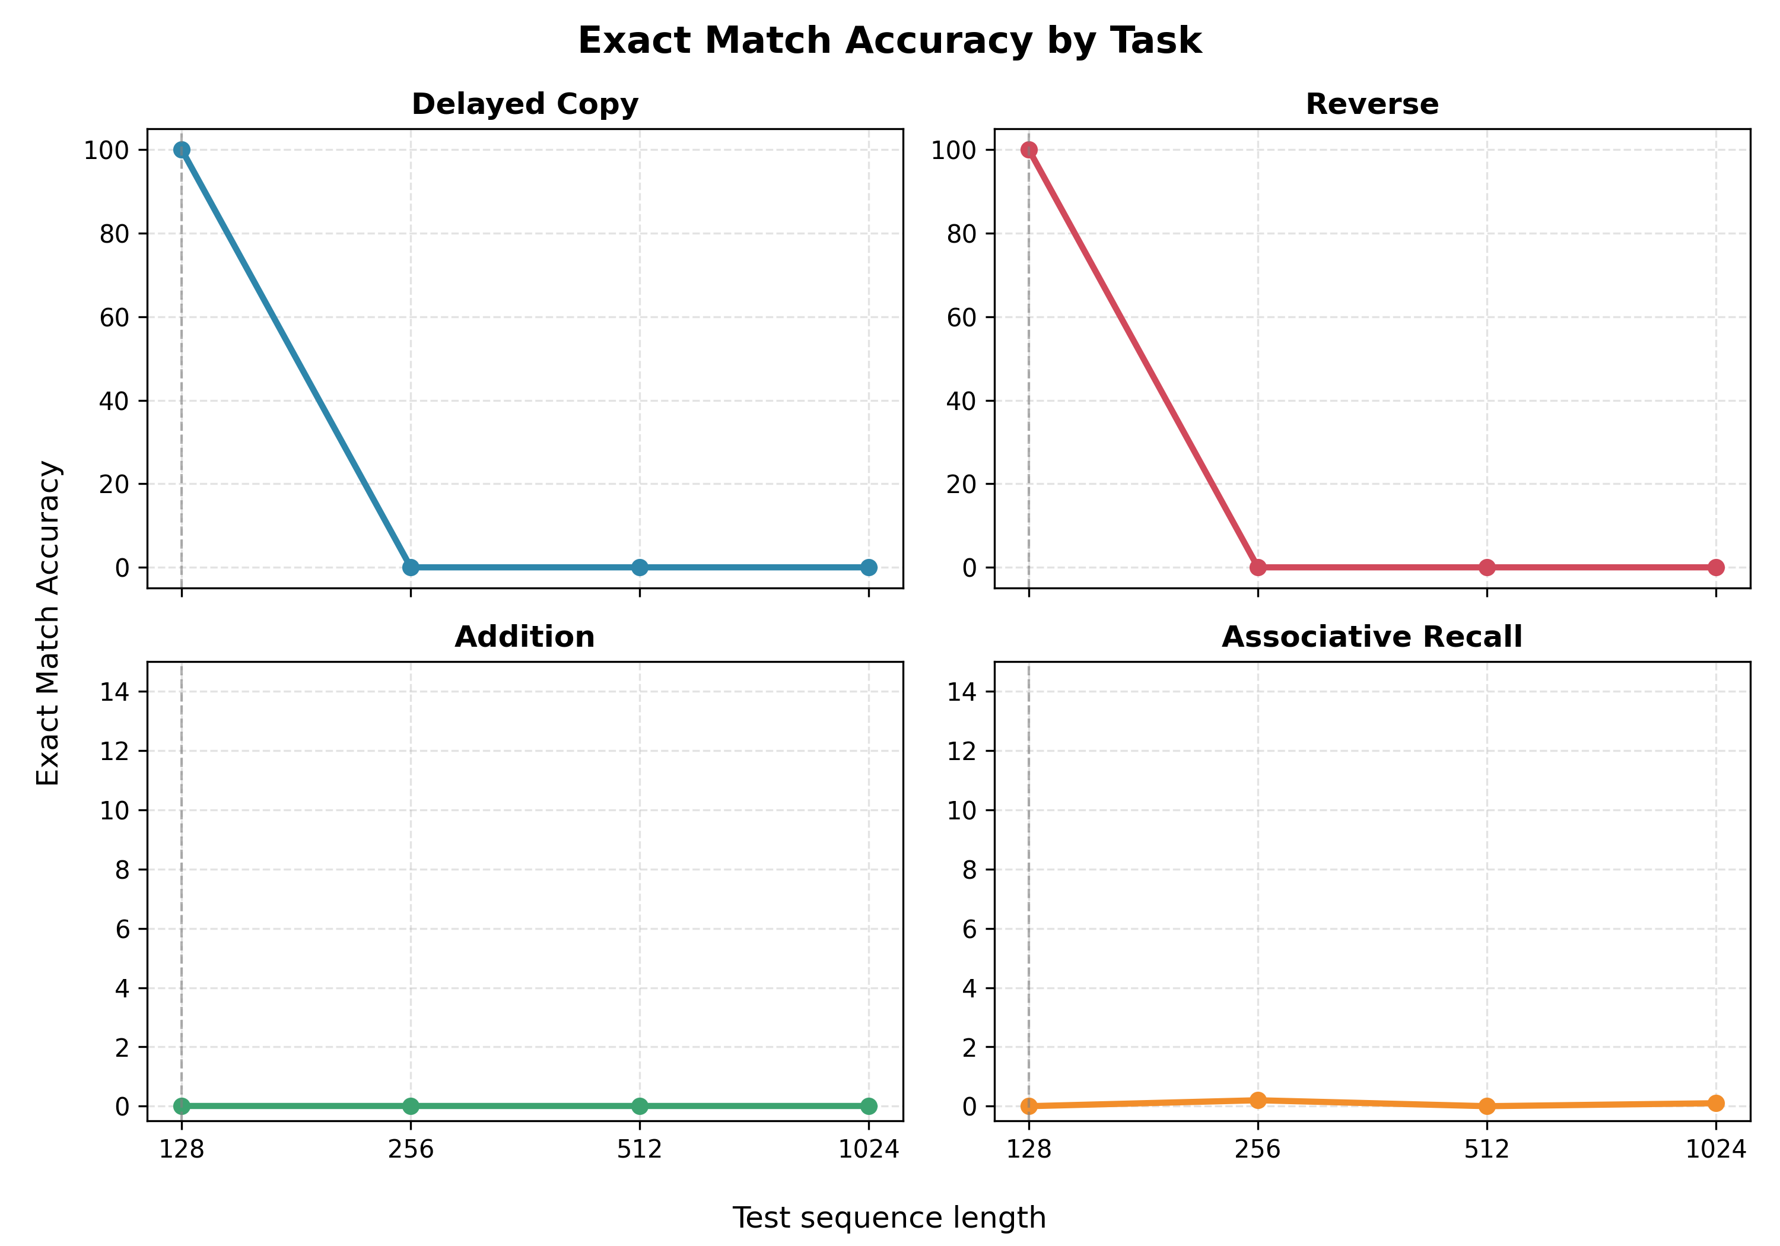
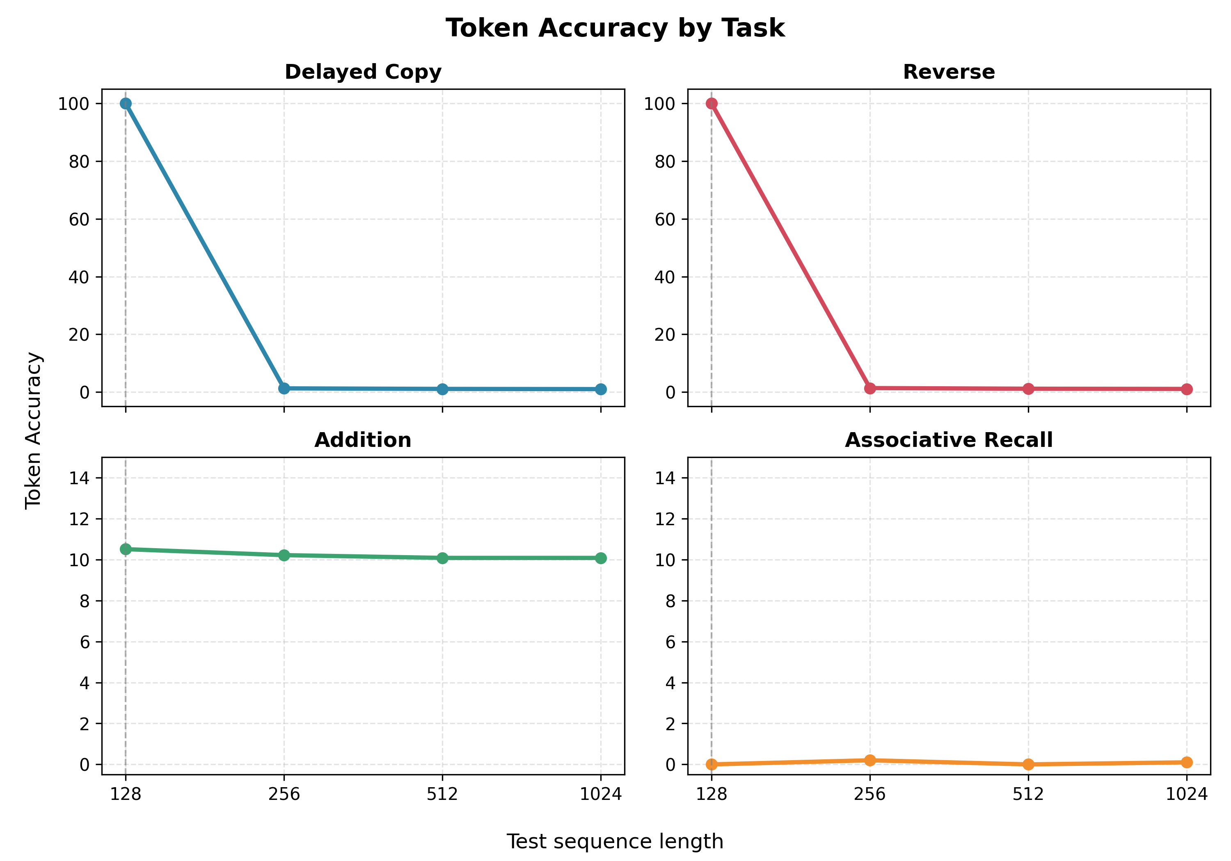
The plots now support the first failure taxonomy
Baseline results already split into distinct failure types
Pattern A: learned at train length, failed on longer lengths. Pattern B: did not reliably learn the training length.
7 / 8

Slide 8
Next step: positional encodings on validated tasks
The baseline is ready to extend, but only where the task is learnable
Priority
Run next
Reason
1
Learned vs sinusoidal vs NoPE
Simplest PE comparison; low implementation risk
2
Delayed copy, reverse, addition-16
These tasks have validated baseline behaviour
3
Add ALiBi and RoPE
Core paper comparison once the model API is stable
4
Multiple seeds
Move toward Week 7 robustness after PE pilot
Supervisor feedback requested
Does this validation plan justify moving to positional encodings on the three validated tasks while associative recall remains under task-design review?
8 / 8

