Slide 1
PROJECT UPDATE
Length generalisation in sequence models
45
multi-seed PE runs
15
update: experiment matrix, failure analysis, mitigation results, and taxonomy
attention diagnostics
9
mitigation runs
Notes:
Purpose: update supervisor on what has changed since the previous deck.
[Sources] Local project outputs: multiseed results, attention analysis, mitigation summary, failure taxonomy.

Slide 2
The project now asks a question of
Can small Transformers learn length-general algorithms, or do they learn length-specific shortcuts?
Synthetic tasks
Train short
Stress length
Explain failure
Addition, delayed copy, reverse, and associative recall were selected to probe algorithmic sequence behaviour.
Models are trained on short or moderate lengths, then evaluated at longer unseen lengths.
Evaluation extends to 1024 to test realistic long-context failure, not only tiny toy sequences.
Results are linked to attention diagnostics and a failure taxonomy, not only raw accuracy.
Current evidence supports length-specific learning rather than robust algorithmic extrapolation.
The work now has results for baseline, positional encoding, robustness, attention, and mitigation.
Notes:
Use this slide to remind the professor why the experimental design changed from simple copy to delayed copy and longer lengths.
[Sources] Project_time_plan.docx, outputs/results/multiseed_results, outputs/analysis.

Slide 3
The experiment matrix is now complete
The core matrix covers task, positional encoding, length, and seed.
3
5
3
45
main tasks
PE variants
random seeds
completed runs
Tasks: addition, delayed copy, reverse.
PE variants: learned, sinusoidal, NoPE, ALiBi, RoPE.
Seeds: 42, 123, 2024, with mean, standard deviation, and standard error reported.
Notes:
This slide answers the robustness requirement: the matrix is not a one-off run.
[Sources] outputs/results/multiseed_results; outputs/plots/multiseed/multiseed_summary.csv.

Slide 4
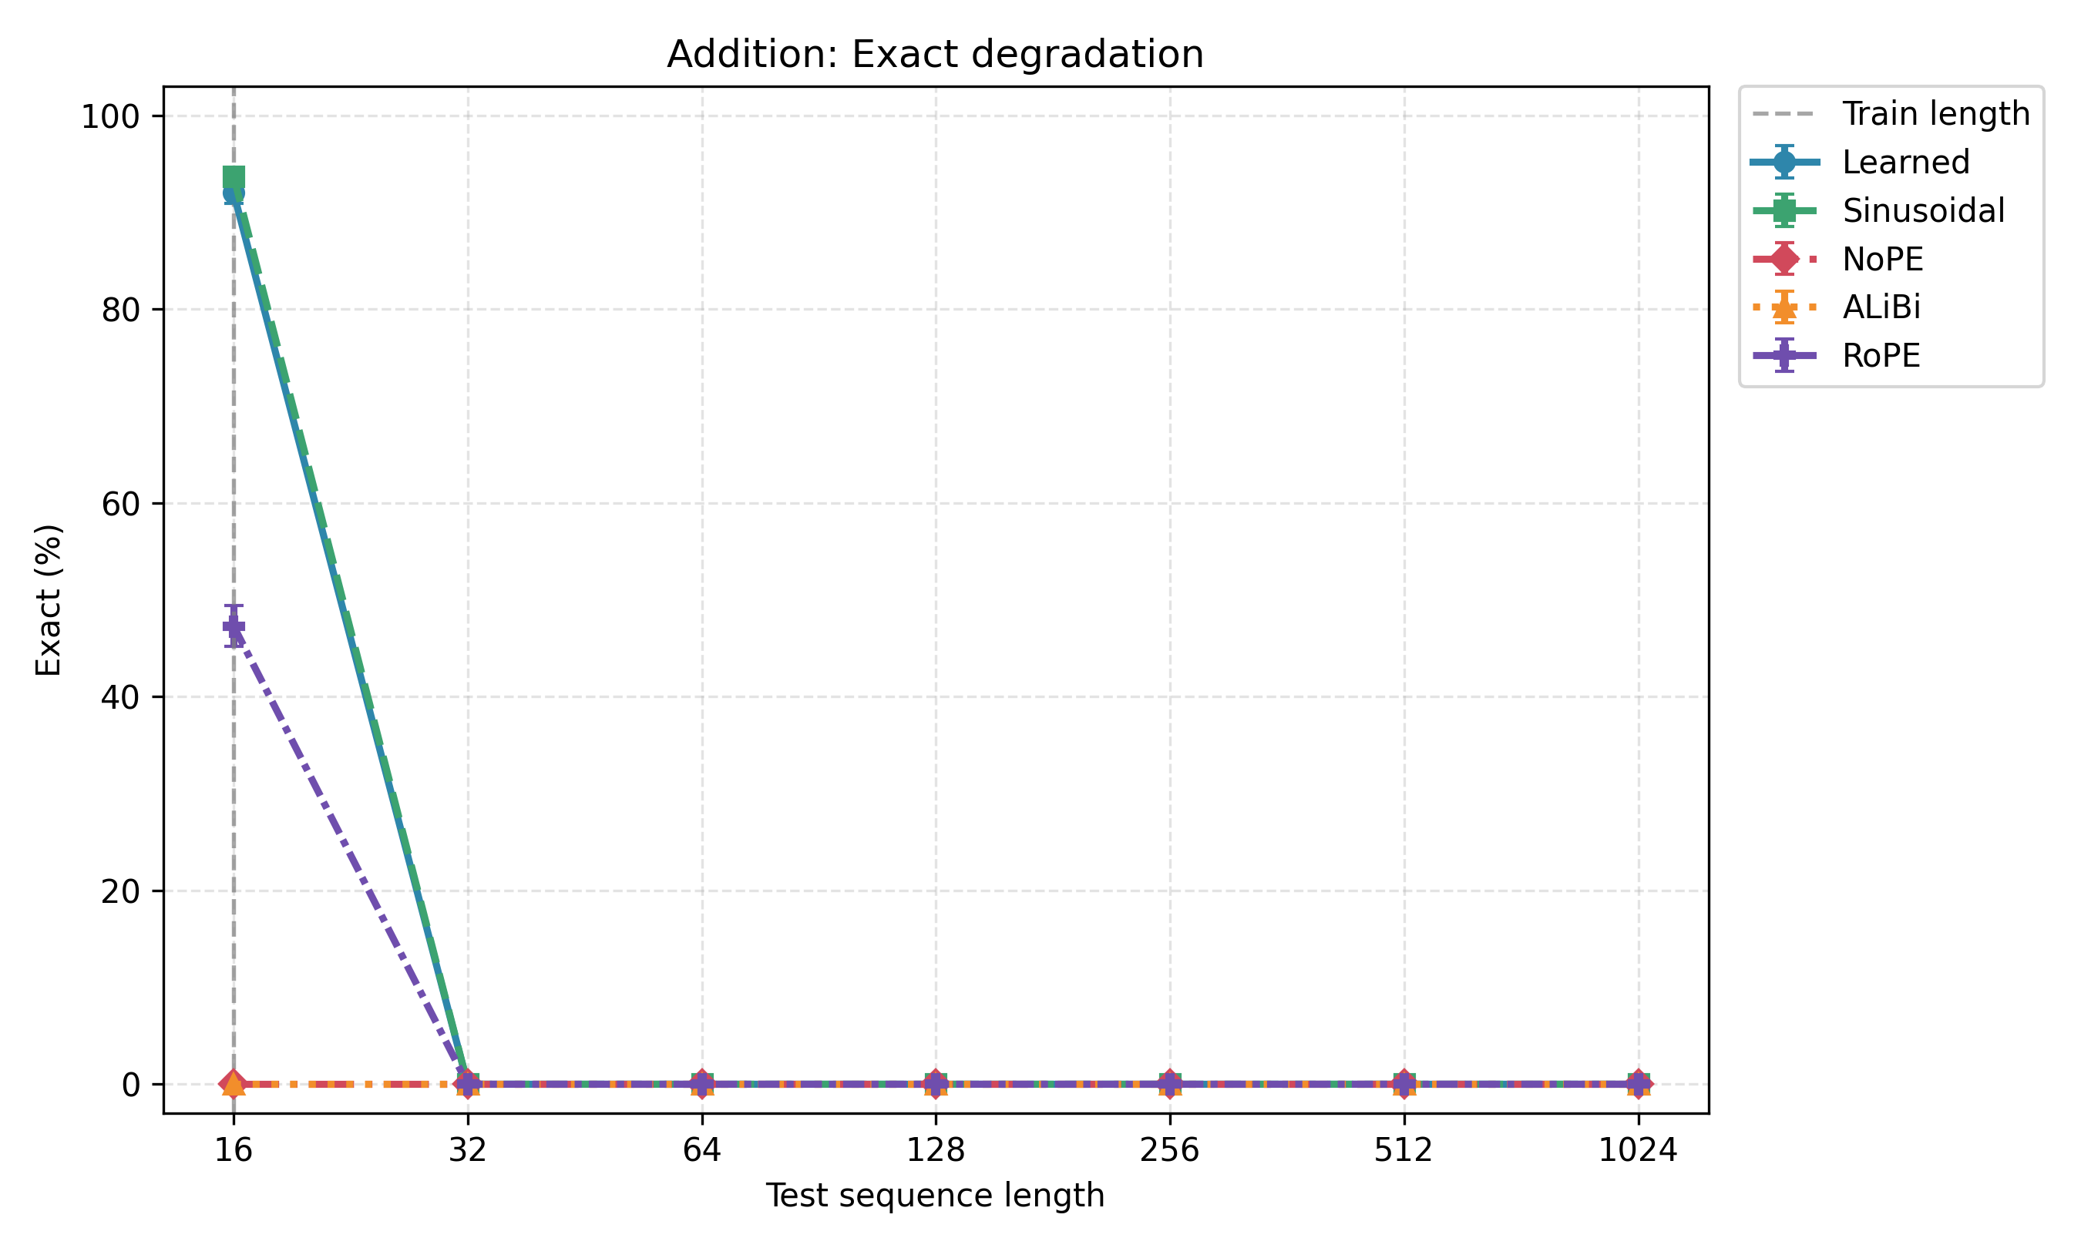
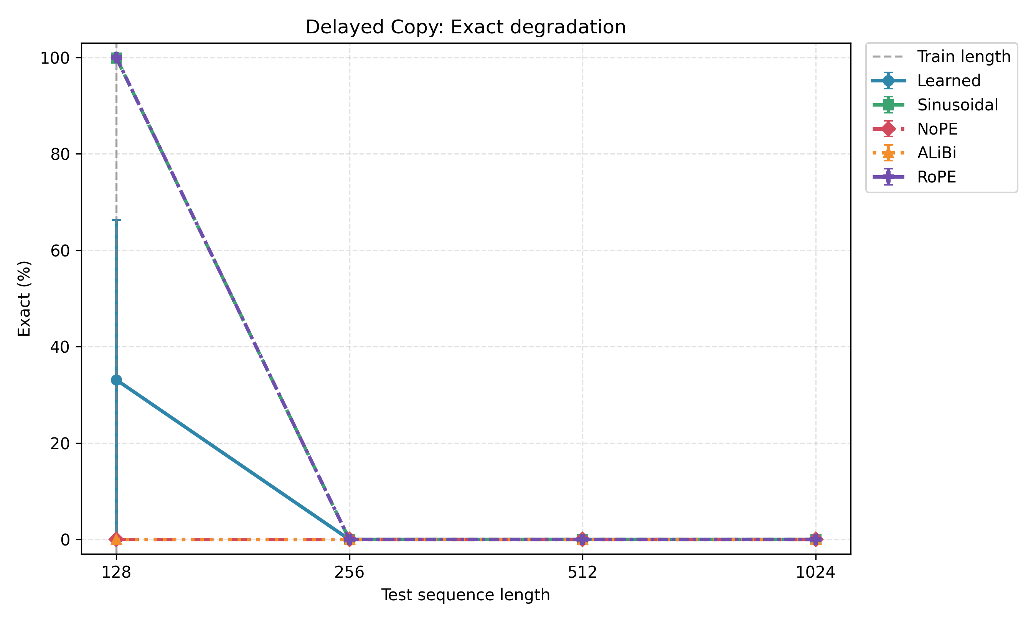
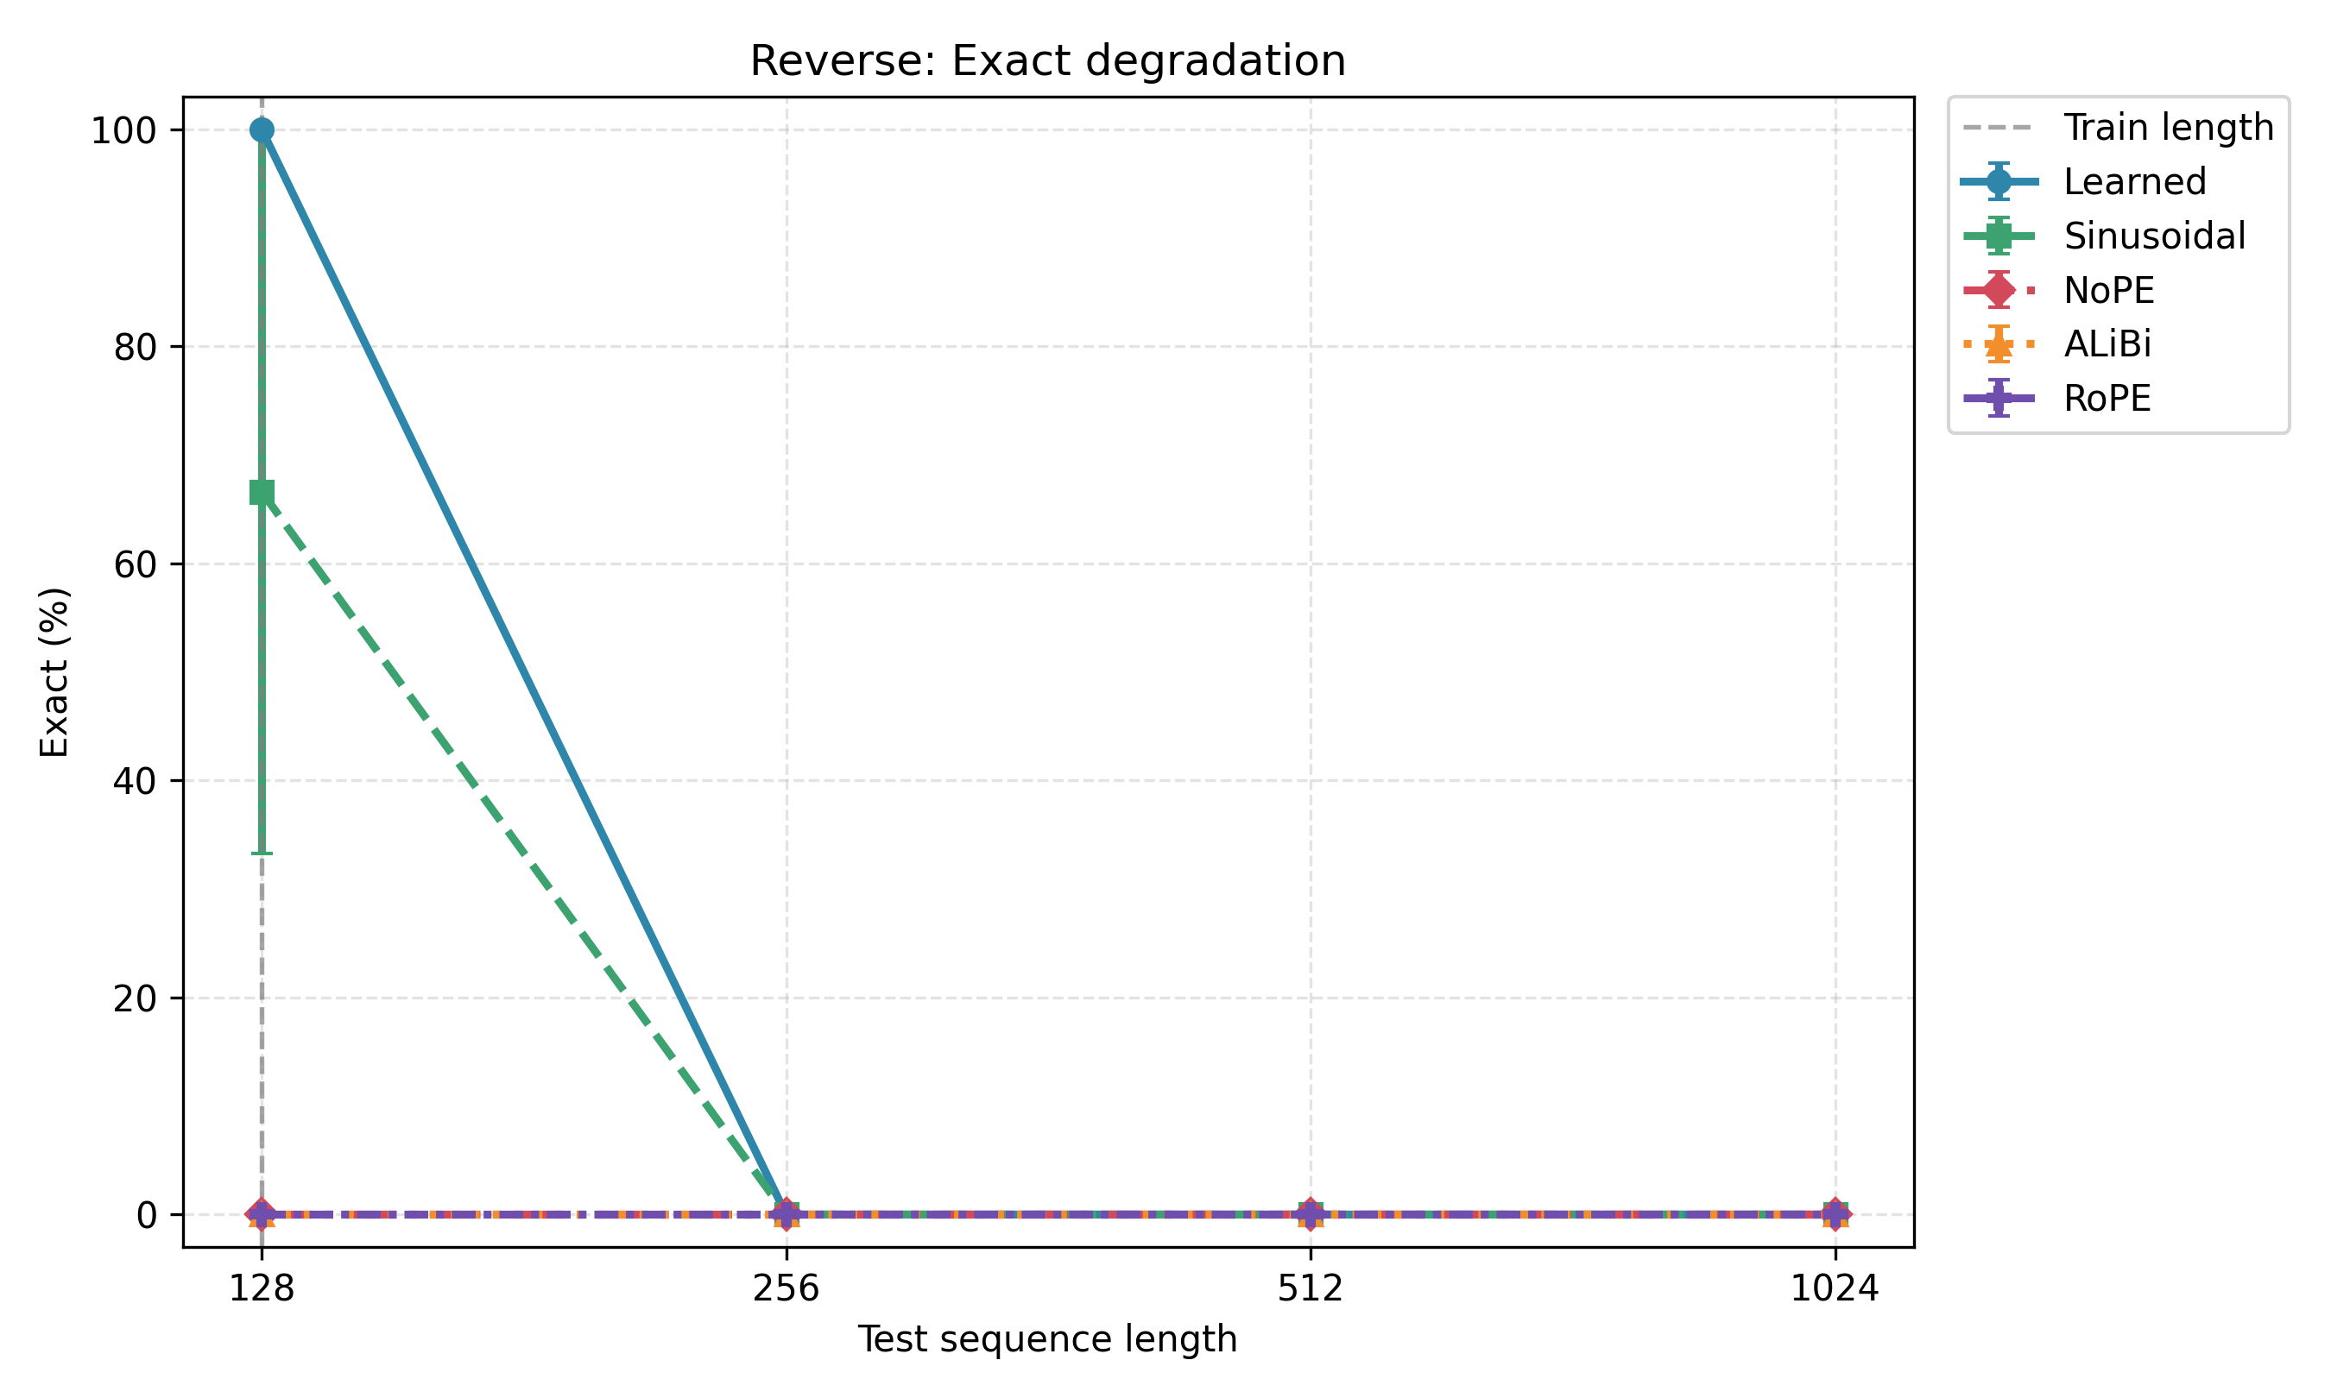
Baseline models fit train length but collapse out of range
Exact match accuracy falls to zero as soon as the model leaves the training distribution.
Addition fails immediately after train length 16.
Delayed copy and reverse fail when moving from 128 to 256.
Notes:
Main result: high in-distribution accuracy does not imply extrapolation.
[Sources] outputs/plots/multiseed/*_exact_degradation_mean_se.png.

Slide 5
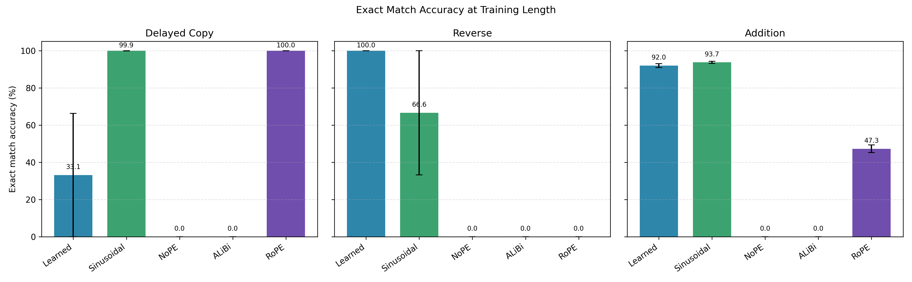
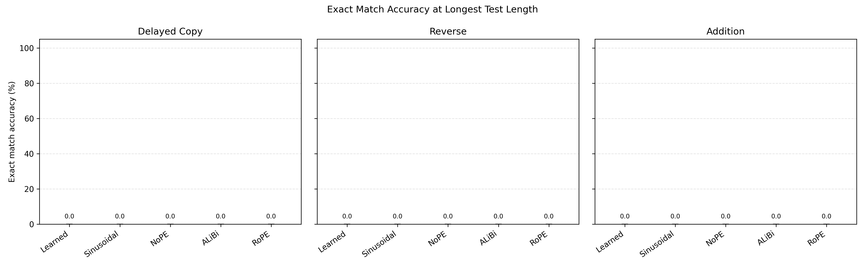
Positional encodings change fit, not the long-length outcome
Some encodings learn the training length; none reliably extrapolate to 1024.
NoPE and ALiBi often underfit at train length in this setup.
Learned, sinusoidal, and RoPE can fit train length, but exact at 1024 remains 0%.
Notes:
This directly addresses the supervisor note about ALiBi and NoPE: they often fail as underfitting cases, not pure extrapolation cases.
[Sources] outputs/plots/multiseed/exact_at_train_mean_se.png; exact_at_longest_mean_se.png.

Slide 6
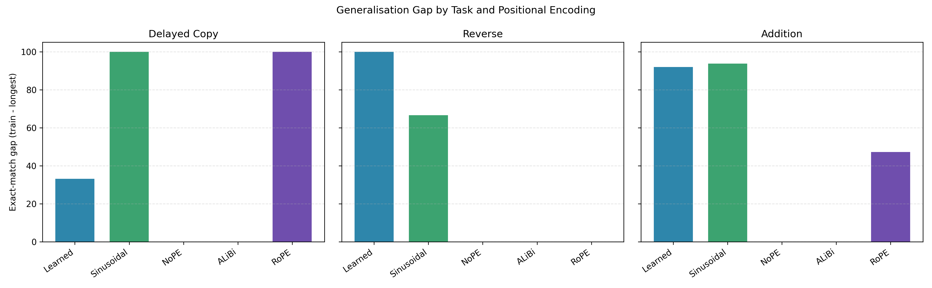
Multi-seed reporting exposes instability
Some settings are stable, while others vary strongly across seeds.
Seed-sensitive cases
Delayed copy learned and reverse sinusoidal have high train-length variance across seeds.
Stable failure cases
Addition learned and sinusoidal fit train length consistently, then fail immediately at length 32.
Reporting choice
Mean, standard deviation, and standard error are now included in summary tables.
Notes:
This slide frames robustness as part of the methodology, not an afterthought.
[Sources] outputs/plots/multiseed/multiseed_summary.csv; generalisation_gap_mean.png.

Slide 7
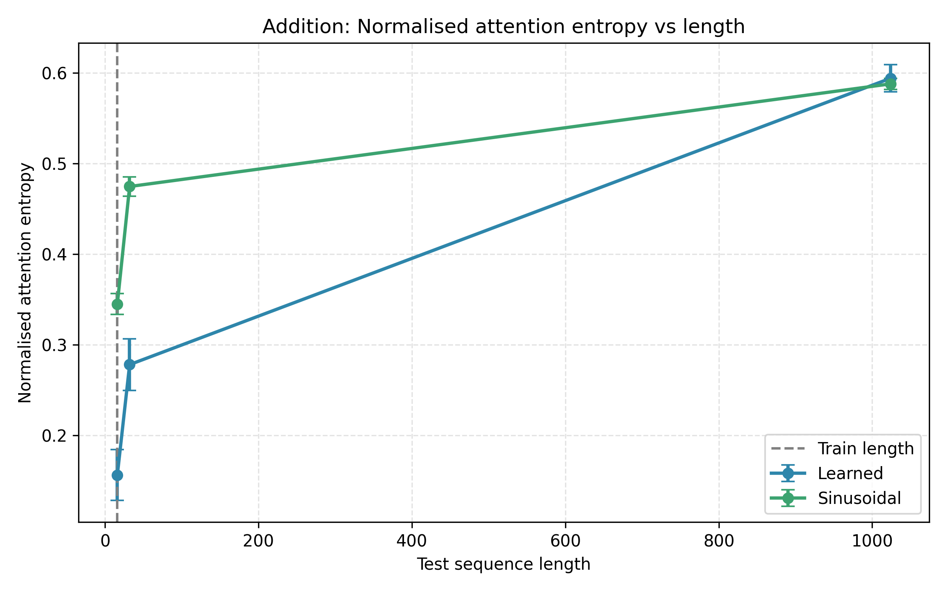
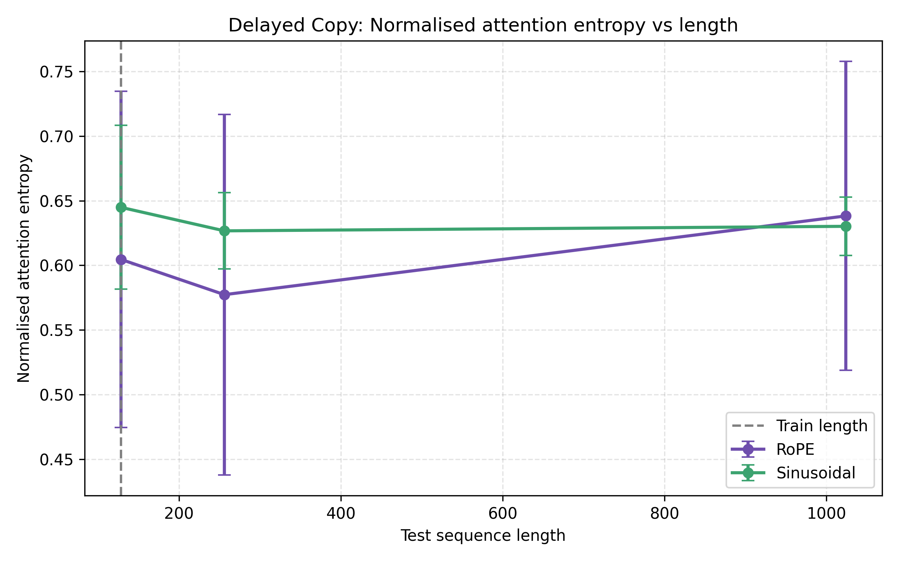
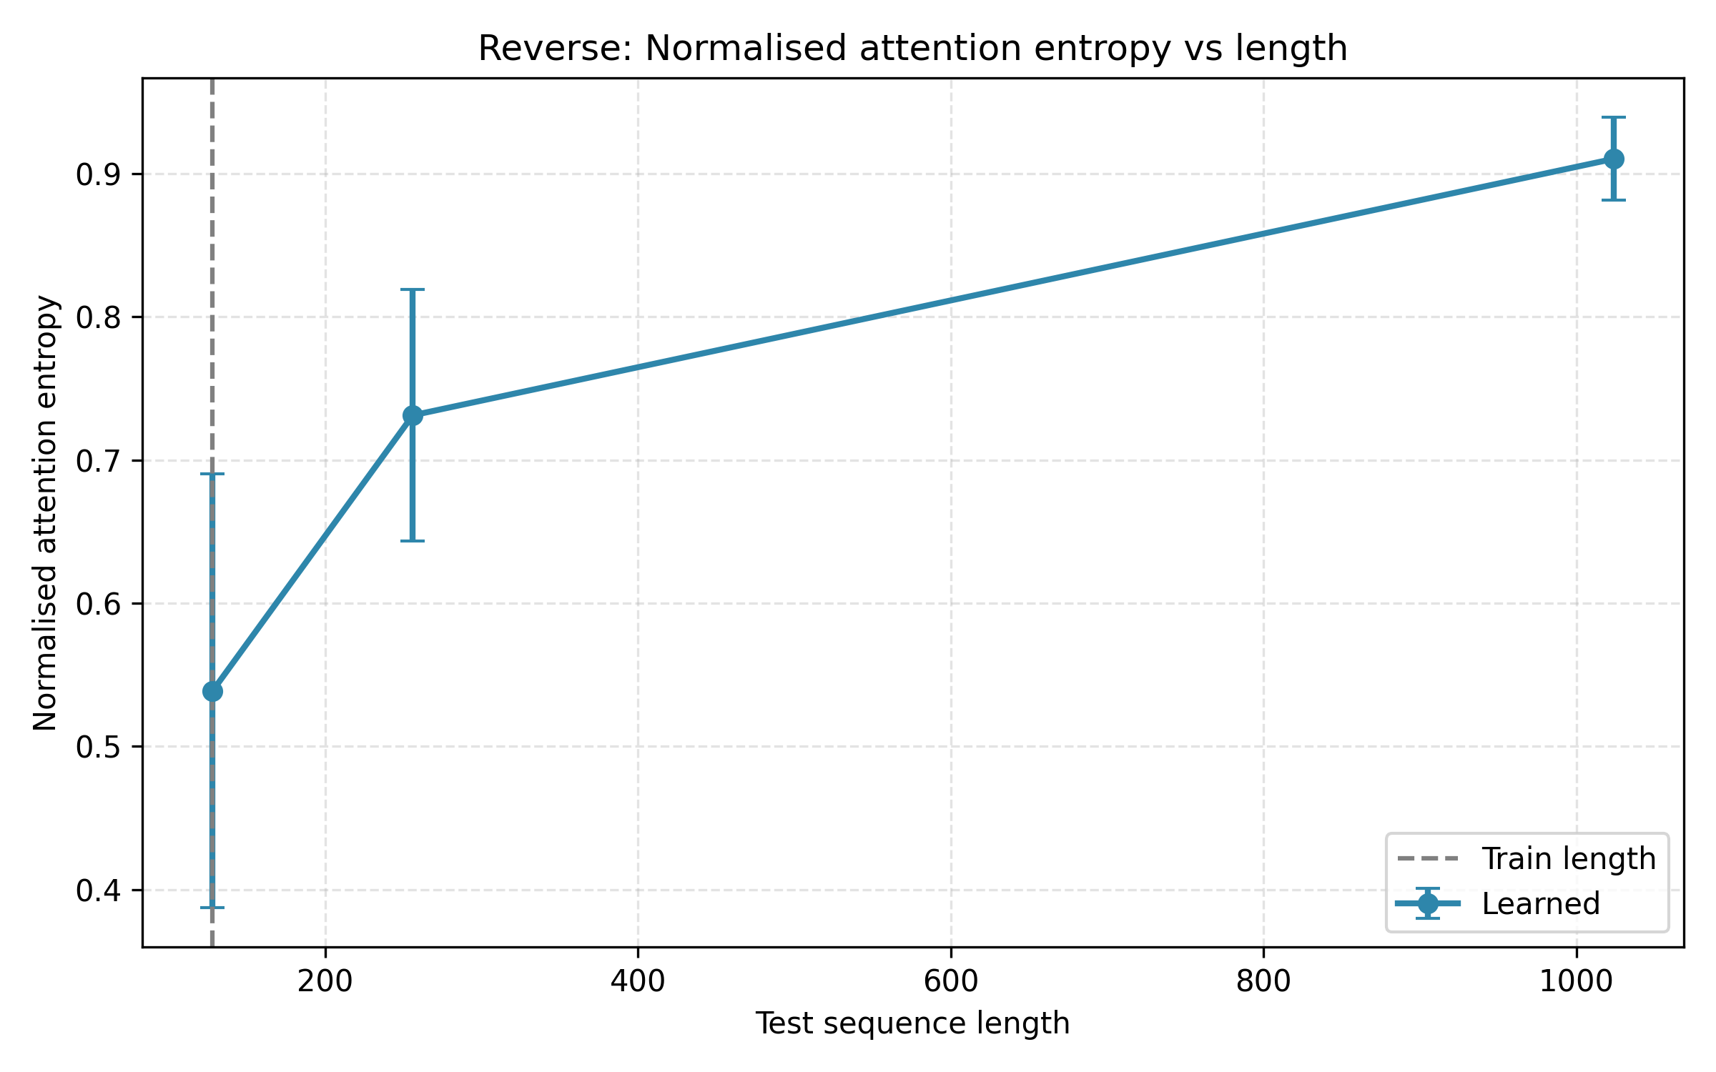
Attention diagnostics help explain the failure
At longer lengths, attention becomes more diffuse and less locally structured.
Addition learned entropy rises from 0.156 at length 16 to 0.594 at length 1024.
Reverse learned entropy rises from 0.539 at length 128 to 0.910 at length 1024.
Notes:
Use this slide for the 'why' story: failure is accompanied by changed attention behaviour, not only lower accuracy.
[Sources] outputs/analysis/attention_summary/attention_with_accuracy.csv and entropy plots.

Slide 8
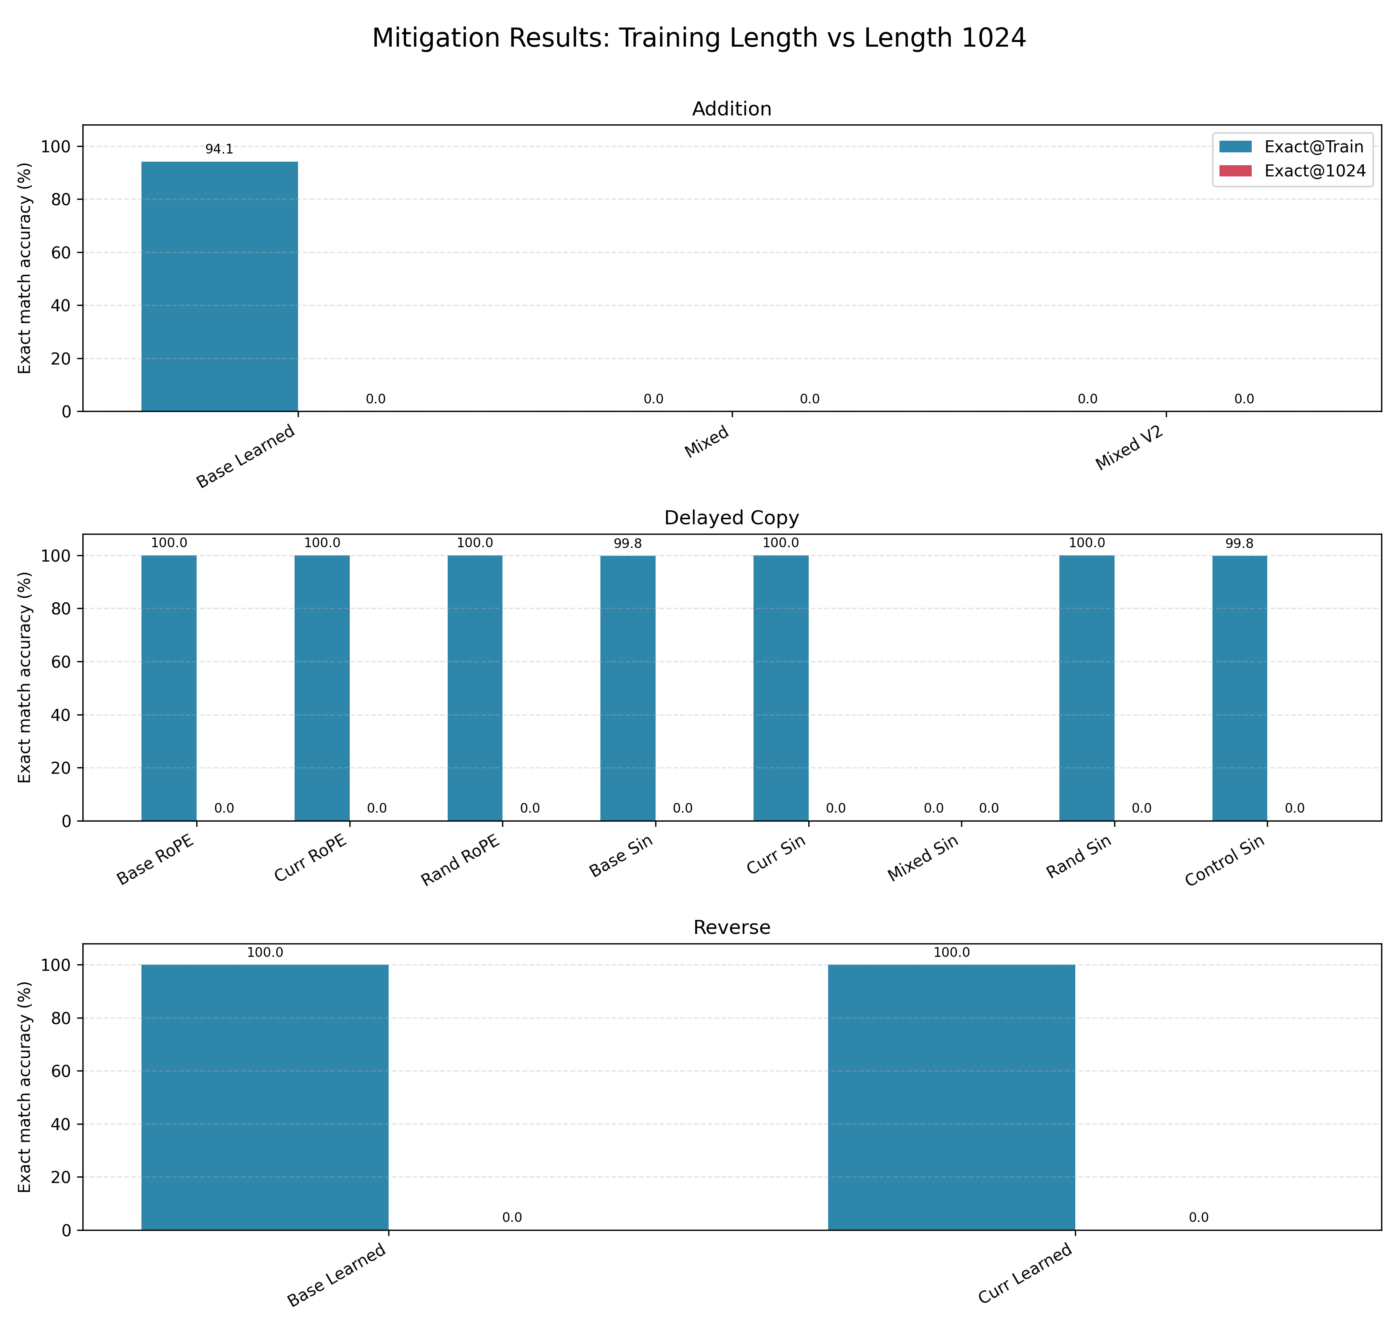
Mitigation attempts did not recover extrapolation
Curriculum and randomised training keep train-length accuracy high, but exact at 1024 remains zero.
Mixed length
Addition and copy underfit at train length.
Curriculum
Copy and reverse fit train length, but fail at 256+.
Randomised
Copy fits train length, but still fails at 256+.
Notes:
This is the Week 8 mitigation result. The key message is not that the work failed, but that simple mitigation is insufficient.
[Sources] outputs/analysis/mitigation_summary/mitigation_summary.csv and mitigation_exact_train_vs_1024.png.

Slide 9
The results now form a failure taxonomy
The taxonomy separates underfitting from true extrapolation failure.
Failure type
Evidence
Affected tasks
Interpretation
Extrapolation collapse
High train exact, 0% long exact
Addition, copy, reverse
Length-specific solution
Underfitting
0% at train length
NoPE, ALiBi, mixed
Not a valid extrapolation test
Seed instability
High std/SE
Copy learned, reverse sinusoidal
Optimisation-sensitive
Attention diffusion
Entropy rises with length
Addition, copy, reverse
Attention pattern shifts
Mitigation-resistant
Train fit, 0% at 256+
Copy, reverse
Simple fixes insufficient
Notes:
This is the bridge from results into dissertation discussion. It helps structure the answer, not only present numbers.
[Sources] outputs/analysis/failure_taxonomy/failure_taxonomy_compact.csv.

Slide 10
What changed since the last update
The project moved from baseline evidence to a complete failure analysis package.
Completed corrected PE matrix after fixing the ALiBi/NoPE configuration issue.
Repeated main experiments across three seeds and reported mean, std, and SE.
Added attention diagnostics at train, first-failure, and longest lengths.
Tested mitigation strategies: mixed, curriculum, and randomised padded training.
Built a failure taxonomy.
Notes:
This slide is useful if the professor asks what is new compared with the previous PPT.
[Sources] Local code and outputs generated since the August 5 deck.

