Slide 1
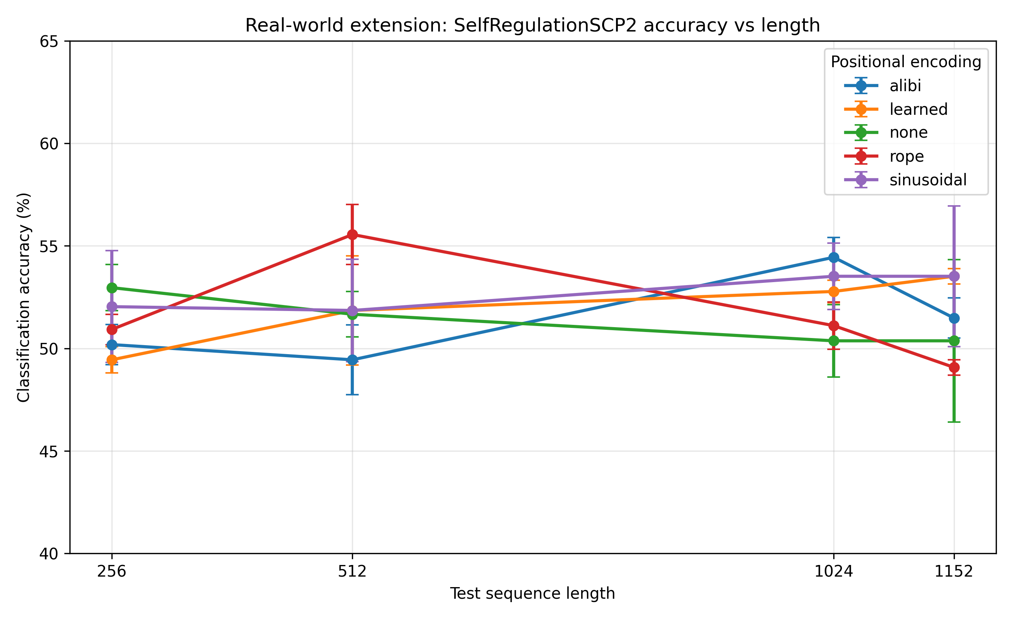
Real-World Extension: SelfRegulationSCP2
As a small real-world extension, I evaluated SelfRegulationSCP2, a long multivariate time-series classification dataset from the UEA archive. Unlike the synthetic tasks, the real-world classification task did not show catastrophic collapse under longer test lengths. Across positional encodings, mean accuracy remained around 49-54% from length 256 to the full length of 1152. This suggests that the severe failures observed in the synthetic benchmark are especially linked to exact algorithmic sequence transformations, while real-world classification may remain usable because partial or local features are still informative.
Plot 01: selfregulationscp2 accuracy vs length

Slide 2
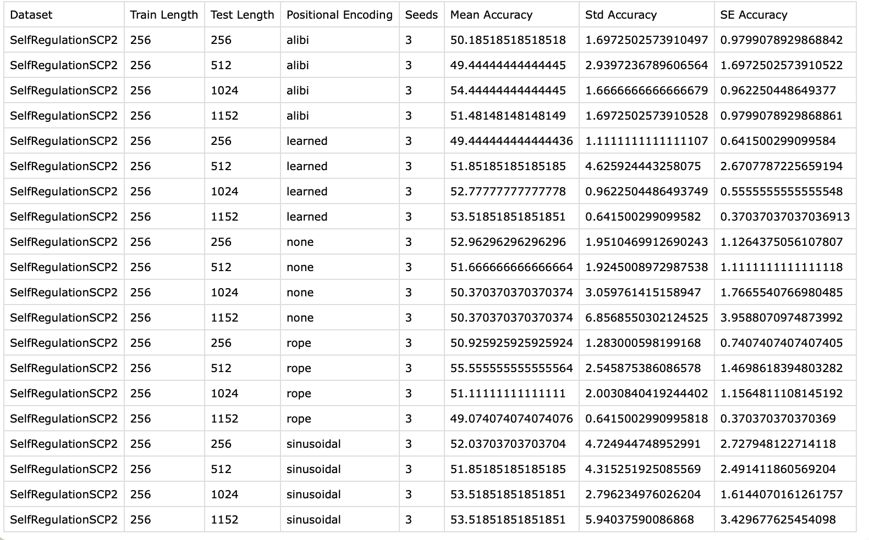
Main interpretation:
Accuracy stays roughly between 49% and 56% across lengths.
There is no catastrophic length collapse like in synthetic sequence-to-sequence tasks.
Learned and sinusoidal are slightly best at full length, both around 53.52%.
RoPE peaks at length 512, around 55.56%, but drops at full length.
NoPE has the largest full-length variation across seeds, with std around 6.86 at length 1152.
ALiBi is stable but modest.
The SelfRegulationSCP2 plot shows classification accuracy across increasing test sequence lengths for five positional encodings. Unlike the synthetic tasks, accuracy does not collapse when the input becomes longer than the training length. Most models remain around 49-54% accuracy from length 256 to the full sequence length of 1152, with some seed variation. This suggests that real-world classification behaves differently from exact algorithmic sequence tasks: even if the model does not learn perfect length-general rules, it can still use informative local or partial patterns in longer inputs.
Table 01: selfregulationscp2 summary table

Slide 3
Aspect | Synthetic Tasks | Real-World Extension
Tasks | Addition, delayed copy, reverse | SelfRegulationSCP2
Task type | Exact sequence prediction | Time-series classification
Train length | Addition: 16, copy/reverse: 128 | 256
Longest test length | 1024 | 1152
Main metric | Exact match + token accuracy | Classification accuracy
Failure pattern | Sharp collapse after training length | No sharp collapse
Typical result | Exact match drops to 0% at longer lengths | Accuracy stays around 49-54%
Interpretation | Model learns length-specific solutions instead of general algorithms | Model may rely on partial/local features that remain useful at longer lengths
Table 02: Comparison synthetic vs real-world

