Slide 1
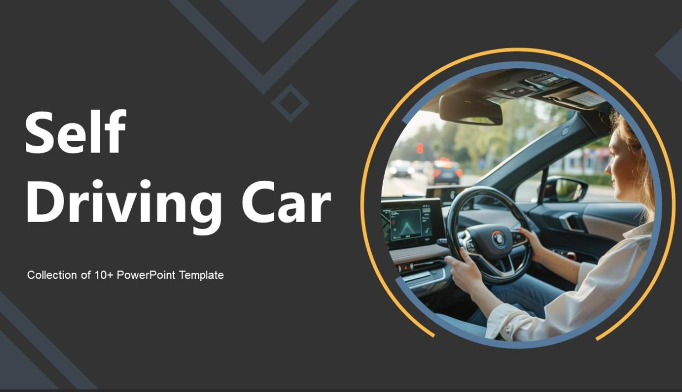
By Aanchal Vyas
DS6A2101

Slide 2
Introduction to Self-Driving Cars
Self-driving cars, also known as autonomous vehicles, use a combination of sensors, cameras, radar, and AI to travel between destinations without a human operator.
They use deep learning, sensor fusion, and computer vision to perceive and react to the environment around them.

Slide 3
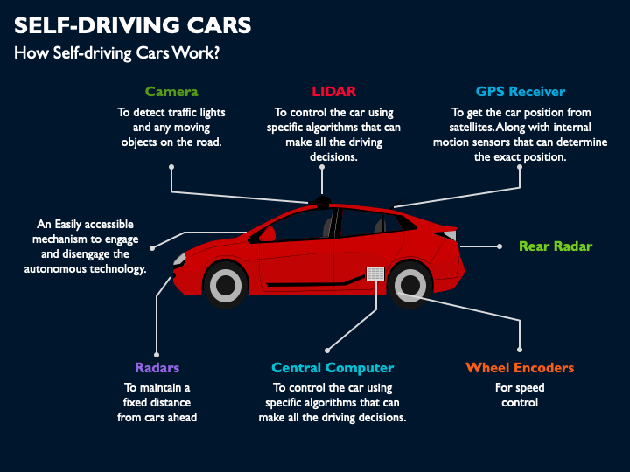

Slide 4
Simulator Setup and Data Collection
A driving simulator is used to collect training data. The simulator replicates real-world driving conditions.
Key steps:
- Download and configure simulator (Udacity)
- Capture camera images and steering angles
- Store dataset for training CNN

Slide 5
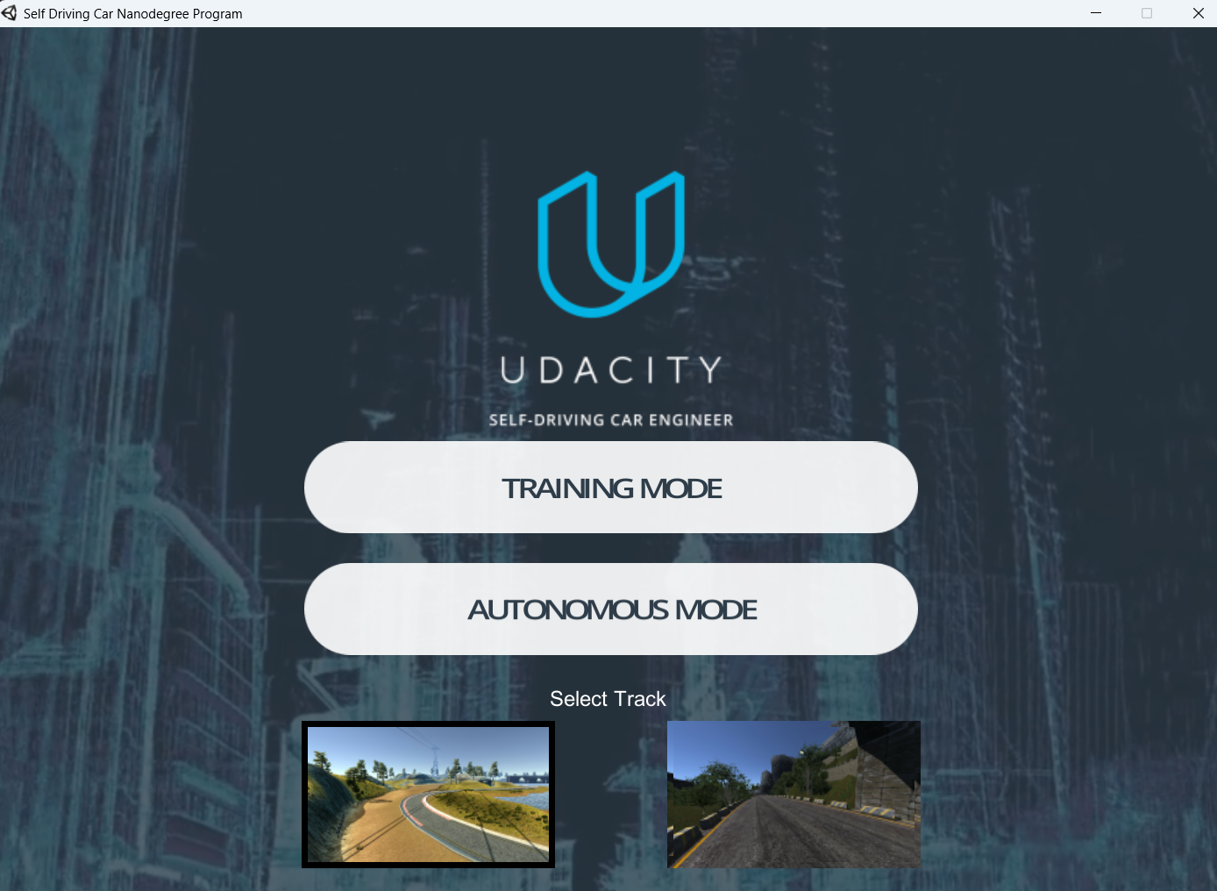

Slide 6
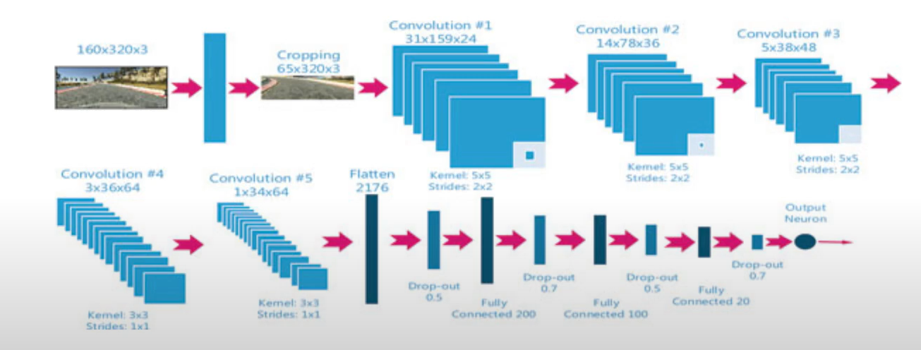
CNN Architecture:

Slide 7
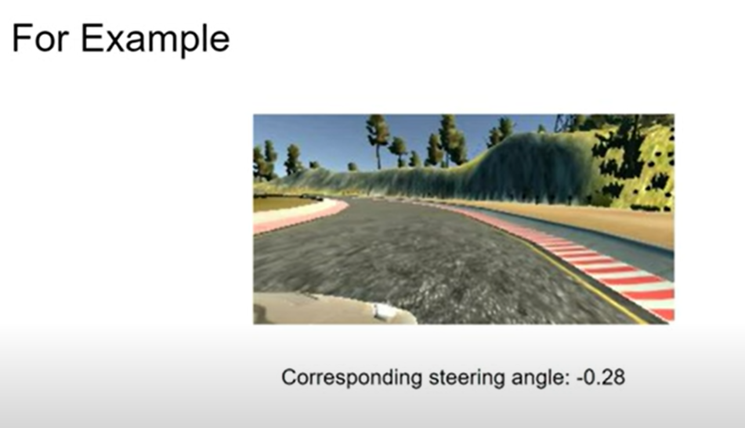
Behavior cloning:
It is a form of supervised imitation learning where an agent learns a policy by directly mimicking expert demonstrations. This involves training a model to predict the actions an expert would take in a given state, effectively reproducing the expert's behavior.

Slide 8
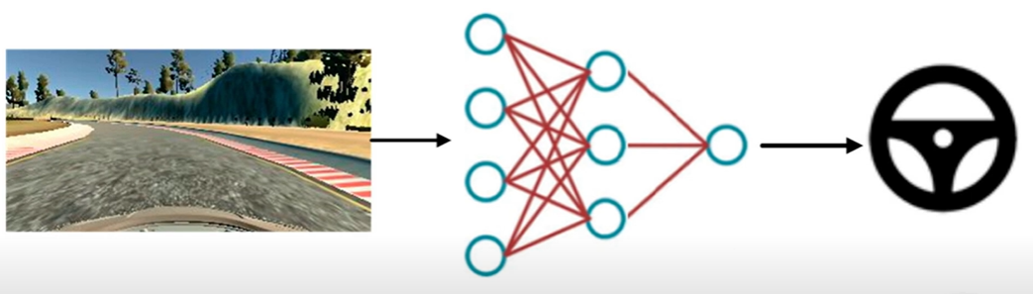
Implementation :
Image acquire in real time
Trained DNN
Steering Angle

Slide 9
Lane Detection with OpenCV
Lane detection is achieved using image processing techniques:
- Convert to grayscale
- Apply Gaussian blur
- Canny edge detection
- Use Hough Transform to detect lines representing lanes.

Slide 10
Lane Detection Code (OpenCV)
gray = cv2.cvtColor(image, cv2.COLOR_BGR2GRAY)
blur = cv2.GaussianBlur(gray, (5, 5), 0)
edges = cv2.Canny(blur, 50, 150)
lines = cv2.HoughLinesP(edges, 1, np.pi/180, 50, maxLineGap=50)

Slide 11
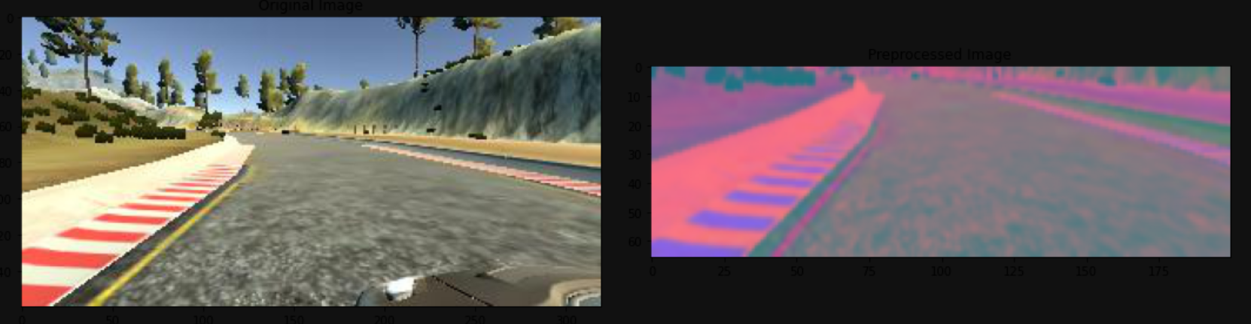
The final output : (After applying augmentation techniques)

Slide 12
Steering Angle Prediction with CNN
We use a Convolutional Neural Network (CNN) to predict steering angles from camera images.
The architecture typically includes:
- Convolutional layers for feature extraction
- Fully connected layers for angle regression

Slide 13
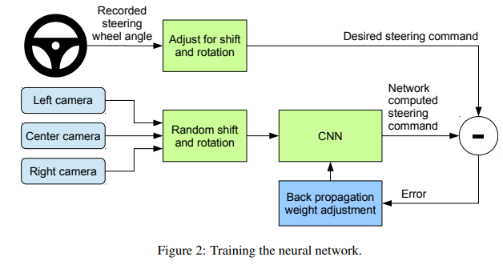
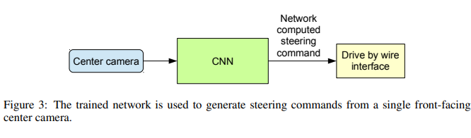

Slide 14
CNN Model for Steering Angle (Keras)
model = Sequential()
model.add(Conv2D(24, (5, 5), strides=(2, 2), activation='relu’))
……………
model.add(Dense(1)) # Output layer for steering angle

Slide 15
Traffic Sign Recognition
Traffic sign recognition helps the car identify and respond to road signs.
Steps:
- Use labeled traffic sign dataset (e.g., GTSRB)
- Train classification model using CNN
- Integrate with main driving logic to enforce rules.

Slide 16
Challenges in Real World Deployment
- Sensor noise and occlusion
- Adapting to weather and lighting changes
- Real-time decision-making
- Regulatory and safety compliance

Slide 17
Conclusion & Future Work
This project demonstrates a basic self-driving pipeline using simulation.
Future work includes:
- Real car implementation
- LiDAR and Radar fusion
- Reinforcement Learning for policy improvement

