Slide 1

Digital Dependence and Its Effect on Sleep Hygiene:
A Study on Nomophobia in University Students
Presenter
Roll Number
Aanoushka Garg
1219
Programme
Institution
B.Sc. (Hons.) Statistics, 2026
Department of Statistics
Hindu College, University of Delhi
Supervisor
Advisors
Dr Manoj Kumar Varshney
Dr Chandrabhan Yadav & Dr Lalit Kumar
Academic Project | B.Sc. (Hons.) Statistics 2026

Slide 2
Introduction — Why This Study Matters
2 / 16
The Problem
Research Question
Smartphones have become extensions of our identity — not just tools. Students spend 8–10 hours/day on phones, often unable to switch off. Nomophobia (No-Mobile-Phone Phobia) is the fear or anxiety of being without one's smartphone. It goes beyond screen time — it's emotional dependency. Three gaps this study fills: ▸ Overemphasis on screen time, not emotional dependency
▸ Indian university students underrepresented in research
▸ Nomophobia, sleep & anxiety rarely studied together
To what extent does nomophobia influence sleep hygiene, and how does anxiety shape this relationship?
8–10 hrs
DSM-5
avg daily phone use
does NOT classify
nomophobia yet
n = 274
77%
Delhi University
students surveyed
showed moderate–
high nomophobia

Slide 3
Review of Literature — What We Know & What's Missing
3 / 16
Smartphone Use & Digital Dependence
Nomophobia as a Construct
Global studies confirm exponential rise in smartphone use among university students. Compulsive use patterns linked to academic disruption and emotional dysregulation (Elhai et al., 2017).
Nomophobia captures emotional dependency beyond usage frequency. Validated via NMP-Q (Yildirim & Correia, 2015). ~73% of students globally show moderate–high nomophobia (Al-Mamun et al., 2023).
Smartphone Use & Sleep Hygiene
Anxiety, Well-being & Digital Dependence
Late-night use delays sleep onset, blue light suppresses melatonin, notifications disrupt sleep continuity. Psychological attachment creates mental alertness even when phone is off (Cain & Gradisar, 2010).
Higher nomophobia consistently associated with higher anxiety. Anxiety mediates smartphone use and mental health outcomes. Indian university mental health remains understudied (Demirci et al., 2015).
Key Gap: No integrated study of nomophobia + sleep + anxiety in Indian university students using validated instruments and formal mediation testing.

Slide 4
Objectives & Hypotheses
4 / 16
Primary Objective:
To examine whether nomophobia influences sleep hygiene among university students and to formally test whether anxiety mediates this relationship.
H#
Variables
Statistic
p-value
Decision
H₁
Phone Use ↔ Sleep Quality
ρ = −0.21
< 0.001
Supported ✓
H₂
Nomophobia ↔ Sleep Quality
ρ = −0.24
< 0.001
Supported ✓
H₃
Nomophobia ↔ Anxiety
ρ = +0.34
< 0.001
Supported ✓
H₄
Anxiety ↔ Sleep Quality
ρ = −0.35
< 0.001
Supported ✓
H₅
Gender ↔ Nomophobia
W = 8285.5
0.311
Not Supported ✗
H₆
Gender ↔ Sleep Quality
W = 8699
0.720
Not Supported ✗
H₇
Phone Use + Nomophobia → Sleep (Regression)
R² = 6.2%
< 0.001
Supported ✓

Slide 5
Research Methodology
5 / 16
Literature
Review
Questionnaire
Design
Primary Data
Collection
n = 274
Reliability &
Power Analysis
Statistical
Analysis in R
Findings &
Interpretation
Sample & Design
Instruments & Reliability (Cronbach's α)
Design:
Cross-sectional, descriptive-analytical
Scale
Instrument
Items
α
Rating
NMP-Q
Nomophobia Questionnaire
4
0.79
Good
Sample:
274 students, North Campus, University of Delhi
PSQI
Pittsburgh Sleep Quality Index
3
0.47†
Multi-dim.
Sampling:
Snowball sampling
GAD-7
Generalised Anxiety Disorder
3
0.81
Good
Power Analysis:
Min n = 84 (r=0.3, α=0.05, 80% power)
→ 274 exceeds substantially
—
Phone Use (adapted)
3
0.80
Good
Normality:
Shapiro-Wilk → non-normal → Spearman + Mann-Whitney
† Sleep α = 0.47 reflects multidimensional nature of sleep hygiene (Buysse et al., 1989) — retained with caution
Software:
R (pwr, psych, ggplot2, ggcorrplot)

Slide 6
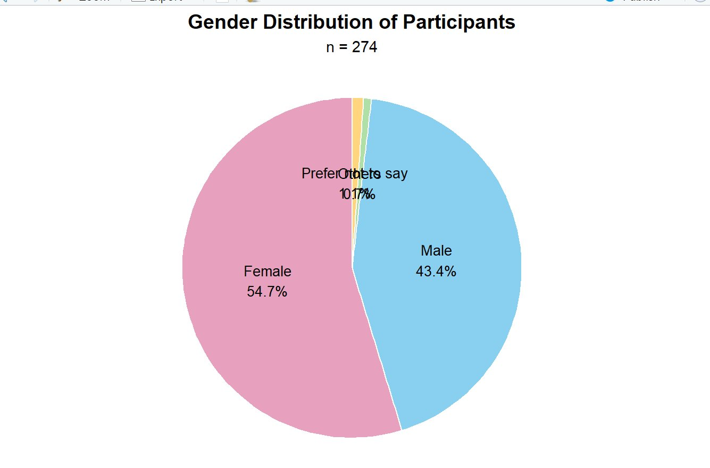
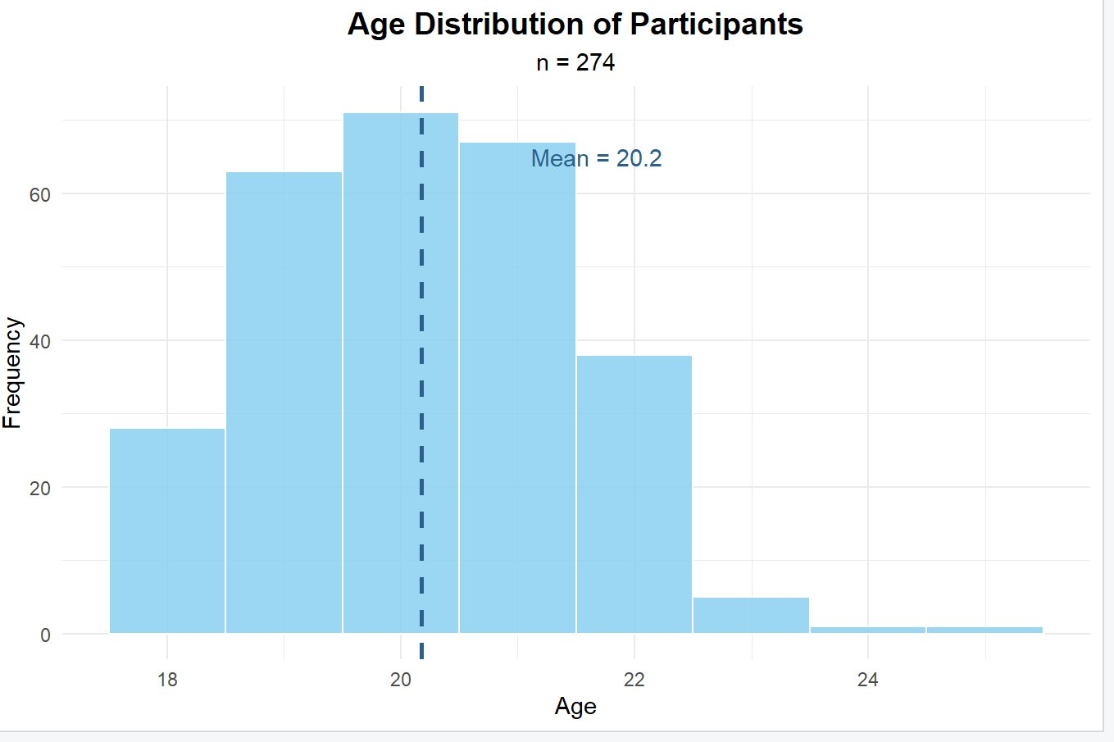
Sample Profile & Descriptive Statistics
6 / 16
274
56.2%
77%
72.6%
61.7%
Total Participants
High Phone Use
Mod–High Nomophobia
Mod–Poor Sleep
Mod–High Anxiety
Figure 1: Gender Distribution
Figure 2: Age Distribution (Mean = 20.2 years, 91.6% aged 17–23)

Slide 7
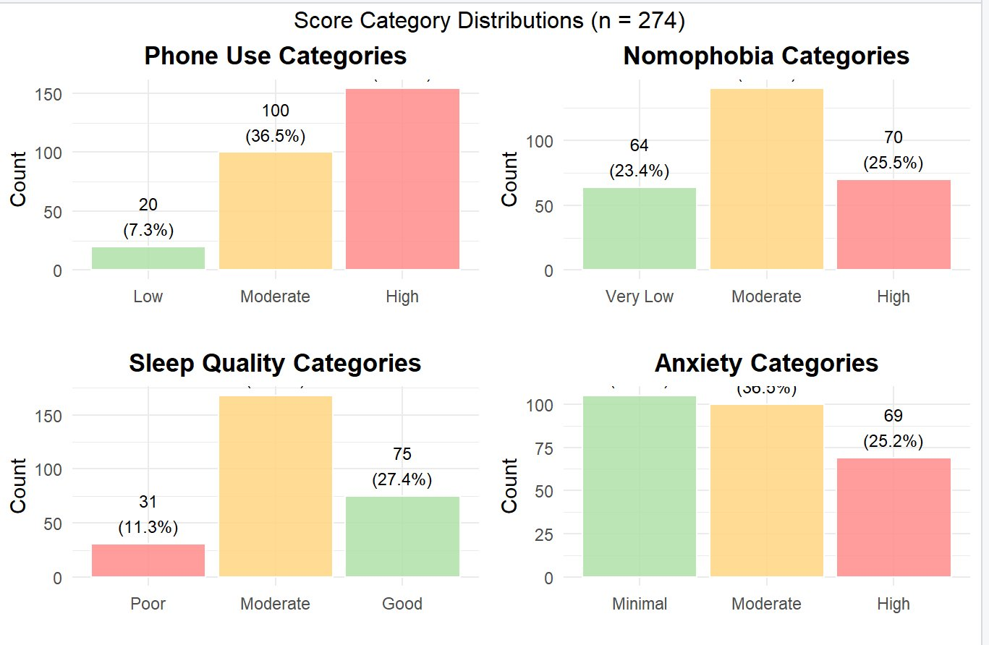
Score Category Distributions (n = 274)
7 / 16
Figure 3: Category distributions across Phone Use, Nomophobia, Sleep Quality and Anxiety — majority of students in moderate-to-high categories across all four variables.

Slide 8
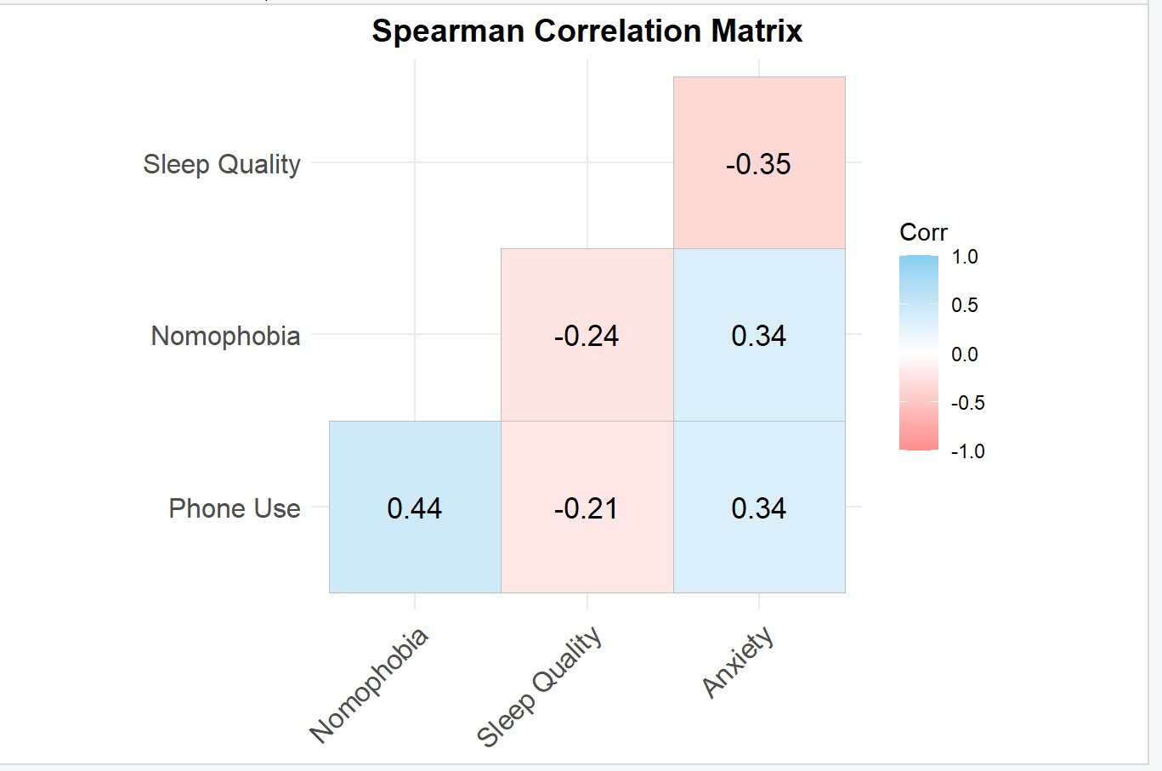
Correlation Analysis — Spearman Rank Correlations
8 / 16
H₁: Phone Use ↔ Sleep
ρ = −0.21, p < 0.001
More phone use = worse sleep
H₂: Nomophobia ↔ Sleep
ρ = −0.24, p < 0.001
Nomophobia stronger than usage
H₃: Nomophobia ↔ Anxiety
ρ = +0.34, p < 0.001
Emotional attachment raises anxiety
H₄: Anxiety ↔ Sleep
ρ = −0.35, p < 0.001
STRONGEST link — highest ρ in study
Figure 4: Spearman Correlation Matrix. All significant correlations p < 0.001.
H₅ & H₆: Gender Comparisons
p = 0.311 / 0.720 (ns)
No gender differences — universal problem

Slide 9
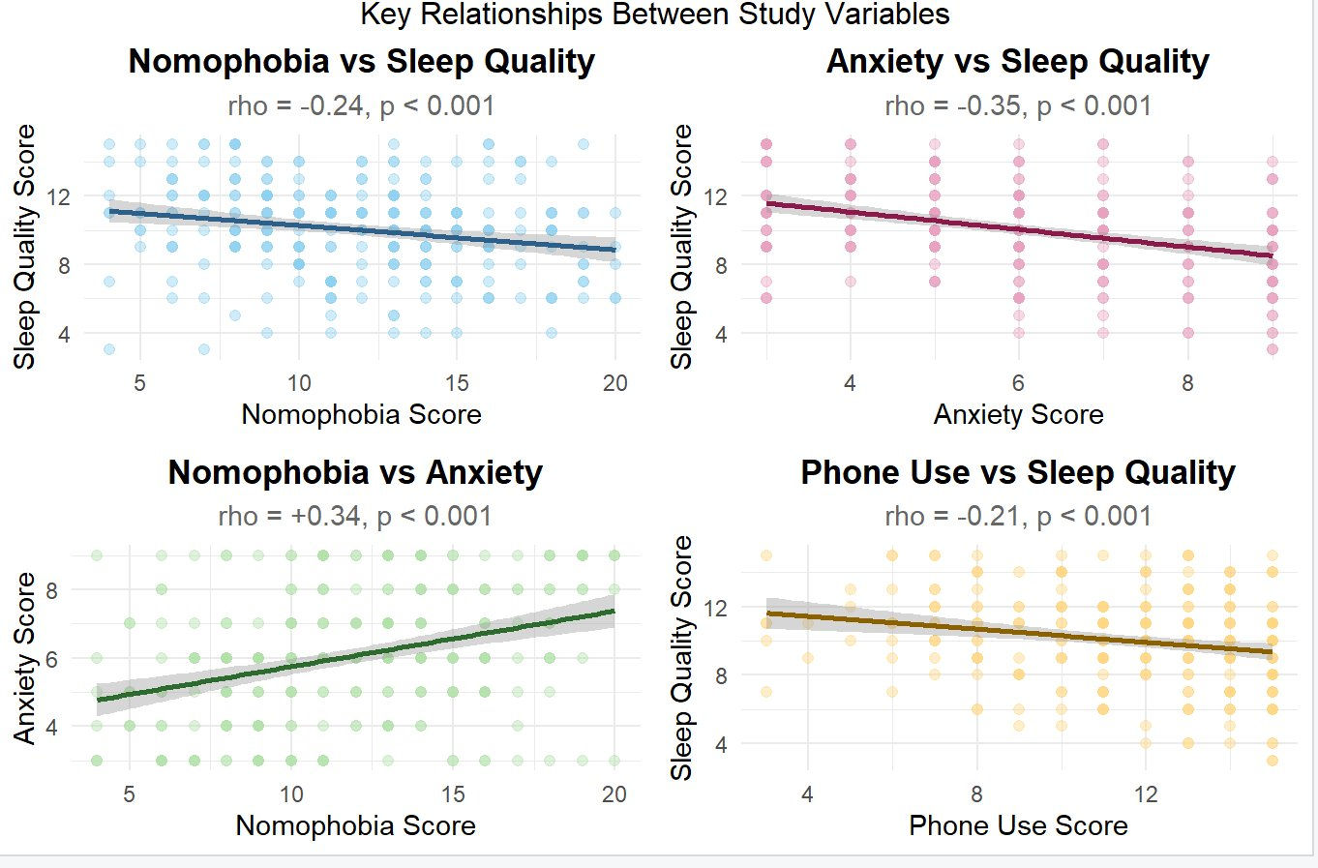
Key Relationships — Scatter Plots with Regression Lines
9 / 16
Figure 5: All four relationships significant at p < 0.001. Note stronger slope for Anxiety vs Sleep (ρ = −0.35) compared to Nomophobia vs Sleep (ρ = −0.24).

Slide 10
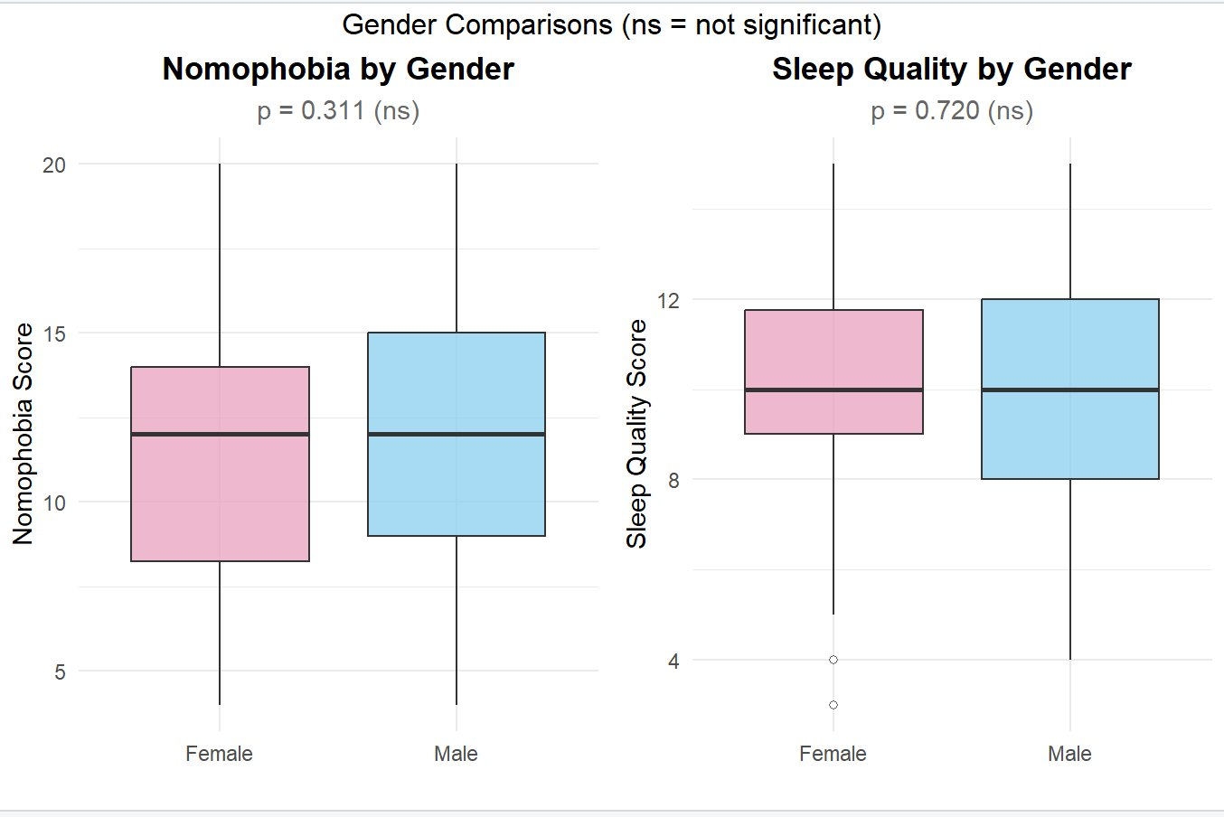
Gender Comparisons — H₅ & H₆
10 / 16
Key Finding: No significant gender differences in nomophobia (p = 0.311) or sleep quality (p = 0.720). Digital dependence is a universal student issue — not gendered.
Figure 6: Virtually identical distributions across gender for both nomophobia and sleep quality scores. Interventions should be universal, not gender-targeted.

Slide 11
Regression Analysis — Predicting Sleep Quality (H₇)
11 / 16
Model 1
Model 2
Model 3 ✓ H₇
Model 4 ★ Best
Phone Use only
Nomophobia only
Phone + Nomophobia
+ Anxiety added
R² = 4.5%
R² = 4.5%
R² = 6.2%
R² = 14.8%
β = −0.188***
β = −0.142***
Both sig. (p < 0.05)
β_anxiety = −0.444***
AIC: 1306.82
AIC: 1306.93
AIC: 1304.07
AIC: 1279.79
Central Finding — The Mediation Signature:
▸ When anxiety entered Model 4, R² nearly TRIPLED — from 6.2% to 14.8%
▸ Phone use became non-significant (p = 0.221) | Nomophobia became non-significant (p = 0.301)
▸ Anxiety remained the SOLE significant predictor: β = −0.444, p < 0.001
▸ AIC dropped 24 points → substantially better model fit
Model 1 — R² = 4.5%
Model 2 — R² = 4.5%
Model 3 — R² = 6.2%
Model 4 — R² = 14.8%

Slide 12
Mediation Analysis — Anxiety as the Bridge
12 / 16
✓ MEDIATION CONFIRMED — Sobel Z = −4.07, p < 0.001 | 53.3% of nomophobia's effect on sleep travels through anxiety
M — Anxiety
(Mediator)
Path a: β = +0.163***
Path b: β = −0.465***
X — Nomophobia
Y — Sleep Quality
Path c' (direct): β = −0.066, p = 0.098 — NON-SIGNIFICANT once anxiety included
Step
Test
β / Z
p-value
Status
1
Nomophobia → Sleep (total, path c)
β = −0.142
0.0004
✓ Sig.
2
Nomophobia → Anxiety (path a)
β = +0.163
< 0.001
✓ Sig.
3a
Anxiety → Sleep controlling for Nomophobia (path b)
β = −0.465
< 0.001
✓ Sig.
3b
Nomophobia → Sleep controlling for Anxiety (path c')
β = −0.066
0.098
✓ Non-sig.
4
Indirect effect — Sobel Test
Z = −4.07
< 0.001
✓ Confirmed
Indirect effect = −0.076 | Proportion mediated = 53.3% | Phone Use also fully mediated: Sobel Z = −3.97, p = 0.0001, 48.6% mediated

Slide 13
Reverse Mediation — The Finding Nobody Expected
13 / 16
Poor Sleep Quality → Anxiety → Higher Nomophobia | MEDIATION CONFIRMED (Z = −3.94, p = 0.0001, 52.2% mediated)
Reverse Med. 1: Sleep → Anxiety → Nomophobia
Reverse Med. 2: Sleep → Anxiety → Phone Use
Step 1 (path c)
β = −0.318, p = 0.0004 ✓
Step 1 (path c)
β = −0.241, p = 0.0004 ✓
Step 2 (path a)
β = −0.262, p < 0.001 ✓
Step 2 (path a)
β = −0.262, p < 0.001 ✓
Step 3 (path b)
β = +0.633, p < 0.001 ✓
Step 3 (path b)
β = +0.447, p < 0.001 ✓
Step 3b (path c')
β = −0.152, p = 0.098 (ns) ✓
Step 3b (path c')
β = −0.124, p = 0.075 (ns) ✓
Sobel Test
Z = −3.94, p = 0.0001 ✓
Sobel Test
Z = −3.75, p = 0.0002 ✓
% Mediated
52.2%
% Mediated
48.6%
The Feedback Loop — Anxiety as the Engine
Nomophobia ↑ Anxiety → Anxiety disrupts Sleep → Poor Sleep ↑ Anxiety → Elevated Anxiety ↑ Nomophobia → cycle repeats
Implication: Treating only one component (phone use restriction, or only sleep hygiene) will produce temporary relief. The entire loop must be addressed — anxiety is the hub.

Slide 14
Discussion & Practical Implications
14 / 16
Nomophobia > Screen Time
Anxiety is the Mechanism
Nomophobia (ρ = −0.24) predicts sleep disruption more strongly than general phone use (ρ = −0.21). Emotional dependency matters more than duration alone.
When anxiety entered regression, R² nearly tripled. In mediation, it absorbed the effects of both predictors. It is the common currency connecting nomophobia and poor sleep.
A Bidirectional System
Gender is Not a Factor
Reverse mediation confirmed: poor sleep also raises anxiety, which raises nomophobia. These three constructs form a self-reinforcing feedback loop — not a linear chain.
No significant differences between male and female students. Digital dependence and its sleep consequences are universally distributed — interventions should be universal too.
For Students
For Universities & Policy
The problem is not the phone — it's the anxiety. Mindfulness, worry journalling, genuine wind-down routines. Recognise that the anxiety is partly by design of these platforms.
Invest in anxiety-targeted wellbeing programmes — mindfulness, CBT, counselling. Not just phone-free zones. Screen time rules without anxiety support will not fix sleep.

Slide 15
Conclusion & Future Directions
15 / 16
Conclusions
Future Directions
H1–H4 ✓
Phone use, nomophobia & anxiety all significantly predict poor sleep (p < 0.001)
1. Bootstrapped mediation analysis (PROCESS macro) for more robust indirect effects
H5–H6 ✗
No gender differences — digital dependence is universal
2. Longitudinal design — to establish which comes first: nomophobia, anxiety, or poor sleep
3. Randomised controlled trial: anxiety-targeted intervention vs screen time reduction
H7 ✓
Phone use + nomophobia together predict sleep disturbance (R² = 6.2%)
4. Broader Indian samples — different institutions, regions, socioeconomic backgrounds
Mediation ✓
Anxiety fully mediates nomophobia → sleep. 53.3% indirect. Sobel p < 0.001
5. Full validated instruments — complete PSQI (7 subscales), full 20-item NMP-Q
Reverse ✓
Poor sleep also raises nomophobia through anxiety (52.2% mediated)
6. Include caffeine, exercise, academic stress, social support in future models
Central Message
The problem is not the phone. It is the anxiety the phone generates.
7. Hindi and regional-language versions of instruments for wider reach
Key Limitations: Cross-sectional design (no causal conclusions) · Snowball sampling · Adapted shortened scales · Sobel test assumes normality of indirect effect

Slide 16
Thank You
Questions & Discussion
Key References
• Baron & Kenny (1986). Mediation analysis. J Pers Soc Psychol, 51(6), 1173–1182.
• Buysse et al. (1989). Pittsburgh Sleep Quality Index (PSQI). Psychiatry Research, 28(2), 193–213.
• Cain & Gradisar (2010). Electronic media and sleep. Sleep Medicine, 11(8), 735–742.
• Cohen, J. (1988). Statistical Power Analysis for the Behavioral Sciences. LEA.
• Demirci et al. (2015). Smartphone use and sleep/anxiety. J Behavioral Addictions, 4(2), 85–92.
• Elhai et al. (2017). Problematic smartphone use and anxiety/depression. J Affect Disord, 207, 251–259.
• Harvey, A. G. (2002). Cognitive model of insomnia. Behaviour Research & Therapy, 40(8), 869–893.
• Spitzer et al. (2006). GAD-7. Archives of Internal Medicine, 166(10), 1092–1097.
• Yildirim & Correia (2015). NMP-Q development. Computers in Human Behavior, 49, 130–137.

