Slide 1
Grid Puzzle Assignment
Technical Documentation • Architecture • Algorithms • Data Flow
Documentation scope
Core grid model, input, rendering, history/undo, level generation, generated solution hint system, game flow, screens, popups, services, persistence, and engineering trade-offs.

Slide 2
1. Assignment Alignment
What the implementation is designed to satisfy
• N × M logical grid is separated from the visual GridView.
• Swipe input is converted into four discrete commands: Up, Down, Left, Right.
• Every successful move is recorded so Undo can reverse it.
• Move limits and solved/lose states are handled by PuzzleGameManager.
• Game state and UI presentation are separated through GameFlowController, ScreenManager and PopupManager.
• Technical diagrams and functional data flow are included in this document and the README.

Slide 3

2. High-Level Architecture
Screens / UI
Game Flow
Gameplay
Core Grid
Services
Core principle
Composition
UI lifecycle
Gameplay code asks the model to perform logical operations. Rendering code visualizes the result. The model does not know about Unity GameObjects.
ServiceRegistry supplies interfaces such as IGameFlowController, ILevelService, ISaveService and IHintService.
ScreenManager handles screens. PopupManager handles queued popups. Flow states coordinate when they appear.

Slide 4
3. Functional Code Flow
User action → logical state → presentation
Swipe / Button
GridCellView
GridView
PuzzleGameManager
GridModel
GridView.MoveTile
State update
GridModel.TryMove validates the move and changes only the logical matrix. PuzzleGameManager creates and stores a BoardMove, registers it with IHintService, decrements remaining moves, then tells GridView to animate the tile.

Slide 5
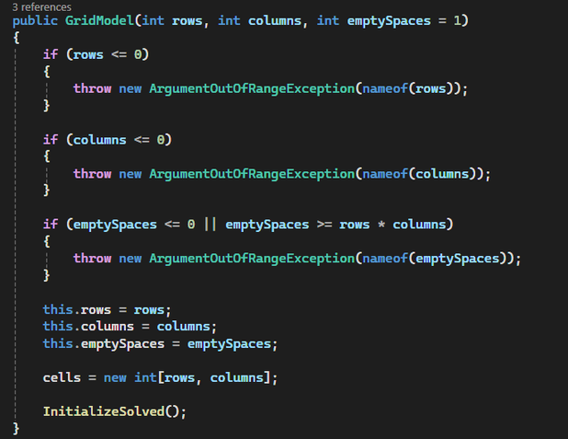
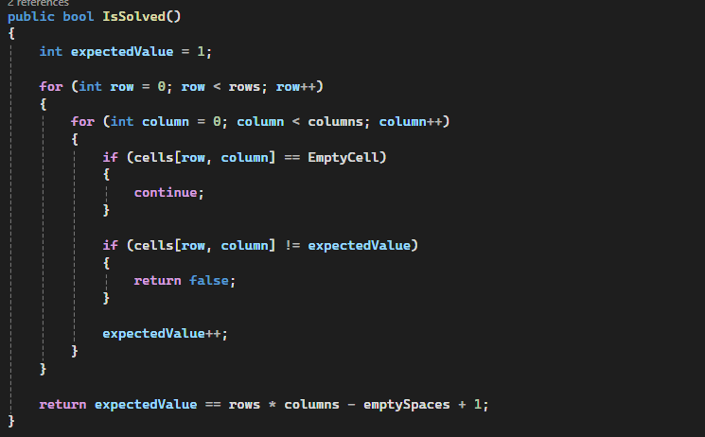
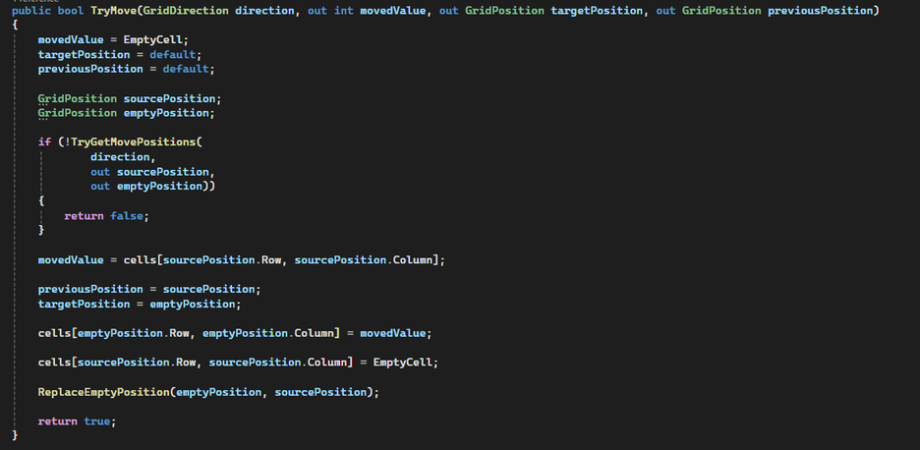
4. GridModel — Responsibility
The logical board is the source of truth
• Stores rows, columns, empty-space count and the integer matrix.
• Uses EmptyCell = -1 to represent an empty slot.
• Validates coordinates before accessing the matrix.
• Performs moves without knowing anything about GameObjects or UI.
• Tracks empty positions so move discovery does not need to scan the entire matrix every time.
Key functions
GetCell • TryMove(direction, ...) • TryMove(sourcePosition, direction, ...) • UndoMove • CanMove • IsSolved • InitializeSolved • ReplaceEmptyPosition

Slide 6
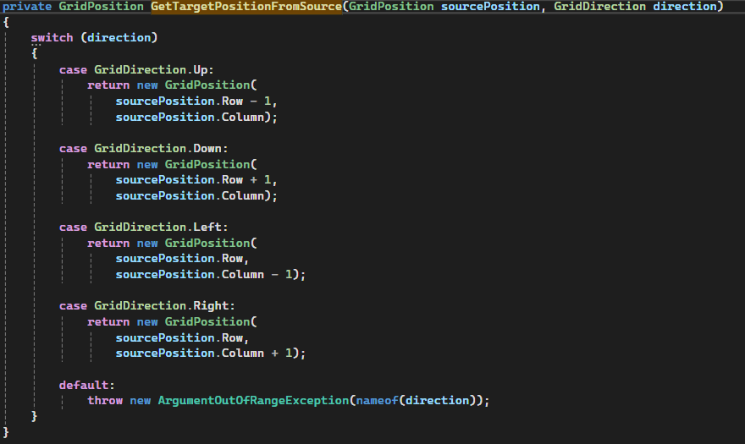
5. Grid Movement — Simple Mathematics
Coordinates use Row / Column
Movement rule
For a tile at (r, c):
Up → (r − 1, c)
Down → (r + 1, c)
Left → (r, c − 1)
Right → (r, c + 1)
A move is valid only when the target is inside the grid and is empty.
Movement only changes one coordinate by 1. The row or column is never changed by more than one step.
Example:
Tile at (2, 3) moving Right → (2, 4)
Tile at (2, 3) moving Up → (1, 3)
This keeps movement predictable and makes validation easy: inside the grid + target is empty = valid move.
Why this is simple

Slide 7
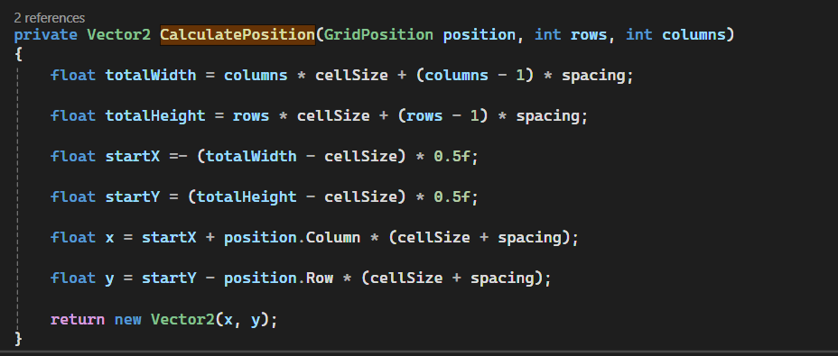
6. Grid Positioning — View Mathematics
Converting a logical cell to a centered UI position
Formula
totalWidth = columns × cellSize + (columns − 1) × spacing
totalHeight = rows × cellSize + (rows − 1) × spacing
startX = −(totalWidth − cellSize) / 2
startY = (totalHeight − cellSize) / 2
x = startX + column × (cellSize + spacing)
y = startY − row × (cellSize + spacing)
Simple explanation
First calculate the complete board size. Then start at the top-left cell and move one cell-size-plus-spacing for every column/row. The half-size offset keeps the board centered.

Slide 8
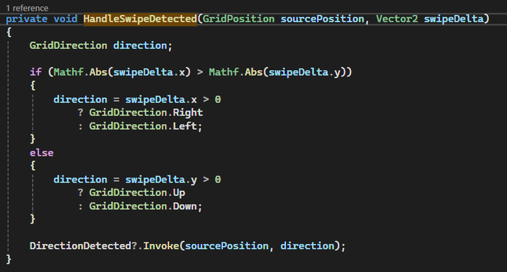
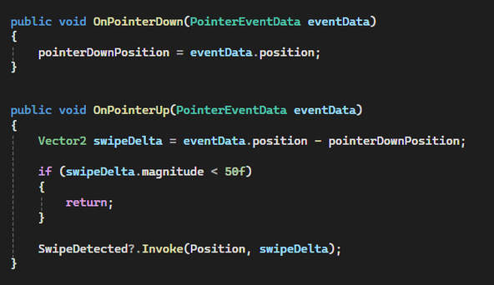
7. Swipe Input
Pointer vector → dominant axis → discrete direction
Decision logic
1. Save pointer-down position.
2. On release, calculate swipeDelta = release − press.
3. Ignore tiny movement when magnitude < 50.
4. Compare |x| and |y|.
5. Larger axis wins.
6. Sign chooses left/right or up/down.
Why dominant-axis comparison works
A diagonal swipe still becomes exactly one command. Example: x = 120, y = 40 → horizontal movement wins → Right.

Slide 9
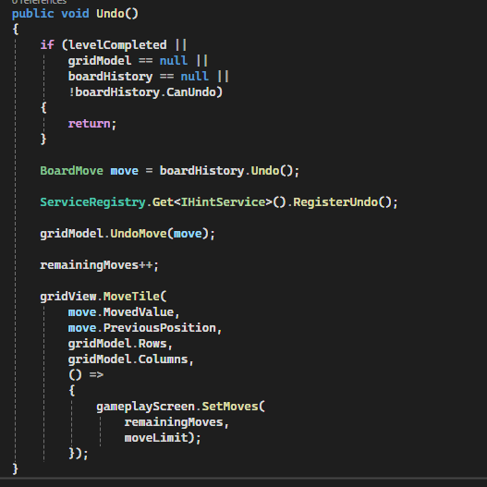
8. Board History & Undo
Store the smallest useful piece of information
Stored state
BoardMove contains:
• MovedValue
• PreviousPosition
• TargetPosition
A Stack<BoardMove> gives LIFO behavior: the newest move is undone first.
Undo sequence
Undo() → Pop move → IHintService.RegisterUndo() → GridModel.UndoMove(move) → remainingMoves++ → animate tile back → refresh move counter.

Slide 10
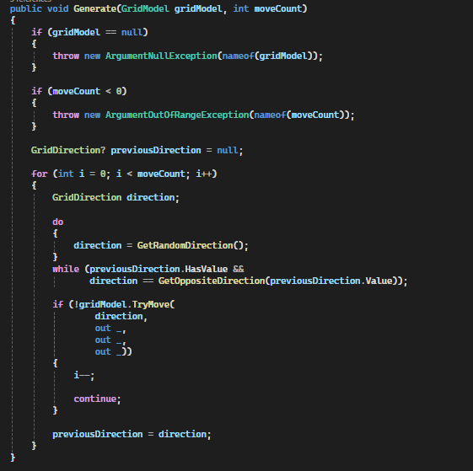
9. Level Generation
Shuffle a solved board by legal moves
Algorithm
Start from the solved board. Repeat moveCount times: 1. Pick a random direction. 2. Reject the direct opposite of the previous direction. 3. Ask GridModel to perform the move. 4. If illegal, retry the iteration. 5. Record the accepted BoardMove in ShuffleMoves.
Important property
Every generated board is reachable from the solved state because the generator creates it exclusively through legal GridModel.TryMove() operations. Each accepted BoardMove records the exact transition, so reversing ShuffleMoves gives a valid path back to the solved state.

Slide 11
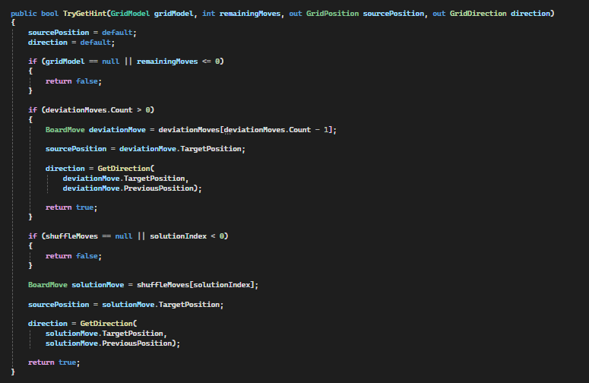
10. Hint System — Generated Solution Path
The hint service reuses the exact shuffle history generated when the level is created.
Generated solution in simple terms
ShuffleLevelGenerator starts from the solved board and performs legal moves. Every accepted shuffle move is stored as a BoardMove. The complete sequence is exposed through ShuffleMoves. The hint service starts at the final shuffle move and reverses the sequence one move at a time. Because the generator only records legal moves, every reversed move is a valid move for the generated level state.
Guaranteed solution path from the generated level back to the solved board.
The system does not need to search the puzzle state space. The level generator has already produced a valid path; the hint system reuses that information instead of solving the board again.

Slide 12
11. Hint System — Player Deviations
The player is not required to follow the generated solution.
Deviation handling
If the player makes a different move, HintService stores it in deviationMoves. Expected solution: A → B Player deviates: A → X → Y Hints reverse deviations in LIFO order: Y → X X → A Once deviations are removed, the generated solution resumes.

Slide 13
The hint service maintains lightweight move history instead of search states.
• shuffleMoves stores the generated solution path. • solutionIndex identifies the next shuffle move to reverse. • playerMoves records successful player moves. • deviationMoves stores moves that diverged from the expected generated solution. • RegisterMove and RegisterUndo keep hint state synchronized with gameplay. State recalculation is O(N), where N is the number of recorded player moves. This is predictable for the bounded move limit.
• shuffleMoves stores the generated solution path.
• solutionIndex identifies the next shuffle move to reverse.
• playerMoves records successful player moves.
• deviationMoves stores moves that diverged from the generated solution.
• RegisterMove and RegisterUndo keep this state synchronized with gameplay.
Hint state recalculation is O(N), where N is the number of recorded player moves.
This avoids generated solution paths, search trees, board-state cloning, and potentially exponential search.

Slide 14
13. Game Flow Controller
Main Menu → Gameplay → Results
MainMenu
Gameplay
Results
StartLevelAsync
CompleteLevelAsync
QuitToMainMenuAsync
Creates LevelContext, clears the previous result, then enters Gameplay.
Stores LevelResult, then enters Results.
Clears level/result context and returns to Main Menu.

Slide 15
14. Game State Responsibilities
State pattern
Each state implements IGameState:
OnEnterAsync() → show the required UI / perform entry work.
OnExitAsync() → hide or clean up that UI.
The controller owns transitions; states own their entry/exit behavior.
Results behavior
On a Win, ResultsState loads CurrentLevel and saves CurrentLevel + 1. Then it presents the result popup.

Slide 16
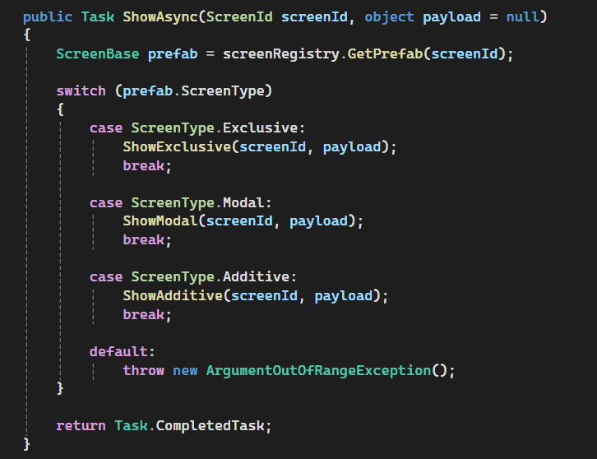
15. ScreenManager
Exclusive, Modal and Additive screen behavior
Screen rules
Exclusive: replaces everything.
Modal: can sit over an Exclusive screen; the Exclusive screen is hidden and retained for restoration.
Additive: can stack with Modal/Additive, but is rejected over an Exclusive screen.
Lifecycle
Show → Resolve → Handle Type → Display

Slide 17
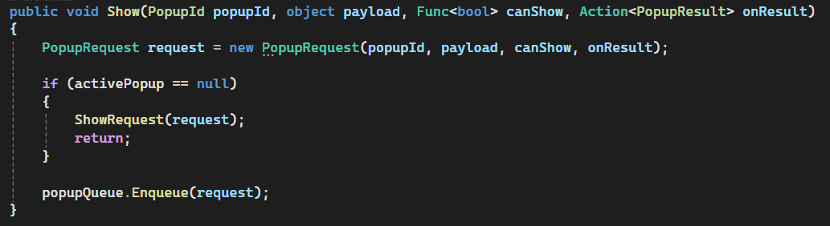
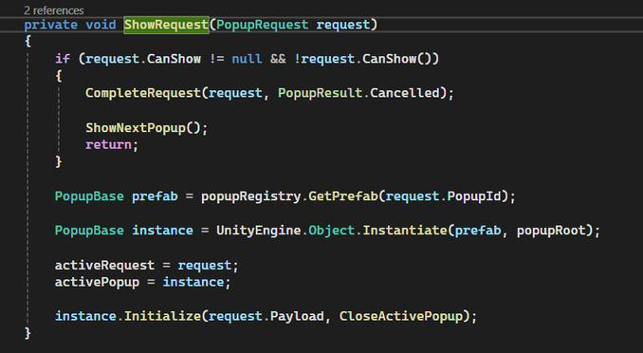
16. PopupManager
Queue popups so only one popup is active
Queue flow
Show request
↓
No active popup? → Show immediately
Otherwise → enqueue
↓
Active popup closes
↓
ShowNextPopup()
↓
Check CanShow()
↓
Instantiate + Initialize()
Safety
Queued requests can be cancelled. Exceptions from request callbacks are caught and logged instead of breaking the popup queue.

Slide 18
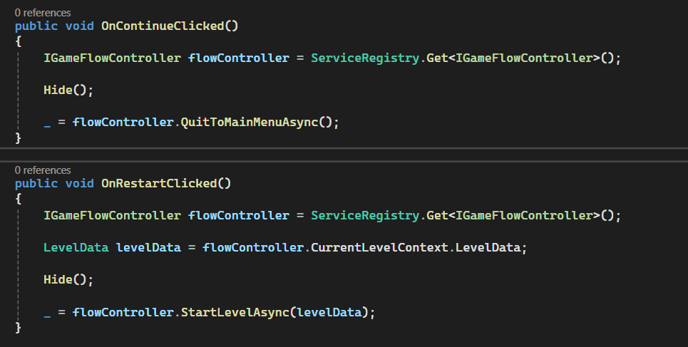
17. Result Popup
Animation
Result text and button parent start at alpha 0.
Container moves to MoveLocation over 0.7 seconds with OutCubic easing.
Text and buttons fade in over 0.3 seconds.
Confetti plays after button fade-in on Win.

Slide 19
18. Services & Dependency Inversion
ISaveService
ILevelService
ServiceRegistry
SaveInt
LoadInt
HasKey
Implementation: PlayerPrefsSaveService
Purpose: hide Unity PlayerPrefs behind an interface.
GetLevel(levelNumber)
Implementation: LevelService
Purpose: provide level data without making UI know how levels are stored.
Register<T>
Get<T>
Has<T>
Unregister<T>
Clear()
Purpose: centralized runtime service lookup.
Design intent
The goal is decoupling, not performance optimization.

Slide 20
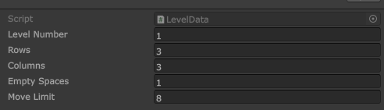
19. LevelData & Data Flow
ScriptableObject keeps level configuration outside gameplay code
Data path
LevelData asset
↓
LevelService.GetLevel()
↓
MainMenuScreen.OnPlayClicked()
↓
GameFlowController.StartLevelAsync()
↓
LevelContext
↓
GameplayState
↓
GameplayScreen.Initialize()
↓
PuzzleGameManager.Initialize()
Level fields
LevelNumber • Rows • Columns • EmptySpaces • MoveLimit

Slide 21
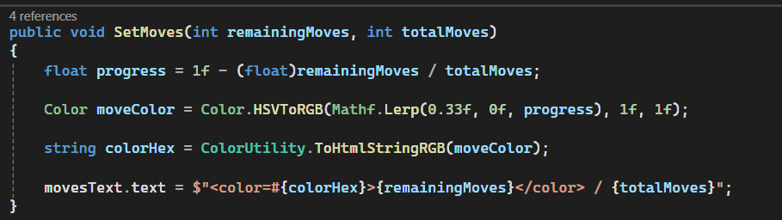
20. Move Counter Mathematics
Simple progress calculation used by GameplayScreen
Formula
progress = 1 − remainingMoves / totalMoves
At the start:
remaining = total → progress = 0
At the end:
remaining = 0 → progress = 1
That value is then mapped from green hue toward red hue.
Why normalize?
A normalized 0→1 value works for any move limit, whether a level has 5 moves or 50.

Slide 22
21. Engineering Trade-offs
What the architecture optimizes for
Clarity
Determinism
Performance
GridModel owns game rules and board state; GridView owns visual representation and animation.
Interfaces such as ILevelService, ISaveService, and ILevelGenerator reduce direct dependencies between systems.
GameFlowController, ScreenManager, and PopupManager give each responsibility a clear owner.
ScriptableObject level data keeps configuration separate from runtime gameplay code.
BoardMove records the exact value + previous position + target position needed for undo.
Undo restores the logical board first, then the view animates to the restored position.
Level generation uses only legal GridModel.TryMove() operations, keeping generated states reachable from the solved board.
The hint system reuses generated shuffle history instead of searching the live board.
GridView animates only the tile that moved, rather than rebuilding the entire board after every move. GridModel tracks empty positions, avoiding unnecessary full-grid searches for movement. BoardHistory stores compact BoardMove deltas rather than complete board snapshots. HintService reverses the recorded shuffle path and handles player deviations in LIFO order. Hint state recalculation is O(N), where N is the number of player moves. No per-frame hint processing, search, search tree, or background solver is required.
Engineering Decision
The hint system intentionally avoids general-purpose search. Since the generator already records a legal path from the solved board to the generated level, reversing that path provides a guaranteed solution. Player deviations are handled separately with lightweight LIFO tracking.

Slide 23
22. Final Data Flow Summary
Input
GridModel
History
Animation
Check State
Flow
Results
Core architectural idea
Input is translated into intent. The logical model decides whether the move is valid. History records the transition and the hint service tracks the move. The view animates the result. Flow controls the lifecycle and results.
Documentation checklist
✓ Architecture ✓ Data Flow ✓ Grid Logic ✓ Swipe Input ✓ Undo ✓ Level Generation ✓ Generated Solution Hint System ✓ Player Deviation Handling ✓ Game Flow ✓ Screen & Popup Management ✓ Services & Dependency Inversion ✓ Performance & Trade-offs ✓ Code Evidence

Slide 24
Thank You!
Final Decision: Hire Me?
Final Decision: Hire Me?
Hire me? Absolutely. Second thoughts? Maybe. But if your second thought is “don’t hire me” — that’s the wrong second thought.
-Just a joke 😄

