Slide 1
Mindset Analysis using Psychometric Games MAP-G
Aanshi Bansal 16103055
Paritosh Malhotra 16103062
Vaibhav Setia 16103069
Shreya 16103070
Navdeep Kaur 16103078
Mentor:
Dr. Manish Kamboj
Consultation:
Dr. Neha Sharma, Assistant Professor,
Human Development,
Gov. Home Science College,
Sector 10, Chandigarh

Slide 2
Objectives
To build a comprehensive platform of psychometric games to analyze favorable traits for teachers and generate trait reports for the same
To perform analysis on the dataset thus formed to detect patterns and suggest measures for improvement.

Slide 3
Motivations
Companies have started using Psychometric tests to evaluate potential candidates
No such framework is in use to evaluate existing and new teachers
This presents an avenue for development of the same

Slide 4
Problem Statement
To develop a platform that uses Psychometric
tests to analyze the favorable traits of the
people in the teaching profession

Slide 5
Proposed Solution: APP FLOW FUNCTIONALITY
Print Trait Report
Sign Up/
Login
Play Games

Slide 6
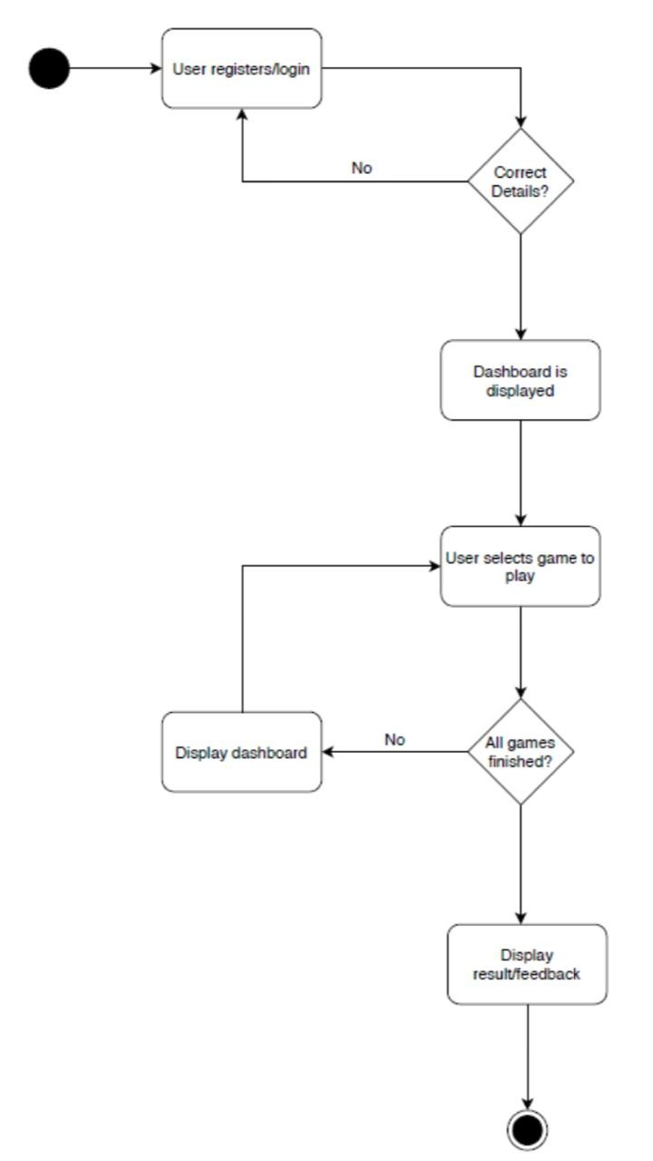
APP FLOW FUNCTIONALITY

Slide 7
Results Achieved: Favorable traits for the Teaching Profession
Experiment and innovate
ATTRIBUTE : RISK
Be flexible
ATTRIBUTE : FLEXIBILTY
Truly Listen
ATTRIBUTE : OPEN MINDEDNESS
Reflection
ATTRIBUTE: KNOW YOURSELF
A Growth Mindset
ATTRIBUTE : ADAPTABILITY
Asking Questions
ATTRIBUTE : CURIOSITY
Learning new Technology
ATTRIBUTE : UNDERSTANDING
Analyzing Capability
ATTRIBUTE: CRITICAL THINKING
Jennifer Gunn, Building a Growth Mindset for Teachers, August 26, 2018, visited 10 September, 2019
*consultation with Dr. Neha Sharma, Assistant Professor, Gov. Home Science College, Sector 10, Chandigarh

Slide 8
Results Achieved: Various games and traits to measure
Building Tower of Hanoi
ATTRIBUTE : PLANNING
Blow a balloon till it explodes
ATTRIBUTE : RISK
Press space bar on red pop up
ATTRIBUTE : ATTENTION
Flash digit sequence on the screen
ATTRIBUTE: MEMORY
Answering a question by hearing clues
ATTRIBUTE : LISTENING
Check facial expression
ATTRIBUTE : EMOTION
Decide size of face
ATTRIBUTE : LEARNING
Money Exchange
ATTRIBUTE: TRUST
Jennifer Gunn, Building a Growth Mindset for Teachers, August 26, 2018, visited 10 September, 2019
*consultation with Dr. Neha Sharma, Assistant Professor, Gov. Home Science College, Sector 10, Chandigarh

Slide 9
Games and their traits implemented till now:
Games
Listening Carefully
Collecting money
Blowing balloon
Match cards
Emotion Predictor
Traits
Risk
Critical Listening
Understanding Capability
Learning Capability
Behavioral analysis
Personality reflection
Face study

Slide 10
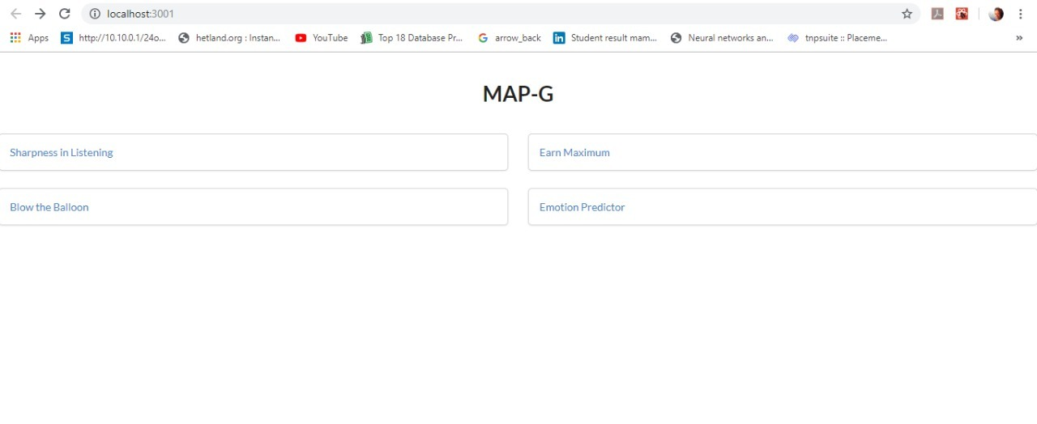
Games Developed

Slide 11
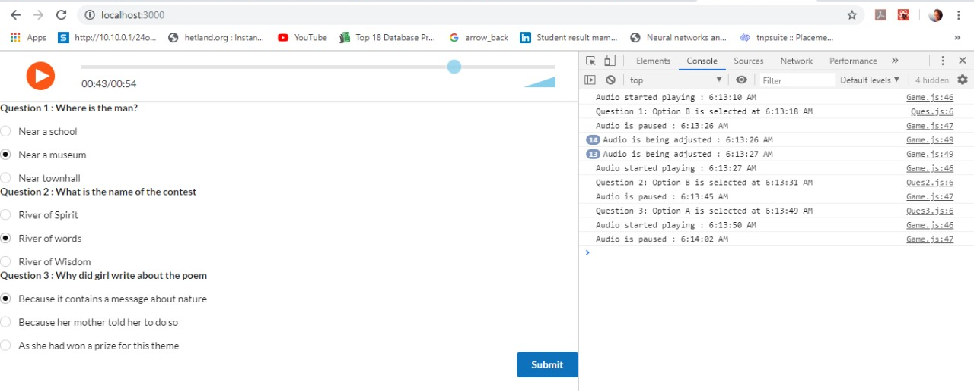
Games Developed
*checked by with Dr. Neha Sharma during our meeting on 3rd October, 2019

Slide 12
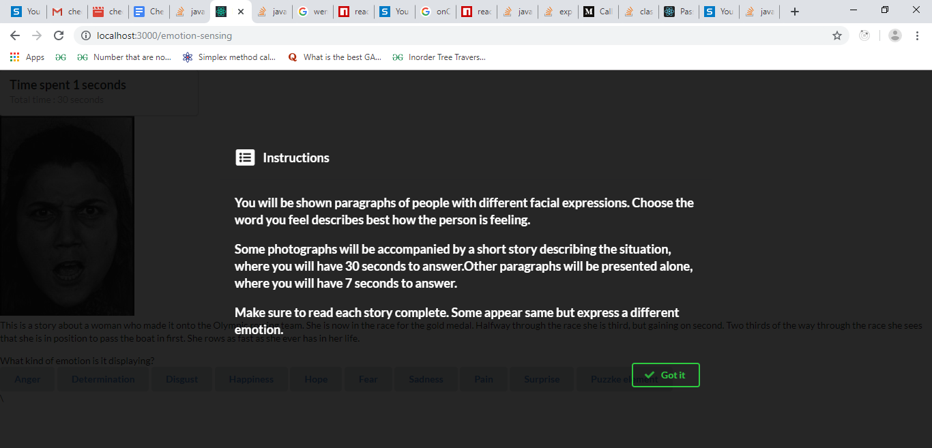
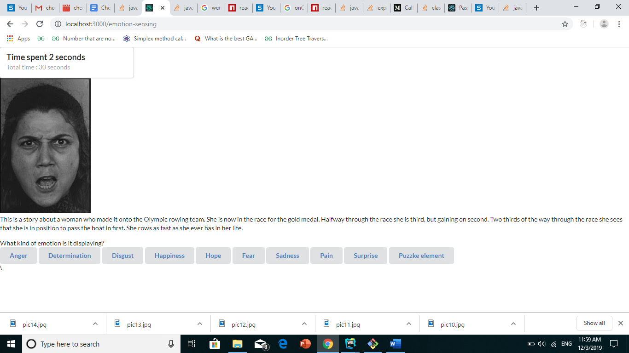
Games Developed
*checked by with Dr. Neha Sharma during our meeting on 20 Nov,2019

Slide 13
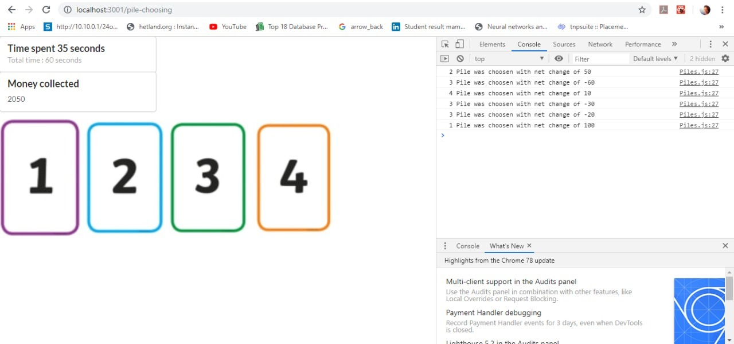
Games Developed
*checked by with Dr. Neha Sharma during our meeting on 20 Nov, 2019

Slide 14
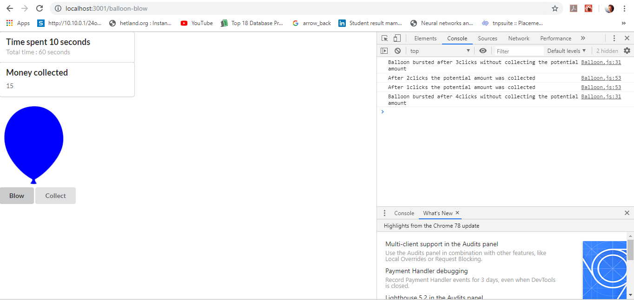
Games Developed
*checked by with Dr. Neha Sharma during our meeting on 20 Nov, 2019

Slide 15
Future Work: Processing the Data Obtained
The next step is to analyze the data obtained from the players playing the games.
This phase is currently being planned as the data can be analyzed in various ways.
Some of the possible techniques which can be used are:
Threshold Values
The simplest method would be to establish a threshold value of the score obtained in a game to classify it as a Favorable or non-Favorable outcome.
While this is simple, it oversimplifies and ignores many of the fine parameters of the data.
Comparative analysis
Similar to fitness apps, comparisons can be drawn within the user base to quantify the performance of the individual user. Needs a sizeable user base to be effective

Slide 16
Future Work: Processing the Data Obtained
Clustering
Data can be clustered together to find out similarity in outputs among different users. This can be cross-referenced with factors like age, institute, qualification etc. to establish trends.
Using Metrics
Metrics can be used to quantify the performance based on the user scores. The metrics shall be derived from methodologies of existing psychometric tests, as advised with ma’am.
Environmental Factors
Various factors which may affect a person’s psychometric logicality or imbalance, setting up parameters to count the same.

Slide 17


Technologies used
React JS
Redux
Django
Django REST Framework

Slide 18
References
Consultation with Dr. Neha Sharma, Assistant Professor, Department of Human Development, Gov. Home Science College, Sector 10, Chandigarh
Jennifer Gunn, ‘Building a Growth Mindset for Teachers’, August 26, 2018, visited 10 September, 2019
Carol Dweck, ‘Mindset: The new Psychology of Success’, Random House Publications, ISBN: 9781400062751
Samy A Azer, ‘The qualities of a good teacher: how can they be acquired and sustained?’ Journal of the Royal Society of Medicine, Feb 2005 https://www.ncbi.nlm.nih.gov/pmc/articles/PMC1079387/
Games from: https://www.neuronation.com/science/brain-games
National Research Council. 2003. Evaluating and Improving Undergraduate Teaching in Science, Technology, Engineering, and Mathematics. Washington, DC: The National Academies Press. https://doi.org/10.17226/10024https://mindsetscholarsnetwork.org/teacher-student-surveys-and-perceptions/
Jess Hennessey, ‘Mindsets and the learning environment: How teachers’ mindsets about mathematical ability influence their practice’, November 7, 2017

