Slide 1
Mindset Analysis using Psychometric Games MAP-G
Aanshi Bansal 16103055
Paritosh Malhotra 16103062
Vaibhav Setia 16103069
Shreya 16103070
Navdeep Kaur 16103078
Mentor:
Dr. Manish Kamboj
Consultation:
Dr. Neha Sharma, Assistant Professor,
Human Development,
Gov. Home Science College,
Sector 10, Chandigarh

Slide 2
Objectives
To build a comprehensive platform of psychometric games to analyze favorable traits for teachers and generate trait reports for the same
To perform analysis on the dataset thus formed to detect patterns

Slide 3
Motivations
Companies have started using Psychometric tests to evaluate potential candidates
No such framework is in use to evaluate existing and new teachers
This presents an avenue for development of the same

Slide 4
Problem Statement
To develop a platform that uses Psychometric
tests to analyze the favorable traits of the
people in the teaching profession

Slide 5
Results Achieved: Favorable traits for the Teaching Profession
Experiment and innovate
ATTRIBUTE : RISK
Be flexible
ATTRIBUTE : FLEXIBILTY
Truly Listen
ATTRIBUTE : OPEN MINDEDNESS
Reflection
ATTRIBUTE: RESPONSE AND THOUGHT PROCESS
A Growth Mindset
ATTRIBUTE : ADAPTABILITY
Asking Questions
ATTRIBUTE : CURIOSITY
Learning new Technology
ATTRIBUTE : UNDERSTANDING
Analyzing Capability
ATTRIBUTE: CRITICAL THINKING
Jennifer Gunn, Building a Growth Mindset for Teachers, August 26, 2018, visited 10 September, 2019
*consultation with Dr. Neha Sharma, Assistant Professor, Gov. Home Science College, Sector 10, Chandigarh

Slide 6
Results Achieved: Various games and traits to measure
Building Tower of Hanoi
ATTRIBUTE : PLANNING
Blow a balloon till it explodes
ATTRIBUTE : RISK
Press space bar on red pop up
ATTRIBUTE : ATTENTION
Flash digit sequence on the screen
ATTRIBUTE: MEMORY
Answering a question by hearing clues
ATTRIBUTE : LISTENING
Check facial expression
ATTRIBUTE : EMOTION
Decide size of face
ATTRIBUTE : LEARNING
Money Exchange
ATTRIBUTE: TRUST
Jennifer Gunn, Building a Growth Mindset for Teachers, August 26, 2018, visited 10 September, 2019
*consultation with Dr. Neha Sharma, Assistant Professor, Gov. Home Science College, Sector 10, Chandigarh

Slide 7


Technologies used
Front end Tech stack
Backend Tech stack
React JS
Redux
Axios
Django
Django REST Framework
Postgres Database

Slide 8


HOSTING
Frontend has been hosted on AWS S3 bucket
3rd party app ‘buddy’ used to automatic deploy new builds from GitHub (vcs)
Frontend URL : http://map-g.s3-website.ap-south-1.amazonaws.com/
Backend has been hosted using an EC2 instance of AWS
Backend IP address: http://54.224.51.29/

Slide 9
Games and their traits implemented till now:
Games
Listening Carefully
Collecting money
Blowing balloon
Emotion Predictor
Traits
Risk
Critical Listening
Understanding Capability
Learning Capability
Behavioral analysis
Personality reflection
Face study
Jennifer Gunn, Building a Growth Mindset for Teachers, August 26, 2018, visited 10 September, 2019
*consultation with Dr. Neha Sharma, Assistant Professor, Gov. Home Science College, Sector 10, Chandigarh

Slide 10
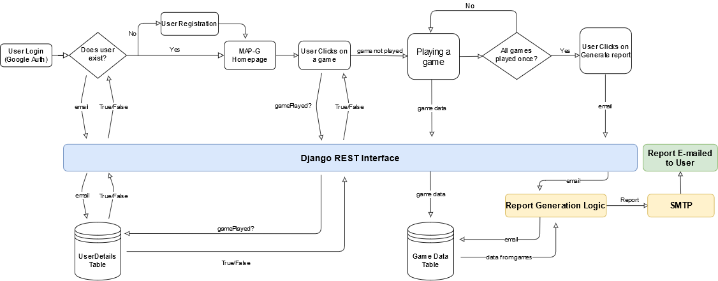
Methodology

Slide 11
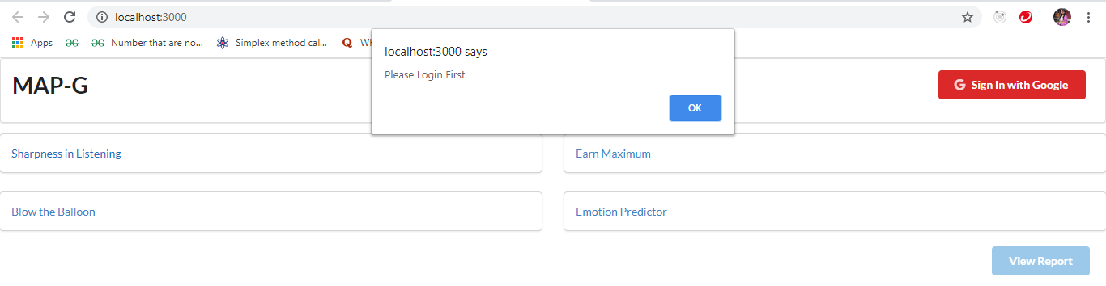
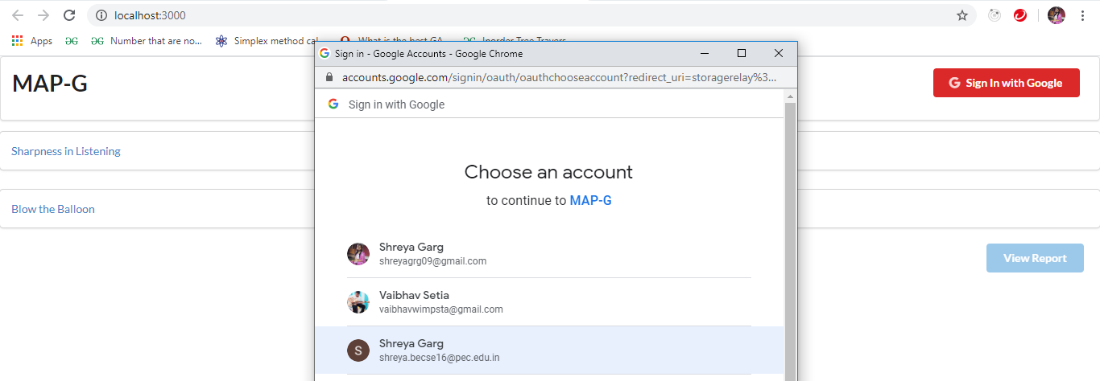
IMPLEMENTATION
Logging into MAP-G system via Gmail

Slide 12
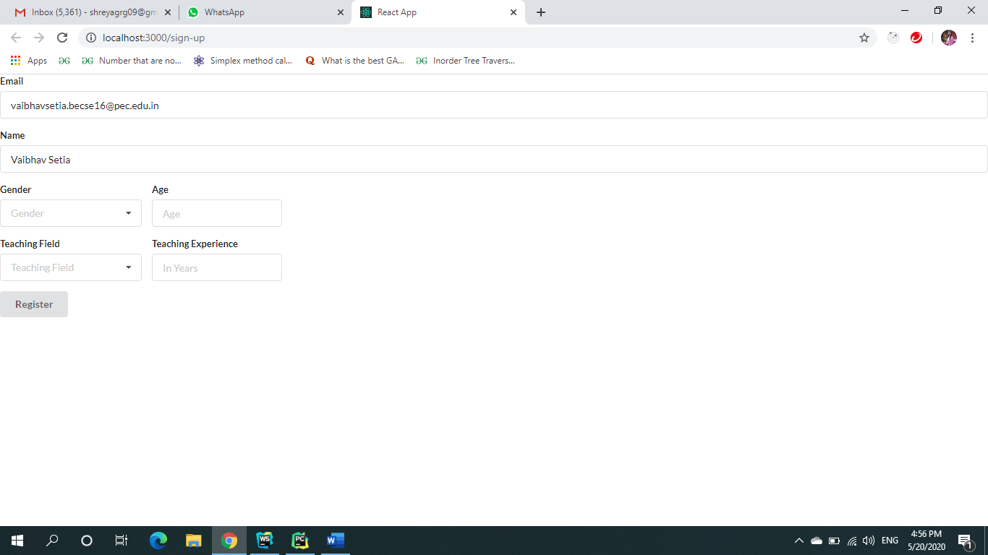
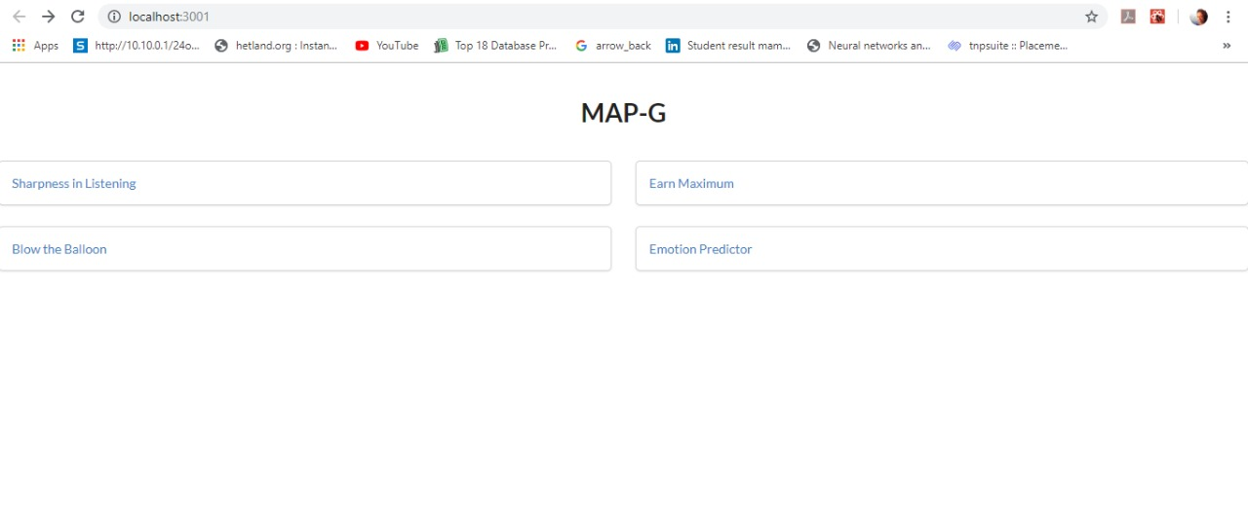
IMPLEMENTATION
Filling the details on logging in for the first time
Selecting Games on Dashboard

Slide 13
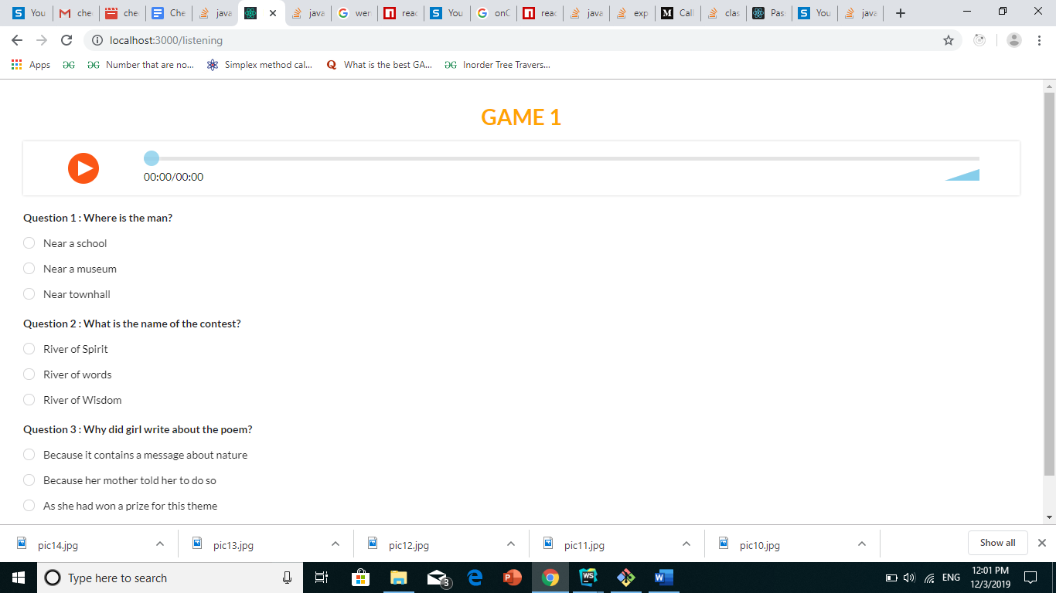
Games Developed
Playing Sharpness in Listening
*checked by with Dr. Neha Sharma during our meeting on 3rd October, 2019

Slide 14
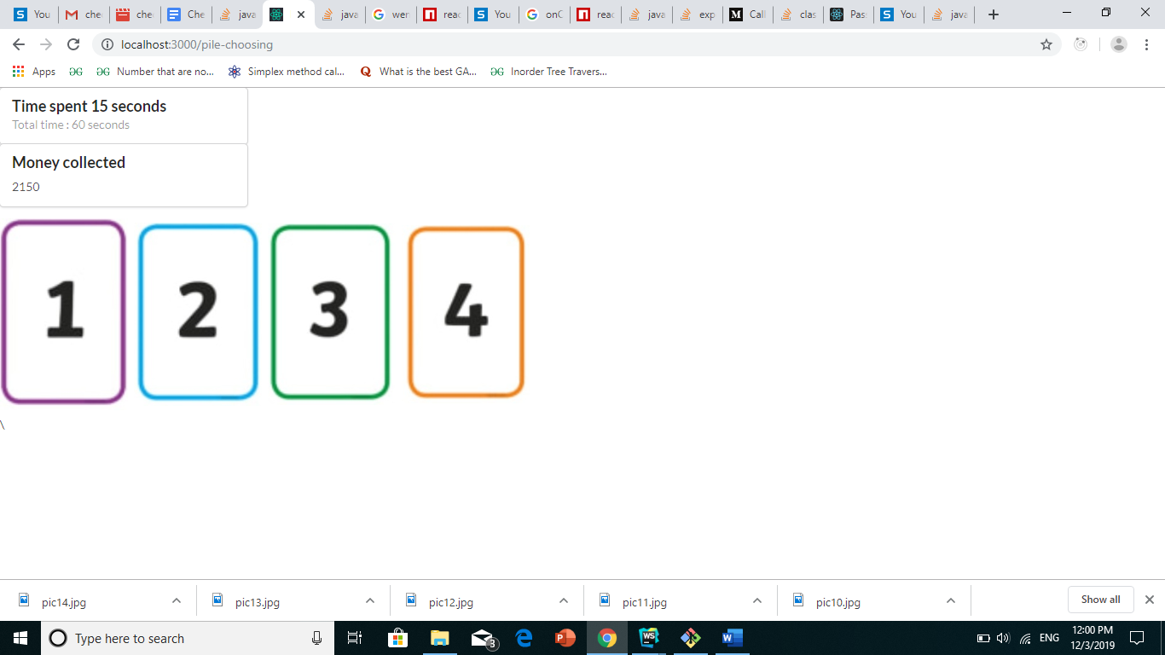
Games Developed
Playing Earn Maximum
*checked by with Dr. Neha Sharma during our meeting on 3rd October, 2019

Slide 15
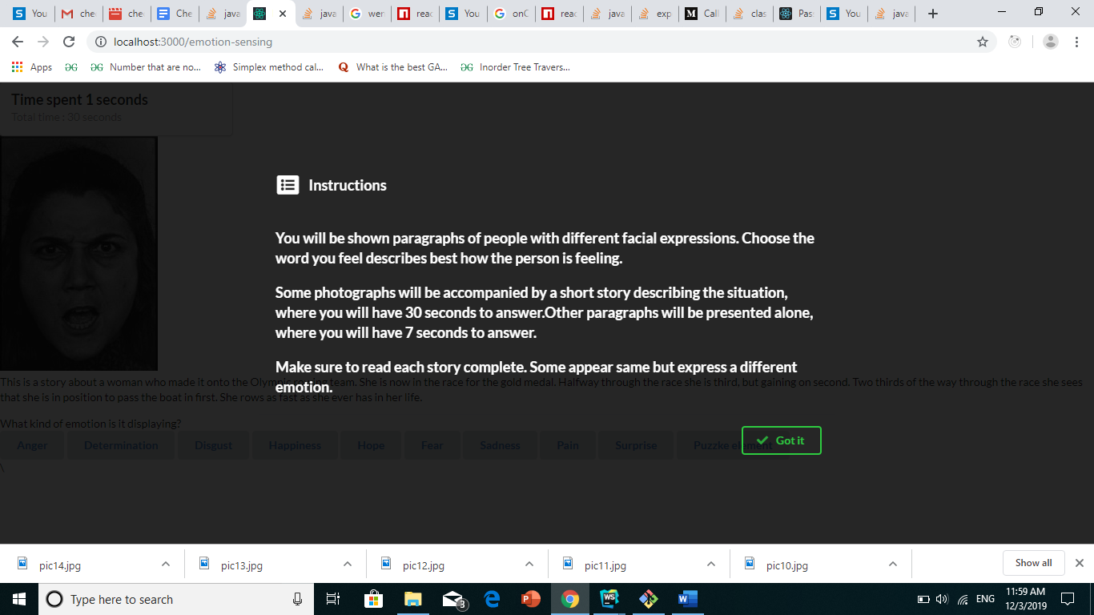
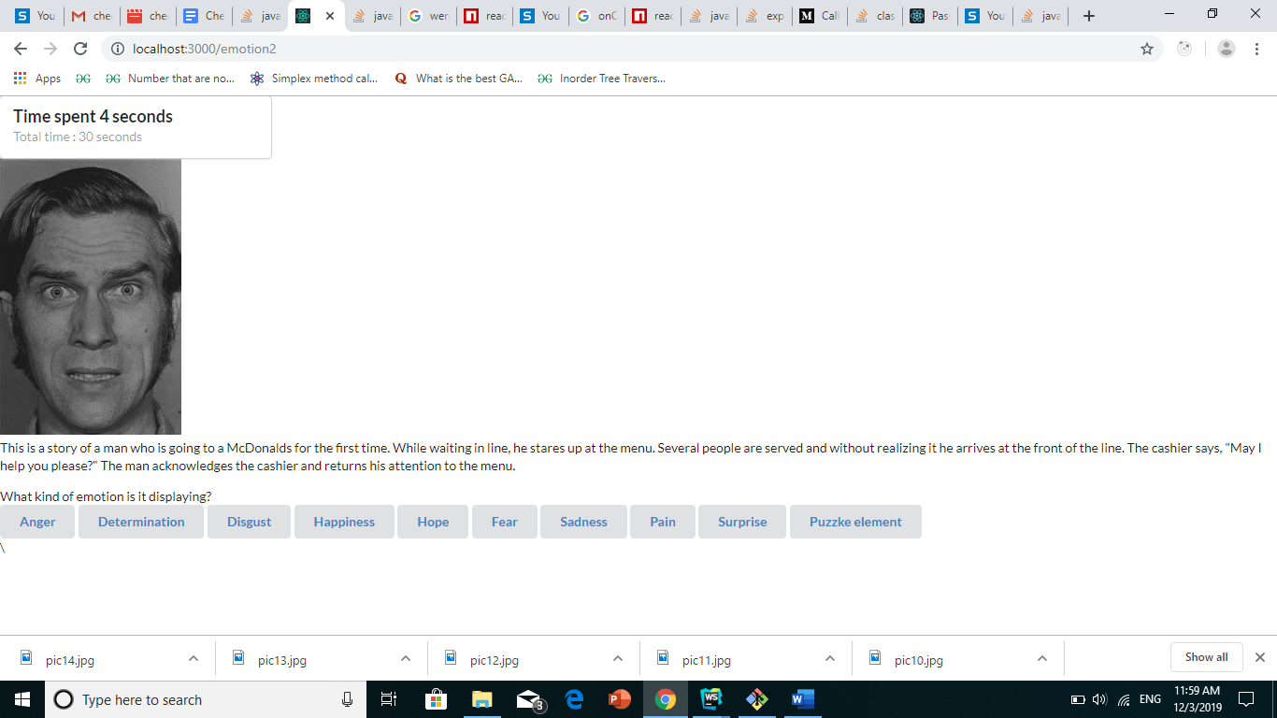
Games Developed
Playing Emotion Predictor
*checked by with Dr. Neha Sharma during our meeting on 20 Nov,2019

Slide 16
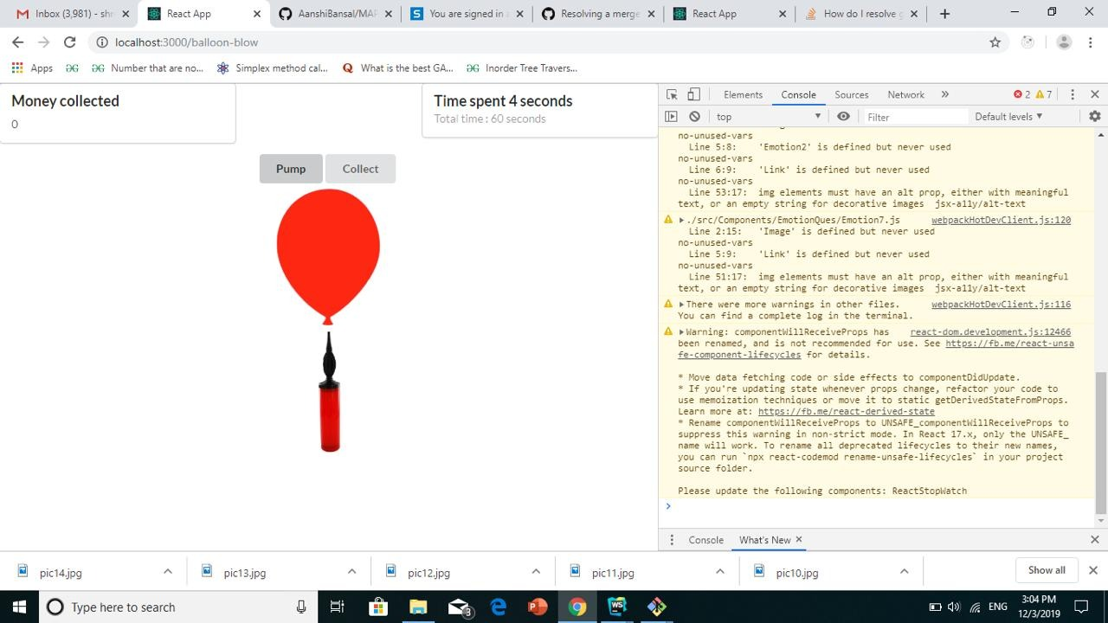
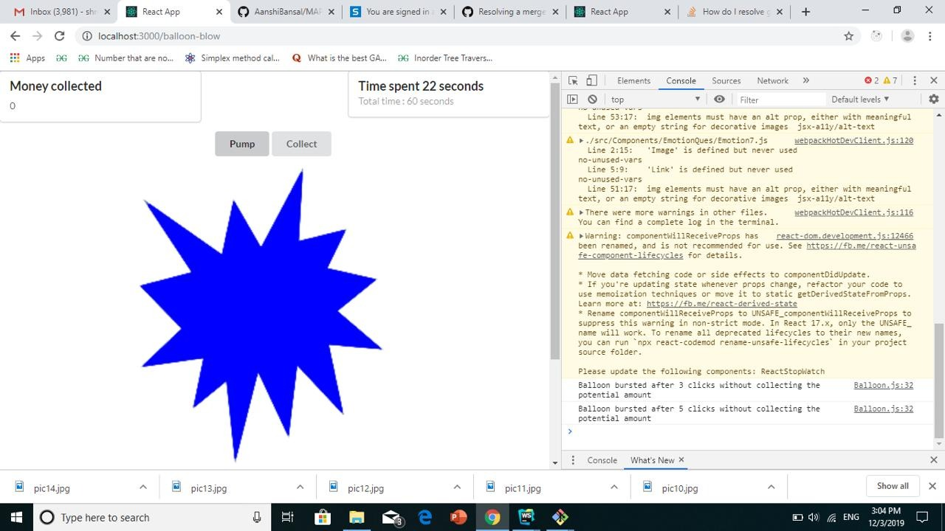
Games Developed
Blow Balloon Game
*checked by with Dr. Neha Sharma during our meeting on 20 Nov,2019

Slide 17
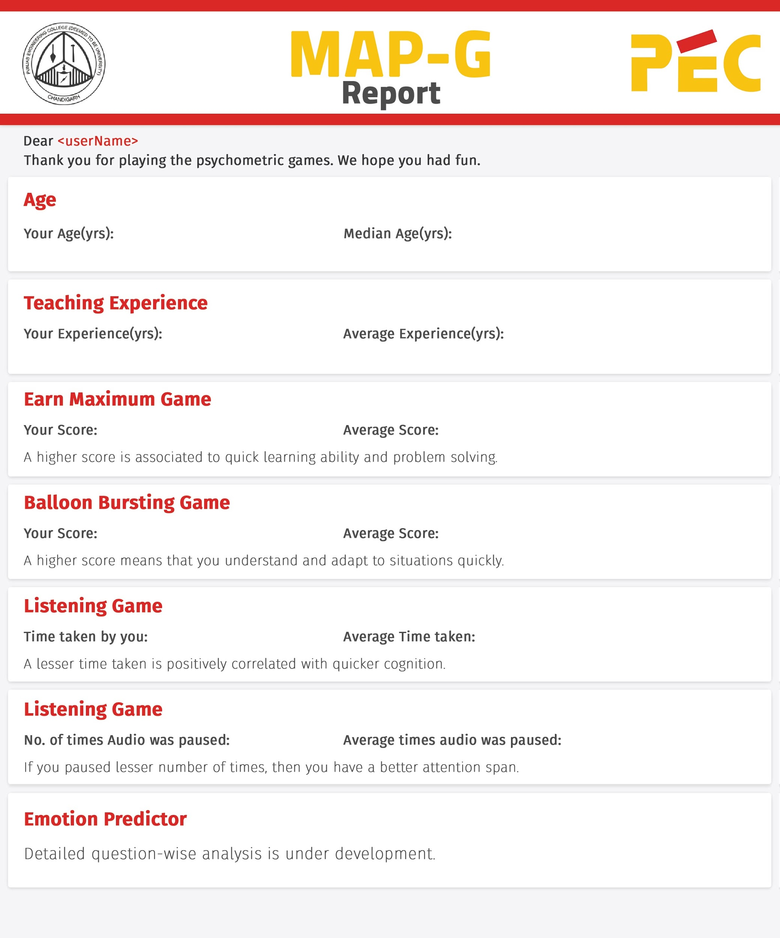
Generating Report

Slide 18
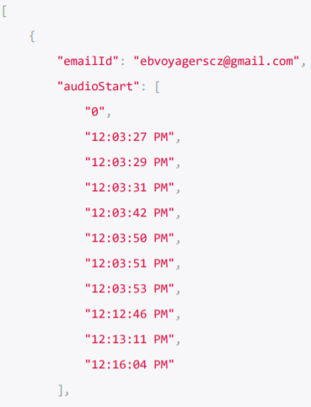
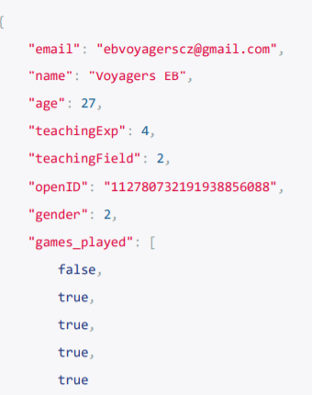
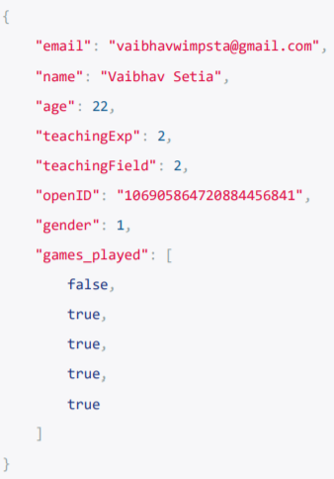
Storing Data on Backend
User Data

Slide 19
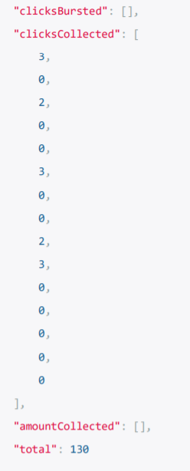
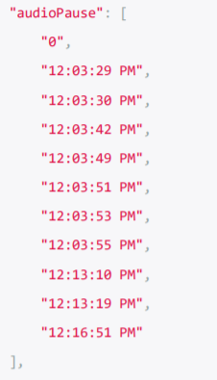
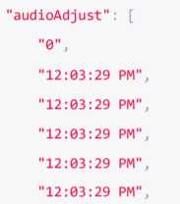
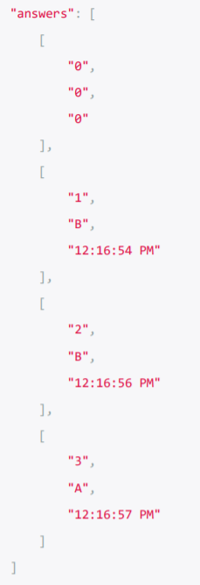
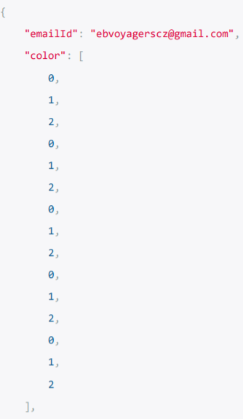
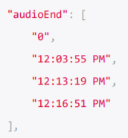
Storing Data on Backend
Listening Game | Balloon Blow

Slide 20
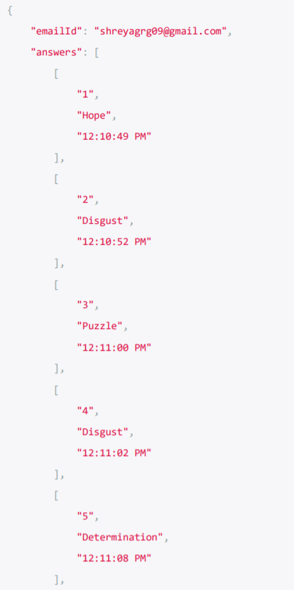
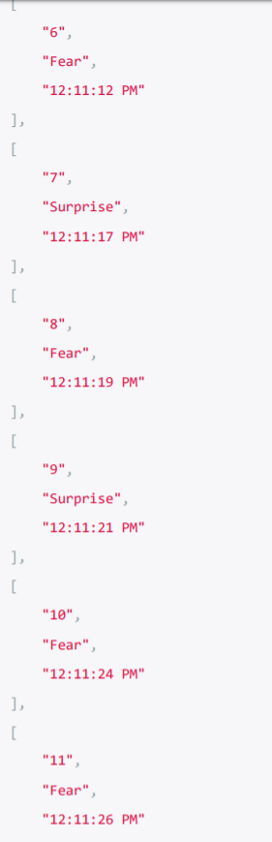
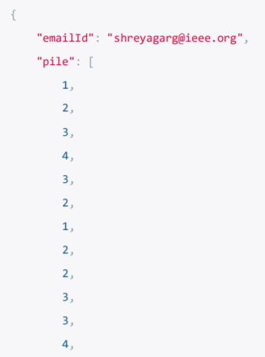
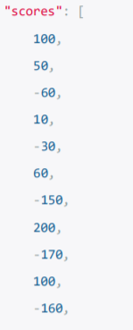

Storing Data on Backend
Pile Choosing | Emotion Predictor

Slide 21
Analysis & Report Generation
Analysis
As conferred with Dr. Neha, we are performing a comparative analysis of a user’s performance in the games with other users. The statistical tools used are median and average
Report Generation
After the data is calculated, it is augmented as text on a base report template (using the OpenCv library of python). The report is then saved locally on the server for record keeping
Emailing the report
The report is then emailed to the user on his/her registered email id. The emails are sent using python’s SMTP module and consist of salutation text with the report attached

Slide 22
Future Work:
Analysis of the data
Can be furthered using ML techniques, like K-nearest neighbors to identify the correlations and patterns in it
Recommendations for Improvements
After the comparative analysis is complete we can suggest the users some activities/measures/resources to improve upon the underlying ability that a particular game targets. Eg: A low score in listening game indicates lack of concentration that can be improved upon by mediation.
Emotion predictor game analysis
As the questions in the emotion predictor game have no correct answer hence a detailed comparative analysis of emotion predictor game requires considerable amount of data

Slide 23
References
Consultation with Dr. Neha Sharma, Assistant Professor, Department of Human Development, Gov. Home Science College, Sector 10, Chandigarh
Jennifer Gunn, ‘Building a Growth Mindset for Teachers’, August 26, 2018, visited 10 September, 2019
Carol Dweck, ‘Mindset: The new Psychology of Success’, Random House Publications, ISBN: 9781400062751
Samy A Azer, ‘The qualities of a good teacher: how can they be acquired and sustained?’ Journal of the Royal Society of Medicine, Feb 2005 https://www.ncbi.nlm.nih.gov/pmc/articles/PMC1079387/
Games from: https://www.neuronation.com/science/brain-games
National Research Council. 2003. Evaluating and Improving Undergraduate Teaching in Science, Technology, Engineering, and Mathematics. Washington, DC: The National Academies Press. https://doi.org/10.17226/10024https://mindsetscholarsnetwork.org/teacher-student-surveys-and-perceptions/
Jess Hennessey, ‘Mindsets and the learning environment: How teachers’ mindsets about mathematical ability influence their practice’, November 7, 2017

