Slide 1
Welcome to Xpense Ease Simplify-Track-Save
Team Members:
M. Eswari – 22B91A61A2
M. Likitha – 22B91A61A3
P. Anusha – 22B91A61C0
4. SK. Sumya – 22B91A61D9

Slide 2
Problem Statement
Managing personal finances effectively is a challenge for many individuals. Without a proper system to track income and expenses, overspending and financial stress become common. Traditional budgeting methods can be time-consuming, and existing digital solutions often lack user-friendliness. There is a need for a simple, intuitive, and efficient tool to help users track expenses, plan budgets, and gain insights into their financial habits.

Slide 3
Technologies used
HTML (Hyper Text Markup Language)
Defines the structure of the Expense Tracker, including the dashboard, expense list, and modals.
Creates the layout for displaying latest expense dates, transaction history, and total spending.
Forms are used for adding expenses, selecting dates, and filtering expense history.
CSS (Cascading Style Sheets)
Enhances the visual design by styling elements like cards, modals, and buttons.
Implements a clean and user-friendly UI, ensuring a seamless experience across devices.
Uses flexbox and grid layouts to organize expense records and financial summaries attractively.
JavaScript (JS)
Adds interactivity to the Expense Tracker.
Enables dynamic filtering of expenses based on selected dates.
Handles form validation, real-time calculations of total spending, and modal interactions for smooth navigation.

Slide 4
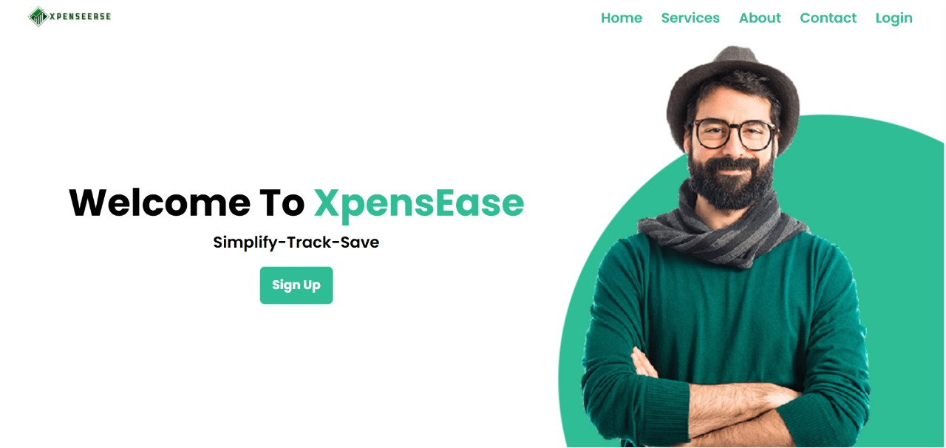
Home Page

Slide 5
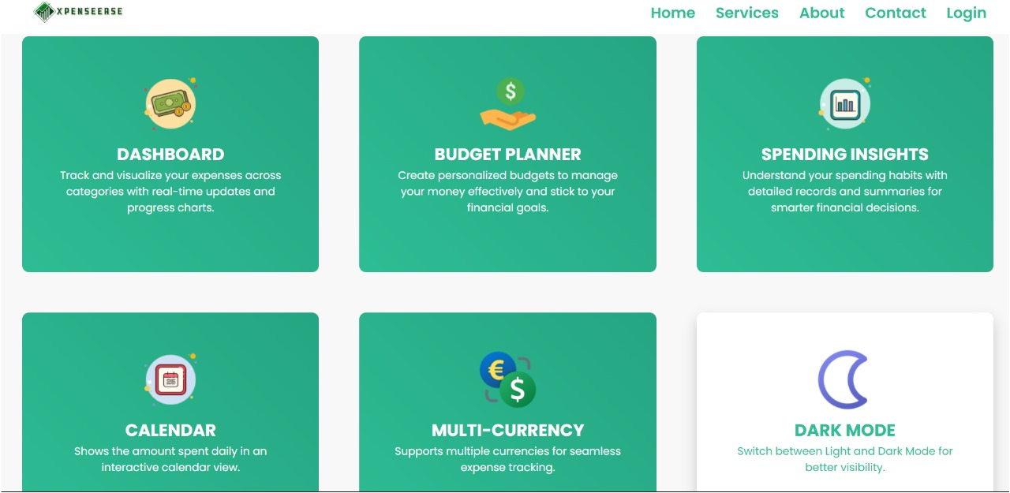

Slide 6
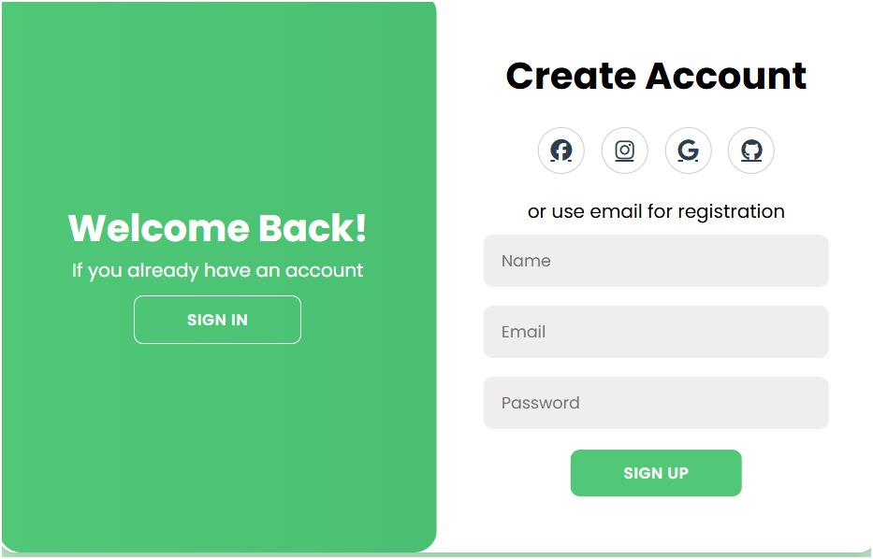
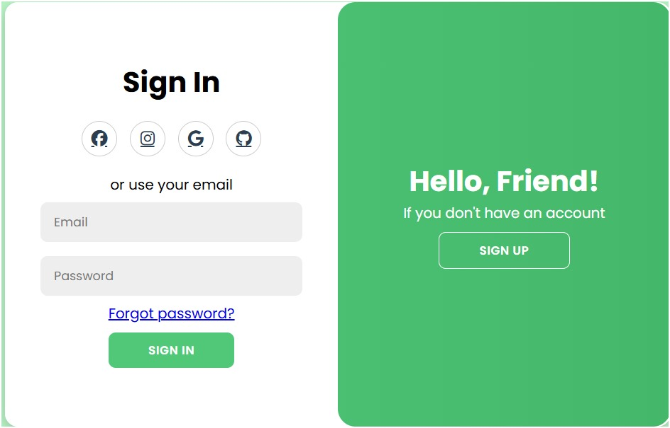

Slide 7
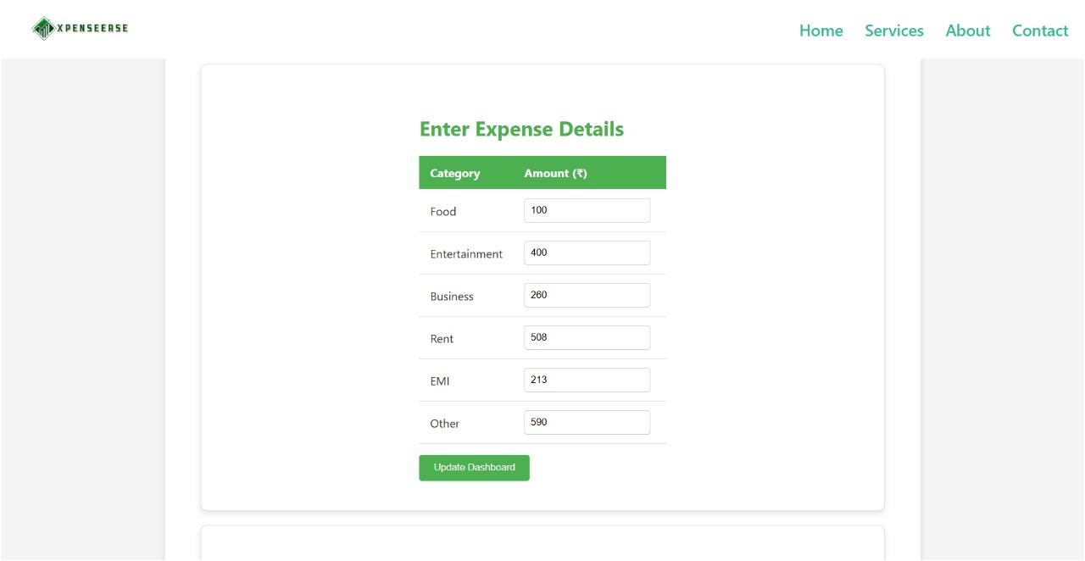
Expense Tracker

Slide 8
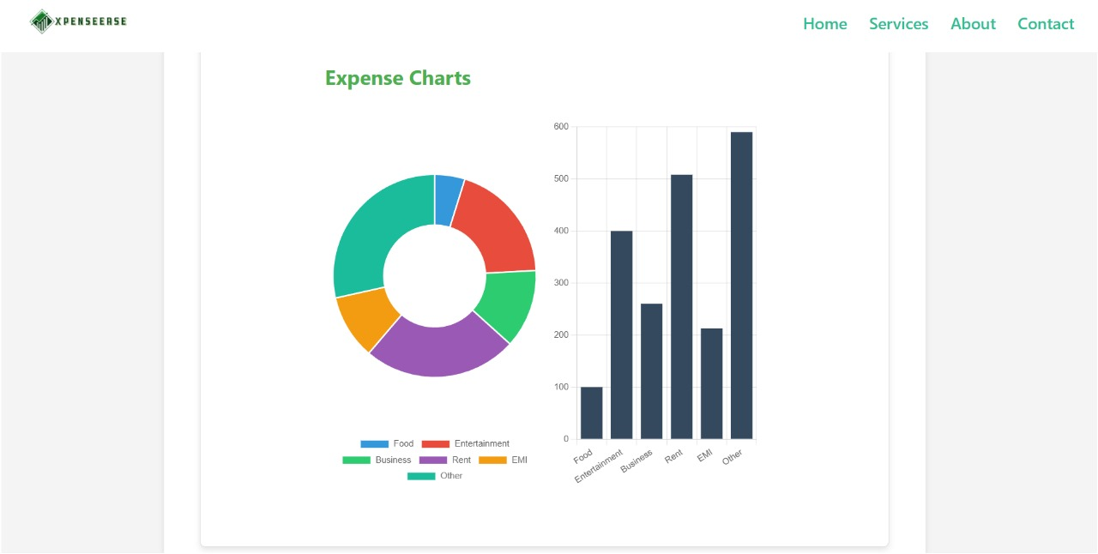

Slide 9
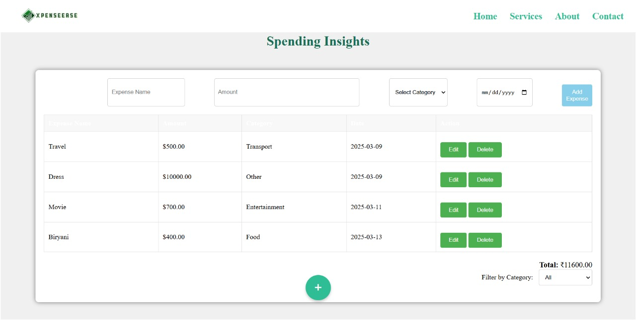
Spending Insights

Slide 10
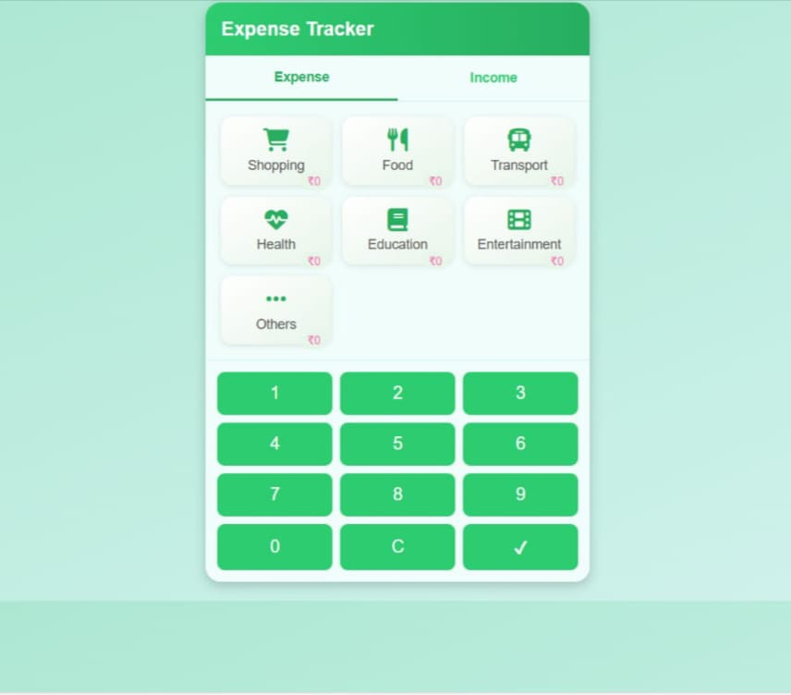

Slide 11
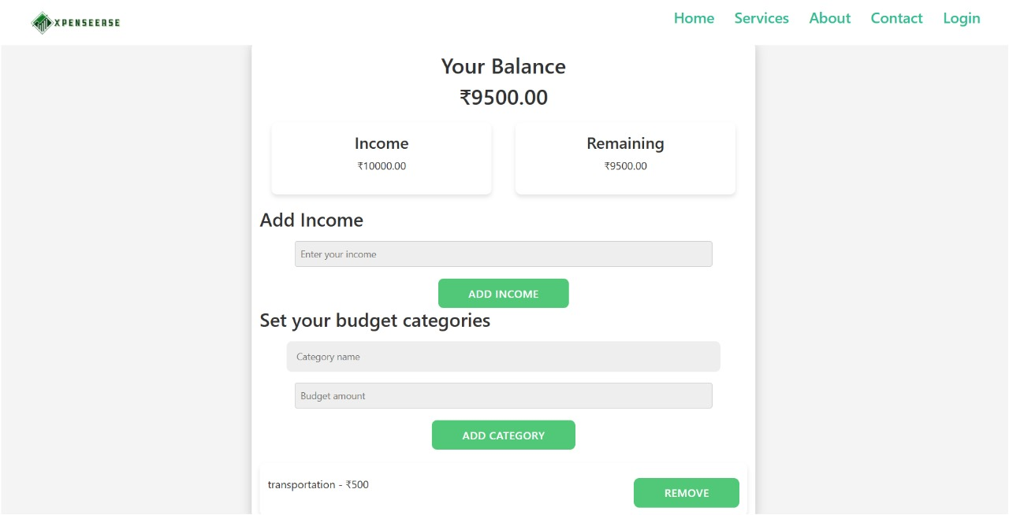
Budget Planner

Slide 12
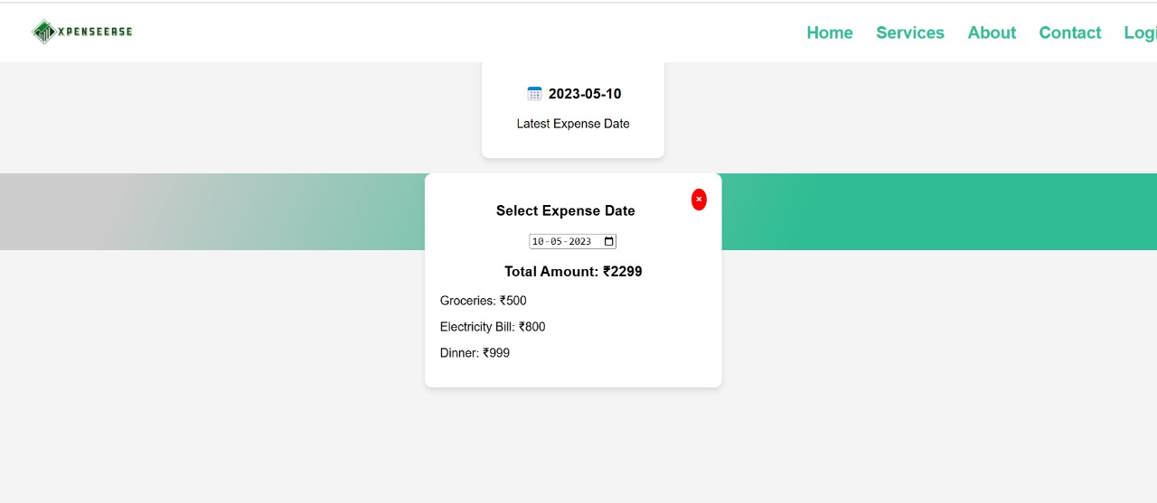
calender

Slide 13
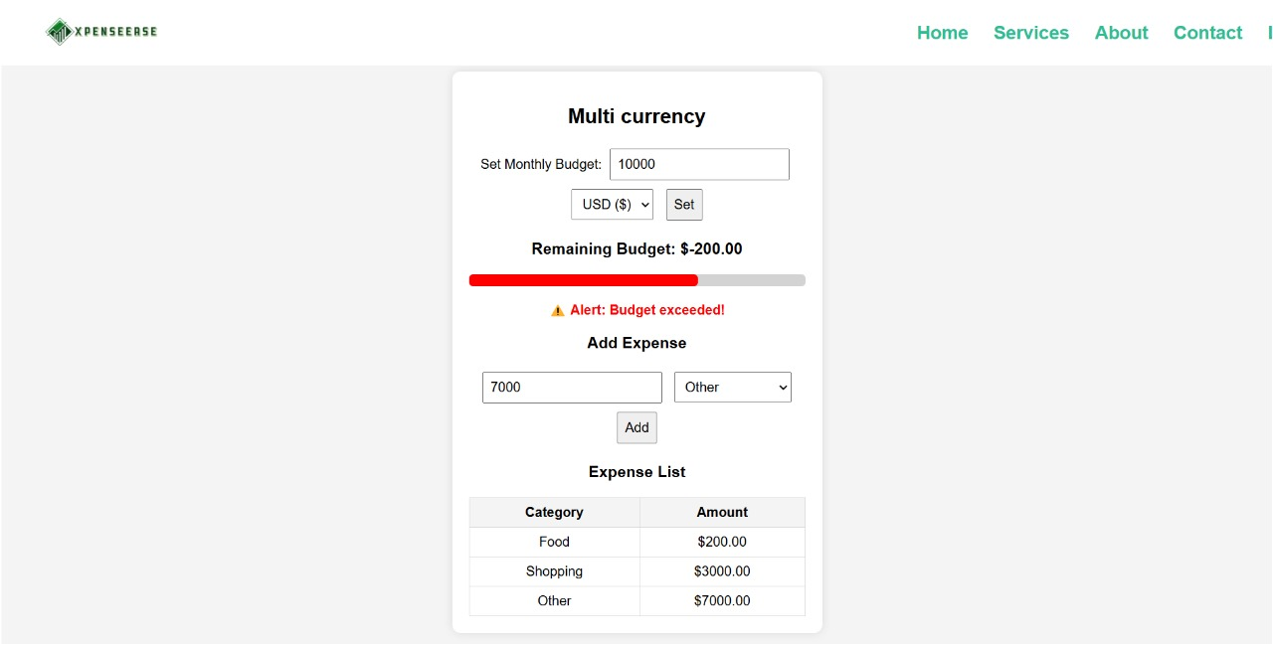
Multi currency

Slide 14
Implementation of Angular
1.To improve user experience with better UI components, faster page transitions, and seamless interactivity.
2. By adding live updates, personalized spending insights, and a highly interactive interface.
3. Integrate AI-based recommendations using AngularJS.
4.It introduce real-time data visualization with animated, AI-driven analytics for better decision-making.
5. Add an automated expense tracker that predicts future spending based on past data and provides timely alerts.

Slide 15

XpenseEase is the perfect companion for anyone looking to take control of their finances, avoid unnecessary expenses, and build a stable financial future!

Slide 16
Thank You!!

