Slide 1
Shelfwise
A library circulation platform, shipped like a production service
Aanvi Solanki · Roll no. 24BCS10170 · DevOps capstone (Session 21)
Notes:
Shelfwise runs a lending library's front desk: catalogue, members, loans, fines and a fair holds queue. The application is the reason; the point of the project is the path every change takes from my laptop to a monitored Kubernetes cluster.

Slide 2
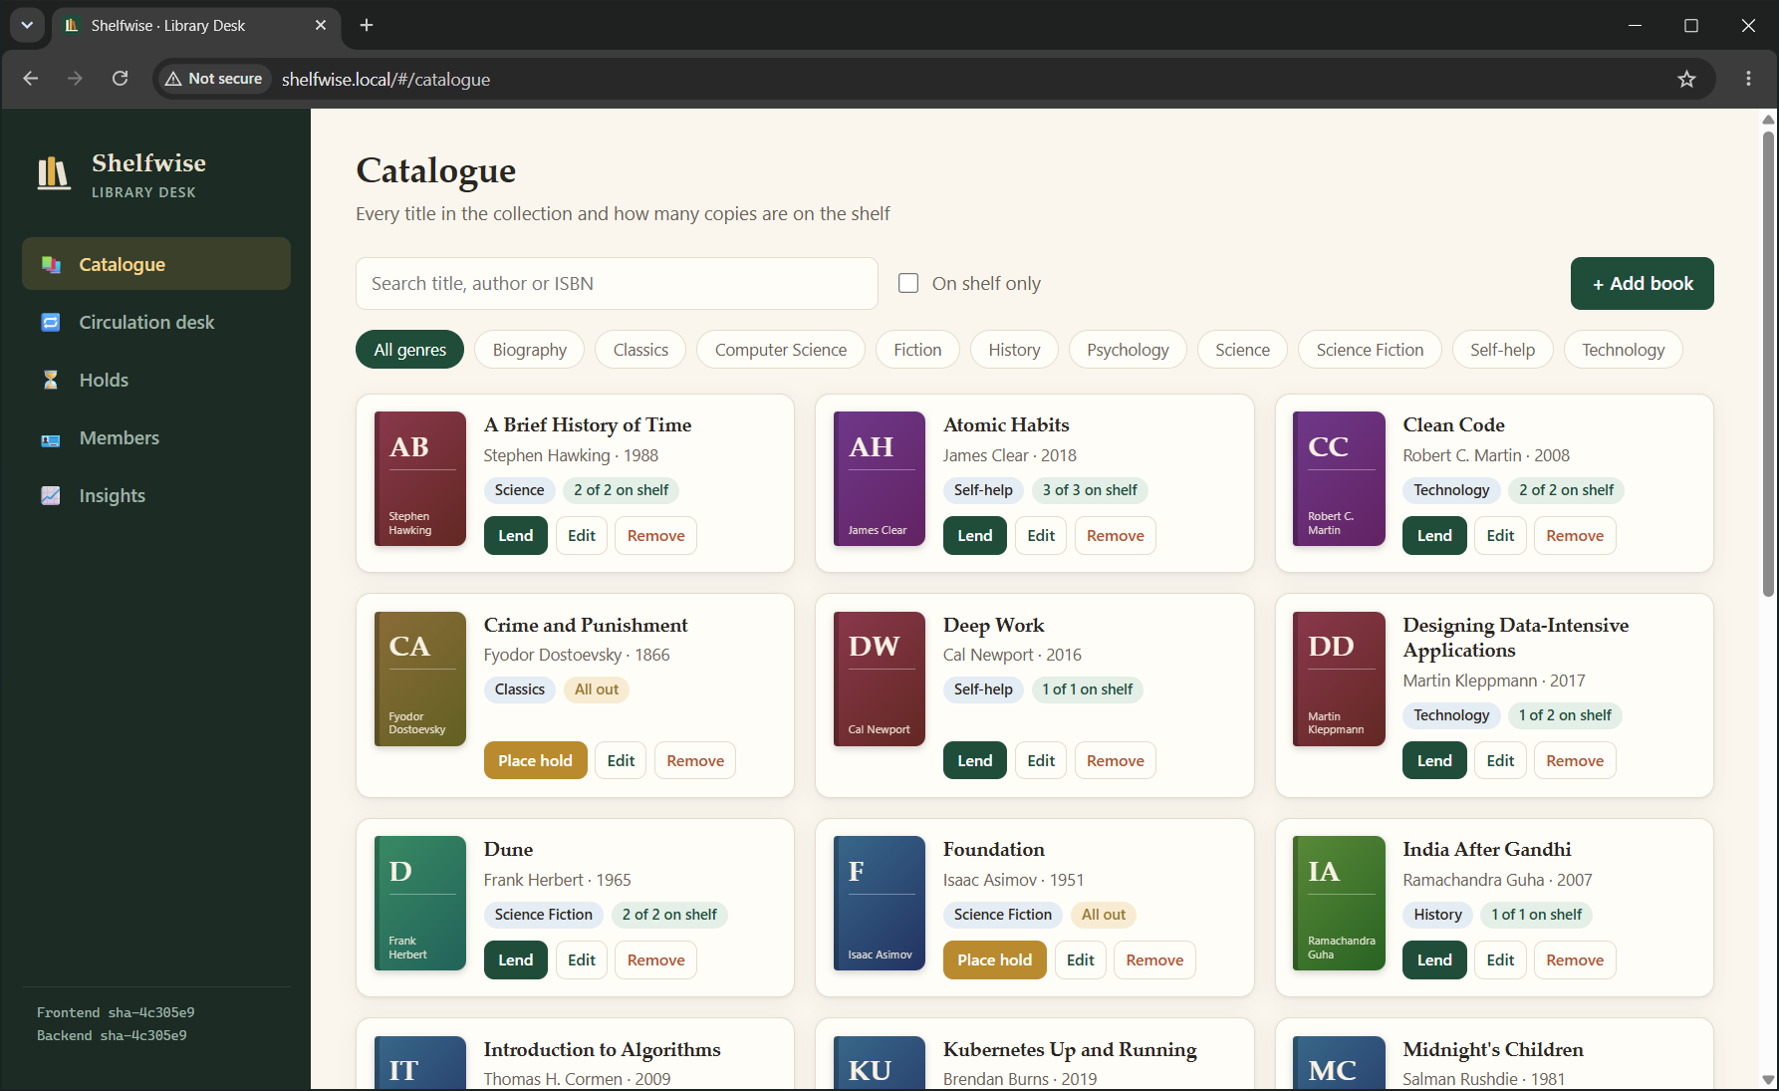
A real domain with real rules, not a CRUD demo
1
Tiered lending
Students 14 days × 5 books, faculty 28 × 10, public 14 × 3; renewal limits per tier
2
Fines
Grace period, per-day rate, per-loan cap; ₹150 owed blocks borrowing until settled
3
FIFO holds queue
A returned copy waits 3 days for the next member, then passes on
All rules are pure functions in backend/app/circulation/, tested with pinned dates
Notes:
FastAPI + SQLAlchemy + Alembic with four related tables, React frontend. 25 REST operations. The rules live in one pure module, so the 111 tests can pin any date without mocking the clock.

Slide 3
Every commit travels the same automated path
1
2
3
4
5
6
git push
Quality gates
Trivy gate
GHCR
Image Updater
Argo CD
main or a PR
ruff · 111 tests · build · helm · terraform · gitleaks
0 HIGH / CRITICAL or nothing ships
sha-<commit> tags, SBOM, provenance
sees the new tag in ~1 min
rolling update, zero downtime
No bot commits: Image Updater writes the tag to the Argo CD Application, not to Git, so every one of the 50+ commits is mine.
Proven in PR #1: the first commit added tests for a new rule; CI failed and skipped every image job; the second commit made it green.
Notes:
Walk the six stages. Emphasise: tests before images, scan before push, SHA tags for traceability, and GitOps pull instead of CI pushing kubectl commands.

Slide 4
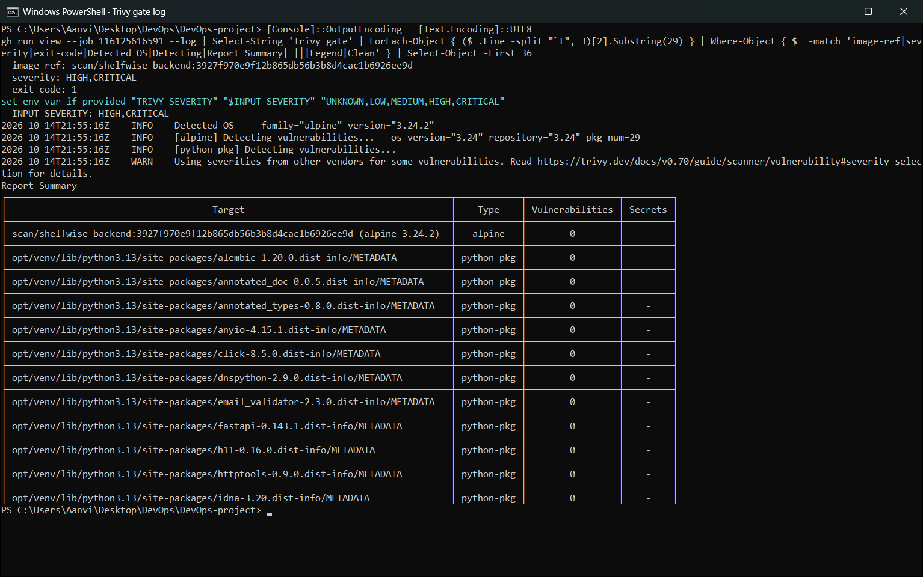
Quality and security, measured
111
0
8
10001
tests passing
HIGH / CRITICAL CVEs
pipeline jobs
non-root UID
98% coverage, isolated SQLite
Trivy on all three images
lint, test, build, helm, tf, secrets, images
read-only root, all caps dropped
What Trivy checks: Alpine OS packages and every Python library in the image, plus secrets in the layers. Clean because runtime images are minimal (multi-stage, no pip, no Node). Re-scanned on every commit; Dependabot proposes updates weekly.
Notes:
Be ready to explain a clean scan: it means no known fixable HIGH/CRITICAL issue at build time, not 'secure'.

Slide 5
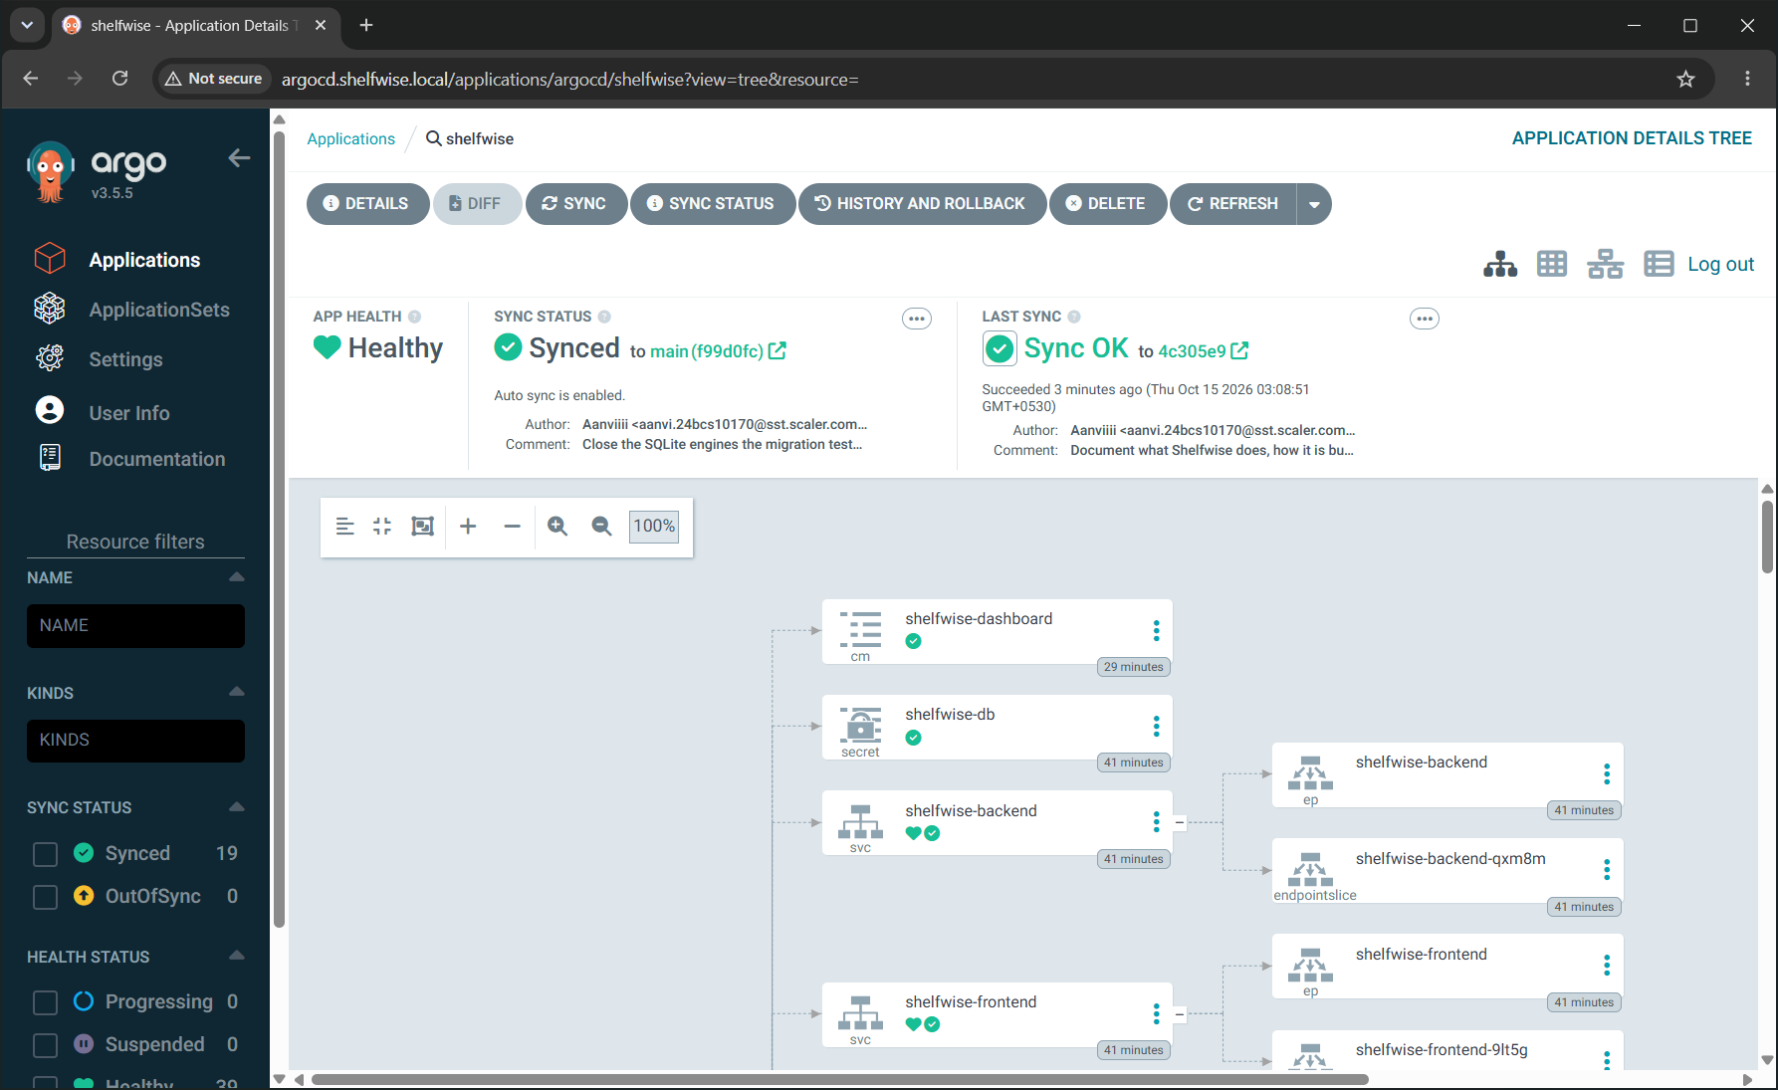
Kubernetes, packaged with Helm, delivered by Argo CD
Helm chart
Deployments, StatefulSet + PVC, ClusterIP Services, Ingress (/ and /api), PDB, NetworkPolicy, helm test
Autoscaling
HPA on CPU scaled the backend 2 → 6 pods under a k6 load test
Hardened
Restricted Pod Security on the namespace; probes split into startup, liveness and readiness
Notes:
Show kubectl get pods,svc,ingress,hpa and helm list live if time allows.

Slide 6
AWS with Terraform, priced for a student
VPC 10.42.0.0/16 · ap-southeast-2 (Sydney)
≈ $0.40
Public subnet
ap-southeast-2a · 10.42.0.0/20
Public subnet
ap-southeast-2b · 10.42.16.0/20
per hour, paid from AWS credits ($0.50 in total)
EKS node · m7i-flex.large
EKS node · m7i-flex.large
No NAT gateway: saves ~$1.40/day
Free plan: Sydney, On-Demand, Free Tier nodes
Pinned to standard support (extended is 6×)
Hand-written resources, no modules
eks-down.ps1 removes LB + volume, then destroy
EKS 1.35 control plane · access entries · Pod Identity for EBS
Internet gateway · budget alert · every resource tagged Project=shelfwise
Notes:
terraform plan / apply / destroy screenshots are in docs/SUBMISSION.md (M7). Applied in Sydney (the only region a Free plan account allows), deployed, then destroyed: 24 resources, about $0.50 of credits.

Slide 7
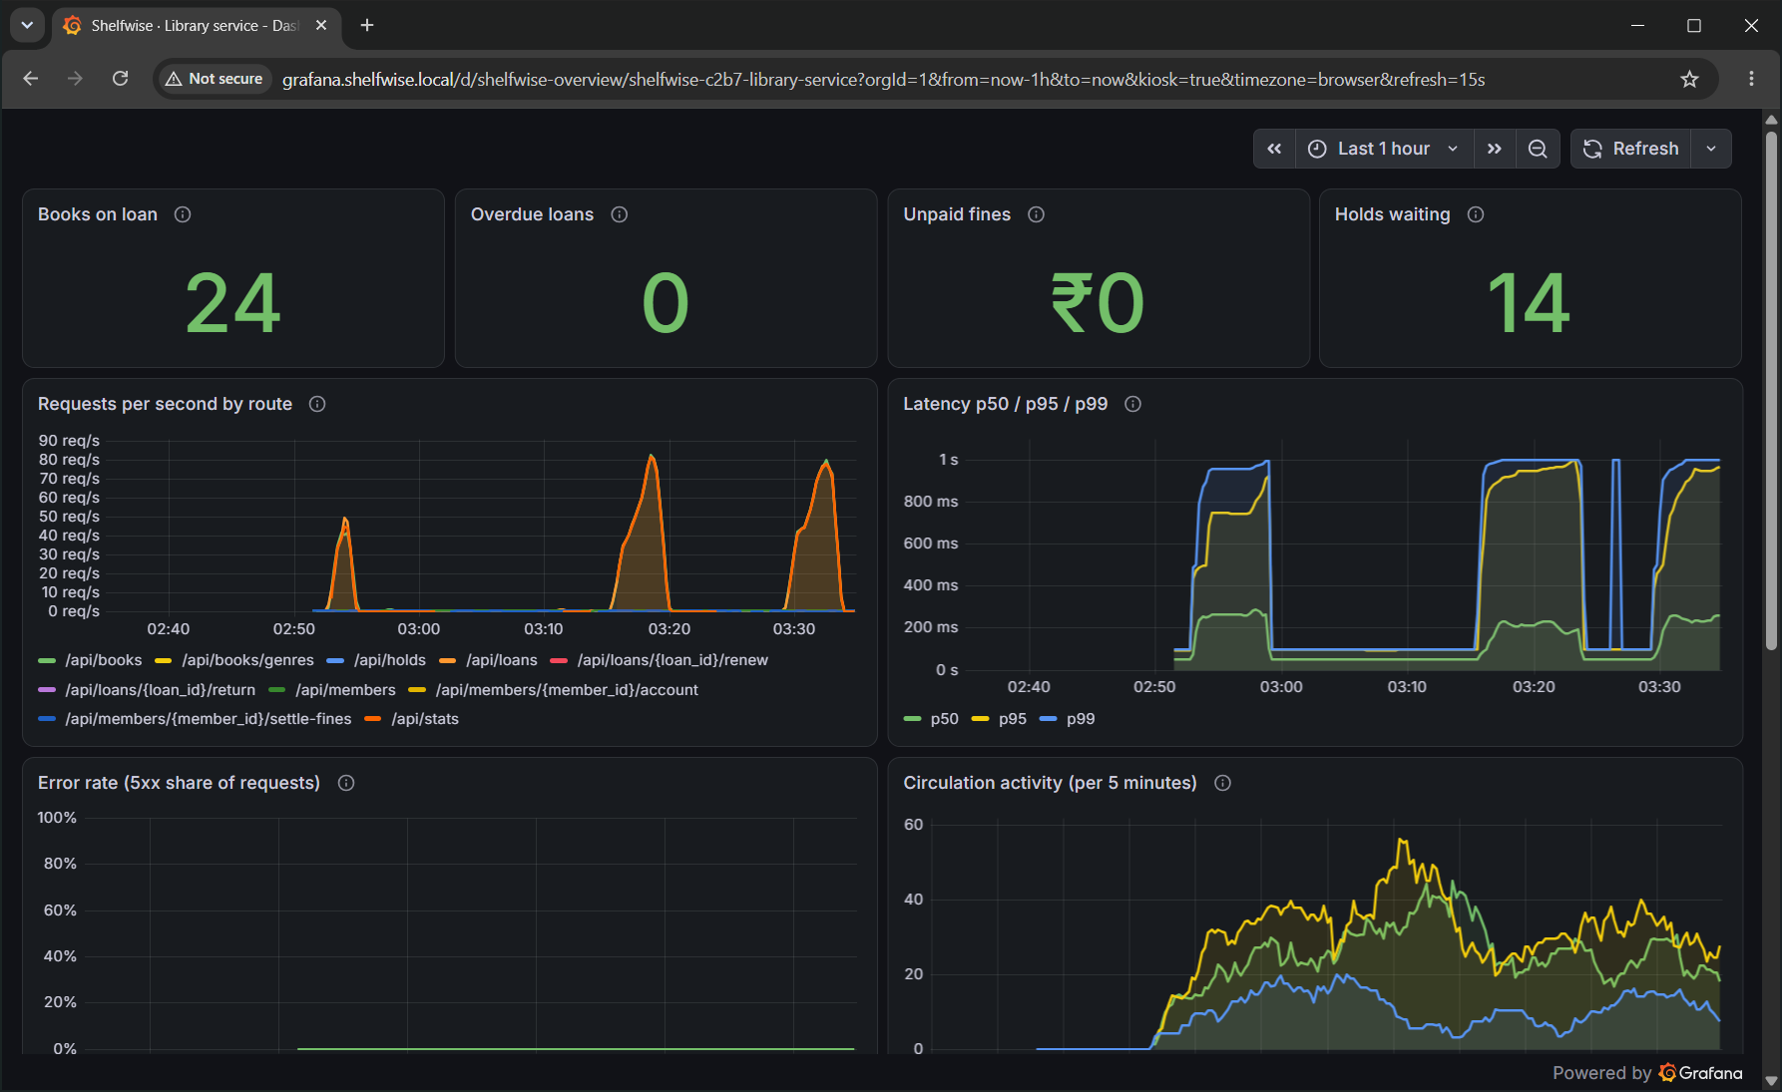
Observability: the library's health on one screen
HTTP metrics per route
Requests, p50/p95/p99 latency, 5xx ratio
Library metrics from Postgres
Books on loan, overdue, unpaid fines, holds waiting, refusals by reason
Five alert rules
Backend down, error rate, slow requests, HPA at max, overdue backlog; two went pending under load
Notes:
Prometheus scrapes via a ServiceMonitor shipped in the chart; the dashboard is a ConfigMap loaded by Grafana's sidecar.

Slide 8
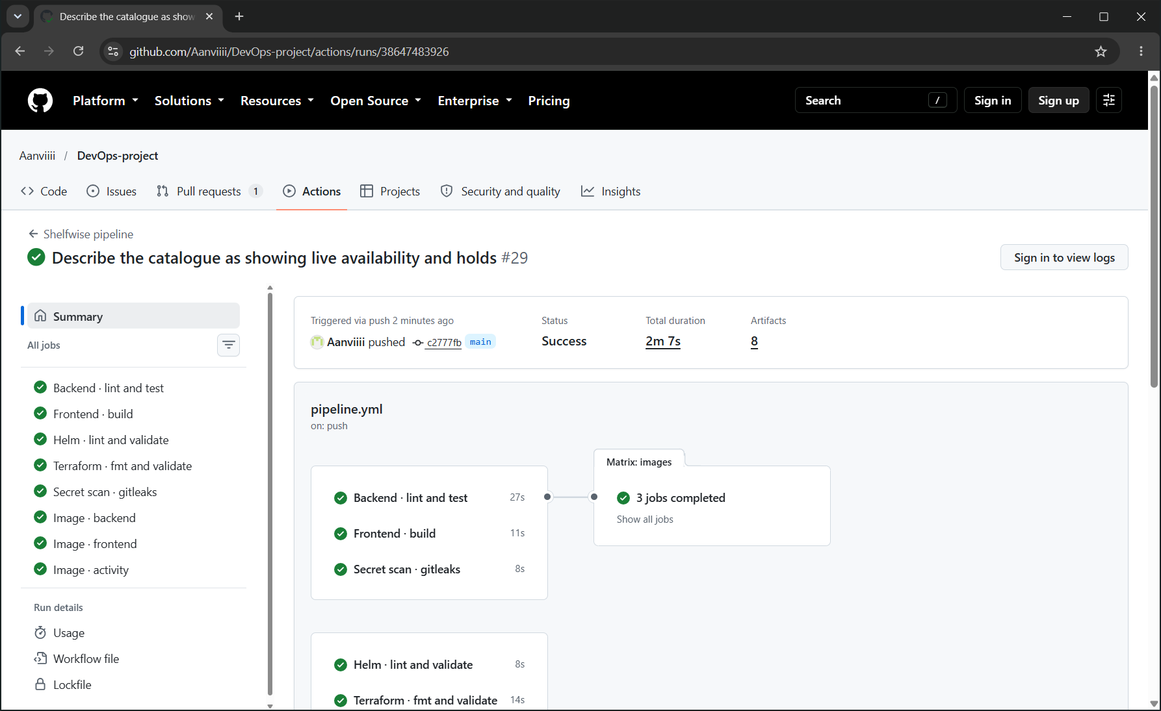
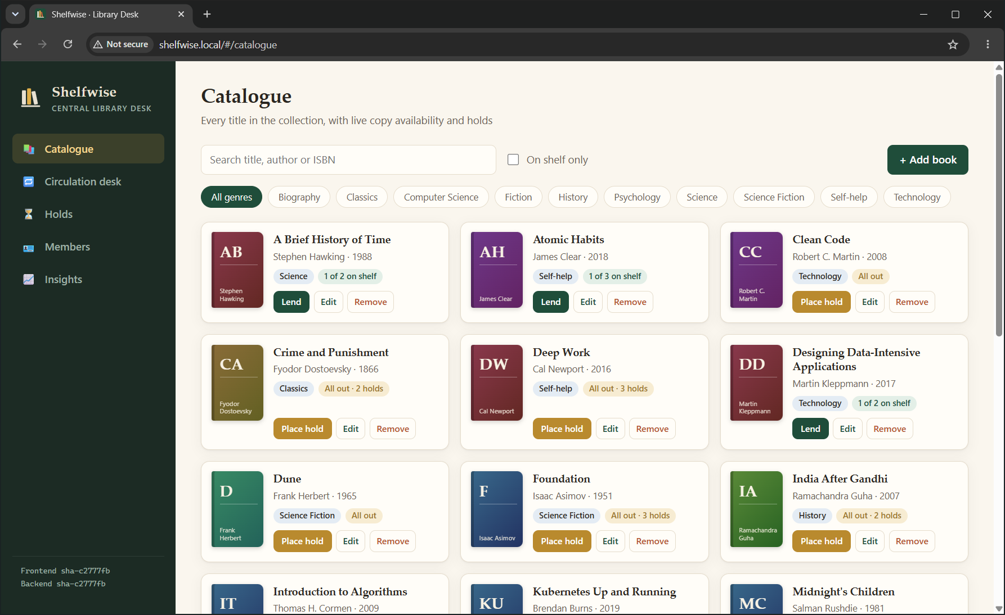
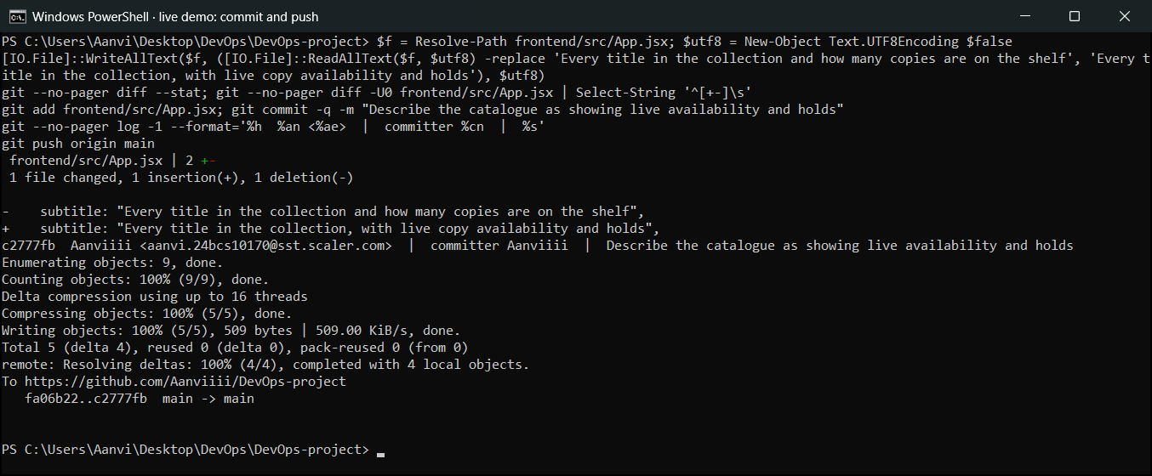
Live demo: one commit, no manual deploy
1 · Commit and push a UI change
2 · Pipeline: test, build, scan, publish
3 · Argo CD rolls out; the page updates
About five minutes from git push to the new version serving traffic. The sidebar and the X-Shelfwise-Version header name the running commit, so every pod traces back to its source.
Notes:
Do it live: edit the sidebar subtitle in VS Code, commit, push, narrate the Actions run, watch Argo CD, refresh the browser.

Slide 9
What I would do next
Move Postgres to Amazon RDS for backups and failover
Replace ingress-nginx with the Gateway API
Add staff login (OIDC) in front of the Ingress
Troubleshooting runbook: troubleshooting/RUNBOOK.md · Evidence: docs/SUBMISSION.md
Notes:
Close by showing the troubleshooting lab if time allows: break the Service selector, find it with endpointslices, fix it.

