Slide 1
Multi-class Resume Classification Framework for Skill Extraction
Anwesha Karmakar

Slide 2
Introduction
Manual processing of resume is time consuming and inefficient
Finding a suitable candidate can be challenging due to vast number of applications
Machine learning can automate the process of skill extraction and classification

Slide 3
Research Question
How can a multi-class resume classification framework be used to accurately extract and predict skills from resumes?

Slide 4
Challenges
Determination of high-level skills such as web developer from low-level skills such as Java, Python etc.
Skills can often be overlapped

Slide 5
Objectives
Investigate the state of the art broadly around skill extraction and resume classification.
To propose and design a multi-class resume classification framework for extracting skills from resumes
To implement the framework for classifying the skills in 10 classes
To evaluate the performance using accuracy and precision

Slide 6
Previous works
Word embedding and CNN models have been used by past researchers
However, application of transfer learning is not widely researched for skill extraction and classification

Slide 7
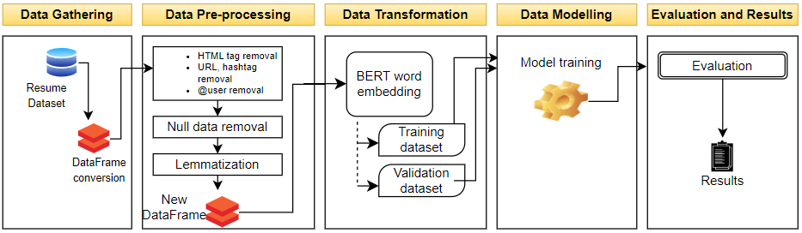
Methodology
Data gathering
Data pre-processing
Data transformation
Data modelling
Evaluation and results

Slide 8
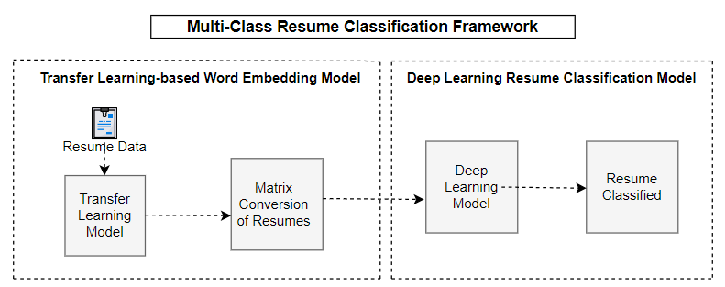
Design of Classification Framework
Transfer learning-based
word embedding model
Deep learning resume
classification Model

Slide 9
Transfer Learning-based Word Embedding
BERT base uncased is used for word embedding
Textual inputs are tokenized using BERT tokenizer
Advantage:
Uses pre-trained knowledge of Wikipedia data
Better contextual meaning extraction

Slide 10
Deep Learning Resume Classification Model
Bidirectional LSTM model is used
Multiple dense layers
Two dropout layers
One flatten layer
Softmax activation function

Slide 11
Dataset
Dataset contains 29,783 text resumes and their corresponding labels
10 different IT skills are present in the data
Obtained from GitHub public repository

Slide 12
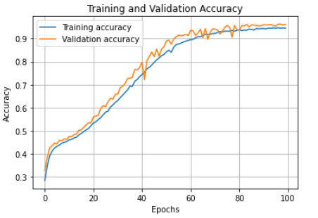
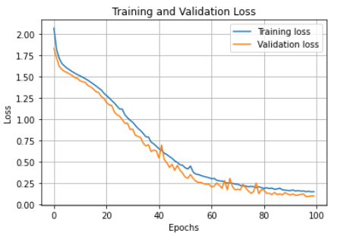
Training Strategy
Epochs: 100
Loss function: Categorical cross entropy
Adam optimizer to reduce loss function
Batch size: 16 (default)
Training samples: 80% of data
Validation samples: rest 20%

Slide 13
Model Optimization
Adam optimizer was used for fine tuning
Learning rate of 0.00000753 was found suitable

Slide 14

Evaluation
Accuracy
Loss function
Precision
Sensitivity
Specificity

Slide 15
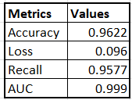
Results
The proposed model achieved 96.18% validation accuracy
The validation loss obtained was 0.096
Mean sensitivity and specificity obtained was 99% and 96% respectively
It outperforms existing methods in terms of accuracy.

Slide 16
Conclusion
The research shows that the combined technique of transfer learning and deep learning performed better than previous works in classifying resumes.
Promising accuracy, precision, recall or sensitivity, specificity
This work has the potential to improve recruitment process

Slide 17




Thank you

