Slide 1
Agenda
Problem Statement
Objective and Dataset Source
Dashboard
Insights
Recommendation

Slide 2
Problem Statement Mitron Bank is a legacy financial institution headquartered in Hyderabad. They want to introduce a new line of credit cards, aiming to broaden its product offerings and reach in the financial market. Strategy director of Mitron Bank, Mr Bashnir Rover asked Peter Pandey ,a data analyst at AtliQ Data Services to provide valueable insights from datasets of 4000 customers across five cities on their online spend and other details.

Slide 3
Objective The objective of this problem statement is to outline the specific challenge and goal of the project, which is to analyze the dataset provided by Mitron Bank in order to provide actionable, data-driven recommendations for tailoring the new line of credit cards to customer needs and market trends. Dataset Data Source: Taken dataset from Codebasic resume project challenge. Data Quality: Clear and concise

Slide 4
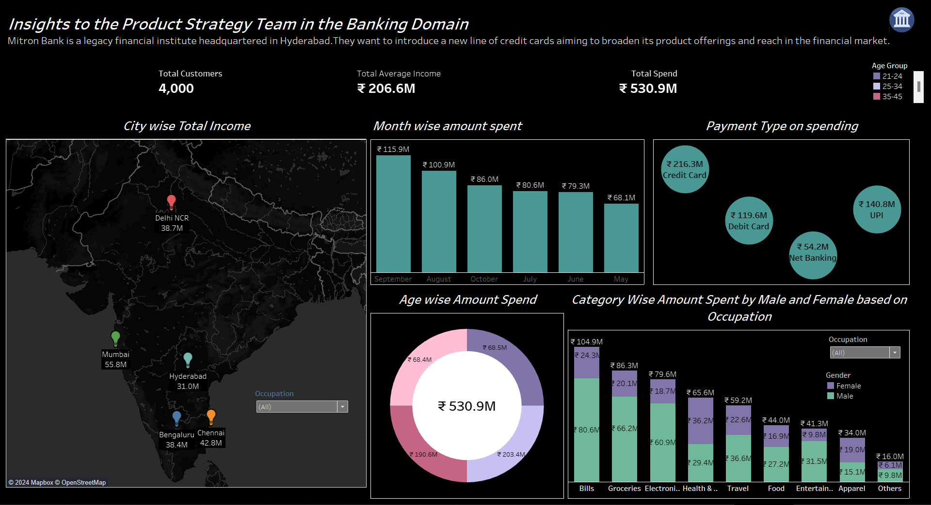
My Viz Dashboard link: https://public.tableau.com/app/profile/aanya.rathi/viz/codebasics_17034254785150/Dashboard5?publish=yes Screenshots of Viz Dashboard: I am adding screenshots of my visualization dashboard in case you find overlapping or distorted content when viewing on your device.

Slide 5
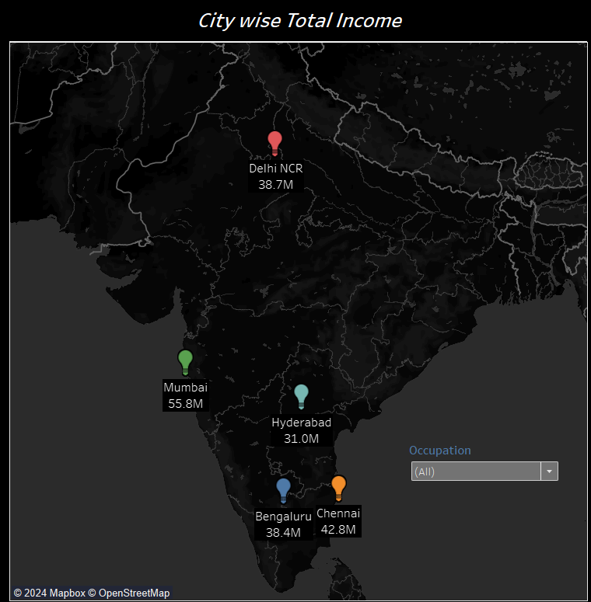
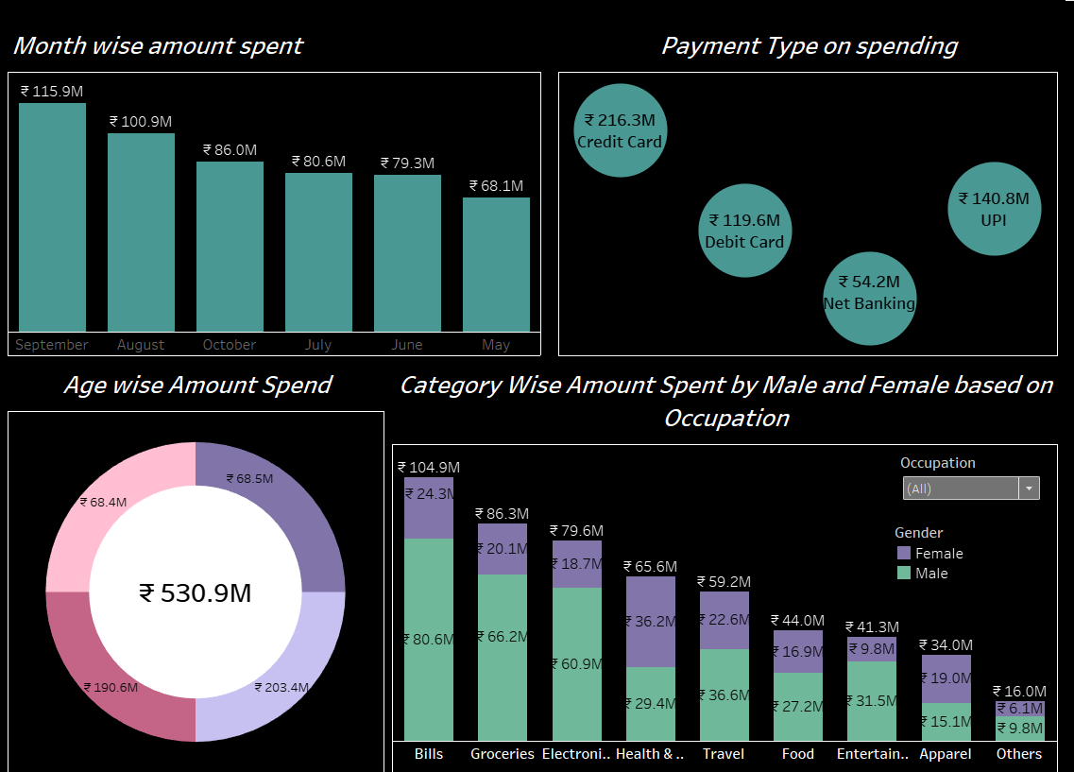

Slide 6
Insights
There are total 4000 customers across five different cities.
Among four different methods of payment , the highest transaction done by credit card.
Men spent more amount than the amount spent by female.
Bills, Groceries, Electronics are the top three categories with the highest money spent.
The highest amount spent in the month of September and August and less amount spent in the month may, June and July.
People of the age group 25-34 spend the most and people of age 45+ are the least spender.
Salaried IT employee have the highest income and also spend the most while government employee have the least income and spend less.

Slide 7
Recommendation
Design a rewards program that aligns with customer spending behaviour. Offer bonus points or cashback in categories where customers spend the most like bills, groceries, electronics etc.
Customer spend less in the month of may, June contrary to the fact that people generally have vacations on these months so providing discounts on tour packages will be beneficial.
Offer flexible payment options that align with customers cash floe and spending behavior. This could include customizable payment due dates, installment plans for large purchases, and the ability to link the credit card with various payment platforms.

