Slide 1
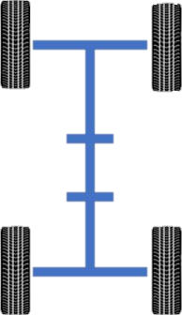
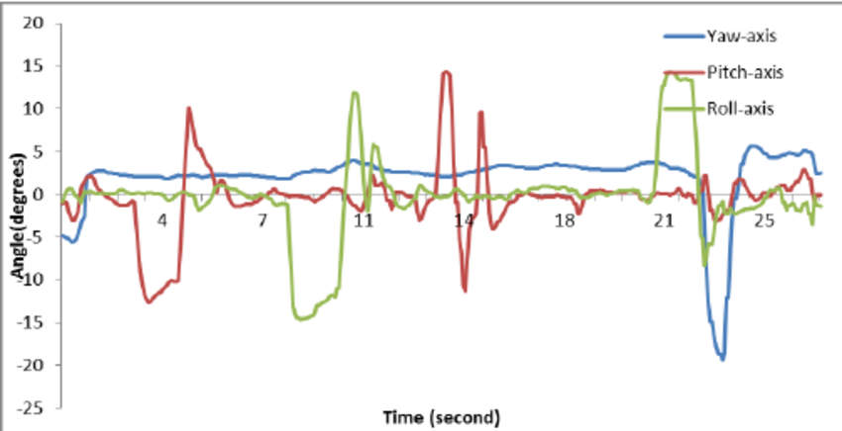
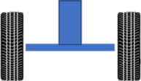

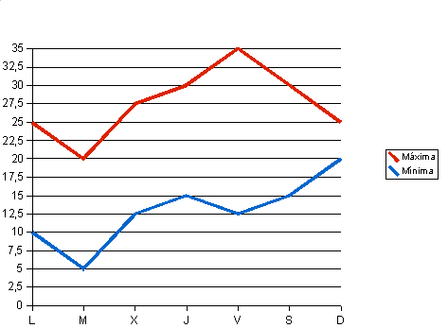
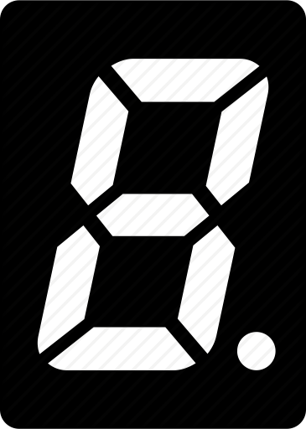
Telemetry2020 – by Aaron Perez Ontiveros
Roll
Pitch
Yaw
Flexing points
°C
%
Camera
Light
Camera controller
Camera view angle
Date and Time

