Slide 1
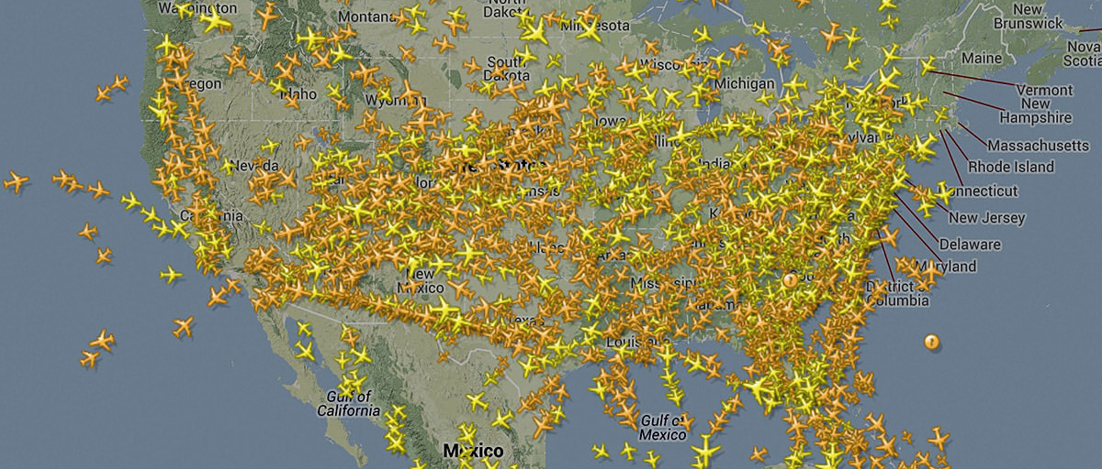

Cleaning Data in SQL Server
This Photo by Unknown author is licensed under CC BY-NC-ND.
Cleaning data fetched from various datasets.
This Photo by Unknown author is licensed under CC BY-SA-NC.

Slide 2
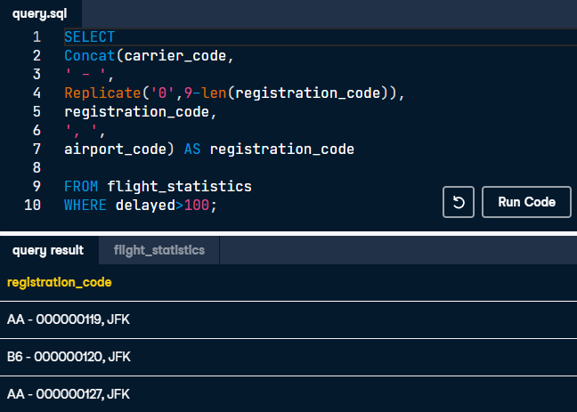
Unifying flight name formats using Replicate()
You need to get every register with more than 100 delays from the flight_statistics table. In a unique column, you have to concatenate the carrier_code, registration_code, and airport_code, having a similar format to this one: "AA - 000000119, JFK".

Slide 3
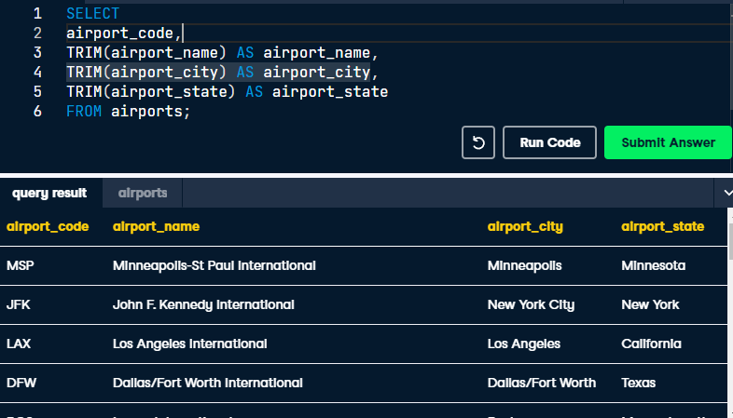
Trim() strings
Examine the content of the airports table, and use the appropriate function to remove the leading and trailing spaces.

Slide 4
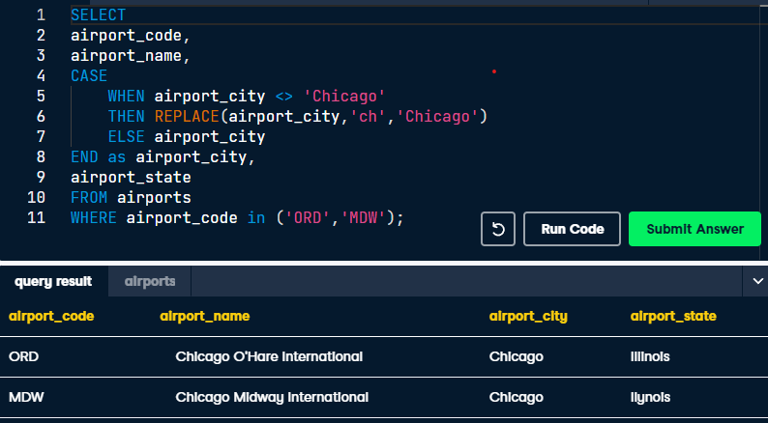
Unifying name formats with Case(),Replace()
There are inconsistent values for 'Chicago' in the airport_city column, with values such as 'ch'. You will treat these inconsistent values by replacing them.

Slide 5
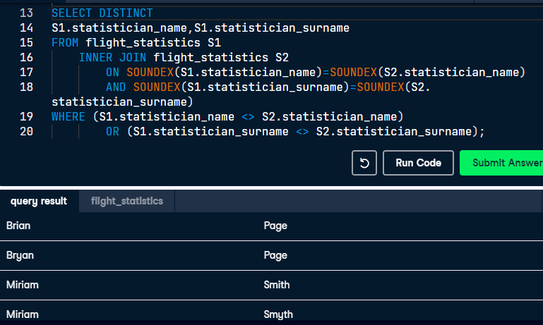
Comparing names with SOUNDEX()
Some statistician_name and statistician_surname are written in a different way, such as Miriam Smith and Myriam Smyth. You think about comparing with SOUNDEX() the names of the statisticians. If the result of SOUNDEX() is the same, but the texts you are comparing are different, you will find the data you need to clean.

Slide 6
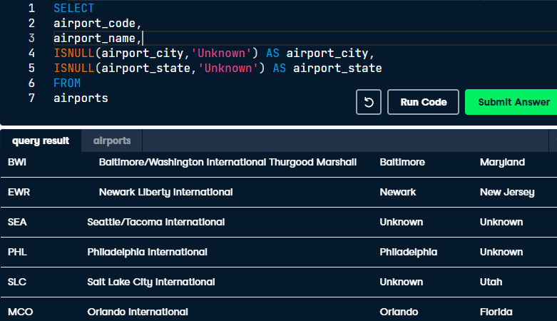
Filling missing values using ISNULL()
Replace the missing values for airport_city and airport_state column with the 'Unknown' string.

Slide 7
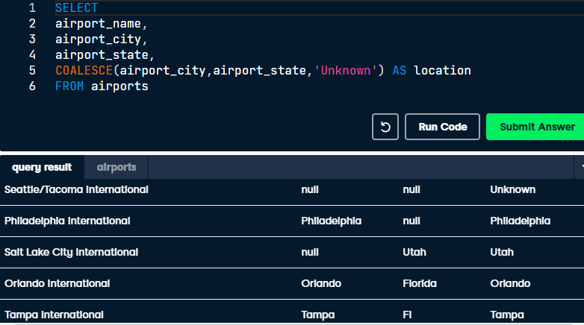
Filling missing values using COALESCE()
Now, you want to create a new column, location, that returns the values of the airport_city column, and in case it has NULL values, return the value of airport_state. Finally, if airport_state is also NULL, you want to return the string 'Unknown'.

Slide 8
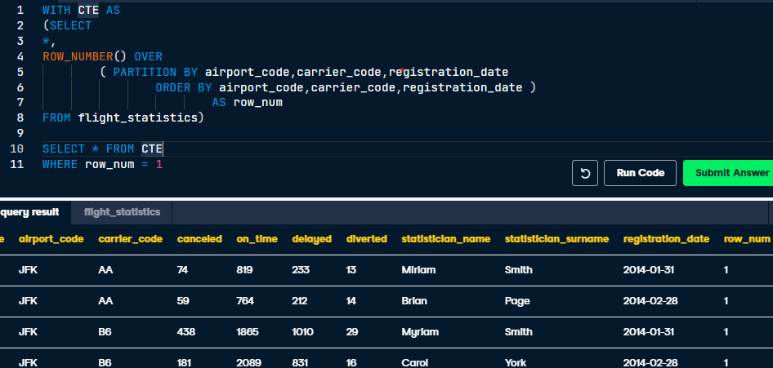
Treating duplicates with Row_number()
Get all the rows without duplicates. You consider that the repeating group for this table is formed by the columns airport_code, carrier_code, and registration_date.

Slide 9
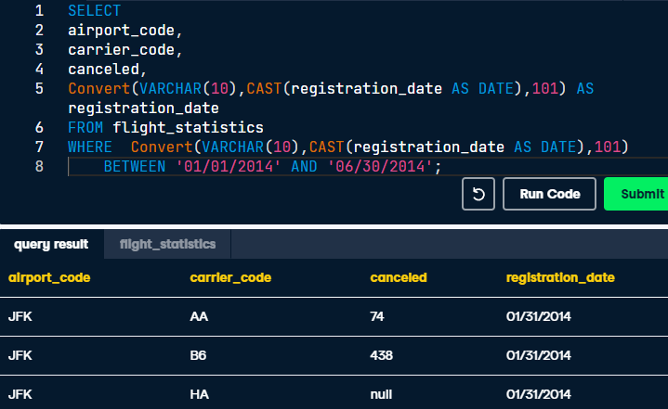
Convert() Dates Format
The format of the registration_date column is yyyy-mm-dd, and you want to show the results in the format of mm/dd/yyyy, which is hardcoded as 101, using the CONVERT() function. Notice that the type of the registration_date column is VARCHAR(10) and not a date.

Slide 10
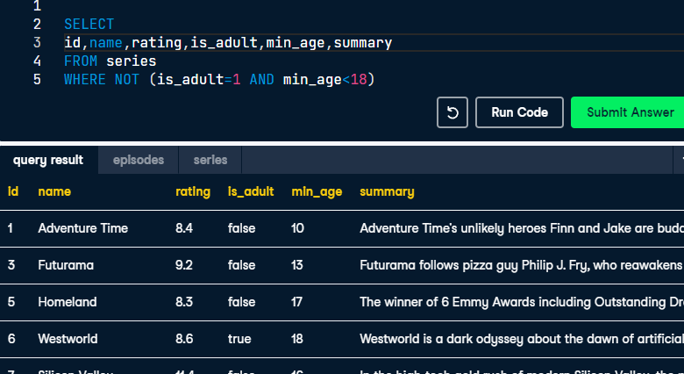
Excluding inaccurate data from a TV Series dataset
In a TV series dataset there are contradictory values, some rows with a TRUE value in its is_adult column have a number smaller than 18 in its min_age column. Can you find these rows with inaccurate data?

Slide 11
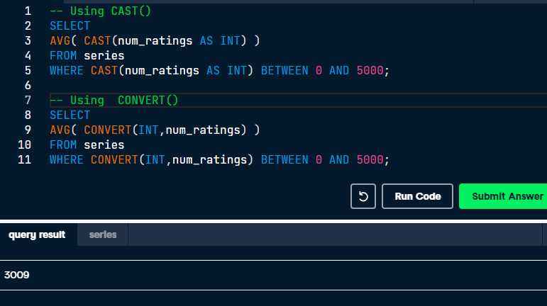
Converting Data Types Using CAST() or CONVERT()
Tables could store data with different types than you want. Sometimes you will need to convert these types to the correct ones to perform the operations you want.
The num_ratings stores integer numbers, but this time it was designed as VARCHAR(5).

Slide 12
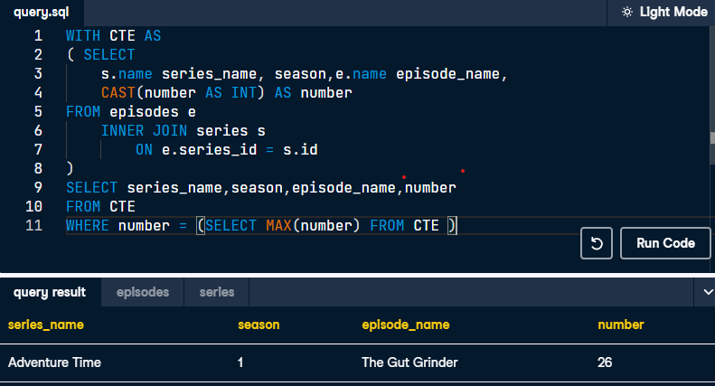
The TV series with most episodes
In the episodes table, there is a column named number. It stores the number of each episode within a season for every series. This column was designed as VARCHAR(5), but it actually stores numbers.
Can you guess which is the series with most episodes within a season?

Slide 13
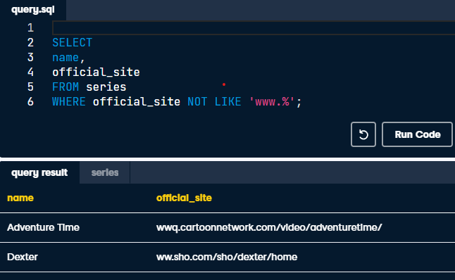
Find Wrong URLs using Like()
Prepare a script that checks every official_site value from the series table to analyze possible wrong URLs (not starting with www.).

Slide 14
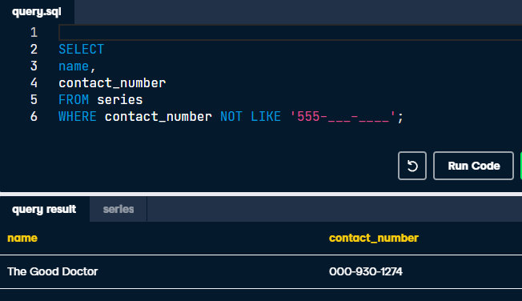
Checking Phone Numbers using Like()
prepare a script that checks every contact_number value from the series table to get those numbers which are not of the format 555-xxx-xxxx.

Slide 15
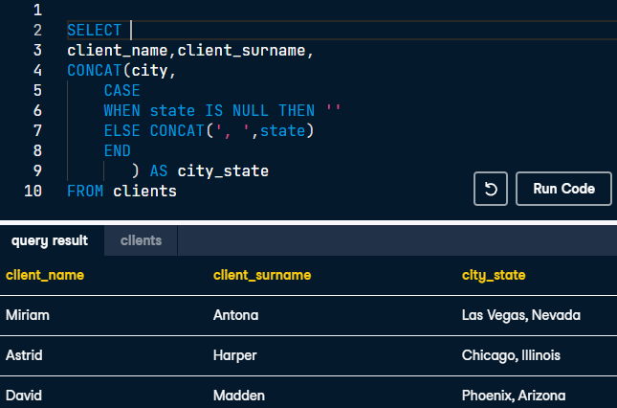
Concatenating cities and states with Concat()
Concatenate the names of the cities with the states using the CONCAT() function, while using a CASE statement that returns blank when state is NULL and performs a normal concatenation otherwise.

Slide 16
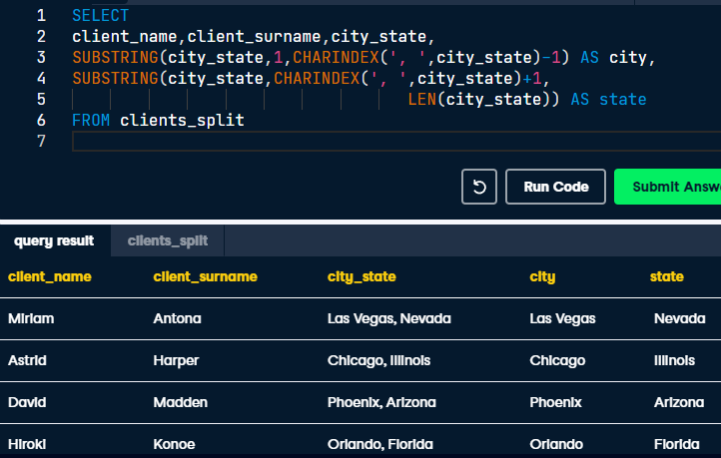
Split Column with Substring( ) and Charindex( )
You need to split this city_state column into two new columns, one for the city and the other one for the state.

Slide 17
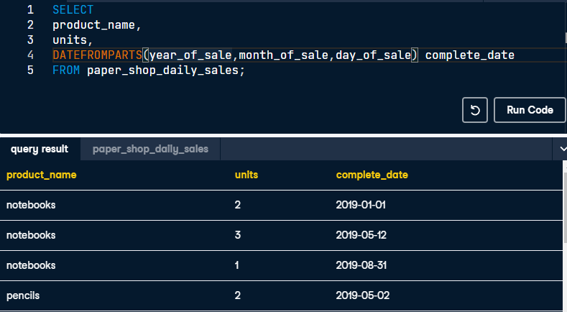
Combine Different Parts of a Date: DATEFROMPARTS( )
Combine the columns, year_of_sale, month_of_sale, and day_of_sale, in the paper_shop_daily_sales table.

Slide 18
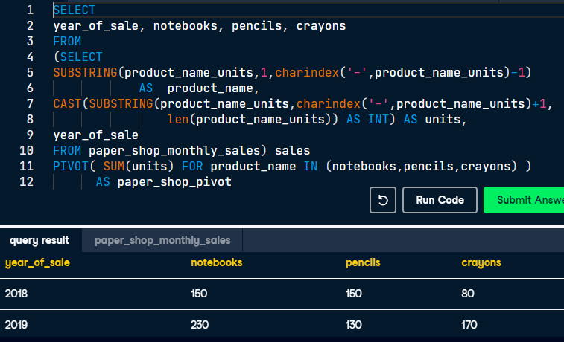
Turning rows into columns: Pivot( )
The structure of the table paper_shop_monthly_sales is not appropriate for the report. You want to generate a report with this appearance:
|year_of_sale|notebooks|pencils|crayons| |------------|---------|-------|-------| | 2018 | 150 | 150 | 80 | | 2019 | 230 | 130 | 170 |

Slide 19
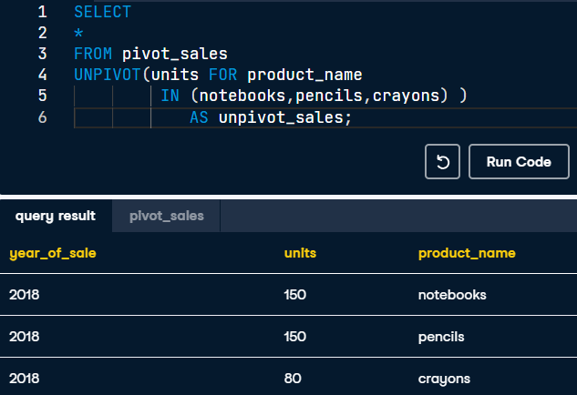
Turning columns into rows: Unpivot( )
Suppose you stored the result from the previous exercise in a new table called pivot_sales, and now you want to turn the columns notebooks, pencils, and crayons into row values.

