Slide 1
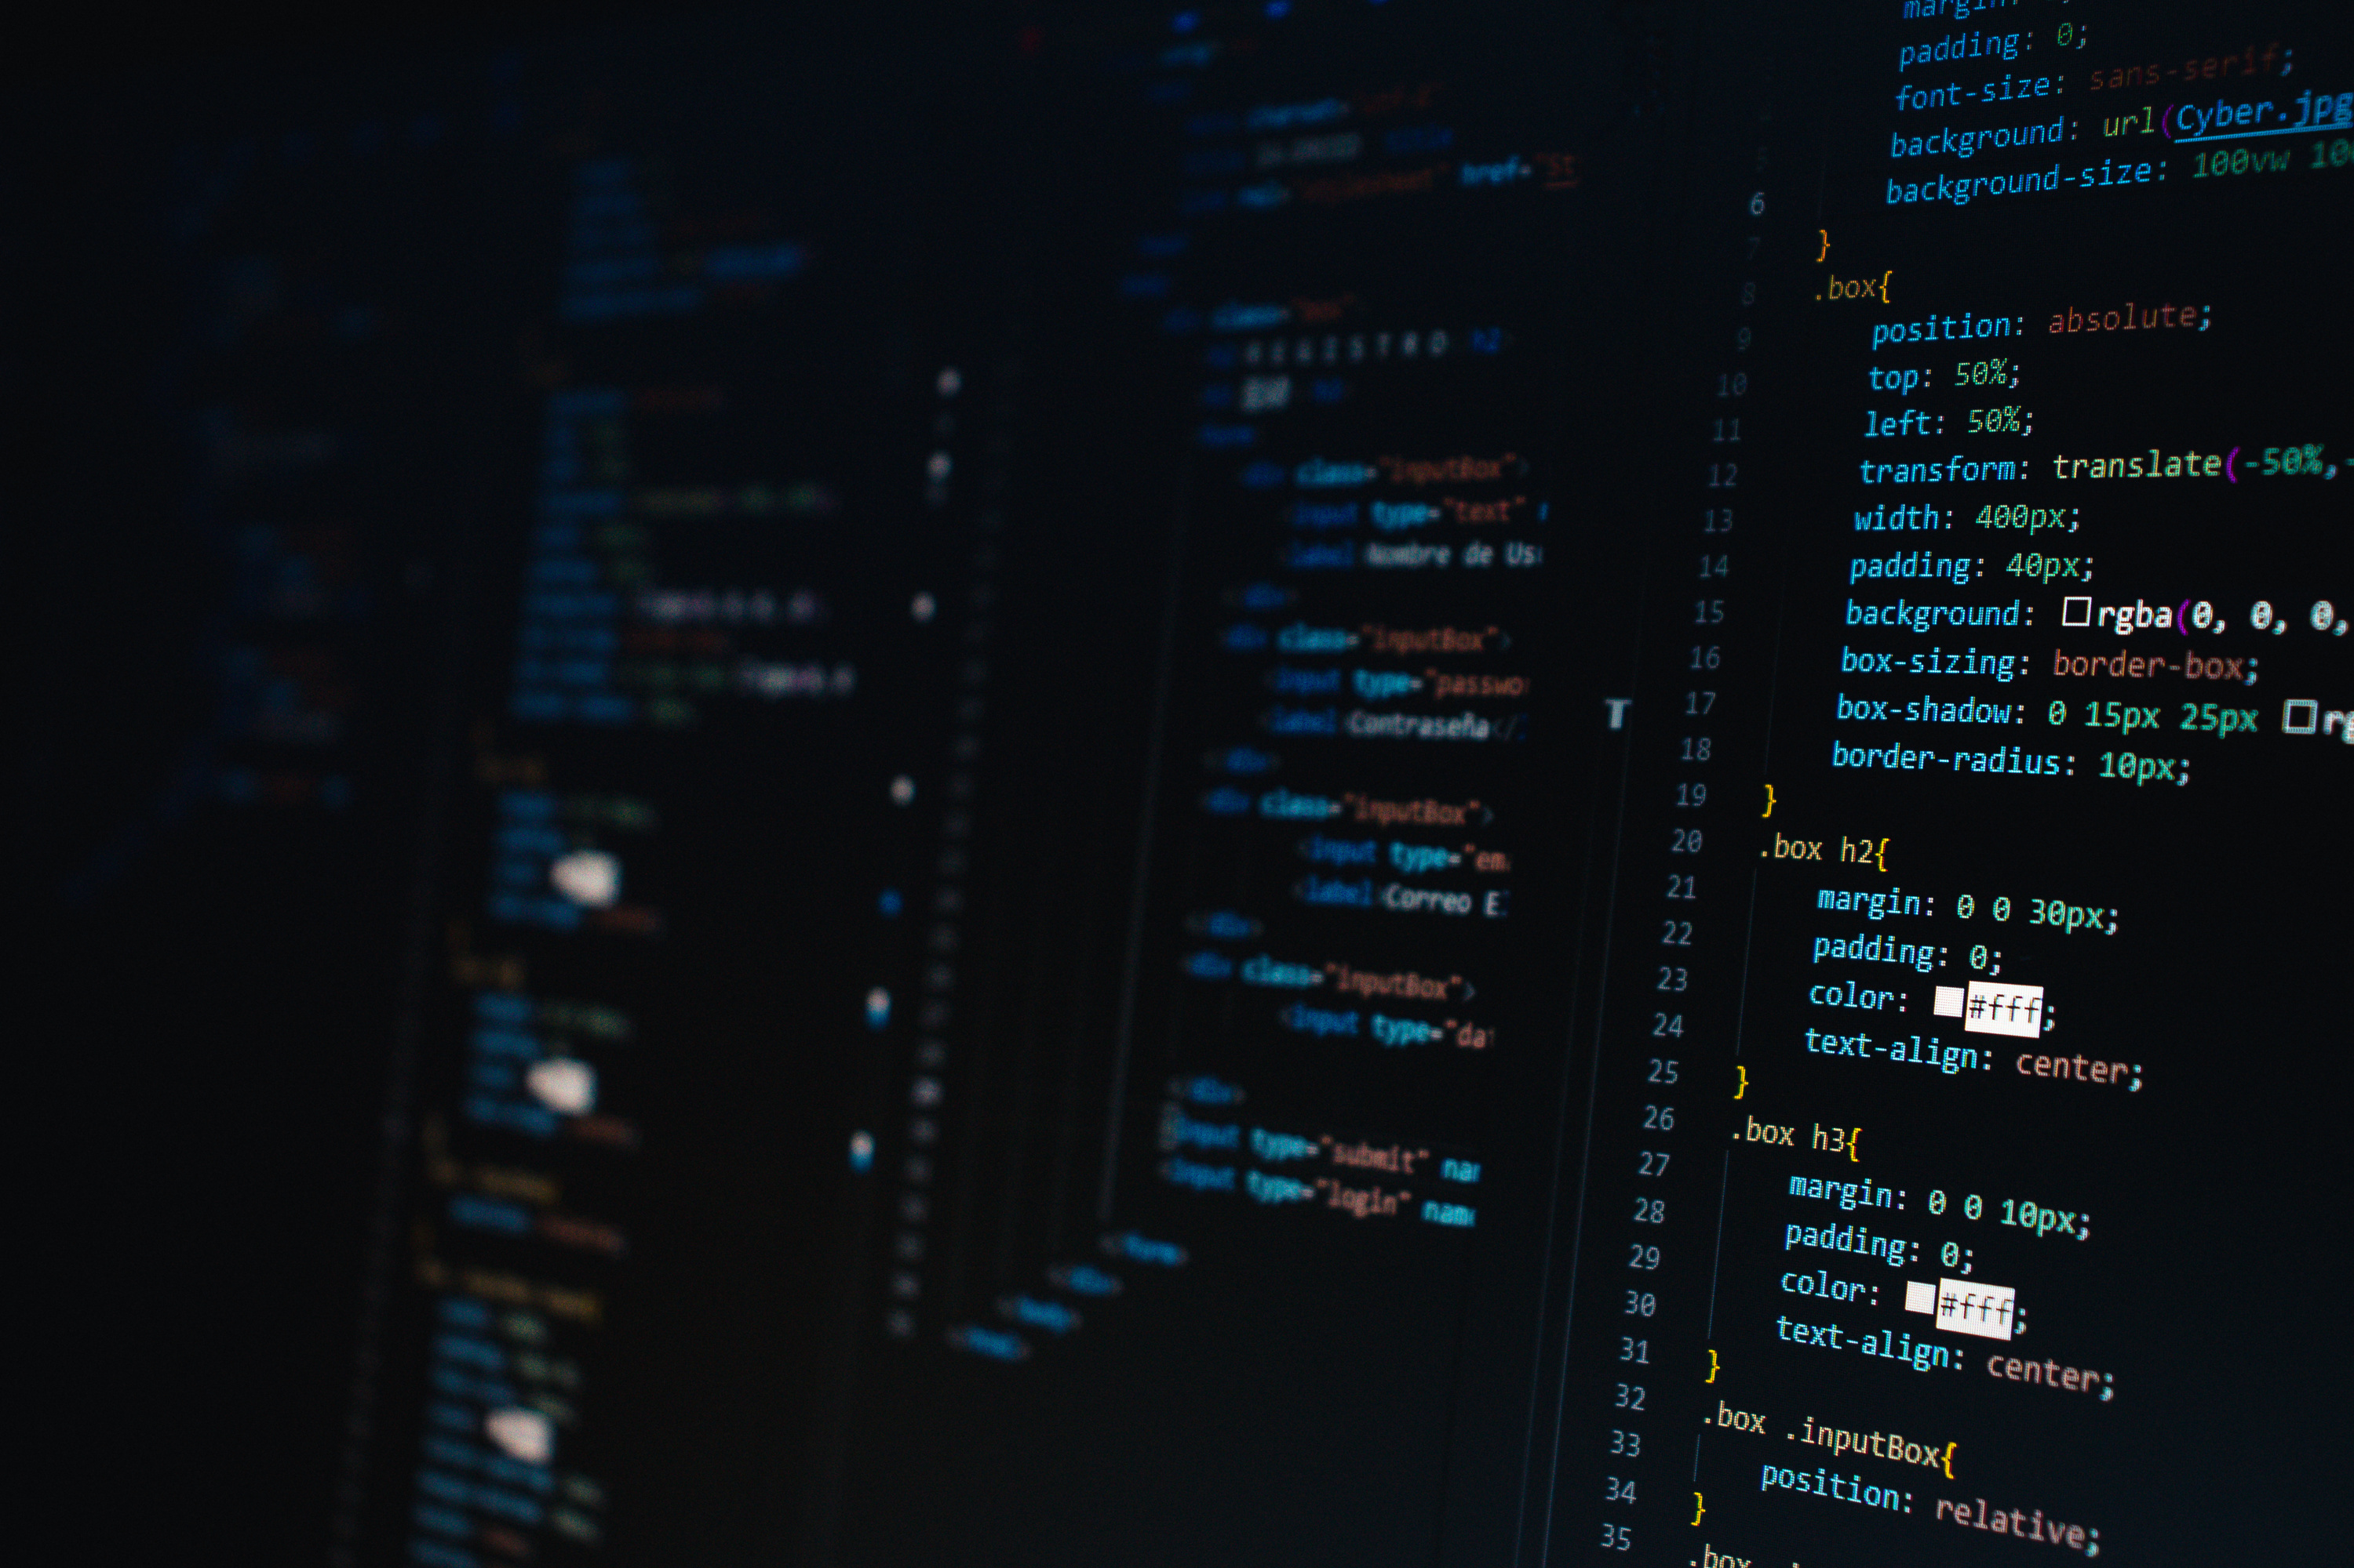
SLIIT 2ND YEAR 2ND SEMESTER
Introduction to Cyber Security (IE2092)
DEEPFAKE TECHNOLOGY
AS A CYBERSECURITY THREAT
Exploring AI-driven synthetic media as an emerging cybersecurity challenge
H.M.Aaqib | IT24102514

Slide 2
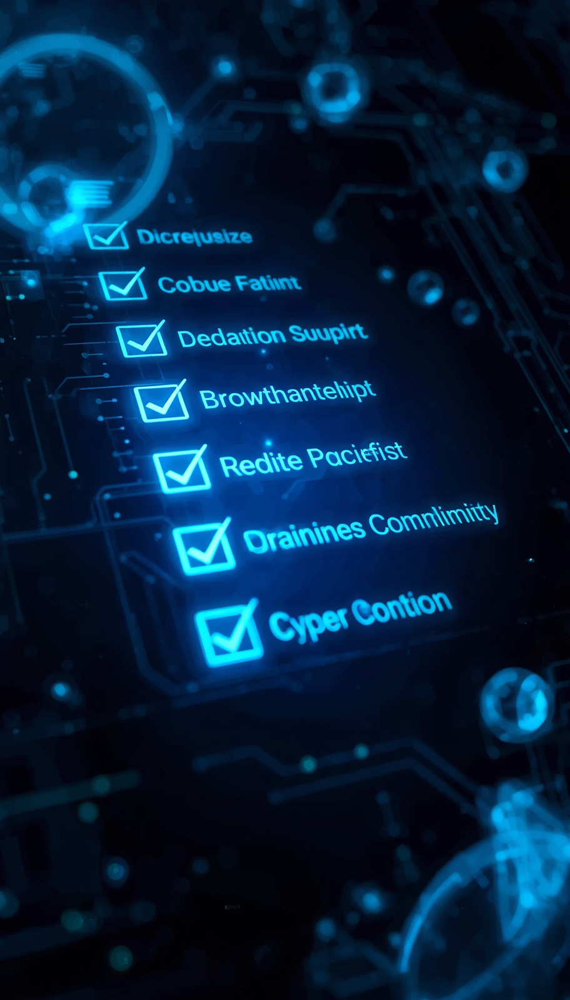
DEEPFAKE TECHNOLOGY
IE2092 CYBER SECURITY
01
Presentation Overview
AGENDA
• Abstract Overview
• Introduction to Deepfakes
• Evolution Timeline 2014-2025
02
• GAN Origins and Consumer Access
• Corporate Fraud and Voice Cloning
• Multimodal Deepfakes
• Contemporary Threat Landscape
• Future Developments
• Conclusion and Recommendations

Slide 3
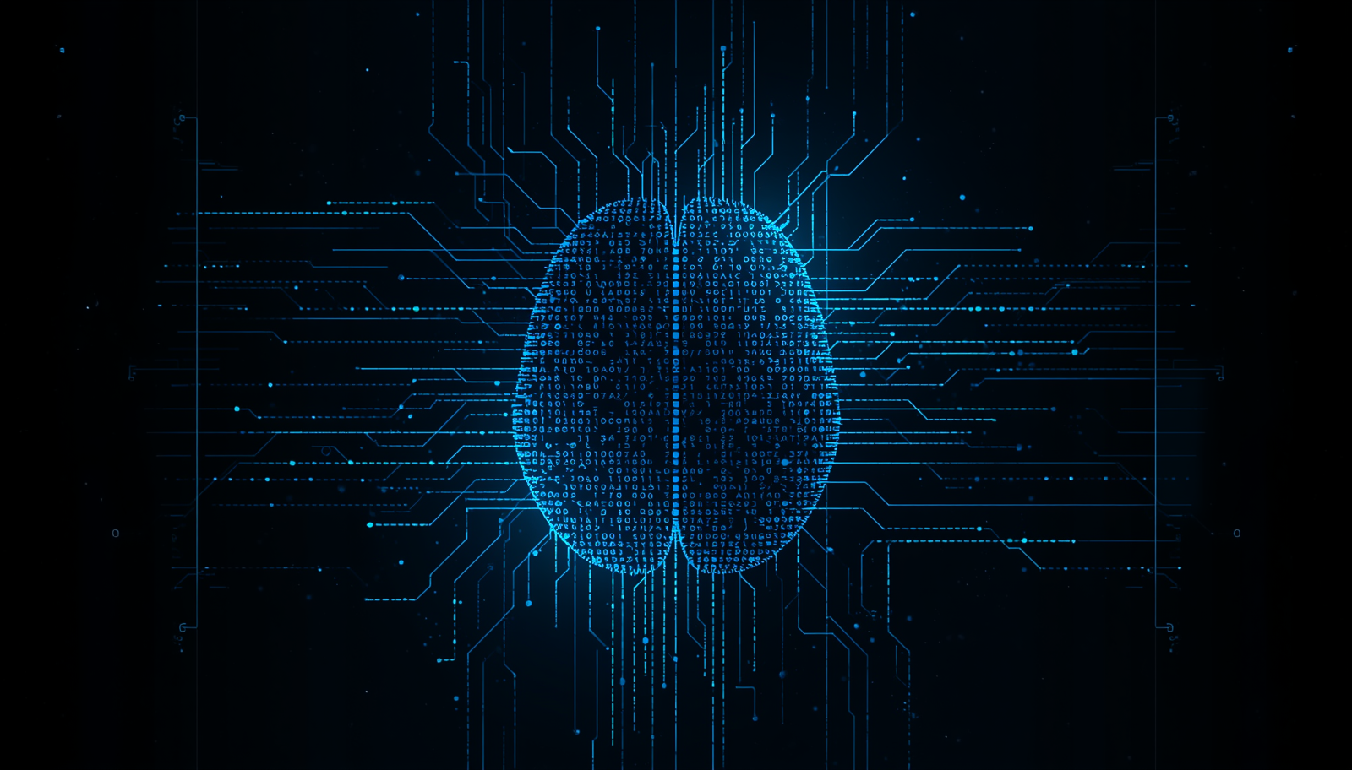
DEEPFAKE TECHNOLOGY AS A CYBERSECURITY THREAT
IE2092 CYBER SECURITY
Key Themes Summary
ABSTRACT OVERVIEW
01
02
AI-driven deepfakes evolved from research novelty to major cybersecurity threat
GANs enable hyper-realistic synthetic media manipulation

Slide 4
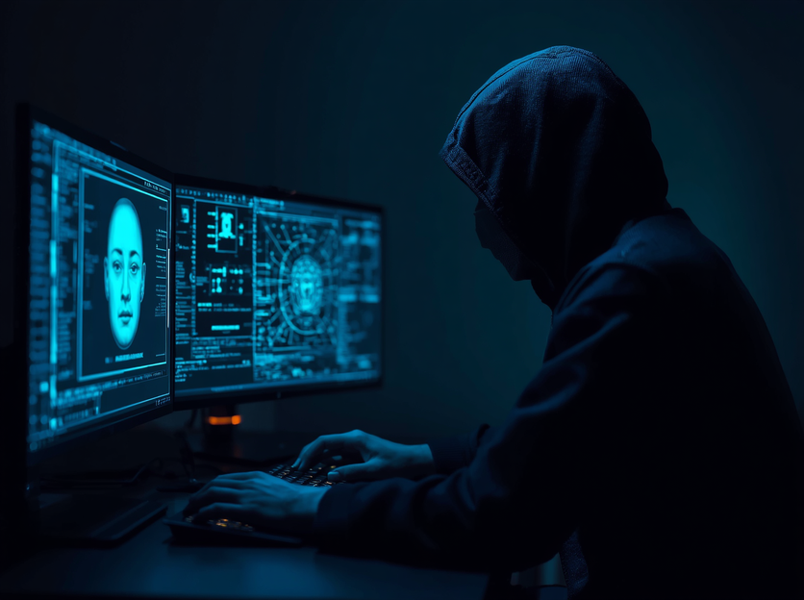
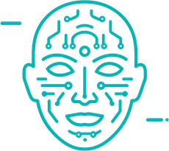
DEEPFAKE TECHNOLOGY AS A CYBERSECURITY THREAT
IE2092 CYBER SECURITY
Introduction – Defining the Threat
WHAT ARE DEEPFAKES?
• Deepfake = deep learning + fake AI-generated synthetic media
• Exploits human perception and trust in audiovisual content
• 900% growth in deepfake videos between 2018 and 2020
• Consequences: financial fraud, political manipulation, trust erosion
• Social engineering attacks bypass traditional security measures
INTRODUCTION TO THE EMERGING DIGITAL THREAT

Slide 5

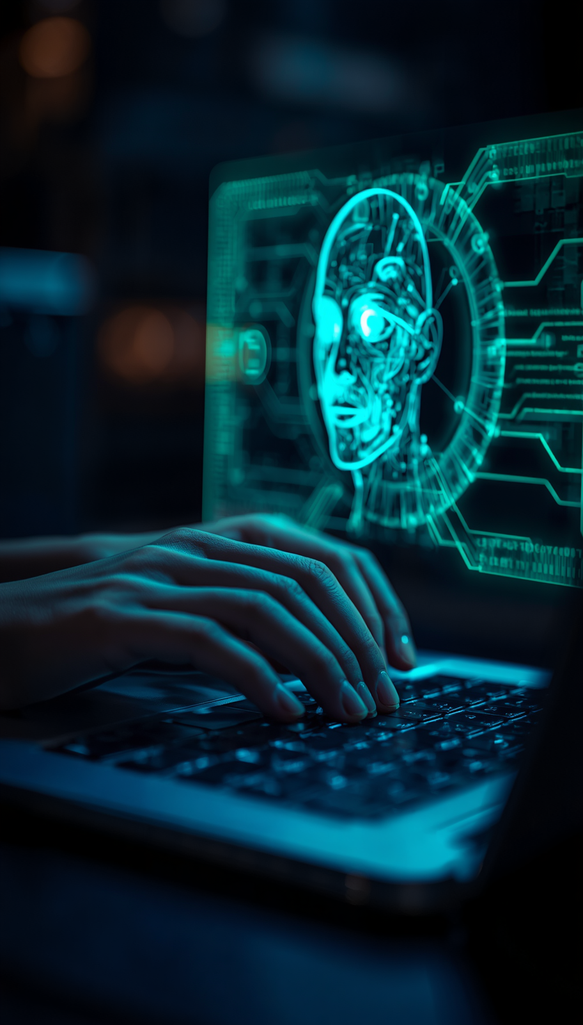
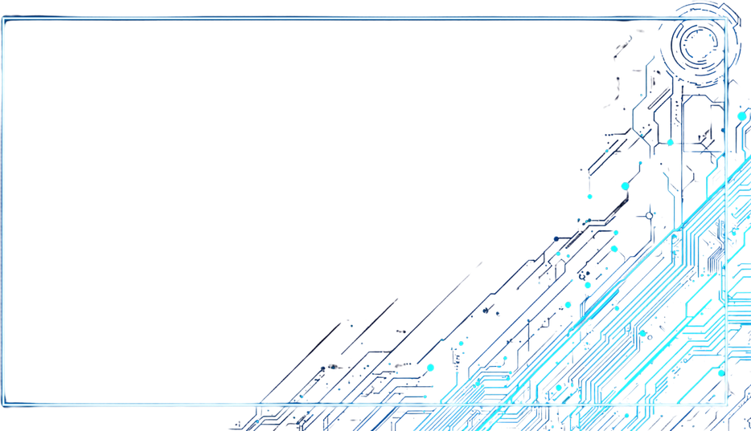
DEEPFAKE EVOLUTION
IE2092 CYBER SECURITY
From Research to Global Threat
EVOLUTION TIMELINE 2014-2025
• 2014-2017: Academic Origins – GAN architecture introduced
• 2017-2019: Consumer Access – DeepFaceLab, FaceSwap tools
• 2019-2021: Corporate Fraud – Voice cloning, €220k loss
• 2021-2023: Multimodal Deepfakes – $25M Hong Kong fraud
• 2023-2025: Contemporary Threat – DaaS, state-sponsored ops

Slide 6
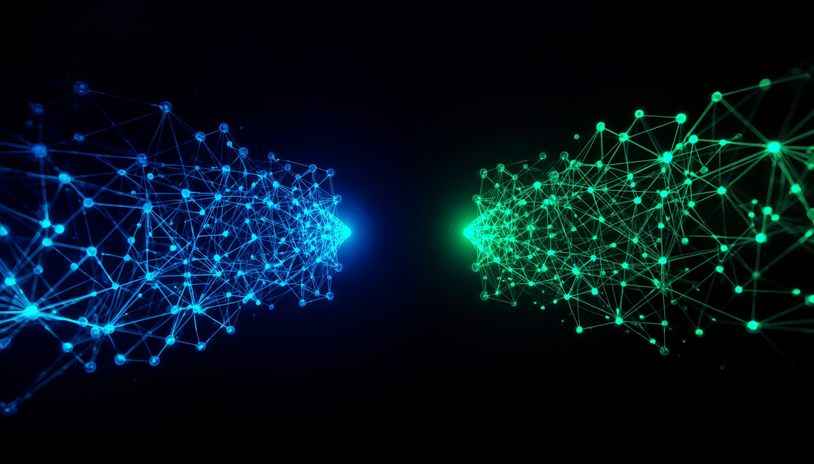

DEEPFAKE TECHNOLOGY
2014-2019
The Democratization of Deepfake Technology
GAN ORIGINS & CONSUMER ACCESS
GAN ARCHITECTURE
• 2014: Ian Goodfellow introduces Generative Adversarial Networks
• Generator and discriminator networks compete adversarially
• 2017: DeepFaceLab and FaceSwap tools released publicly
• 96% of 2019 deepfakes were non-consensual intimate imagery
• Democratization lowered barriers for malicious actors

Slide 7

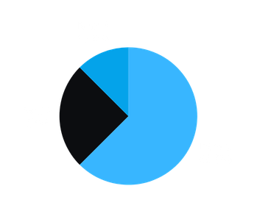
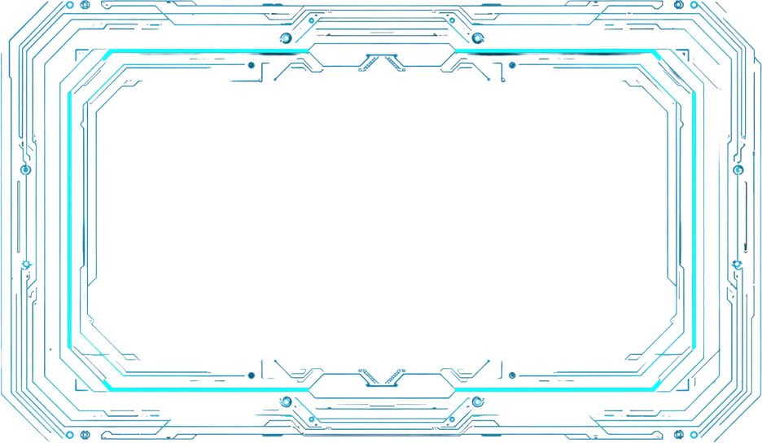
DEEPFAKE TECHNOLOGY AS A CYBERSECURITY THREAT
IE2092 CYBER SECURITY
The Rise of AI-Powered Fraud
CORPORATE FRAUD AND VOICE CLONING (2019-2021)
• 2019: UK energy firm loses €220,000 via AI voice cloning
• CEO voice impersonated in real-time phone call
• Business Email Compromise integrates deepfake videos
• FBI reports $1.8 billion BEC losses in 2020
• Political disinformation campaigns target elections globally

Slide 8
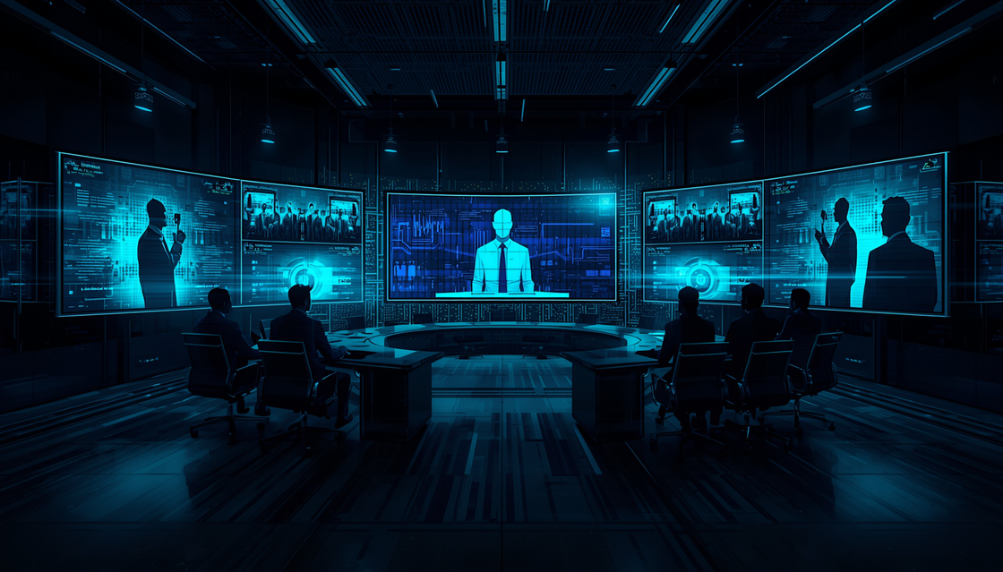
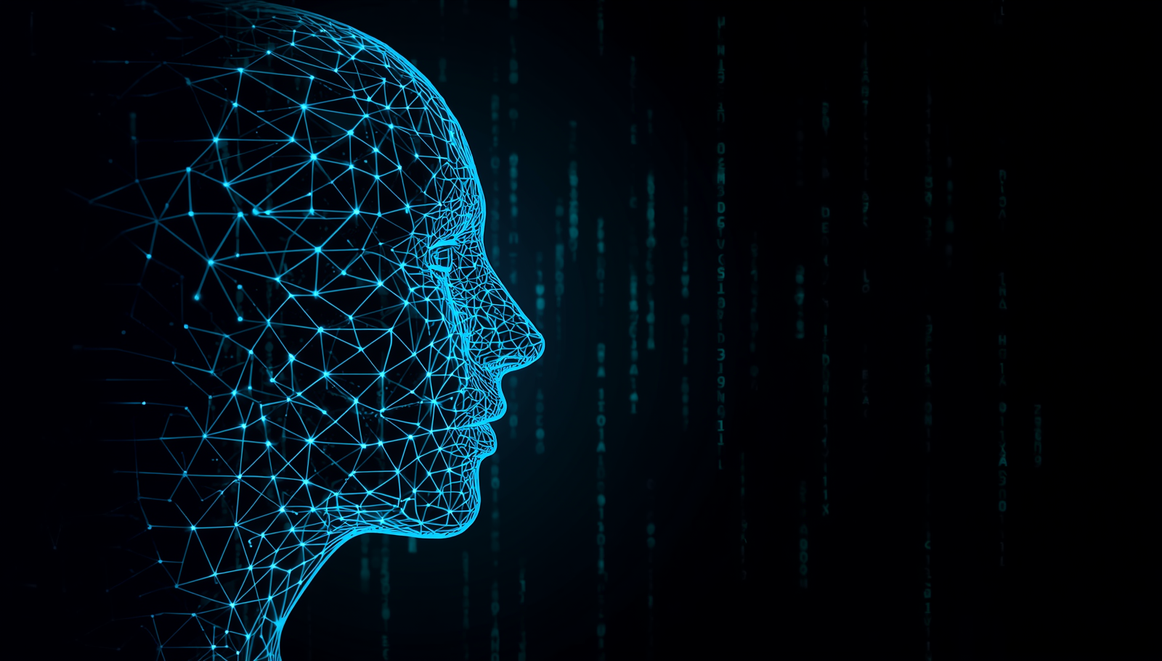
DEEPFAKE TECHNOLOGY AS A CYBERSECURITY THREAT
IE2092 CYBER SECURITY
$25M Hong Kong Fraud Case
MULTIMODAL DEEPFAKES (2021-2023)
INTEGRATED AI MANIPULATION AT SCALE
• Face, voice, body language manipulated simultaneously
• Diffusion models create coherent synthetic narratives
• Employee deceived by AI-generated video conference
• All participants including CFO were deepfake personas
• 15 fraudulent transfers authorized
• Deepfake-as-a-Service platforms emerge on dark web

Slide 9
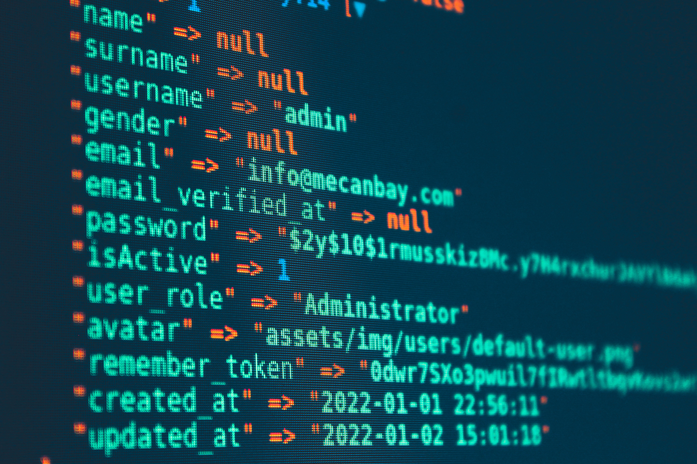
DEEPFAKE THREATS
IE2092 CYBER SECURITY
Attack Vectors Expanding Rapidly
CONTEMPORARY THREAT LANDSCAPE (2023-2025)
09
10
• Text-to-video synthesis (OpenAI Sora) enables realistic generation
• Synthetic identity attacks bypass KYC verification
• AI phishing and bot networks converge
• State-sponsored disinformation targets elections
• Biometric authentication compromised
• Liveness detection bypassed across jurisdictions

Slide 10
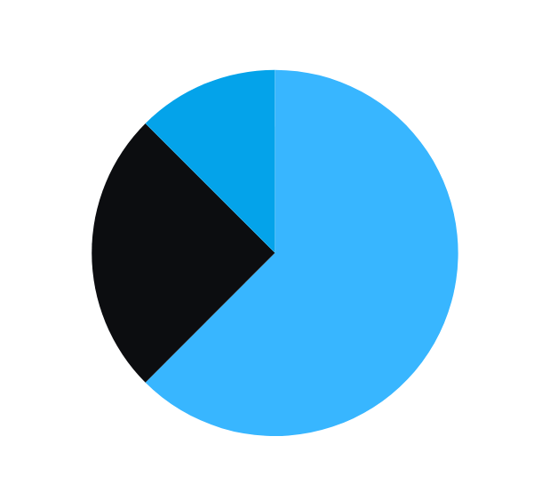
DEEPFAKE TECHNOLOGY
FUTURE DEVELOPMENTS
10
Emerging Threats 2025-2030+
FUTURE DEVELOPMENTS
• Real-time mobile deepfake generation
• Live call fraud capabilities
• AI detection at scale by 2026-2028
• Edge computing expands attack surface
• 2025-2027: Real-time mobile deepfakes enable live call fraud
• 2025-2026: C2PA cryptographic media provenance standards
• 2025+: EU AI Act enforcement requires transparency labeling
• 2030+: Quantum-accelerated generation poses critical threat

Slide 11


DEEPFAKE TE15
CHNOLOGY AS A CYBERSECURITY THREAT
IE2092 CYBER SECURITY
Key Insights and Responses
CONCLUSION AND RECOMMENDATIONS
• Deepfakes evolved from research to operational cybersecurity threat
• Confirmed losses: $25M Hong Kong fraud, €220k UK voice cloning
• Attack sophistication consistently outpaces defensive measures
• Recommendations: AI-driven detection, cryptographic provenance
• Multimodal authentication, legal frameworks, media literacy
11

Slide 12
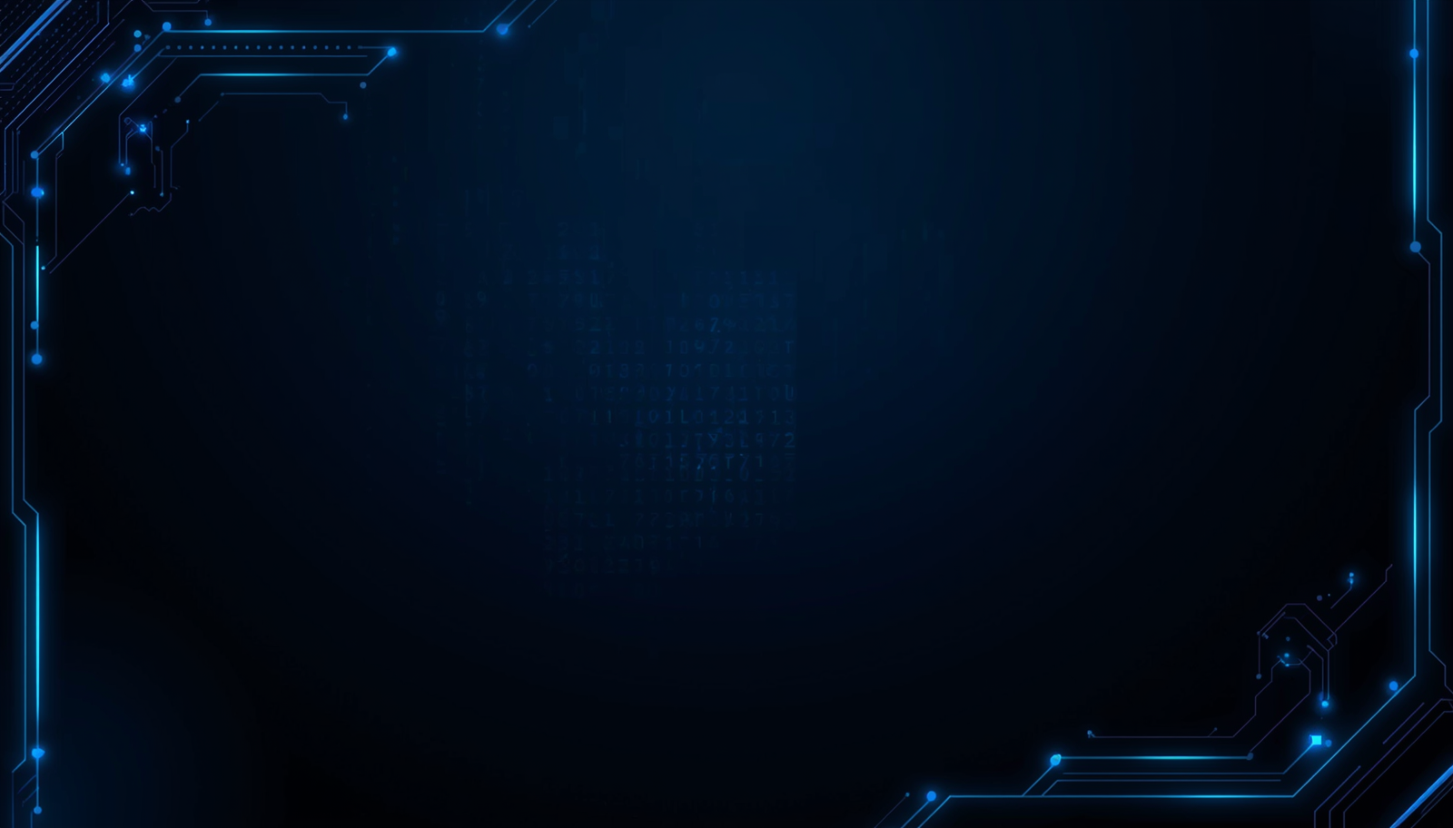
H.M.AAQIB
IT24102514
THANK
YOU

