Slide 1

Case Study
Cyclistic Bike Share
May 24, 2022
Presented by: Aaquib Kudchikar

Slide 2

Contents
Introduction
Data Insights
Summary
Recommendation

Slide 3
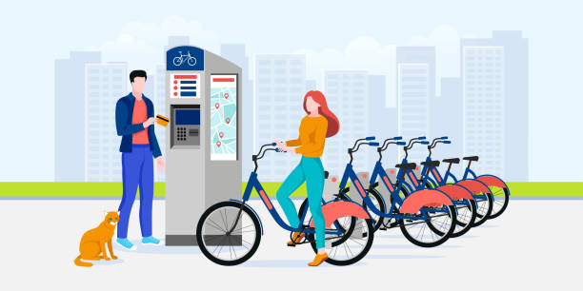
Statement of Business Task
Understand how do annual members and Casual rides use Cyclistic bikes differently.
This comparison along with other tasks will later be used to design marketing strategies aimed at converting casual riders into members.

Slide 4
Insights from Last 12 Months
May 2021 – April 2022
Let’s Dive In …

Slide 5

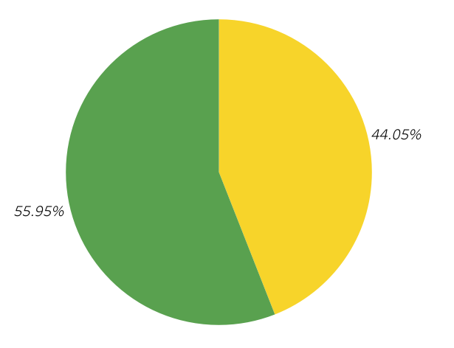
Total Ride Share of Each User Group
# 1
Number of rides taken by Members is 12 % more than rides taken by Casual users.
However . . .
Member - 3221113
Casual - 2536298

Slide 6
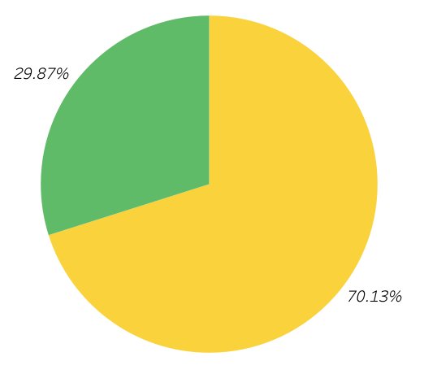
Avg. Duration Ride Share of Each User Group
# 2
Average ride duration Casual Riders is nearly 2.5 times more than Members.
Member - 02:33:03
Casual - 05:59:17

Slide 7
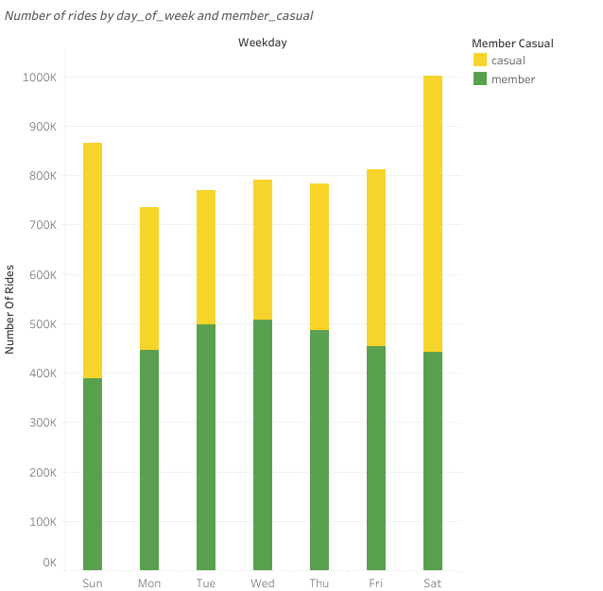
Weekly Breakdown of Number of Rides
# 3
The number of Casual rides are significantly more weekends compared to weekdays

Slide 8
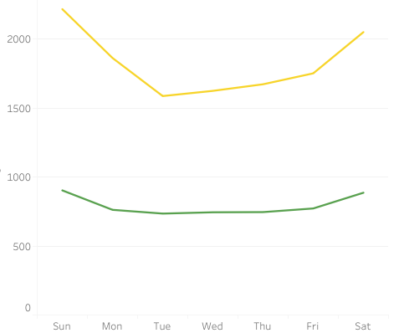
Weekly Breakdown of Average duration of Rides
# 4
Casual rides are riding for more duration on weekends compared to weekdays and 2 Times more than Member riders.

Slide 9
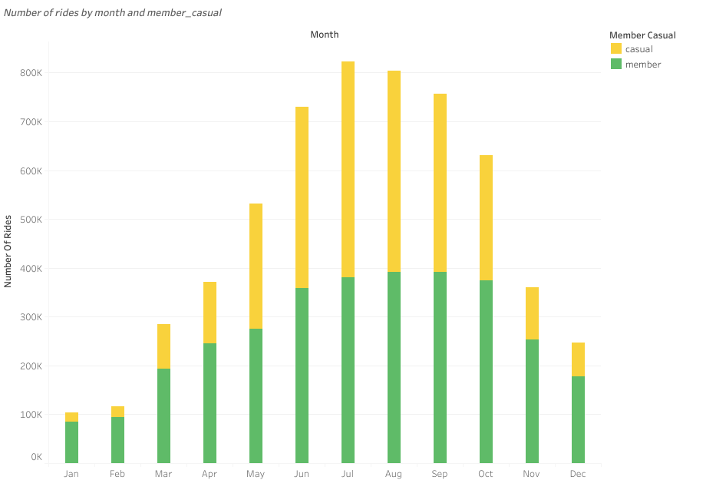
Annual Breakdown of Number of Rides
# 5
Number of rides of casual riders increase and hits its peak on July
and August

Slide 10
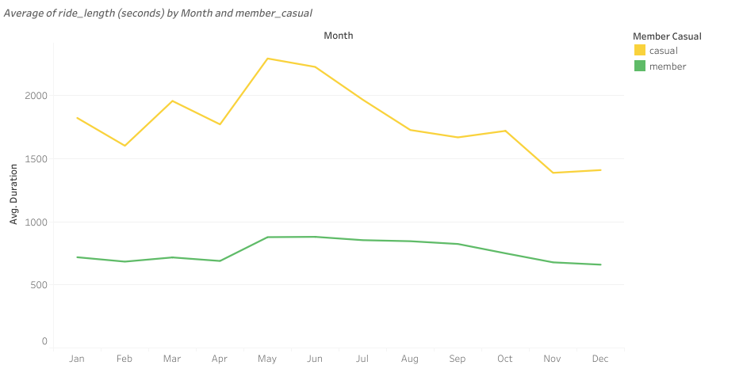
Annual Breakdown of Average Duration of Rides
# 6
Casual Riders dominate the annual average duration by 2 Times than Member riders

Slide 11
Let’s summarize the Insights . . .

Slide 12
Summary
Casual riders are most active on Weekends and tend to take longer rides
Casual riders ride 2 Times longer on Weekends and takes more no of rides than members
Casual riders mostly use bikes for recreational
Unlike members who have consistent activity throughout the year, casual riders use of bikes on weekends and holidays suggests they use them for recreational purposes
Causal riders take longest rides on the months of July August and September
On its peak on July, average ride duration of casual riders is 3x more than members
Overall, Casual riders take less number of rides but for longer durations
Casual riders take 12 % less rides than Members but for 2.5x longer duration.

Slide 13

Recommendations
Now that we know how Casual users use bike share differently, We Can:
Design riding packages by keeping recreational activities, weekend contests, and summer events in mind as more casual riders are inclined towards it.
If customers are charged on duration basis, offer specialized discounts and more longer rides and thus it results in high revenue.
Design seasonal packages, It allows flexibility and encourages casual riders to get membership for specific periods they want rather than paying for annual subscription.
Effective and efficient promotions by targeting casual riders at the busiest times.
Days: Weekends
Months: June, July, August and September

Slide 14




Thank you
Aaquib Kudchikar
Aaquibkudchikar7@gmail.com
github.com/AaquibCodes

