Slide 1

DMA COURSE PROJECT [18ECSC301] NETWORK TRAFFIC ANALYSIS [5DMACP08] Team no : 7A
Name | USN | ROLL NO
Aayush Rajwade | 01FE18BCS005 | 105
Aman Kumar | 01FE18BCS029 | 129
Annapoorna Pattar | 01FE18BCS040 | 140
Ayush Utsav | 01FE18BCS059 | 159

Slide 2
TEAM CONTRIBUTION
1.Literature survey, Understanding of the dataset and problem space. | Aayush Rajwade | Aman Kumar | Annapoorna Pattar | Ayush Utsav
2.EDA | Aayush Rajwade | Aman Kumar | Annapoorna Pattar | Ayush Utsav
3.Data Preprocessing | Aayush Rajwade | Aman Kumar | Annapoorna Pattar | Ayush Utsav
4.Model-1[RF] | Aayush Rajwade | - | - | Ayush Utsav
5.Model-2[KNN] | - | Aman Kumar |  | Ayush Utsav
6.Model-3[LR] | Aayush Rajwade | - | Annapoorna Pattar | -
7.Bias-Variance Tradeoff | Aayush Rajwade[RF] | - | - | Ayush Utsav[KNN, LR]
8.Post Model Analysis | Aayush Rajwade | - | - | Ayush Utsav
- | [Feature Importance] |  |  | [Confusion Matrix]
- | [ROC Curve]

Slide 3
1.PROBLEM STATEMENT
“For the given NetML dataset, prediction of top-level annotation for binary classification of malware.”

Slide 4
2.DATASET DESCRIPTION
The training dataset consists of 387268 rows and 62 columns.
The test dataset consists of 48394 rows and 62 columns.
This 62 columns are the summation of 4 set of features namely – metadata , TLS , DNS and HTTP.
TLS , DNS and HTTP are protocol dependent features whereas metadata features is protocol independent.
Metadata set of features have 32 columns , rest 30 columns belong to protocol based set of features (ie. TLS ,DNS and HTTP).
Each row is identified by a unique id whose o/p label contains binary categorical values : malware and benign , stored in a separate o/p file.
We have 387268 unique ids same as the number of rows.
We will predict this label for the given test data.

Slide 5
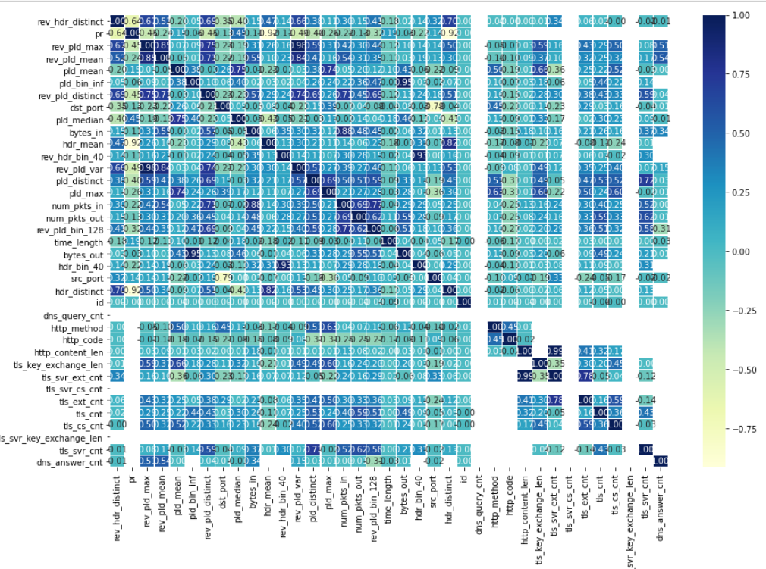
3.EXPLORATORY DATA ANALYSIS
Figure 3.1
Heat map of the Correlation matrix

Slide 6
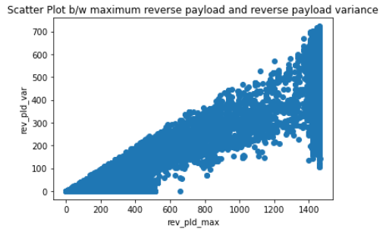
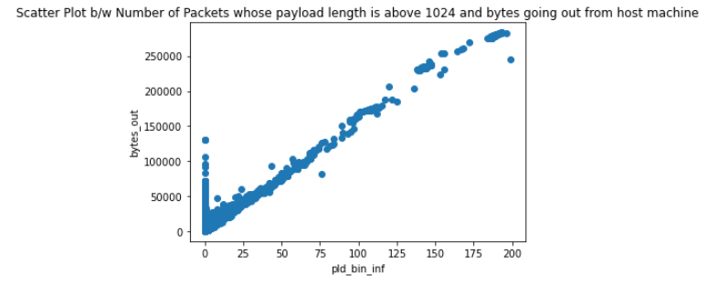
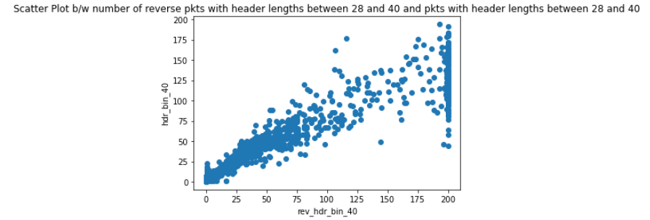
Figure 3.2
Correlation value 0.97
Figure 3.3
Correlation value 0.94
Figure: 3.4
Correlation value 0.9286

Slide 7
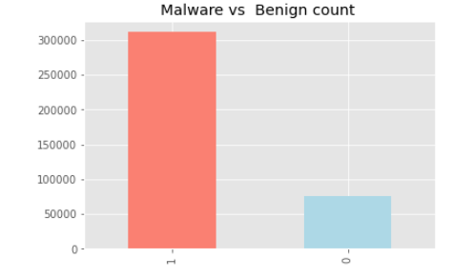
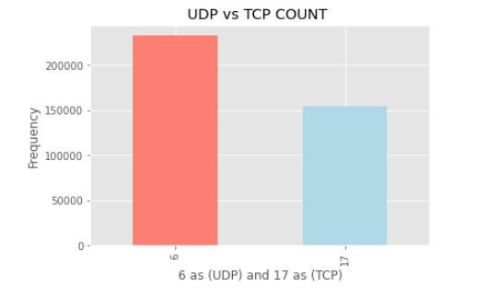
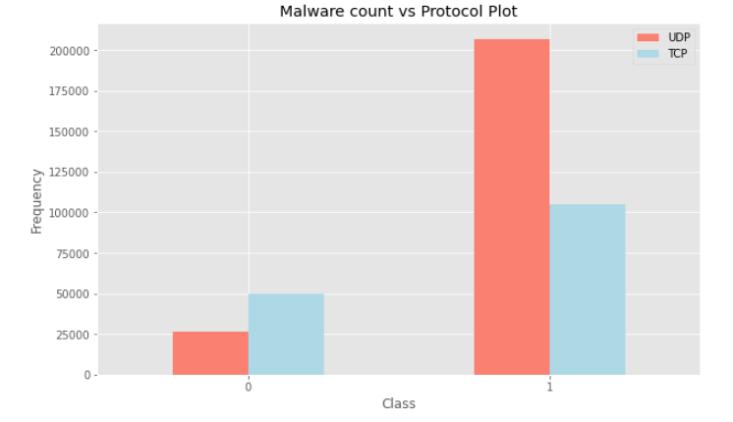
Figure 3.5
Malware count is significantly higher .
Figure 3.6
UDP protocol is used more often .
Figure 3.7
UDP protocol is more prone to malware attack

Slide 8
4. DATA PREPROCESSING
1.Data Cleaning
Dataset has 4 types of features categorized into 2 main features.
Protocol based features had 80-90% missing values.
Metadata features has no missing values.
2.Data Integration
Merged input and output dataset increasing column size to 32.
There were 8 features with object data types.
Breaking these 8 features into individual columns increased column size from 32 to 122.

Slide 9
3.Data Reduction
All the redundant protocol based features were removed.
Removing these features decreased column count from 62 to 34.
2 features ‘sa’ and ‘da’were masked.
Removing these 2 features reduced the column count to 32.
4.Data Transformation
The protocol feature had 2 categorical values: UDP and TCP.
These were encoded as UDP to ‘6’ and TCP to ’17’.
The output prediction class had 2 labels Malware and Benign.
Malware being encoded as ‘1’ and benign as ‘0’.

Slide 10
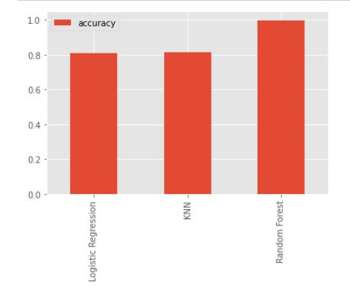
5.ML MODELS
The ML model used for Binary Classification of the NetML dataset are as follows:-
Random Forest Classifiers Model
KNN Classification Model
Logistic Regression Model
Accuracy scores of the models:-
Random Forest Classifiers : 99.77%
Logistic Regression : 81.05%
KNN Classification : 81.53%
Figure 5.1

Slide 11

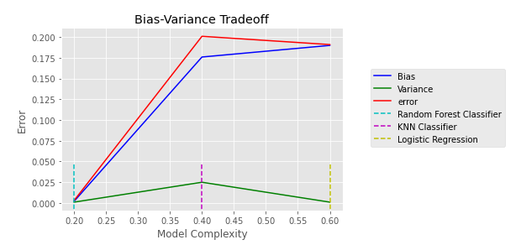


Bias-Variance Tradeoff
Random Forest
KNN Classification
Logistic Regression
Figure 5.2
Bias-Variance Tradeoff clearly indicating RF the best model .
No over fitting on training data .

Slide 12
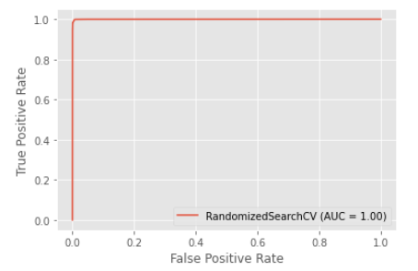
6.POST MODEL ANALYSIS
Figure 6.1
AUC Metric value of 1
AUC metric value 1 indicating near perfect model .
Random Search cross validation was best for hypertuning leading to 1 AUC score .

Slide 13
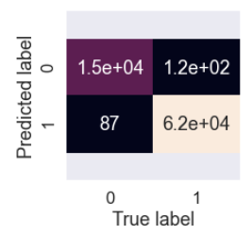
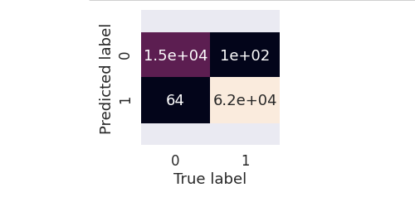
Confusion Matrix
Figure 6.2
Confusion Matrix with hyperparametric feature of 1000 trees
Figure 6.3
Confusion matrix with hyperparameter feature of 1500 trees
Increasing the tree numbers from 1000 to 1500 reduced wrong predictions .
Thereby increasing overall accuracy to 99.77% .

Slide 14
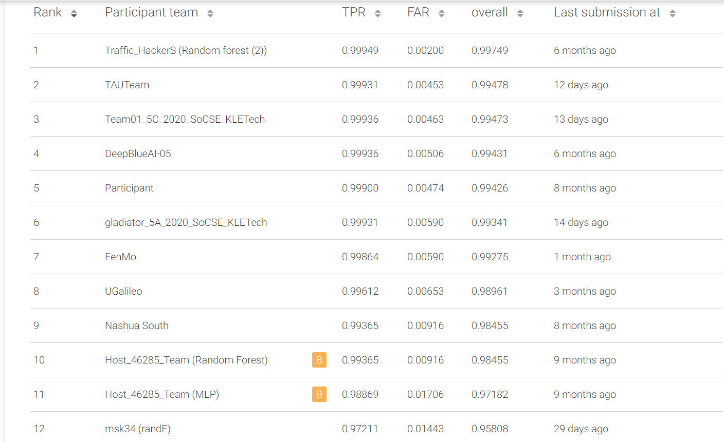
7.Results
The final submission file generated from the tuned model gave the TPR (True Positive Rate) value of 0.99931 and FAR (False Alarm Rate) value of 0.00590.
6th on the leaderboard .
The overall accuracy obtained is 0.99341 on test dataset.
Figure 7.1

Slide 15
References
https://eval.ai/web/challenges/challenge-page/526/overview
https://arxiv.org/pdf/2004.13006v1.pdf [literature survey]
https://scikit learn.org/stable/auto_examples/classification/plot_classifier_comparison.html
https://pandas.pydata.org/docs/user_guide/index.html#user-guide
What Is ROC Curve in Machine Learning using Python? ROC Curve Example (intellipaat.com)

Slide 16

Thank You!

