Slide 1

DMA COURSE PROJECT [18ECSC301] NETWORK TRAFFIC ANALYSIS [5DMACP08] Team no : 7A
Name | USN | ROLL NO
Aayush Rajwade | 01FE18BCS005 | 105
Aman Kumar | 01FE18BCS029 | 129
Annapoorna Pattar | 01FE18BCS040 | 140
Ayush Utsav | 01FE18BCS059 | 159

Slide 2
TEAM CONTRIBUTION
1.Literature survey, Understanding of the dataset and problem space. | Aayush Rajwade | Aman Kumar | Annapoorna Pattar | Ayush Utsav
2.EDA | Aayush Rajwade | Aman Kumar | Annapoorna Pattar | Ayush Utsav
3.Data Preprocessing | Aayush Rajwade | Aman Kumar | Annapoorna Pattar | Ayush Utsav
4.Model-1[RF] | Aayush Rajwade | - | - | Ayush Utsav
5.Model-2[KNN] | - | Aman Kumar | - | Ayush Utsav
6.Model-3[LR] | Aayush Rajwade | - | Annapoorna Pattar | -
7.Bias-Variance Tradeoff | Aayush Rajwade[RF] | - | - | Ayush Utsav[KNN, LR]
8.Post Model Analysis | Aayush Rajwade | - | - | Ayush Utsav
- | [Feature Importance] |  |  | [Confusion Matrix]
- | [ROC Curve]

Slide 3
1.PROBLEM STATEMENT
“For the given NetML dataset, prediction of top-level annotation for binary classification of malware.”

Slide 4
2.Dataset description
The training dataset consists of 387268 rows and 62 columns.
The test dataset consists of 48394 rows and 62 columns.
This 62 columns are the summation of 4 set of features namely – metadata , TLS , DNS and HTTP.
TLS , DNS and HTTP are protocol dependent features whereas metadata features is protocol independent.
Metadata set of features have 32 columns , rest 30 columns belong to protocol based set of features (ie. TLS ,DNS and HTTP).
Each row is identified by a unique id whose o/p label contains binary categorical values : malware and benign , stored in a separate o/p file.
We have 387268 unique ids same as the number of rows.
We will predict this label for the given test data.

Slide 5
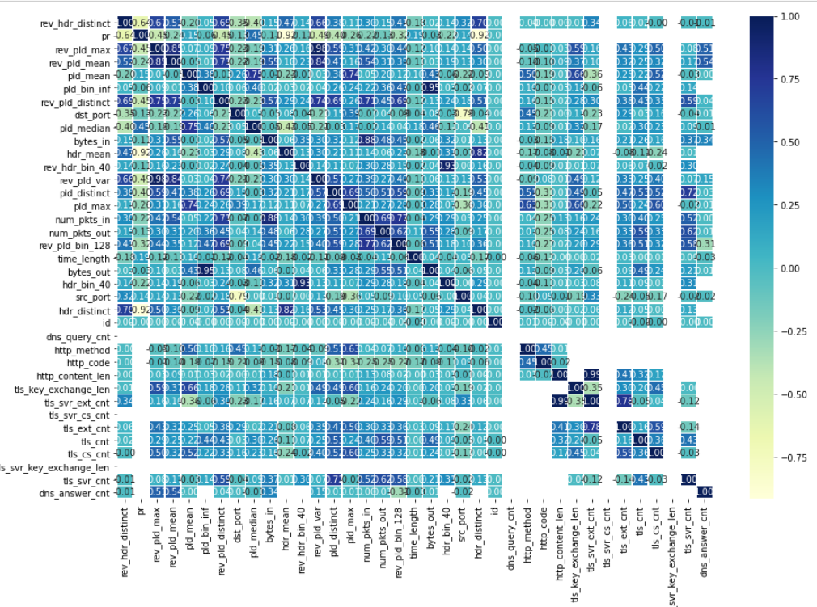
3.EXPLORATORY DATA ANALYSIS
Figure: 3.1

Slide 6
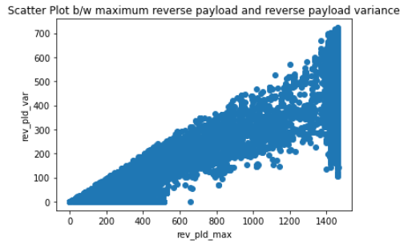
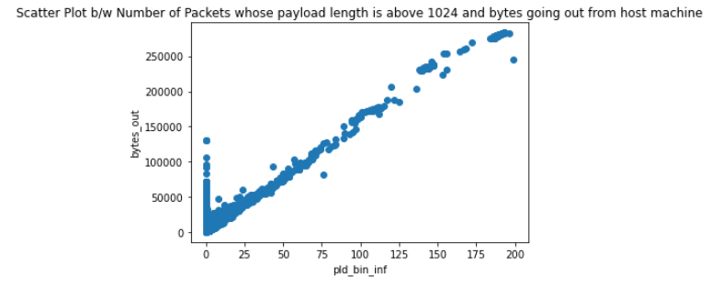
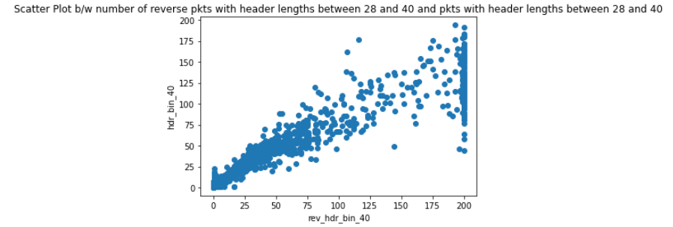
Figure: 3.3
Figure: 3.2
Figure: 3.4

Slide 7
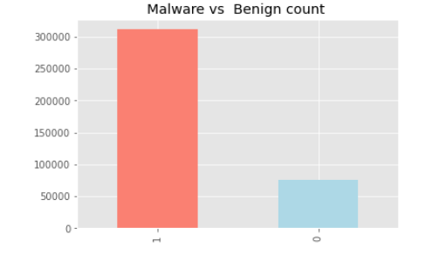
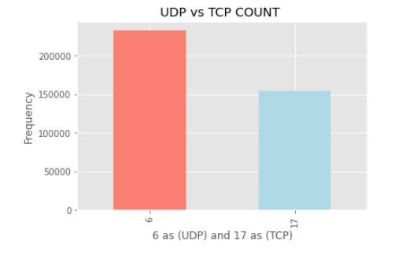
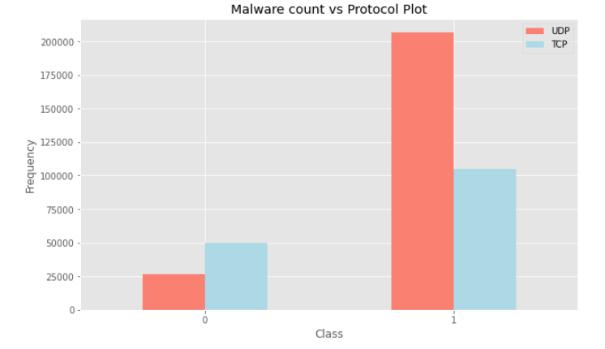
Figure: 3.5
Figure: 3.6
Figure: 3.7

Slide 8
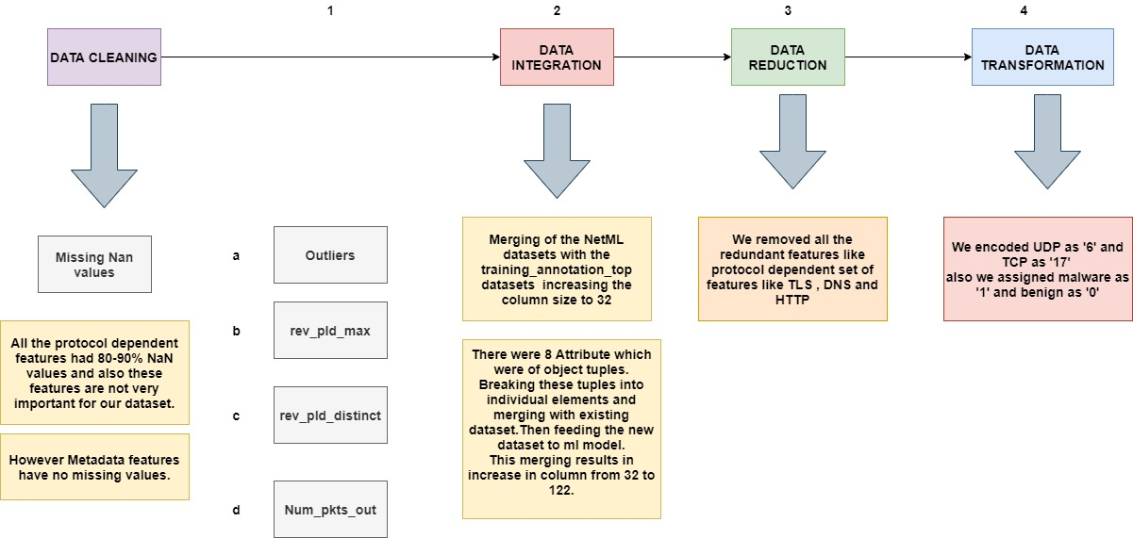
4.DATA PREPROCESSING

Slide 9
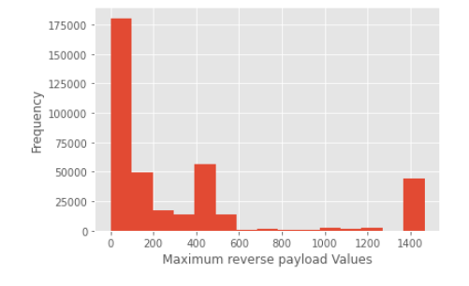
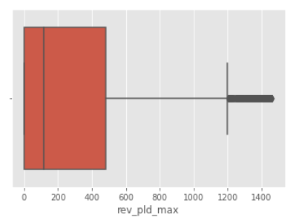
Outlier Analysis
Figure: 4.1
Figure: 4.2
(Maximum reverse payload Values) is Right Skewed
Box Plot indicating outliers b/w 1200-1400

Slide 10
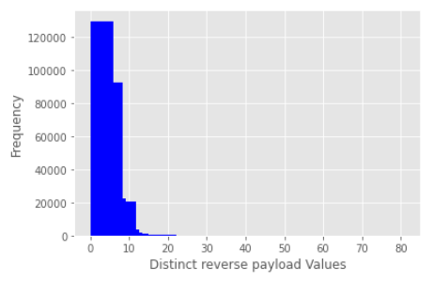
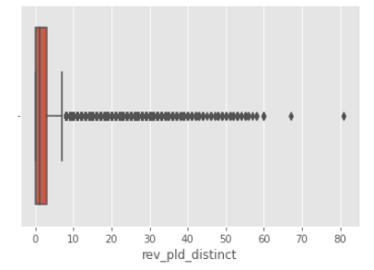
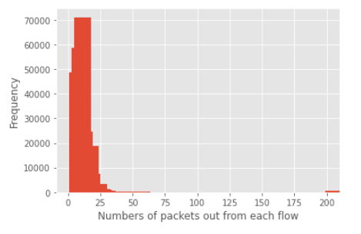
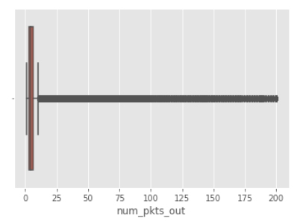
Figure: 4.4
Figure: 4.3
(Distinct reverse payload Values) is Right Skewed
Box Plot indicating outliers b/w 10 - 80
Figure: 4.5
Figure: 4.6
(Numbers of packets out) is Right Skewed
Box Plot indicating outliers b/w 16 - 200

Slide 11
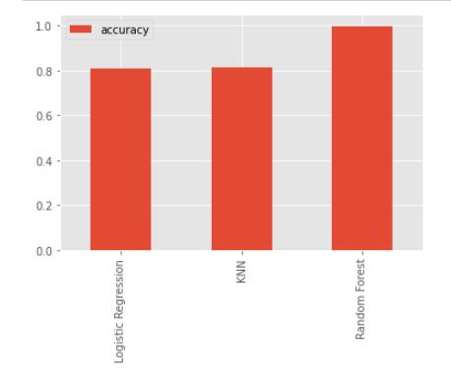
5.ML MODELS
The ML model used for Binary Classification of the NetML dataset are as follows:-
Random Forest Classifiers Model
KNN Classification Model
Logistic Regression Model
Accuracy scores of the models:-
Random Forest Classifiers : 99.77%
Logistic Regression : 81.05%
KNN Classification : 81.53%
Figure: 5.1

Slide 12

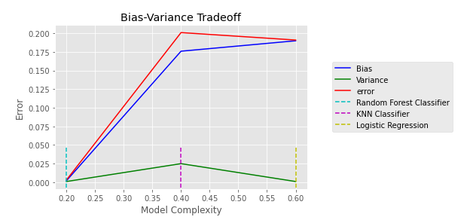


Bias-Variance Tradeoff
Random Forest
KNN Classification
Logistic Regression
Figure: 5.2
Bias-Variance Tradeoff clearly indicating RF the best model and also no overfitting of data .

Slide 13
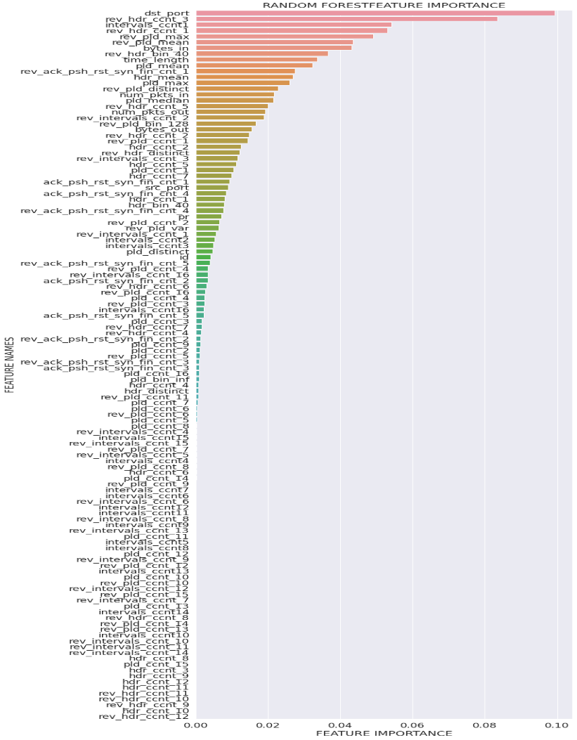
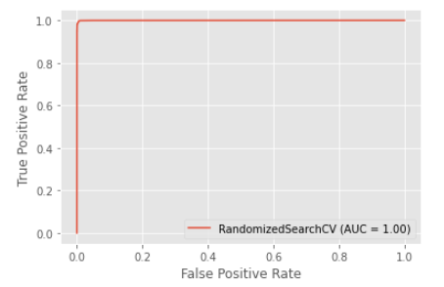
6.POST MODEL ANALYSIS
Figure: 6.1
Figure: 6.2
Graph Showing feature importance in RF model
AUC METRIC INDICATING ALMOST PERFECT MODEL

Slide 14
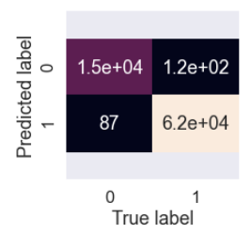
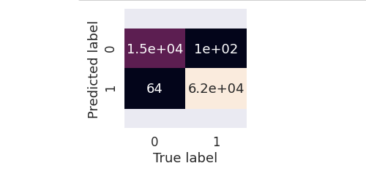
Confusion Matrix
Figure: 6.3
Figure: 6.4

Slide 15
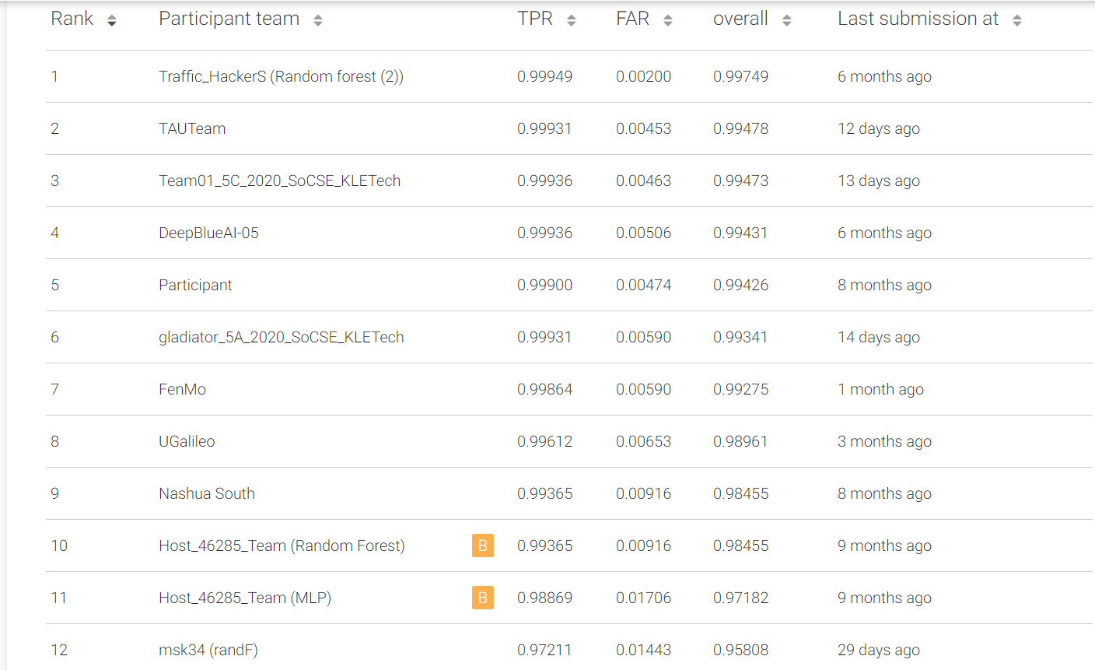
7.Results
The final submission file generated from the tuned model gave the TPR (True Positive Rate) value of 0.99931 and FAR (False Alarm Rate) value of 0.00590.
6th on the leaderboard .
The overall accuracy obtained is 0.99341 on test dataset.
Figure: 7.1

Slide 16
References
https://eval.ai/web/challenges/challenge-page/526/overview
https://arxiv.org/pdf/2004.13006v1.pdf [literature survey]
https://scikit learn.org/stable/auto_examples/classification/plot_classifier_comparison.html
https://pandas.pydata.org/docs/user_guide/index.html#user-guide
What Is ROC Curve in Machine Learning using Python? ROC Curve Example (intellipaat.com)

Slide 17

Thank You!

