Slide 1

TRIBHUVAN UNIVERSITY
INSTITUTE OF ENGINEERING
Kathmandu Engineering College
Kalimati, Kathmandu
MID TERM DEFENSE FOR MAJOR PROJECT ON:
SPARK: Explainable Edge AI for Kinetic Pattern Recognition and Distress Signaling
Submitted By:
AARADHYA DEV TAMRAKAR KAT079BEI001
RUPESH KADEL KAT079BEI034
SANKALPA LAMSAL KAT079BEI039
SONIA THAPA KAT079BEI043
Supervisor : Assoc. Prof. Er. Dipen Manandhar
Department : Electronics, Communication, and Information Engineering
Date : July 13th, 2026

Slide 2
PRESENTATION OUTLINE
Motivation
Methodology
01
07
Introduction
Feasibility Study (Analysis)
02
08
Objectives
Expected Output
03
09
Literature Review
Future Enhancements
04
10
Scope of Project
Conclusion
05
11
Project Applications
References
06
12
July 13, 2026
2

Slide 3
MOTIVATION
Why SPARK, Why Now
684,000
No domestic fall-detection product exists in the Nepali market today
Commercial options such as the Apple Watch SE (2nd gen, above NPR 30,000) are cost-prohibitive and require proprietary ecosystems
Urban WiFi penetration in Kathmandu is increasingly reliable, making a local WiFi-based alert pipeline practically deployable
Published academic systems rely on either threshold-only detection (high false positives) or cloud-dependent ML (unacceptable network dependency)
fatal falls occur worldwide every year — the 2nd leading cause of unintentional injury death (WHO, 2007)
2× by 2035
Nepal's population aged 65+ is projected to double by 2035 (Central Bureau of Statistics, Nepal)
July 13, 2026
Motivation
3

Slide 4
INTRODUCTION
Background & Problem Statement
The Situation Today
Problem Statement
Falls cause serious injuries — hip fractures, traumatic brain injuries, and long-term disability
No domestic fall-detection product exists despite Nepal's growing elderly population
Academic systems use threshold-only detection (high false positives) or cloud-dependent ML (unacceptable network dependency)
No published system has been validated on Nepal-context data or offers per-event classifier explainability
Falls are the leading cause of injury-related mortality among adults over 65 globally
Commercial systems (Apple Watch, Samsung Galaxy Watch, Withings ScanWatch) are cost-prohibitive, proprietary, and black-box (binary verdict, no explanation)
No open-hardware system combines: two-layer gated on-device inference, SHAP-based explainability, adaptive sensitivity profiles, and clinical-format incident reporting on a Nepal-context dataset
SPARK : Signal Pattern Analysis & Real-time Kinetics
July 13, 2026
Introduction
4

Slide 5
OBJECTIVES
What This Project Sets Out to Do
01
02
03
Construct the hardware structure of a wearable edge-computing node.
Integrate a two-layer gated AI architecture for cloud-independent, real-time fall classification.
Implement SHAP-based explainability to log and render transparent feature attribution per event.
July 13, 2026
Objectives
5

Slide 6
LITERATURE REVIEW
Related Work: Contributions & Gaps
Author(s) & Year | Contribution | Limitation / Gap
Kangas et al. (2008) | Compared threshold algorithms on hip and wrist IMU data | Sensitivity 73–95%; false-positive rate exceeding 30% on vigorous ADLs
Bourke & Lyons (2008) | Dual-axis threshold method achieving 96% sensitivity | Specificity on sit-to-stand transitions remained problematic
Sucerquia et al. (2017) | Published the SisFall dataset — 15 fall types, 19 ADL types, 38 subjects | Feature-based classifiers still ran on a connected laptop/server, not the wearable itself
Nho et al. (2021) | 1D CNN on UCI MHEALTH + SisFall — 97.2% sensitivity, 98.1% specificity, <150 KB model | Ran on a Raspberry Pi 3, not a resource-constrained microcontroller
Wang et al. (2020) | LSTM architecture on continuous IMU streams, comparable accuracy | Inference latency unsuitable for real-time embedded detection
David et al. (2021) | Demonstrated TFLite Micro INT8 CNN inference on Cortex-M4 (<250 KB flash) | Establishes general feasibility only — not applied to fall detection
Lundberg & Lee (2017) | Introduced SHAP — a unified framework for model interpretability | Not previously applied at the per-event level in wearable fall detection
Kumar et al. (2022) | Threshold-gated classifier on Arduino Nano 33 BLE Sense | No on-device CNN or gateway-level SHAP explainability
July 13, 2026
Literature Review
6

Slide 7






SCOPE OF PROJECT
What SPARK Covers
On-Device Data Acquisition
Dual-Layer Gated Inference
Sample and filter 6-axis accelerometer and gyroscope data directly on the wearable node at a continuous 100 Hz.
A fast threshold check wakes an on-device, quantized 1D CNN classifier only when a potential fall signature is detected.
Gateway Ingestion & Storage
SHAP Explainability Pipeline
A localized FastAPI + PostgreSQL backend securely saves event history and user configuration data.
Shapley additive feature values are computed at the gateway to show caregivers exactly which movements triggered the alarm.
Instant Caregiver Alerting
Automated Clinical Reporting
Confirmed fall events are routed to a Telegram Bot, messaging caregivers within two seconds of an incident.
Peak movement data and model confidence ratings are packaged into formal PDF incident summary files.
July 13, 2026
Scope of Project
7

Slide 8






APPLICATIONS
Where SPARK Can Be Used
Assistive Technology
Medical & Rehabilitation
Elderly Care Facilities
Real-time, hands-free fall monitoring to increase independence and safety for those living alone.
Assists clinicians in tracking recovery progress and movement patterns post-injury or post-stroke.
Optimizes institutional care, letting a small staff footprint respond instantly to high-priority alerts.
Smart Home & IoT
Clinical Documentation
Research & Development
Functions as a network-independent safety module interfacing with residential intranet hubs.
Automatically logs auditable incident data required for formal medical reports and compliance audits.
An open-hardware reference design providing a localized South Asian regional IMU motion dataset.
July 13, 2026
Project Applications
8

Slide 9
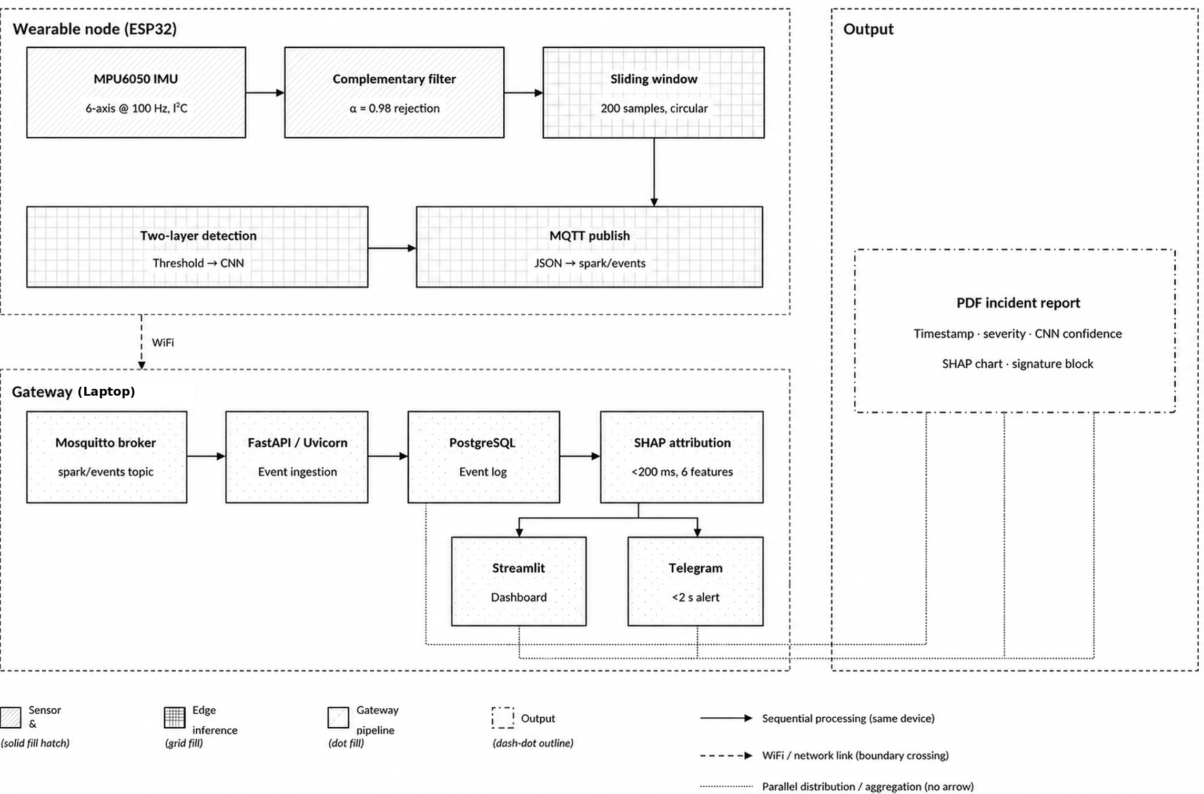
METHODOLOGY · 1
System Block Diagram
Two physical subsystems — a battery-powered wearable node and a laptop gateway — connected over a local WiFi network. On a confirmed fall, the wearable node publishes a JSON event over MQTT; the gateway ingests, logs, explains, alerts, and reports.
July 13, 2026
Methodology
9

Slide 10
July 13, 2026
10

Slide 11
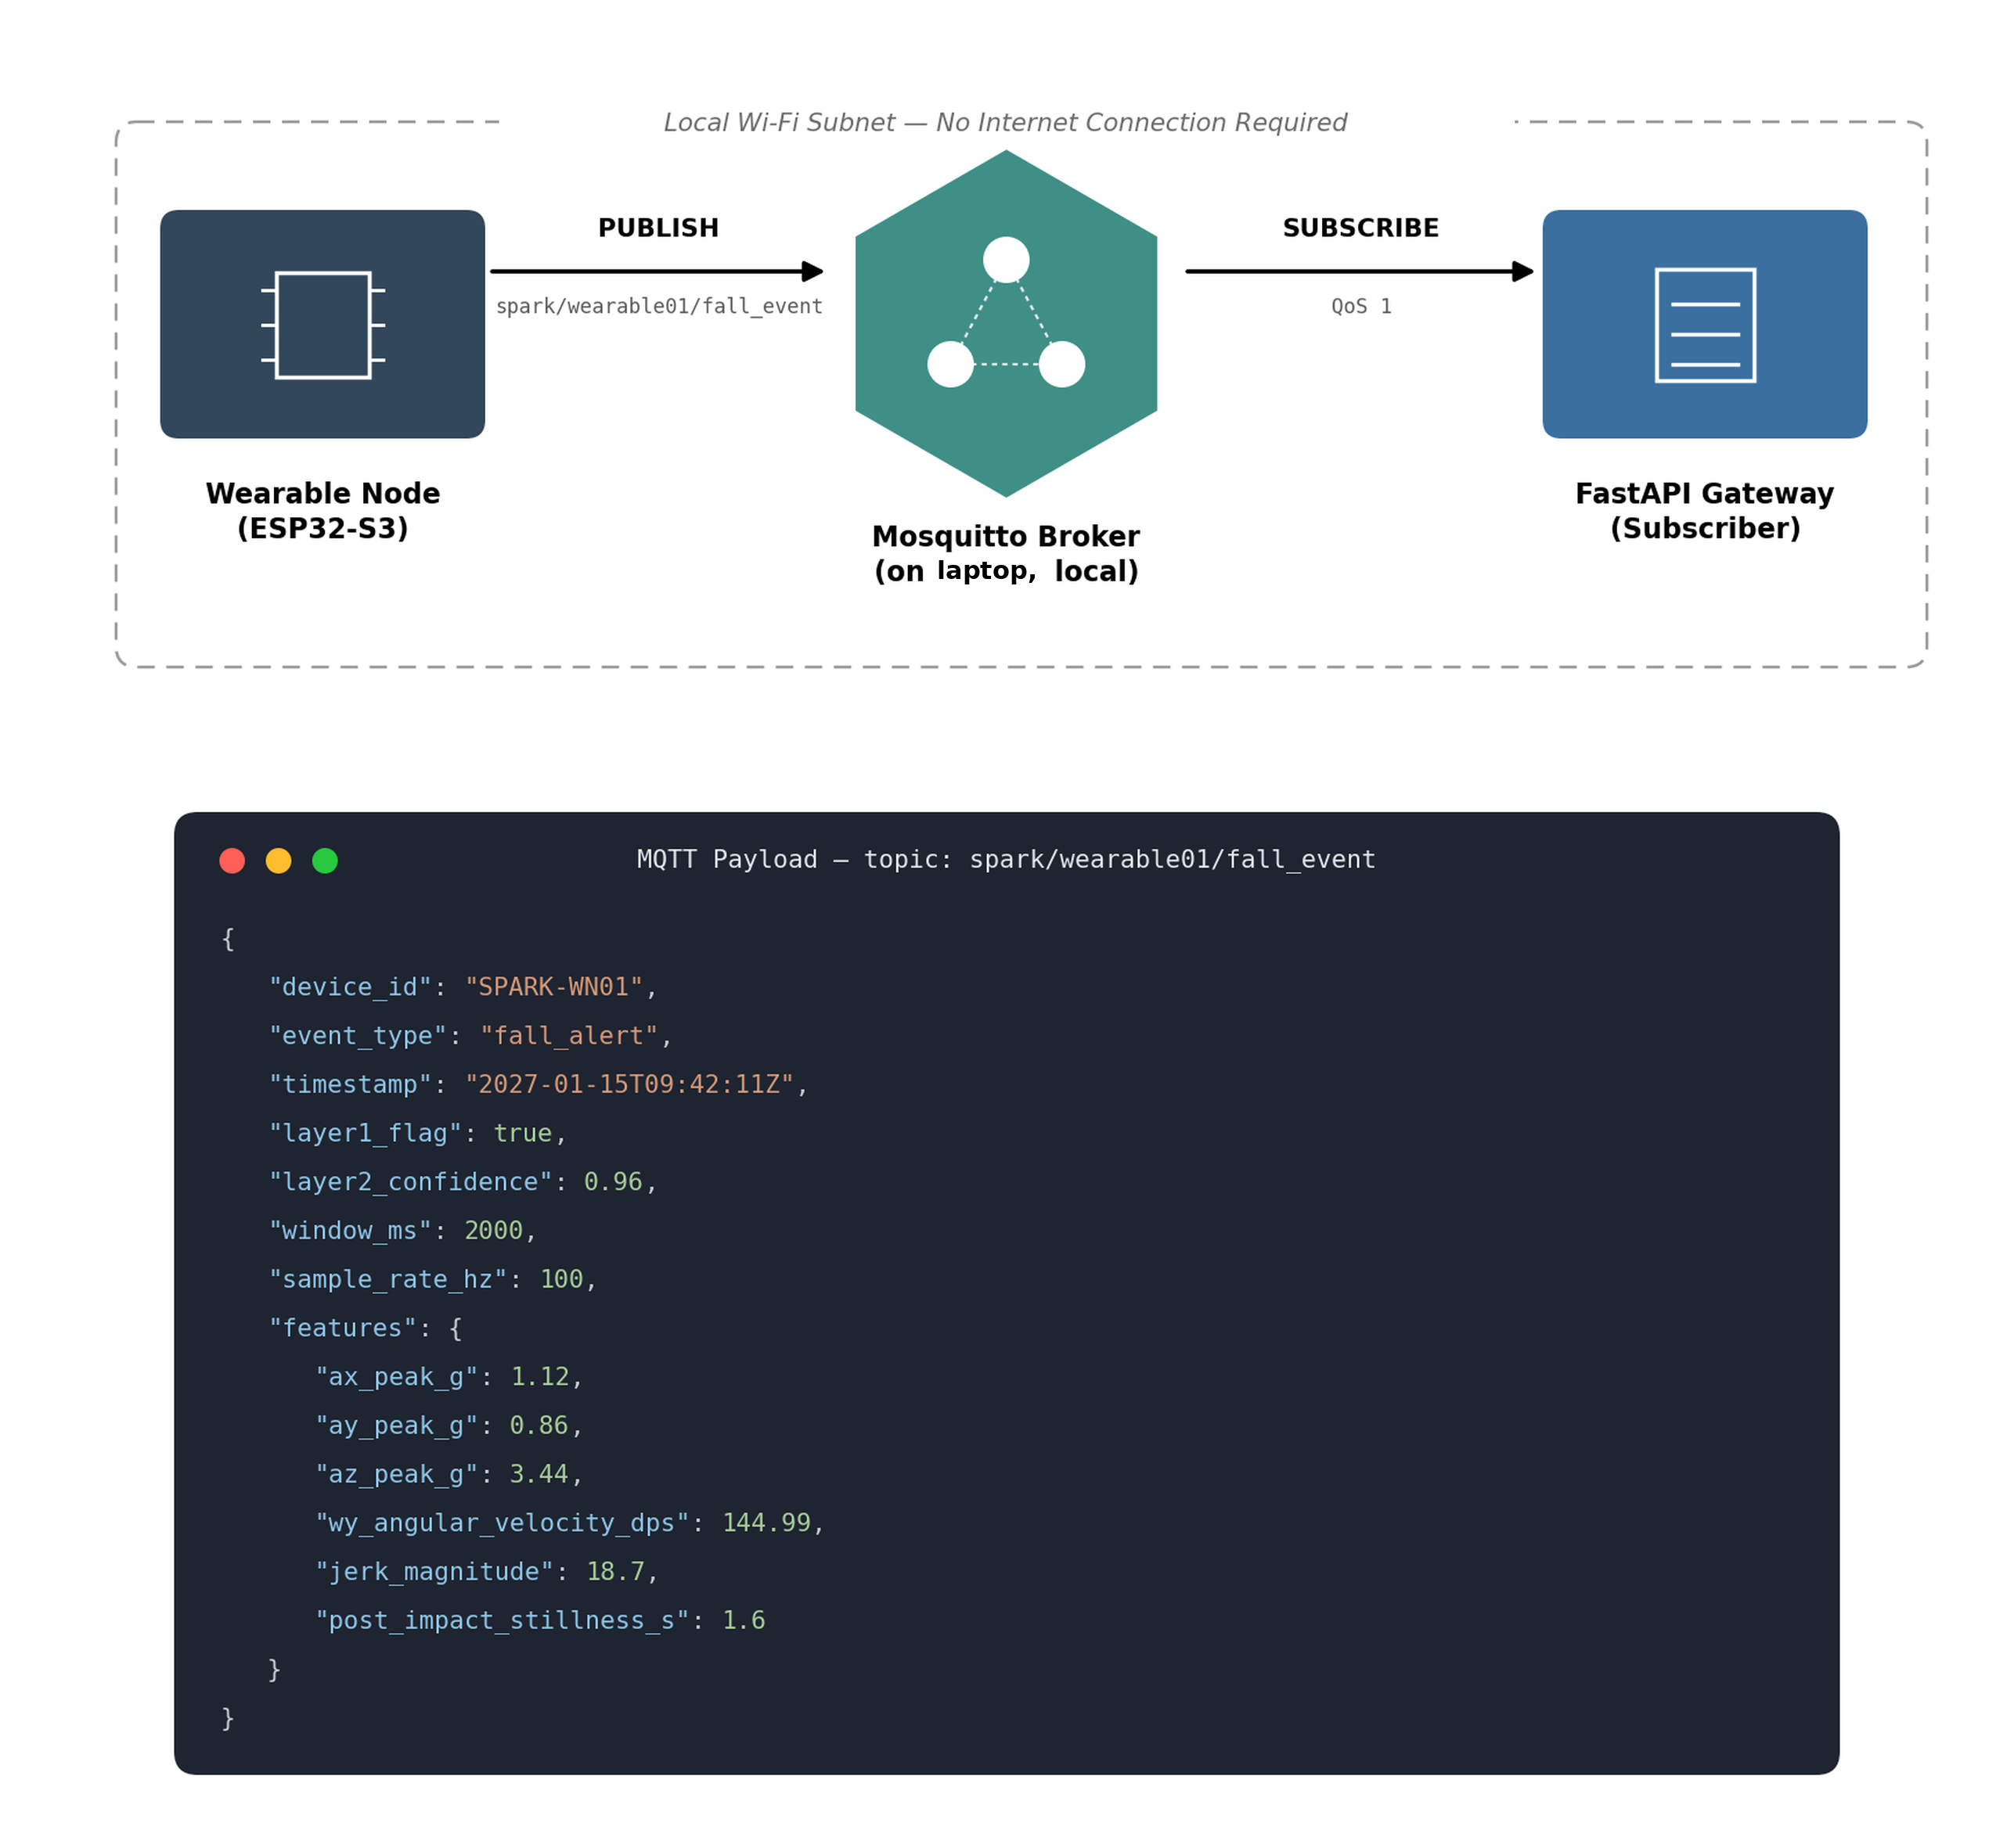
July 13, 2026
11

Slide 12
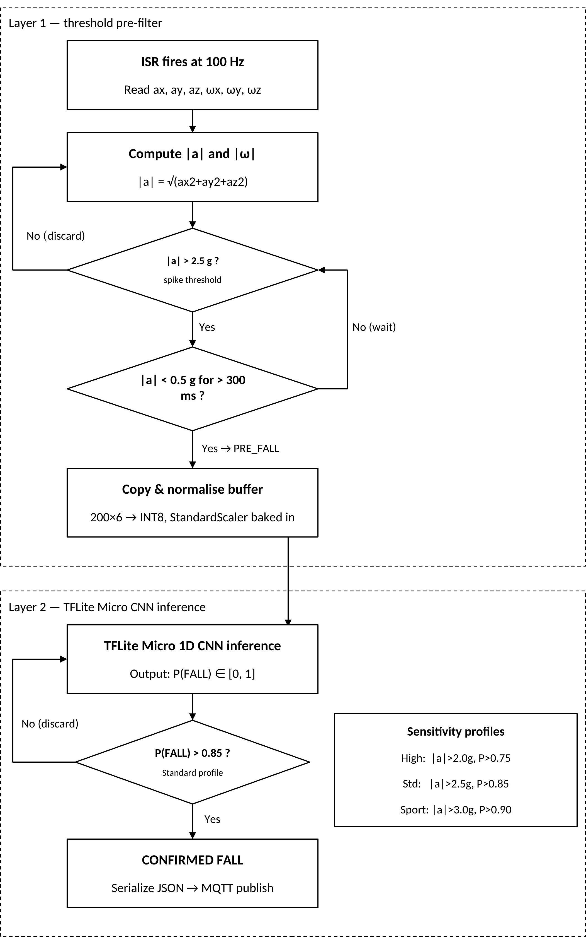
(Standard profile)
METHODOLOGY · 2
Working Principle
July 13, 2026
Methodology
12

Slide 13
METHODOLOGY · 3
Operational Workflow
Preprocessing & Filtering
Raw IMU sampled at 100 Hz over I²C; complementary filter (α = 0.98) fuses accelerometer and gyroscope readings.
Noise / Artifact Handling
DLPF cutoff at 20 Hz on the accelerometer; filtered stream stored in a 200-sample circular sliding-window buffer.
Feature Extraction
Layer 1 computes resultant acceleration |a| and angular velocity |ω|; the latched window is normalized with firmware-baked StandardScaler parameters.
Classification / Decision
Layer 1 threshold gates Layer 2 TFLite Micro 1D CNN inference, producing P(FALL); a CONFIRMED_FALL is raised when P(FALL) > 0.85 (Standard profile).
Aggregation & Output
The confirmed event is serialized as JSON over MQTT; the gateway logs it, computes SHAP attribution, dispatches alerts, and generates a PDF report.
July 13, 2026
Methodology
13

Slide 14
METHODOLOGY · 4
Flow of the Proposed System
Layer 1 — Threshold Pre-Filter
Sensitivity Profiles
High Sensitivity
ISR fires at 100 Hz — read ax, ay, az, ωx, ωy, ωz
|a| > 2.0 g, 200 ms rest
P(FALL) > 0.75
↓
Compute |a| = √(ax²+ay²+az²) and |ω|
Standard (default)
|a| > 2.5 g, 300 ms rest
↓
P(FALL) > 0.85
|a| > spike threshold? → if No, discard
↓
Sport Mode
|a| < rest threshold for rest duration? → if Yes, raise PRE_FALL
|a| > 3.0 g, 400 ms rest
P(FALL) > 0.90
↓
Copy & normalise buffer (200×6 → INT8, StandardScaler baked in)
Switching profiles requires no firmware reflash — the gateway publishes new parameters to the ESP32 via MQTT.
July 13, 2026
Methodology
14

Slide 15
METHODOLOGY · 4
Flow of the Proposed System
Layer 2 — TFLite Micro CNN Inference
TFLite Micro 1D CNN inference — outputs P(FALL) ∈ [0,1]
↓
P(FALL) > sensitivity-profile threshold? → if No, discard
↓
CONFIRMED_FALL — serialize JSON → MQTT publish
July 13, 2026
Methodology
15

Slide 16

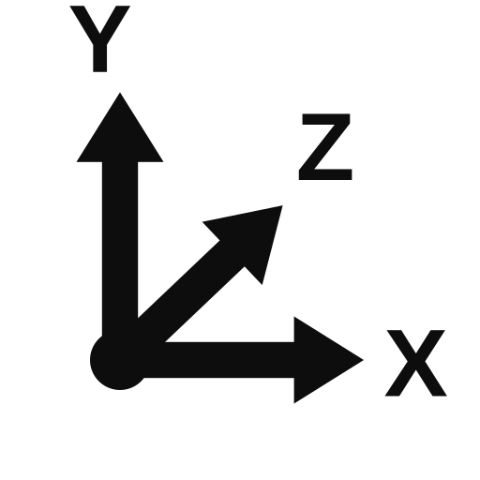

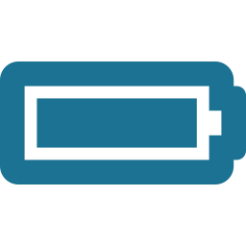



METHODOLOGY · 5
Hardware Requirement
ESP32-S3
INA219 Sensor
Dual-core Xtensa LX7, 8 MB PSRAM, WiFi
Current / voltage telemetry over I²C
MPU6050 6-Axis IMU
Velcro Wrist/Chest Strap + Mount
Accelerometer + gyroscope, I²C
Secures the enclosure to wrist or chest
Laptop (Gateway Host)
Laptop Storage (existing)
Team-owned, NPR 0
Hosts PostgreSQL DB, logs & models
18650 Li-ion Cell
USB-C Cables
2000–3000 mAh wearable power source
Power & program ESP32; charge TP4056
TP4056 Charger Module
Passive Components
USB-C, 1 A CC/CV charge controller
Resistors & capacitors for signal conditioning
AMS1117-3.3 LDO
Regulates cell voltage to 3.3 V rail
July 13, 2026
Methodology
16

Slide 17




METHODOLOGY · 6
Software Requirement
PlatformIO / Arduino C++
PostgreSQL 14
ESP32 firmware development
Event log storage
TensorFlow / Keras
Streamlit
1D CNN training
Clinical dashboard
TFLite Converter + TFLite Micro
python-telegram-bot
INT8 quantization & on-device inference
Caregiver alert delivery
ArduinoJSON
ReportLab
Event payload serialization
PDF incident report generation
Mosquitto (MQTT Broker)
SHAP (Python library)
Wearable-to-gateway messaging (Message Queuing Telemetry Transport)
Per-event feature attribution
FastAPI / Uvicorn
Git & GitHub
Gateway REST backend
Version control & open-source release
July 13, 2026
Methodology
17

Slide 18
METHODOLOGY · 7
Machine Learning Architecture
1D CNN Layer Sequence
Training Protocol
Conv1D (32 filters, kernel 5) → ReLU
Trained in TensorFlow/Keras on combined UCI MHEALTH + SisFall data, fine-tuned on self-collected KEC data (transfer learning: freeze conv layers, retrain Dense layers)
Adam optimizer (lr = 1e-3), batch size 64, 50 epochs with early stopping (patience = 10 on validation loss)
80/10/10 train/validation/test split, stratified by subject
Class weighting applied to address imbalance between fall events and ADL windows
Target: Sensitivity ≥ 90%, Specificity ≥ 90% on held-out test set
INT8 post-training quantization via TFLite Converter for edge deployment (target ≤ 120 KB flash)
↓
MaxPool1D (2)
↓
Conv1D (64 filters, kernel 3) → ReLU
↓
GlobalAveragePooling1D
↓
Dense (32, ReLU)
↓
Dense (2, Softmax)
July 13, 2026
Methodology
18

Slide 19
METHODOLOGY · 8
Algorithm Architecture Diagram
Input
Conv1D + MaxPool
Conv1D + GAP
Dense
Softmax
200 × 6
INT8
→
32 filters, k5
pool 2 (200→100)
→
64 filters, k3
GAP (100→64)
→
64 → 32, ReLU
→
FALL P=0.91
ADL P=0.09
threshold: P(FALL) > 0.85 → CONFIRMED_FALL
Two Conv1D blocks (with MaxPool after the first) compress the 200-sample IMU window to a 64-channel feature map, which GlobalAveragePooling1D collapses before a Dense + Softmax head. INT8-quantized for TFLite Micro deployment on the ESP32.
July 13, 2026
Methodology
19

Slide 20
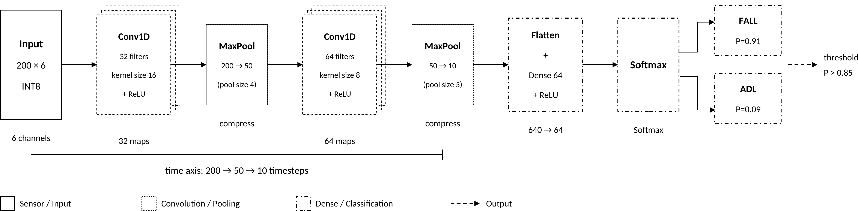
July 13, 2026
20

Slide 21
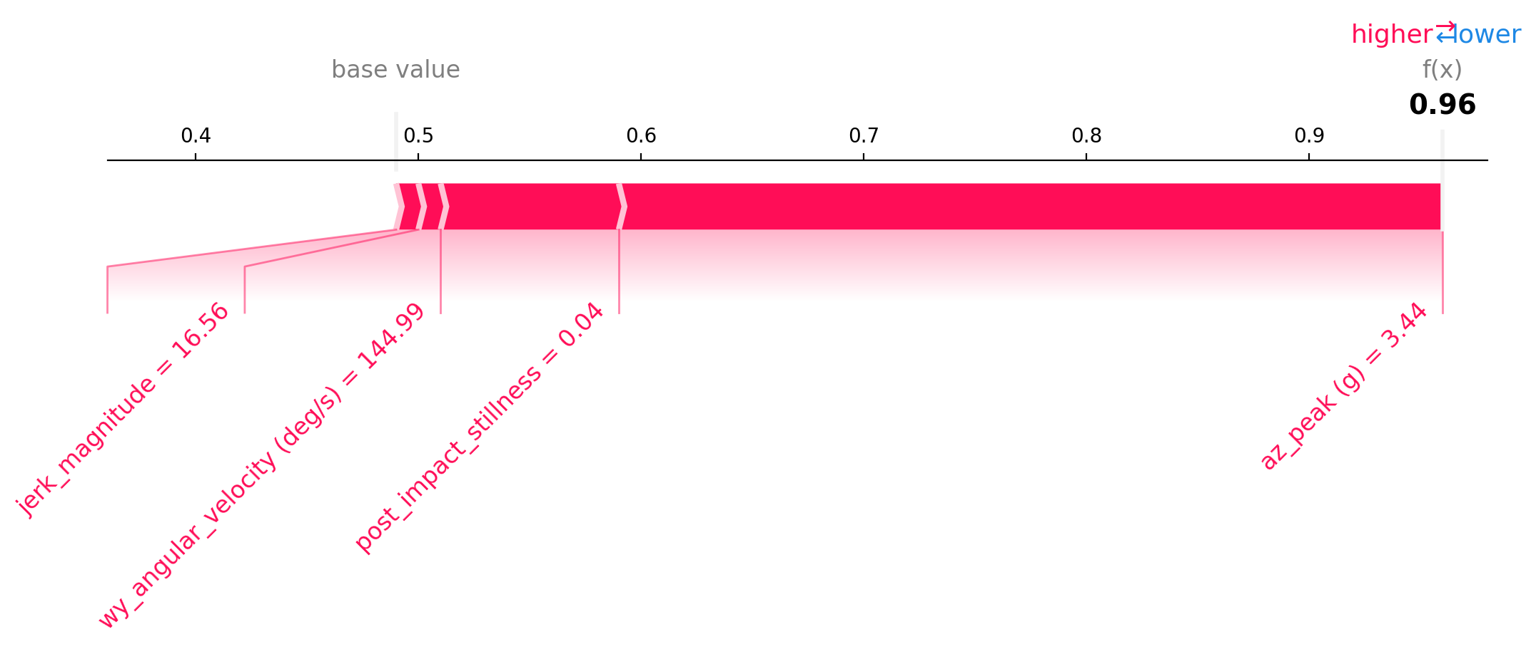
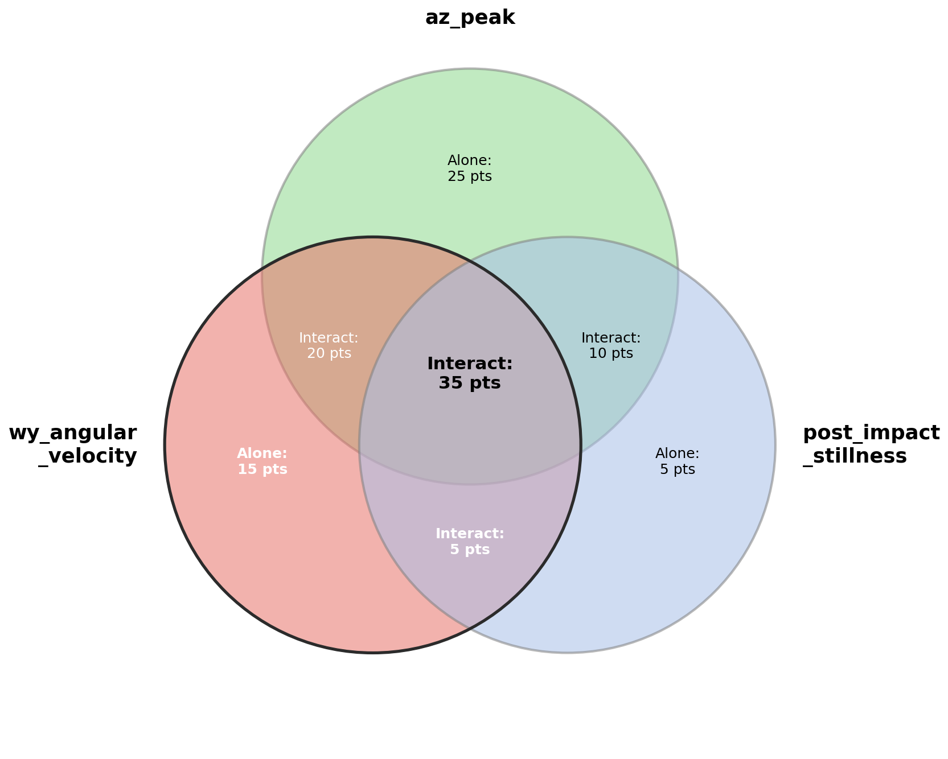
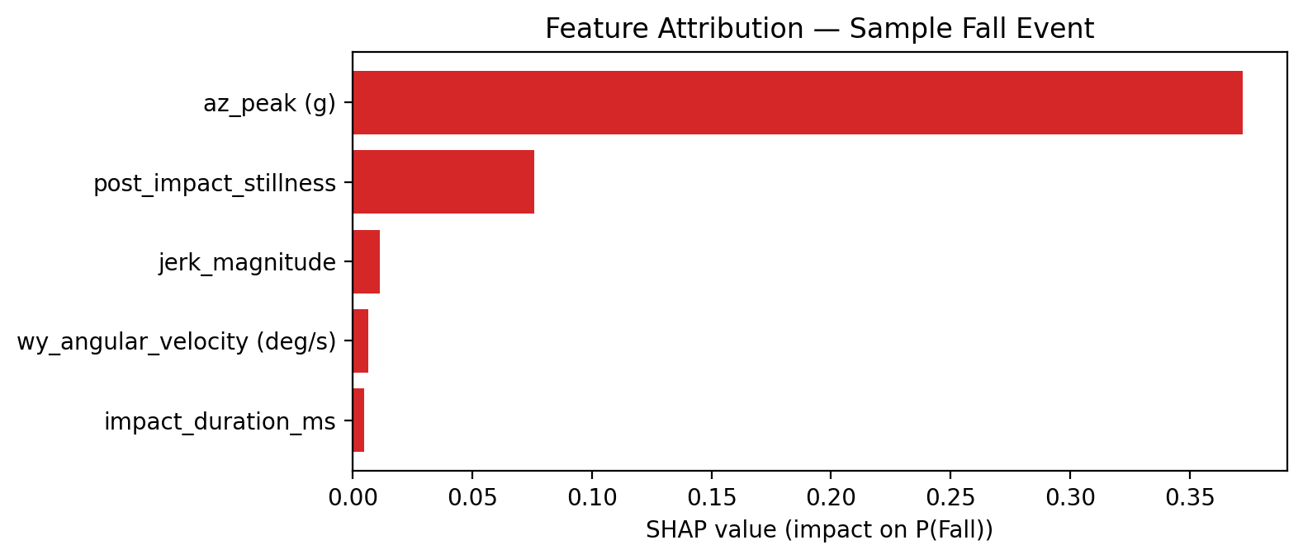
July 13, 2026
21

Slide 22
METHODOLOGY · 9
Dataset Preparation
UCI MHEALTH
SisFall
Self-Collected KEC Dataset
23 physical activities, 10 subjects, 3 body-worn IMUs at 50 Hz — resampled to 100 Hz; fall-relevant windows extracted.
15 fall types + 19 ADL types from 38 subjects at 200 Hz — downsampled to 100 Hz; falls = positive class, ADLs = negative class.
Controlled fall simulations (forward trip, lateral L/R, sitting-to-floor) and ADLs (walking, running, stair-climbing, sit-to-stand, bending) recorded at 100 Hz. Target: ≥500 fall windows + ≥2000 ADL windows. To be published on GitHub as “KEC Wearable Fall Dataset in Nepal Context.”
All datasets windowed at 2 seconds with 50% overlap. Per-channel StandardScaler normalization is applied, with scaler parameters (mean, std) baked into the firmware as constant arrays.
July 13, 2026
Methodology
22

Slide 23
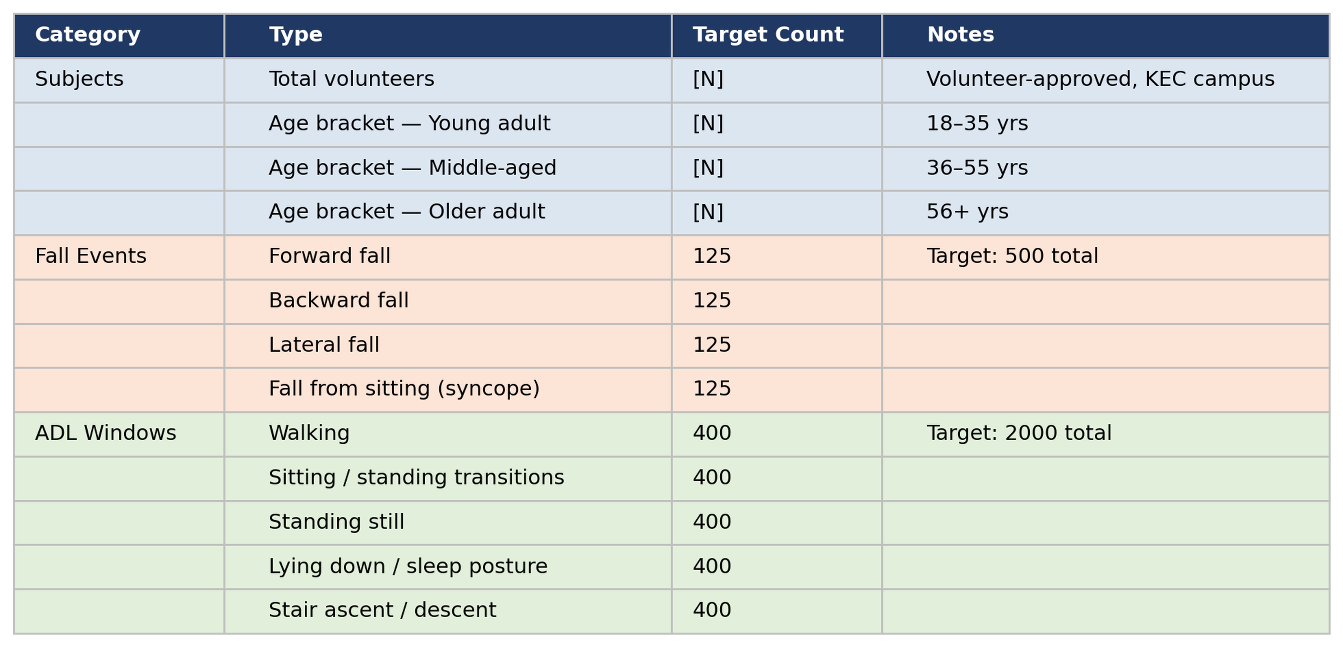
Data Collection Protocol
July 13, 2026
Methodology
23

Slide 24


ANALYSIS
Feasibility Study
Technical Feasibility
Economic Feasibility
TFLite Micro CNN inference demonstrated on Cortex-M4 class hardware below 250 KB flash — ESP32 offers a larger 520 KB SRAM / 4 MB flash envelope
INT8 quantization reduces the 1D CNN to ~80–120 KB of flash, leaving headroom for the Arduino SDK, WiFi stack, and ring-buffer firmware
Layer 1 threshold logic completes in under 1 ms; Layer 2 CNN inference runs only on candidate windows (typically <5 per hour of normal ADL)
WiFi-MQTT pipeline delivers JSON payloads to the gateway within 50–100 ms under typical indoor conditions
SHAP gateway pipeline computes per-event attributions in under 200 ms — well below the 2-second Telegram alert deadline
All software libraries are open-source and actively maintained; no custom PCB fabrication or restricted-component imports required
All hardware is procurable locally from Himalayan Solutions, Breadfruit Electronics, Daraz, SLT Pvt. Ltd., Giga Nepal, and RoboNepal within one day
Gateway runs on team-owned laptop hardware — zero incremental gateway cost
Cost Estimate | Amount (NPR)
Total Cost Estimate | 15,004/-
Departmental Ask (net of self-funded items) | 13,025/-
Two wearable nodes and development consumables. Full component breakdown in Table 4.1 of the proposal.
July 13, 2026
Feasibility Study
24

Slide 25
EXPECTED OUTPUT
The impact WE will make
Hardware Deliverables
Software Deliverables
Functional wearable node — ESP32-S3 + MPU6050, 18650 battery, TP4056 charger, AMS1117-3.3 LDO, INA219 telemetry, 3D-printed enclosure
Gateway unit — Laptop running the complete SPARK gateway stack
Power characterization report — active/idle current draw and estimated battery life (target ≥25 hours from a 2000 mAh cell)
ESP32 firmware (PlatformIO/Arduino C++) — full sensing, filtering, two-layer detection, and MQTT publishing pipeline
Trained, quantized 1D CNN — INT8 TFLite model (≤120 KB) targeting Sensitivity ≥ 90% and Specificity ≥ 90%
Gateway backend — FastAPI/PostgreSQL, SHAP pipeline, Telegram alerts, Streamlit dashboard, ReportLab PDF reports
Self-collected KEC Wearable Fall Dataset — ≥500 fall windows + ≥2000 ADL windows, published openly
GitHub repository — firmware, gateway software, trained model, dataset, and schematic with a reproducible README
July 13, 2026
Expected Output
25

Slide 26
EXPECTED OUTPUT
Timeline (7th & 8th Semester)
May
Jun
Jul
Aug
Sep
Oct
Nov
Dec
Jan
Feb
Mar
Documentation
Planning
Design
Build
Test
Analyze
Review
Launch
July 13, 2026
26

Slide 27


FUTURE ENHANCEMENTS
Where SPARK's Architecture Can Grow
Extensible Alert Channels
Adaptive Sensitivity Beyond Launch
The Observer-pattern gateway design allows a new alert channel — such as SMS — to be added without modifying the gateway core.
The Strategy-pattern sensitivity profiles (High / Standard / Sport) already support switching without firmware reflash, enabling configuration for broader deployment contexts.
Broader Regional Deployment
Growing the Open Dataset
The open-hardware reference design is positioned for low-cost elderly fall monitoring across South Asian care settings beyond Nepal.
Continued public contribution to the Nepal-context IMU dataset and reference design as a resource for further academic research.
July 13, 2026
Future Enhancements
27

Slide 28
CONCLUSION
Closing the Gap in Elderly Fall Care
Nepal's population aged 65+ is projected to double by 2035, yet no affordable domestic fall-detection solution exists today.
SPARK combines a two-layer gated edge AI pipeline — a threshold pre-filter gating a quantized TFLite Micro 1D CNN — for fully on-device, cloud-independent fall detection under 200 ms.
A SHAP-based explainability pipeline, adaptive sensitivity profiles, and auto-generated clinical PDF reports make every alert auditable rather than a black-box verdict.
No prior published system combines on-device gated inference, per-event explainability, adaptive sensitivity, and Nepal-context validation in a single open-hardware design.
SPARK contributes a Nepal-context wearable IMU dataset and an open-source reference design for low-cost elderly fall monitoring across South Asian care settings.
July 13, 2026
Conclusion
28

Slide 29
REFERENCES
Bibliography
[1]
World Health Organization, WHO Global Report on Falls Prevention in Older Age. Geneva, Switzerland: World Health Organization, 2007.
[2]
Central Bureau of Statistics, Nepal, National Population and Housing Census 2021: Population Projection Report. Kathmandu, Nepal: National Statistics Office, Government of Nepal, 2021.
[3]
M. Kangas, A. Konttila, P. Lindgren, I. Winblad, and T. Jämsä, “Comparison of low-complexity fall detection algorithms for body attached accelerometers,” Gait & Posture, vol. 28, no. 2, pp. 285–291, 2008.
[4]
A. K. Bourke, J. V. O’Brien, and G. M. Lyons, “Evaluation of a threshold-based tri-axial accelerometer fall detection algorithm,” Gait & Posture, vol. 26, no. 2, pp. 194–199, 2008.
[5]
A. Sucerquia, J. D. López, and J. F. Vargas-Bonilla, “SisFall: A fall and movement dataset,” Sensors, vol. 17, no. 1, p. 198, 2017.
[6]
O. Baños et al., “mHealthDroid: a novel framework for agile development of mobile health applications,” in Proc. 6th Int. Work-Conf. Ambient Assisted Living and Daily Activities (IWAAL), 2014, pp. 91–98.
July 13, 2026
References
29

Slide 30
REFERENCES
Bibliography (Contd.)
[7]
Y.-H. Nho, J. G. Lim, and D.-S. Kwon, “Deep convolutional neural network for fall detection using inertial sensor data from wearable devices,” IEEE Sensors J., vol. 21, no. 22, pp. 26305–26315, 2021.
[8]
Y. Wang, M. Chen, X. Wang, R. H. M. Chan, and W. J. Li, “LSTM-based fall detection system using wearable sensors,” IEEE Sensors J., vol. 20, no. 11, pp. 6107–6116, 2020.
[9]
R. David et al., “TensorFlow Lite Micro: Embedded machine learning for TinyML systems,” in Proc. Machine Learning and Systems (MLSys), vol. 3, 2021, pp. 800–811.
[10]
A. Kumar, V. Sharma, and R. Singh, “Microcontroller-based fall detection for elderly monitoring using a threshold-gated classifier on Arduino Nano 33 BLE Sense,” Int. J. Embedded Syst. Appl., vol. 12, no. 1, pp. 1–12, 2022.
[11]
S. M. Lundberg and S.-I. Lee, “A unified approach to interpreting model predictions,” in Advances in Neural Information Processing Systems (NeurIPS), vol. 30, 2017, pp. 4765–4774.
[12]
G. Yao et al., “Interpretation of electrocardiogram heartbeat by CNN and GRU,” Computational and Mathematical Methods in Medicine, vol. 2021, 2021.
July 13, 2026
References
30

