Slide 1
Topic A: Sentiment Analysis
Team Members:
Muhammad Rehan
Saira Batool
Diya Sonavale
Sahil Salunkhe
Fida Ali Baig
Aaradhya Deotale
Big Data Project Final Presentation

Slide 2
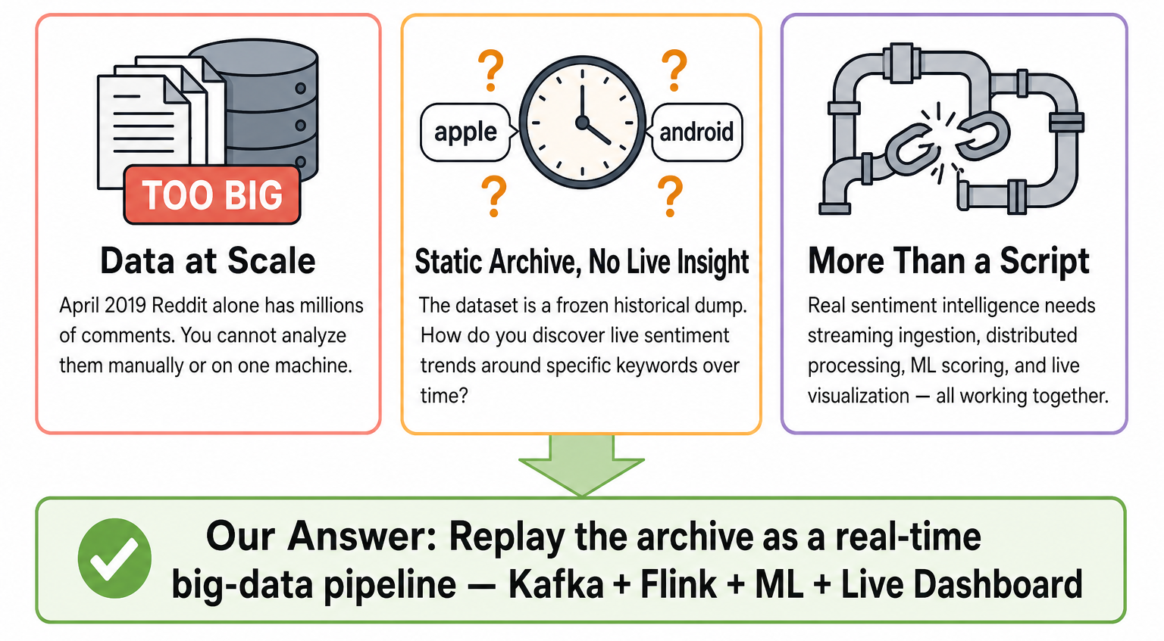
The Problem We are Solving!

Slide 3
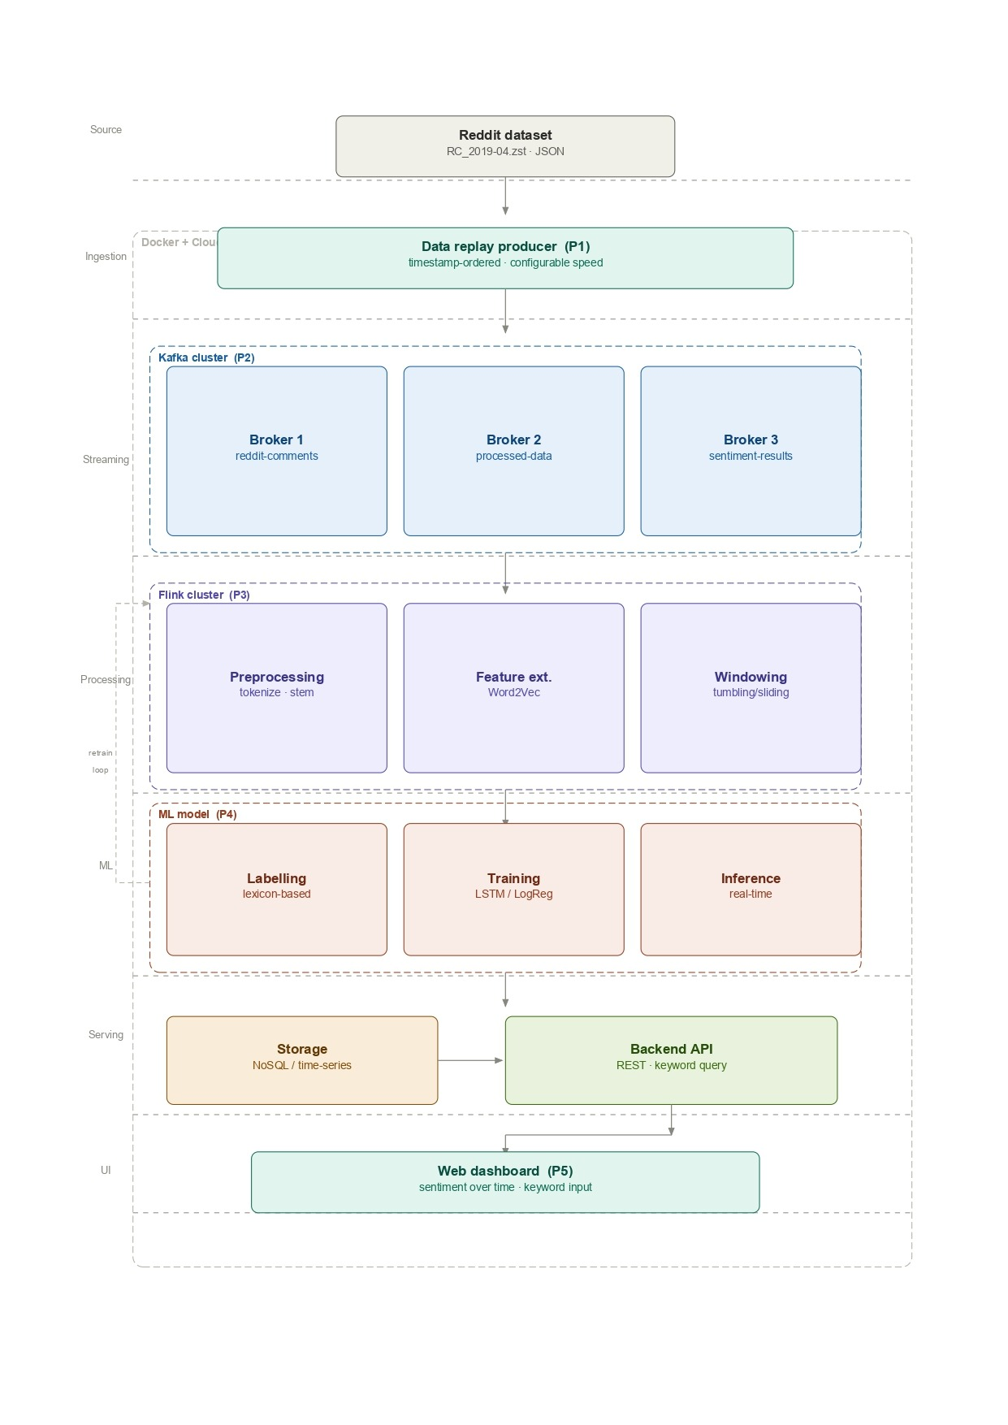
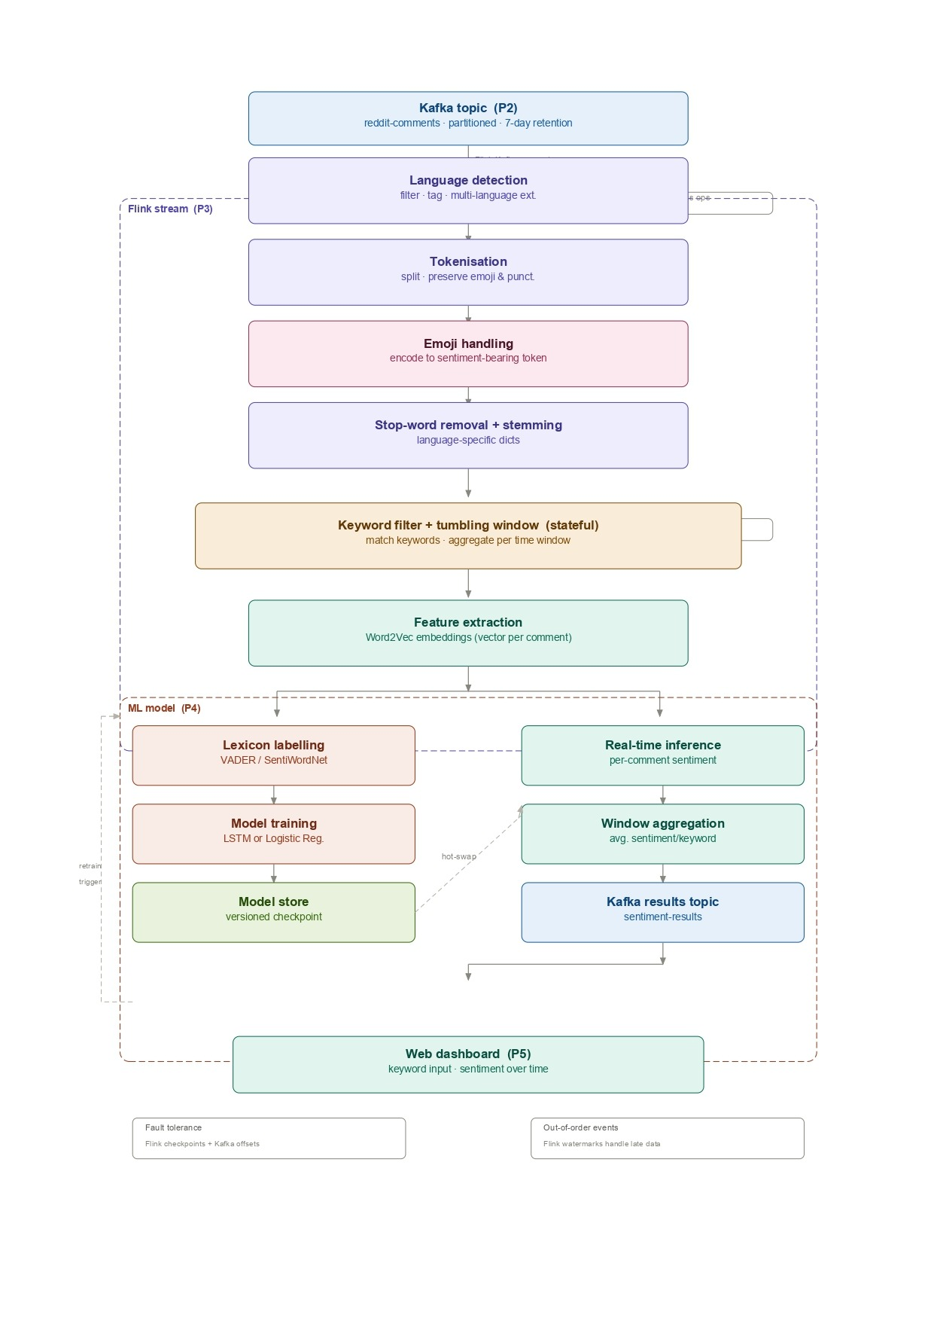
Architecture pipeline before implementation

Slide 4
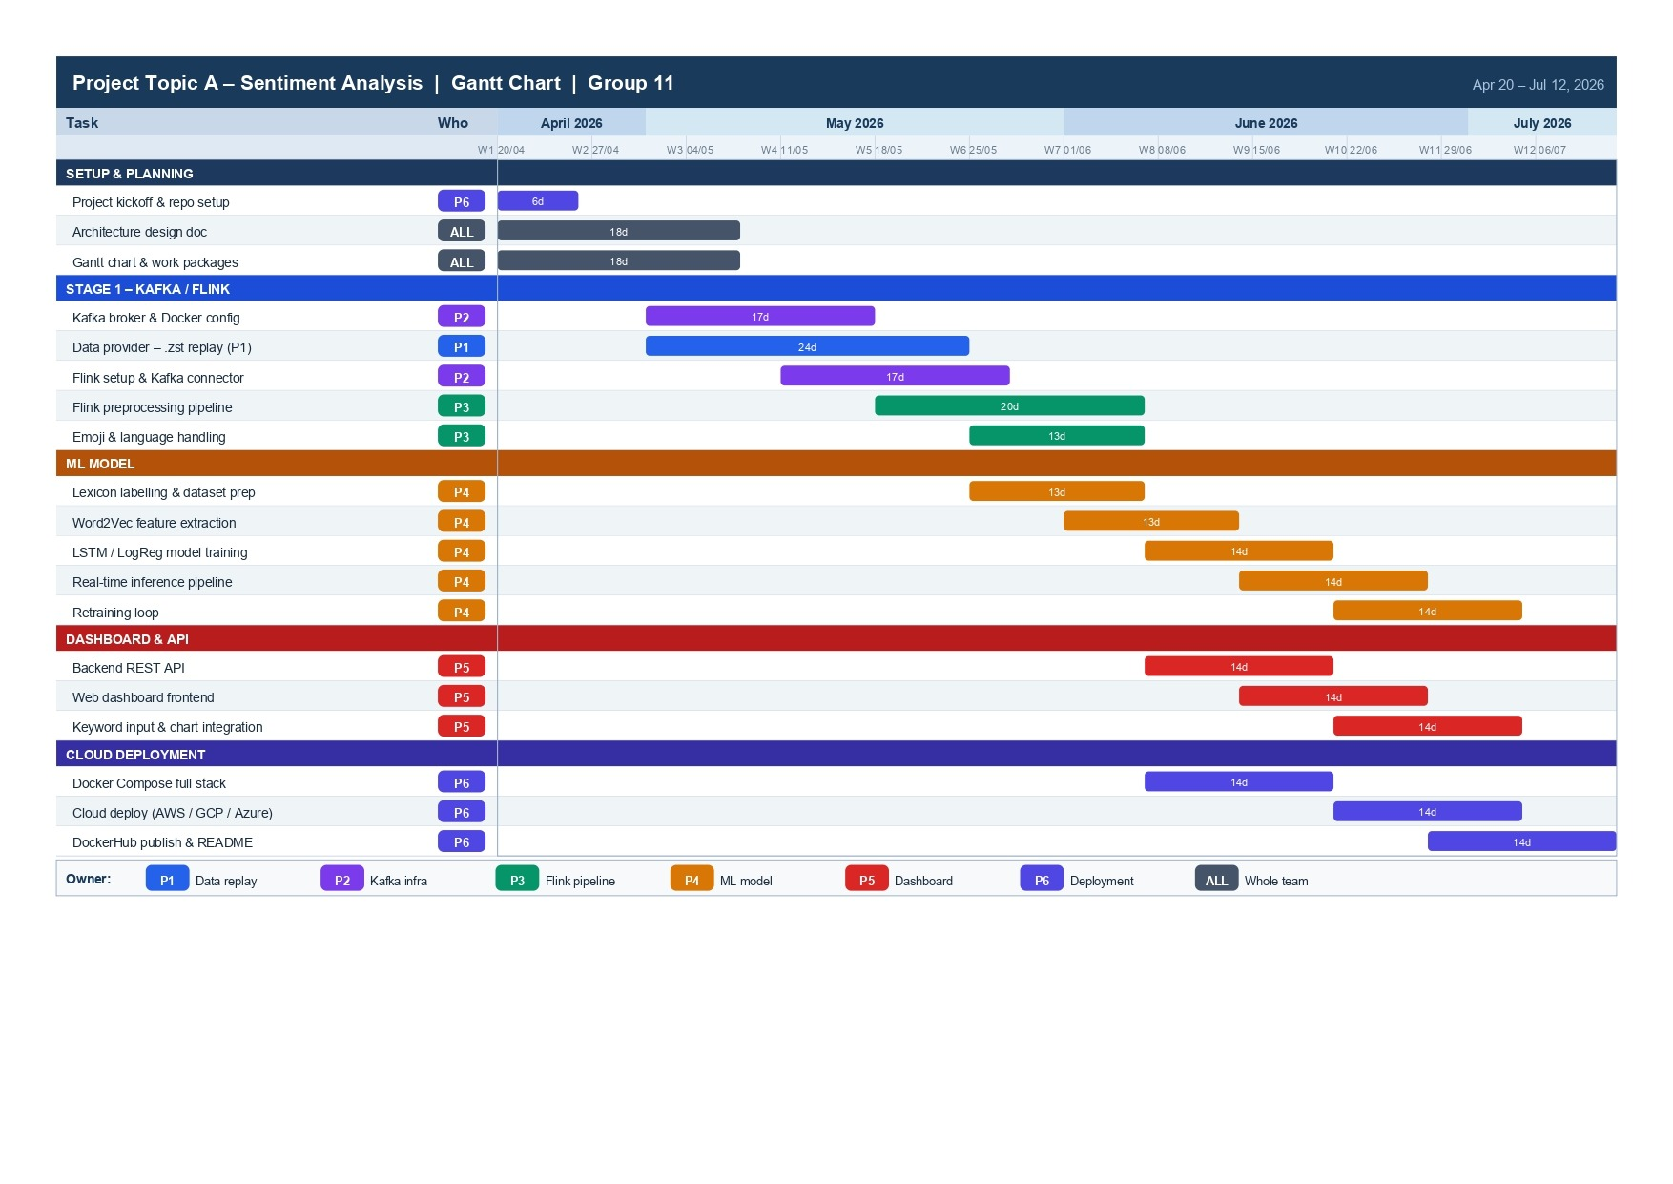
Timeline

Slide 5
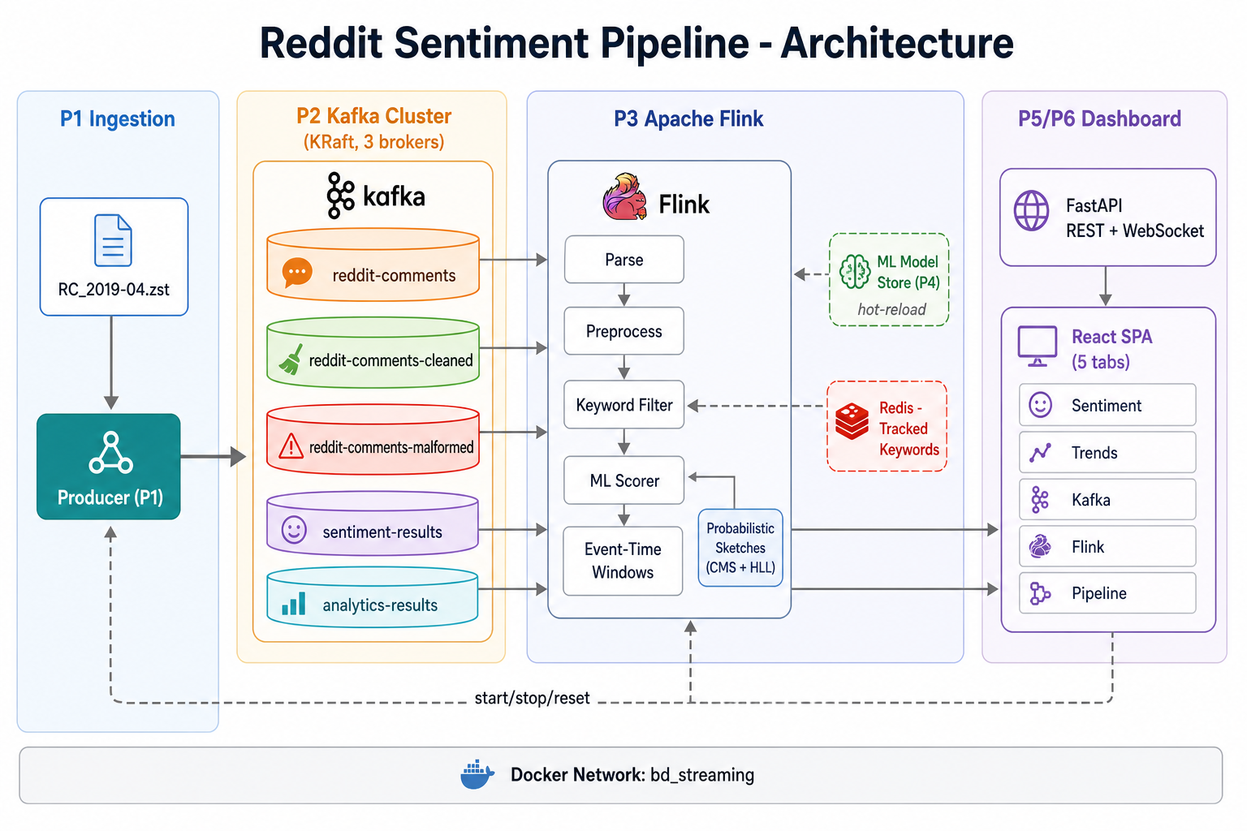
Actual Architecture Pipeline

Slide 6
Thank you!

