Slide 1
Cyclistic Bike-Share Analysis
Ayoub Aaraichi — Junior Data Analyst
Google Data Analytics Capstone

Slide 2
Business Task
Determine how annual members and casual riders use Cyclistic bikes differently.
  Insights support marketing strategies to convert casual riders into annual members.
  Executives require evidence-driven recommendations.

Slide 3
About the Data
Dataset: Divvy public bike-share data (2019 Q1 & 2020 Q1).
  Includes timestamps, ride length, station data, and rider type.
  No personal identifying information included.
  Cleaned dataset: ~790,000 rides.

Slide 4
Data Cleaning & Preparation
Standardized column names across years.
  Created fields: ride_length, day_of_week, month, hour.
  Removed negative and unrealistic ride durations.
  Ensured consistent data types for merging.

Slide 5
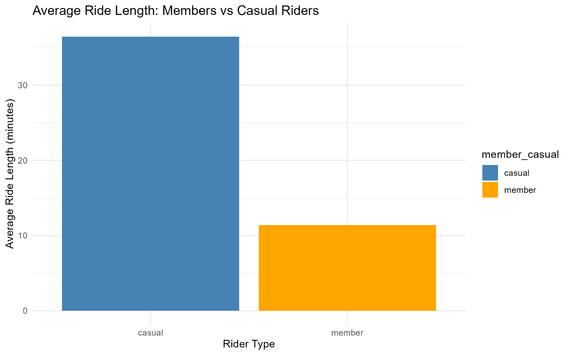
Average Ride Length
Casual riders average 36.5 minutes per trip.
  Members average 11.4 minutes per trip.
  Indicates leisure vs. commuter behavior difference.

Slide 6
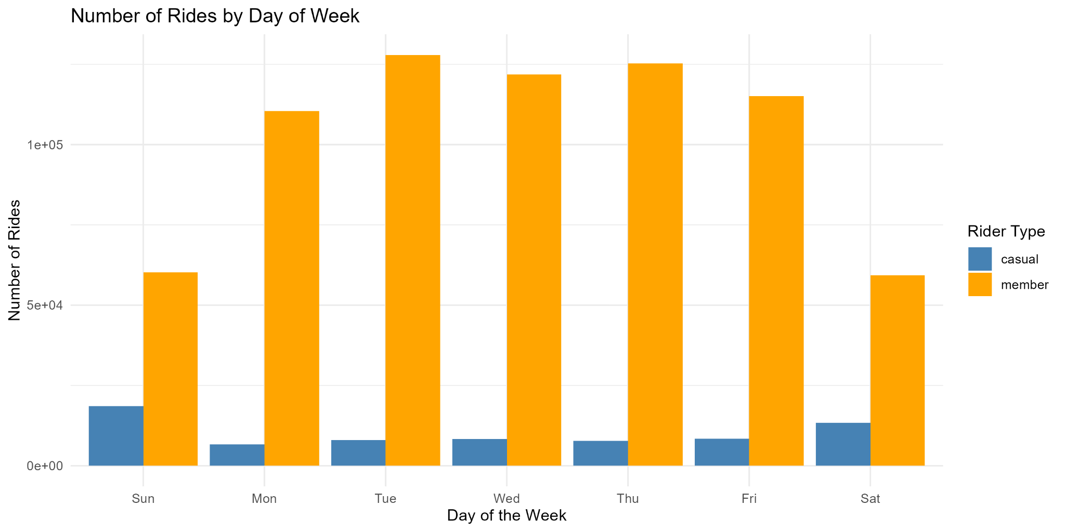
Rides by Day of Week
Casual riders peak on weekends.
  Members peak Monday–Friday.
  Clear segmentation: leisure vs. commuters.

Slide 7
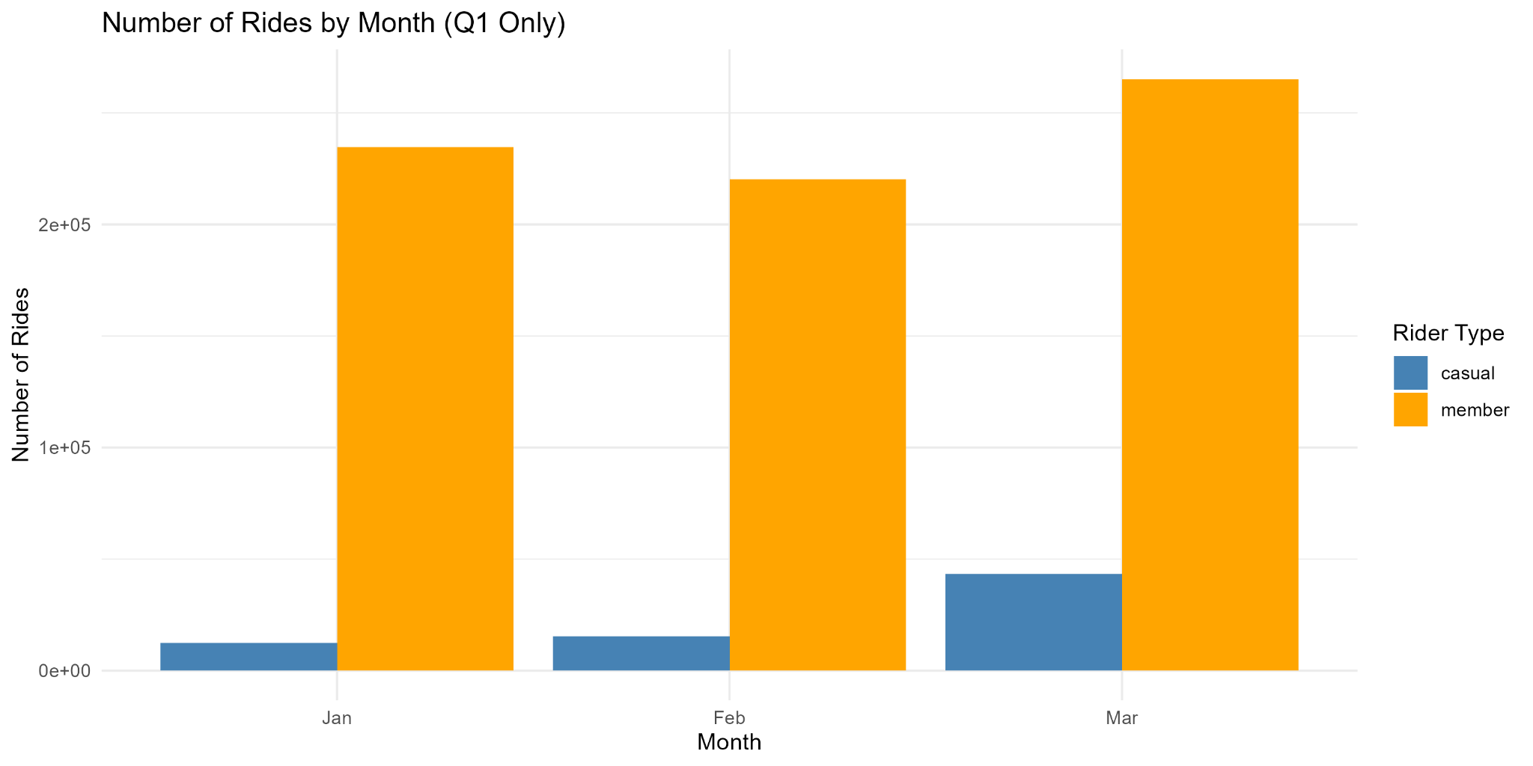
Rides by Month (Q1 Only)
Casual riding increases dramatically from Jan → Mar.
  Member usage remains steady.
  Seasonality offers conversion opportunities.

Slide 8
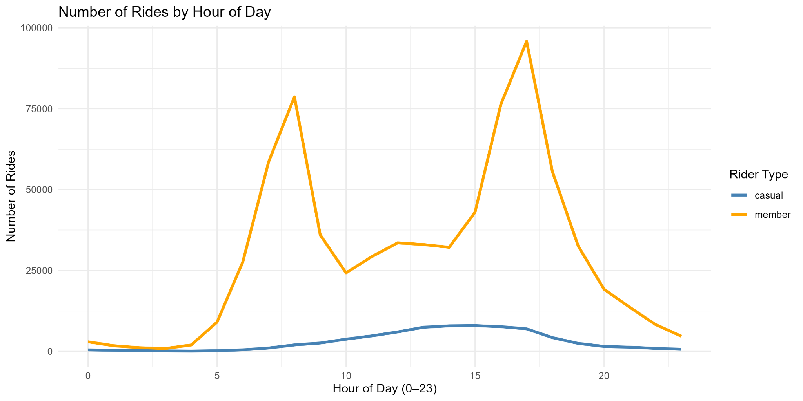
Rides by Hour of Day
Members ride most during commute hours (7–9 AM, 4–6 PM).
  Casual riders ride mid-day.
  Strong behavioral pattern differences.

Slide 9
Key Insights Summary
Casual riders take 3× longer rides.
  Casual usage peaks weekends and warm months.
  Members follow predictable weekday commute patterns.
  Clear differentiation enables targeted marketing strategies.

Slide 10
Final Conclusion
Members and casual riders show distinct usage patterns.
  Understanding these patterns enables strategic membership growth.
  Data supports targeted, behavior-based marketing campaigns.

Slide 11
Recommendation 1: Seasonal Promotions
Target casual riders during warm-season spikes.
  Offer discounted spring/summer membership upgrades.
  Use in-app prompts after long weekend rides.

Slide 12
Recommendation 2: Commuter-Focused Benefits
Promote membership as a weekday commuter solution.
  Employer discount partnerships.
  Advertise during morning/evening ride peaks.

Slide 13
Recommendation 3: Digital Behavioral Targeting
In-app notifications after long rides.
  Weekend social media ads for leisure riders.
  Personalized emails highlighting savings.

Slide 14
Next Steps
Run A/B tests on membership campaigns.
  Introduce commuter trial passes.
  Add weather & location data for deeper personalization.
  Monitor conversion metrics and optimize campaigns.

Slide 15
Conclusion
Cyclistic can grow membership by targeting casual riders.
  Behavior-based marketing increases conversion likelihood.
  Strong data patterns guide actionable strategies.

