Slide 1
Shadow
Flora 510 Yulin

Slide 2
Since the invention of film,human life has been extended at least three times longer than before.
Our group plans to integrate the films we have seen and visualize their types and quantities.Try to figure out what’s behind it.

Slide 3
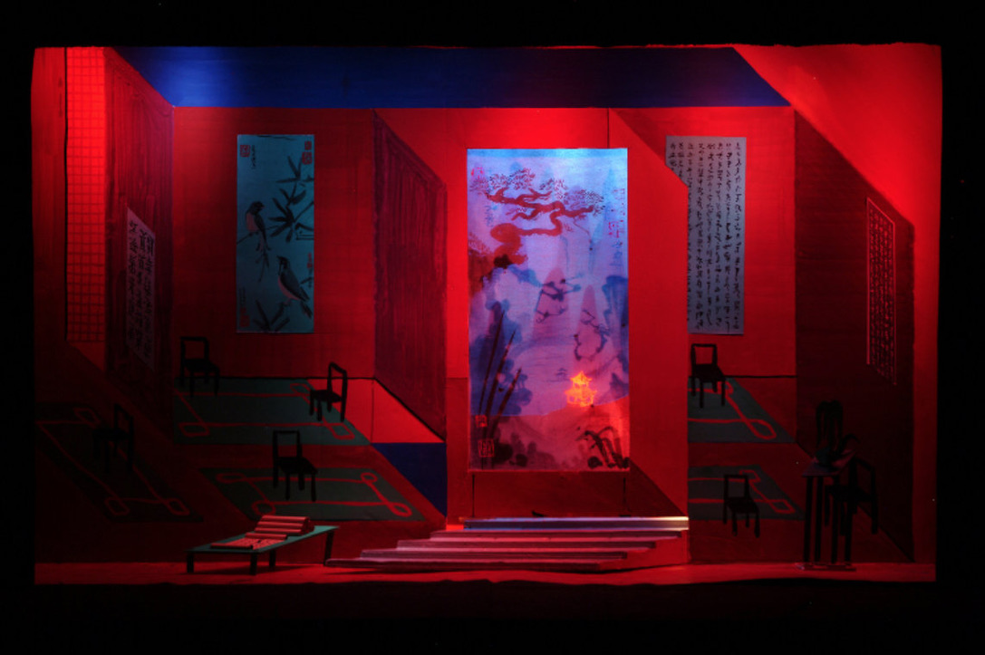
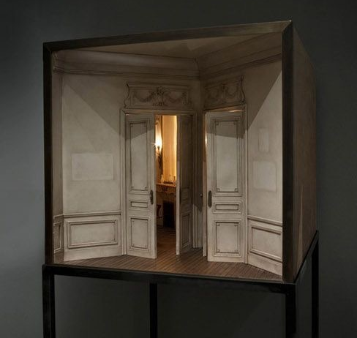
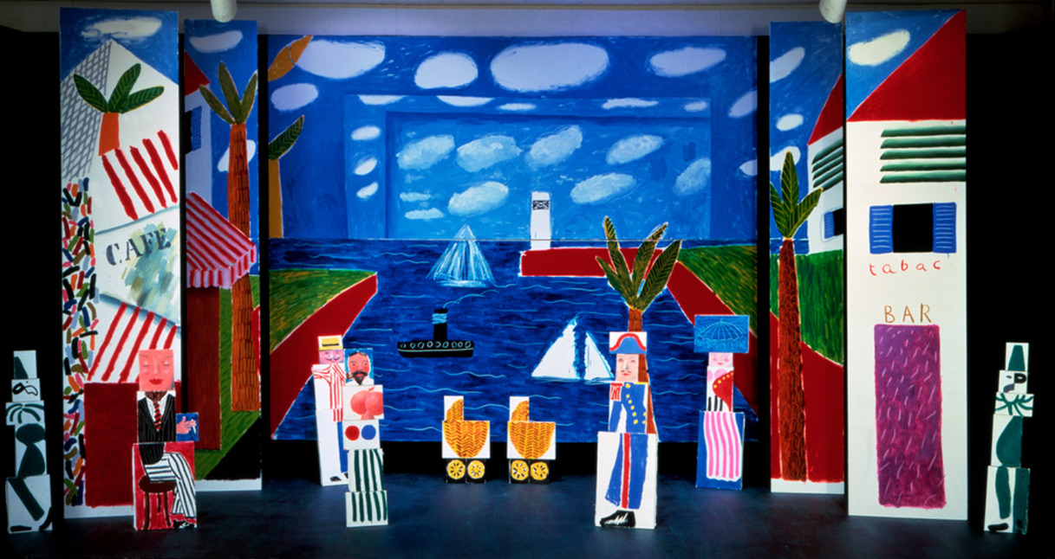
Inspiration
Artwork, Images, anything that inspired this project idea
Artwork, Images, anything
that inspired this project idea

Slide 4
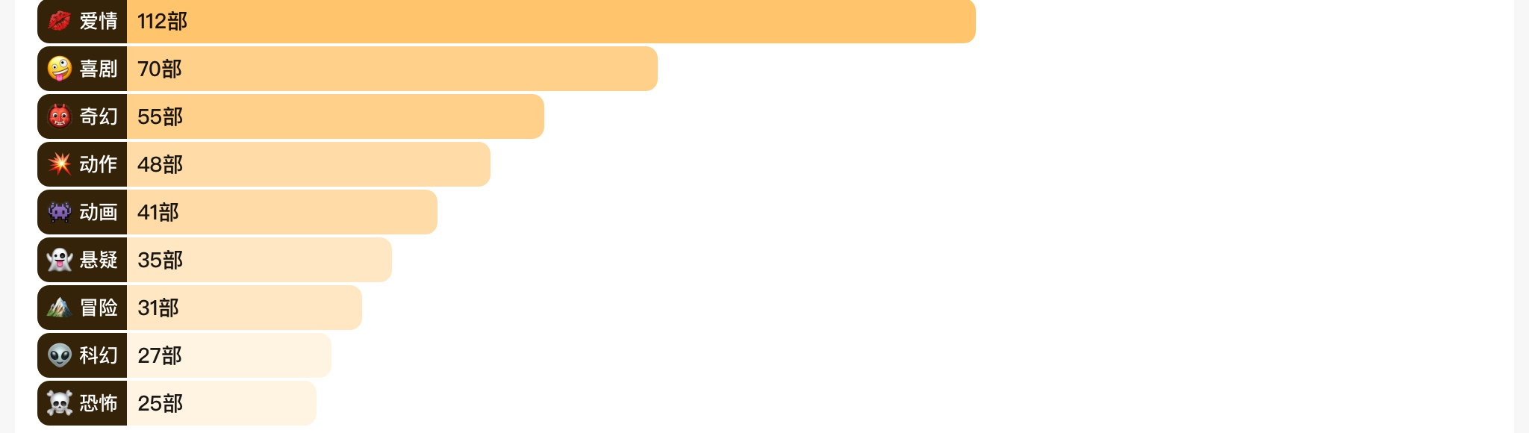
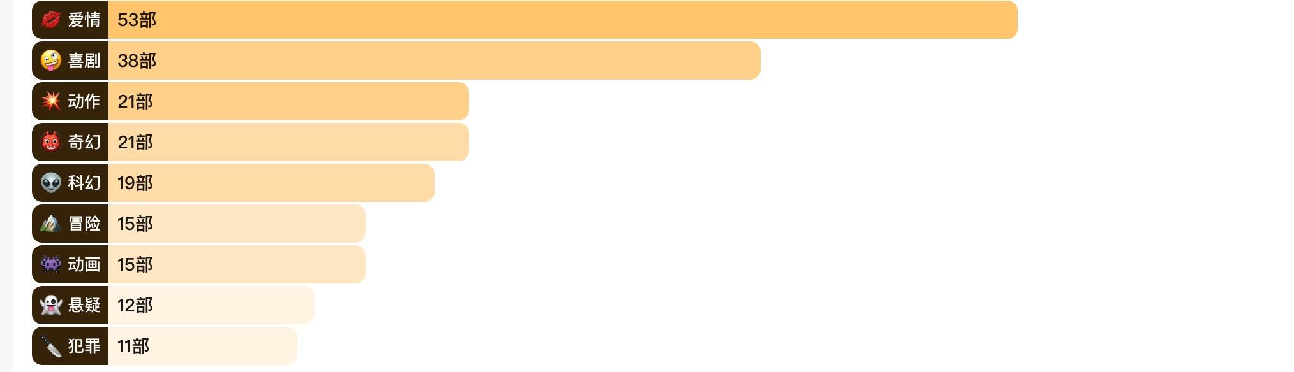
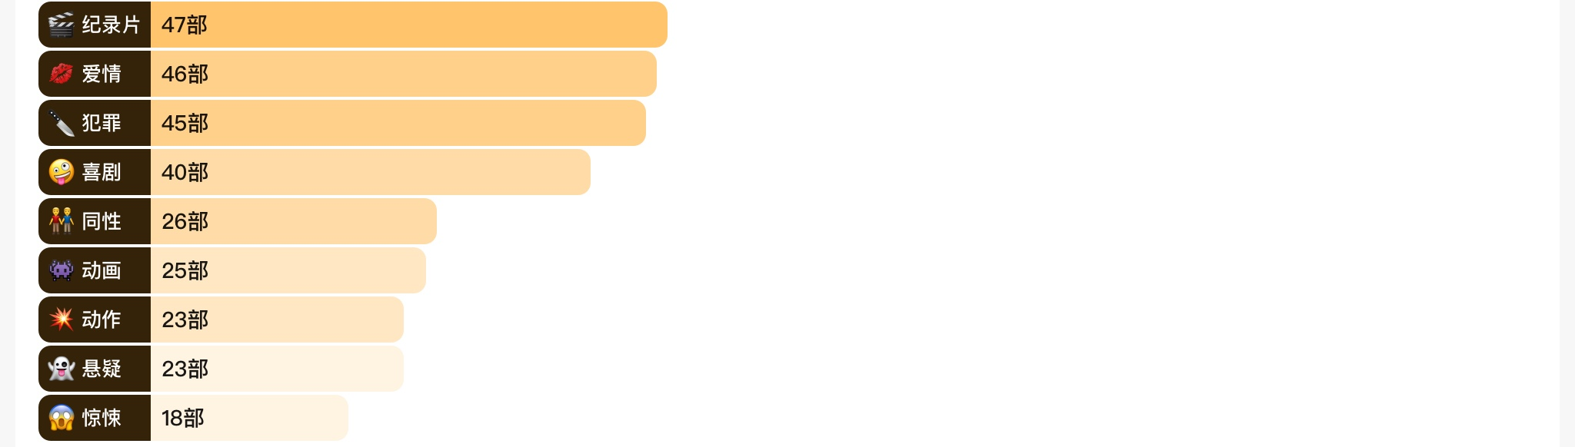
Data you will use

Slide 5
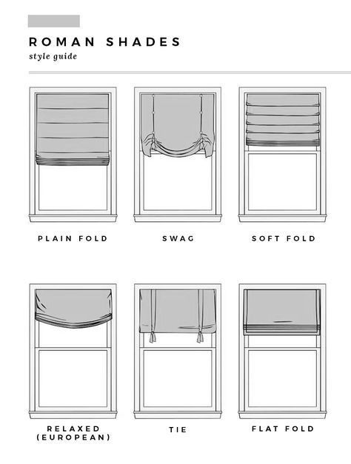
How you will translate the data?
Number of movies

Slide 6
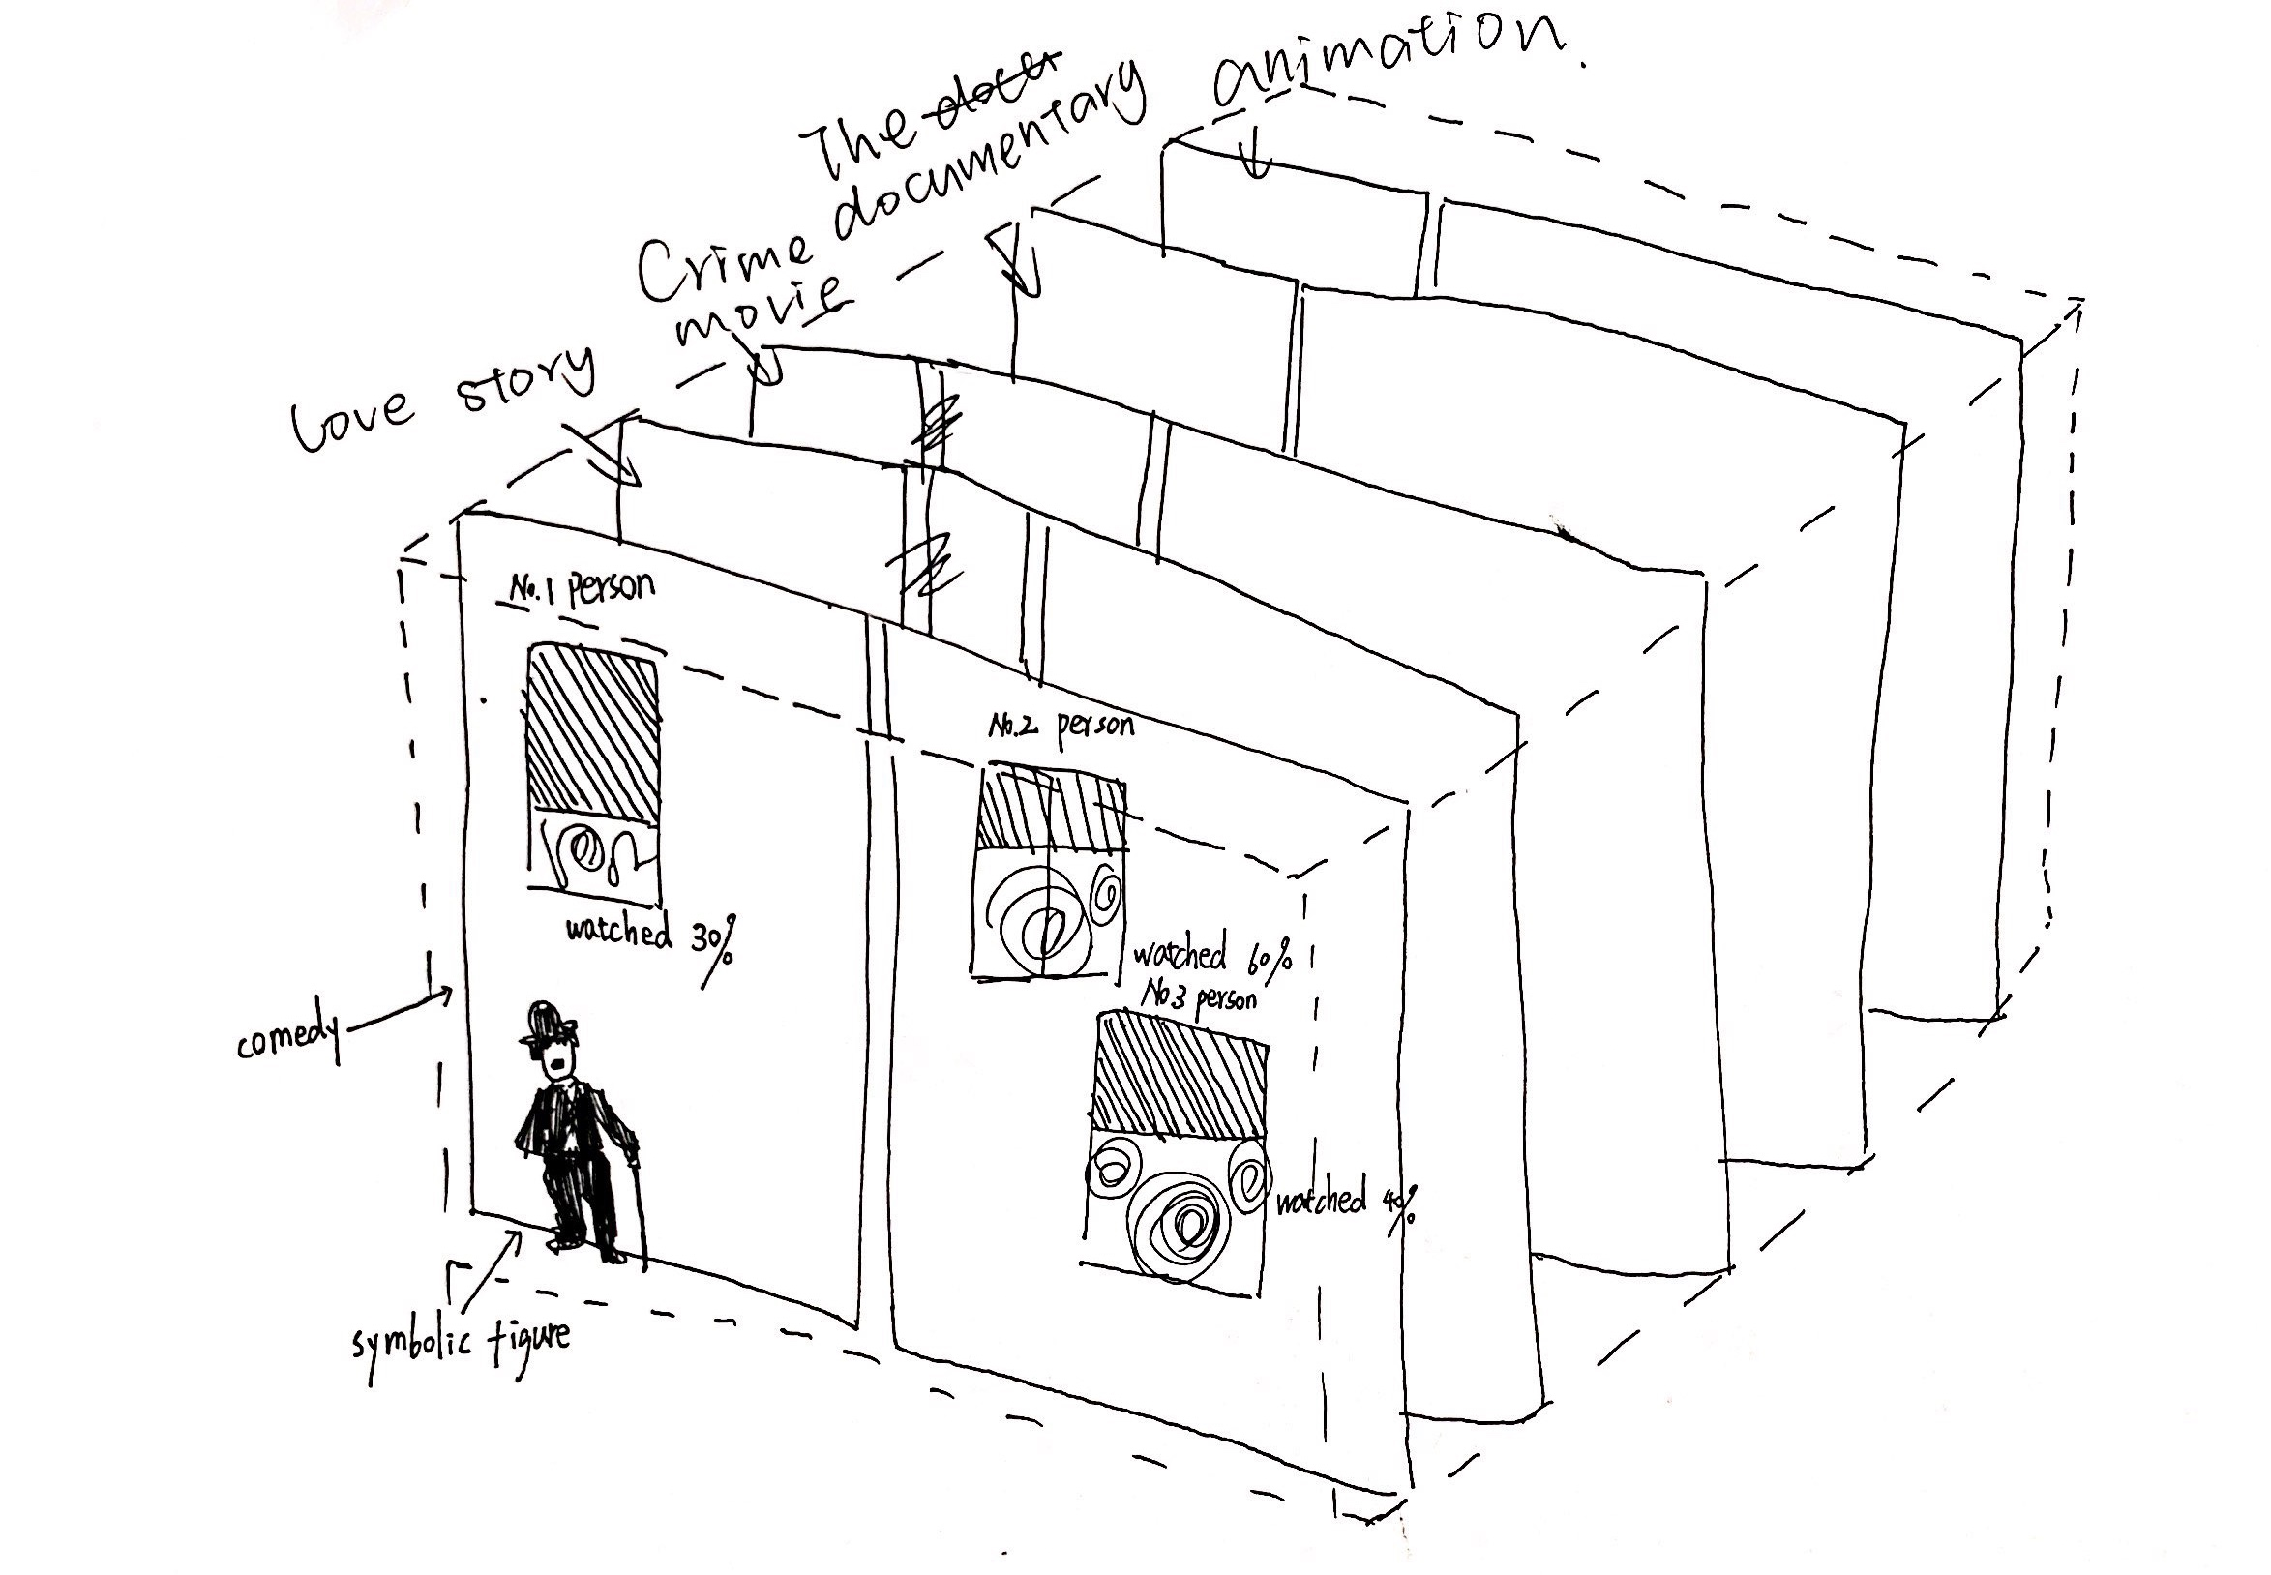
Form Sketches
Sketches of final form
Sketches of final form idea

Slide 7
Timeline for Completion
1.Draw a detailed sketch of each scene
2.Select material
3.Making model

Slide 8
Thank you

