Slide 1
AstroShield
NASA Space Apps Challenge 2025 – Meteor Madness
Team AstroShield · Delhi, India

Slide 2
About Us
We are team SpaceGeeks! We are a team of 4 students from Somerville School, Vasundhara Enclave, East Delhi. We are currently in Grade 10th, and are 15 year olds. Our names are Aarav Gupta, Arjun Singh, Ayush Jha and Joyraj Chanda. We all have a keen interest in the fields of Space and Technology. Aarav and Ayush have contributed in Frontend equally. Arjun has helped in the development of Backend, and Joyraj has provided all the required data for the development, and helped in testing of the Website.

Slide 3
Challenge & Problem
Planetary-defense datasets are split across NASA and Earth-science silos.
Decision-makers and educators lack instant, trustworthy impact assessments.
Manual calculators are slow, error-prone, and inaccessible to the public.

Slide 4
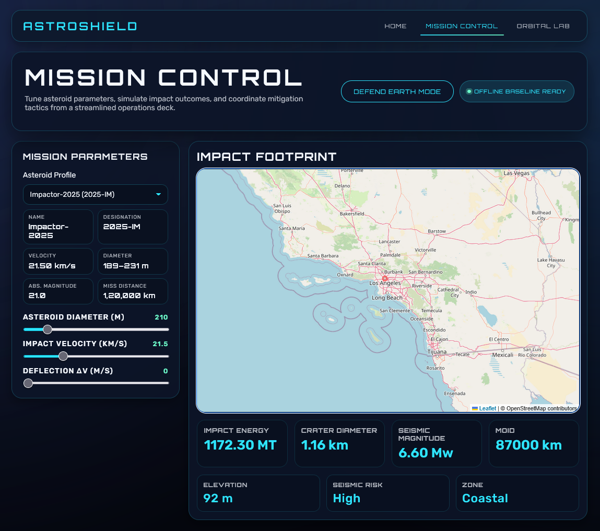
Solution Overview
Unified mission console auto-syncs NASA NEO data with Earth context.
Auto-updating controls animate kinetic energy, crater, and seismic metrics.
Defense Mode and Orbital Lab enable rapid scenario exploration.

Slide 5
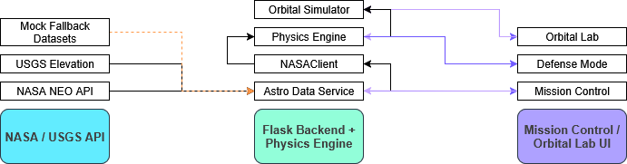
Architecture & Data Flow
Flask backend orchestrates NASA fetches with deterministic fallbacks.
Physics engine computes energy, crater, seismic, and orbital solutions.
Front-end (Leaflet, Three.js, GSAP) renders impact maps and orbital viz.

Slide 6
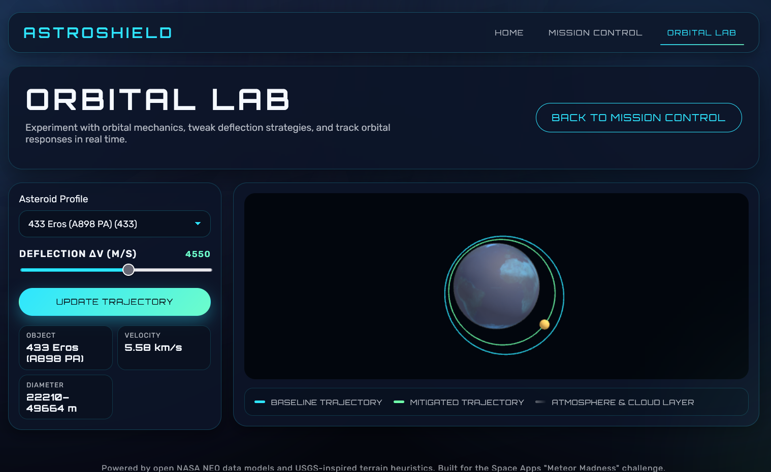
Key Features
Auto-run simulations with live NASA vs fallback status indicator.
Defense Mode countdown evaluates mitigation success in real time.
3D Orbital Lab visualizes baseline vs deflected trajectories.

Slide 7
Impact & Value
Communicates complex planetary-defense science in minutes for any audience.
Enables rapid ‘what-if’ decision support for mitigation planning.
Classroom-ready visuals drive STEM outreach and citizen science engagement.

