Slide 1
AstroShield
NASA Space Apps Challenge 2025 – Meteor Madness
Team AstroShield · Delhi, India

Slide 2
Challenge & Problem
Planetary-defense datasets are split across NASA and Earth-science silos.
Decision-makers and educators lack instant, trustworthy impact assessments.
Manual calculators are slow, error-prone, and inaccessible to the public.

Slide 3
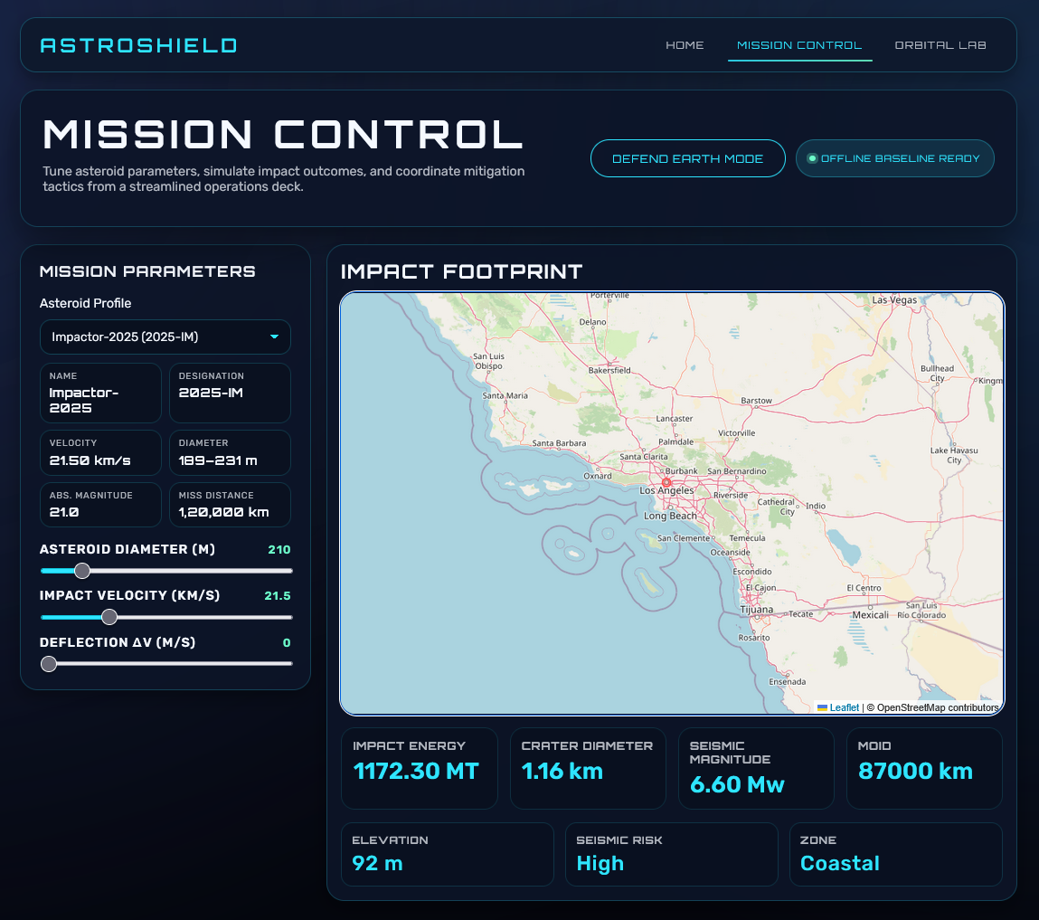
Solution Overview
Unified mission console auto-syncs NASA NEO data with Earth context.
Auto-updating controls animate kinetic energy, crater, and seismic metrics.
Defense Mode and Orbital Lab enable rapid scenario exploration.

Slide 4
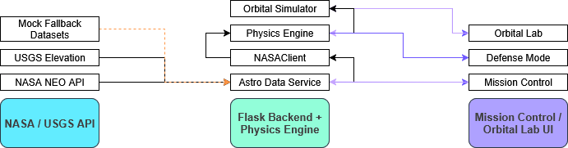
Architecture & Data Flow
Flask backend orchestrates NASA fetches with deterministic fallbacks.
Physics engine computes energy, crater, seismic, and orbital solutions.
Front-end (Leaflet, Three.js, GSAP) renders impact maps and orbital viz.

Slide 5
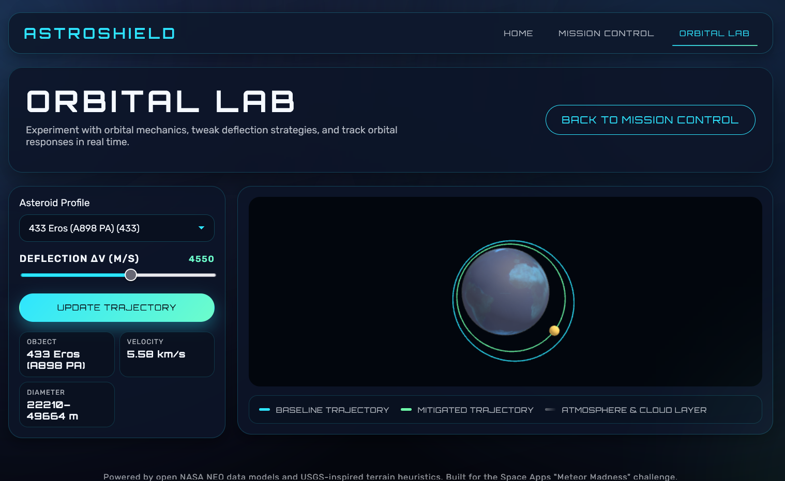
Key Features
Auto-run simulations with live NASA vs fallback status indicator.
Defense Mode countdown evaluates mitigation success in real time.
3D Orbital Lab visualizes baseline vs deflected trajectories.

Slide 6
Impact & Value
Communicates complex planetary-defense science in minutes for any audience.
Enables rapid ‘what-if’ decision support for mitigation planning.
Classroom-ready visuals drive STEM outreach and citizen science engagement.

