Slide 1
Developing a Standardized and Reproducible
Evaluation Framework for IoV Intrusion
Detection Using the CICIoV2024 Dataset
Project Progress Presentation
[Aarav Bhandari]
[220905448]
[CSE Core — B.Tech]
Under the guidance of
Dr. Girija Attigeri
[Associate Professor, School of Computer Engineering]
1 / 20

Slide 2
Presentation Outline
1
Introduction
6
Work Done So Far
2
Literature Survey / Background Theory
7
Remaining Work
3
Problem Definition
8
Scope
4
Objectives
9
Conclusion
5
Methodology
10
References
2 / 20

Slide 3
Introduction
The Controller Area Network (CAN) bus — the primary communication protocol connecting all Electronic Control Units in modern vehicles — was designed without authentication, encryption, or access control, making it fundamentally vulnerable to cyberattacks such as Denial-of-Service and sensor spoofing. Despite a growing body of ML-based intrusion detection research, the field lacks a standardized, reproducible evaluation framework, with studies using inconsistent preprocessing, incompatible split strategies, and no assessment of robustness or zero-day generalization — making it impossible to fairly compare or validate approaches for real-world deployment.
3 / 20

Slide 4
Literature Survey / Background Theory
20 references organized across 5 thematic categories, elaborate table in the following slides.
01 CICIoV2024 Dataset
02 IoV & CAN Security Surveys
03 ML-Based CAN IDS
[1] Neto et al. [2] Le & Alsmadi [3] Janbi
[4] Rajapaksha [5] Özdemir [6] Lampe [7] PeerJ [8] Wu
[9] Song [10] Hossain [11] Tariq [12] Yang [13] Nazeer [14] Miller
04 Benchmark Datasets
05 Core ML Algorithms
[15] Car-Hacking [16] OTIDS [17] CANet/SynCAN [18] ROAD
[19] XGBoost — Chen & Guestrin [20] LightGBM — Ke et al.
⚠ Key Finding: After strict deduplication, F1-Macro drops from ~1.0 to 0.64 — the 'accuracy trap' (Le & Alsmadi [2])
4 / 20

Slide 5
Literature Survey — References 1–7 (Dataset & IoV Security Surveys)
 | # | Authors (Year) | Yr | Contribution | Drawbacks / Limitations
 | CICIoV2024 Dataset [1–3]
 | 1 | Neto et al. | 2024 | Proposed CICIoV2024 — realistic benchmark with 5 attacks on real 2019 Ford vehicle; baseline ML evaluation included. | Single vehicle model; extreme class imbalance (GAS: 25 unique frames after dedup).
 | 2 | Le & Alsmadi | 2026 | Applied strict deduplication; exposed the "accuracy trap"; honest baseline established (F1-Macro ≈ 0.64). | Only K-Fold used; no holdout or zero-day evaluation; small post-dedup dataset limits generalizability.
 | 3 | Janbi | 2025 | Evaluated 25 ML models on CICIoV2024; ensemble/tree-based models outperform all others under class imbalance. | No robustness evaluation; no adversarial testing; no cross-dataset validation.
 | IoV & CAN Security Surveys [4–7]
 | 4 | Rajapaksha et al. | 2023 | Comprehensive survey of AI-based in-vehicle IDS (2016–2022); identifies inconsistent evaluation protocols as the core gap. | Survey only — does not implement or validate solutions to identified gaps.
 | 5 | Özdemir et al. | 2024 | Reviews 85 CAN anomaly detection papers; covers statistical, rule-based, and DL methods; highlights dataset quality limitations. | Focused on anomaly detection only; limited multi-class attack classification coverage.
 | 6 | Lampe & Meng | 2023 | Comprehensive review of CNN, LSTM, GRU, Bi-LSTM for automotive IDS; analyses temporal modelling suitability per architecture. | Survey only; no new experimental results; excludes classical ML comparison.
 | 7 | PeerJ Survey | 2023 | Systematic literature review covering CAN bus and Automotive Ethernet; proposes fine-grained DL-IDS taxonomy. | Limited to DL methods; no benchmarking against classical ML baselines.
5 / 20

Slide 6
Literature Survey — References 8–14 (ML-Based CAN IDS)
 | # | Authors (Year) | Yr | Contribution | Drawbacks / Limitations
 | ML-Based CAN Intrusion Detection Systems [8–14]
 | 8 | Wu et al. | 2024 | Reviews deep transfer learning for IoV IDS; shows TL reduces training time and memory for embedded deployment. | TL limited when source/target domains differ significantly; no CICIoV2024 evaluation.
 | 9 | Song et al. | 2020 | Deep CNN achieves high detection accuracy on Car-Hacking dataset; validates DL for real-time CAN monitoring. | Tested on one dataset only; no evaluation on unseen attack types or cross-dataset generalization.
 | 10 | Hossain et al. | 2020 | LSTM captures temporal CAN traffic patterns; achieves high accuracy; demonstrates sequence modelling for IDS. | Performance degrades on attack types absent from training; attacks are simulated rather than real.
 | 11 | Tariq et al. | 2020 | Random Forest CAN-ADF framework; high recall on known attacks; structured evaluation approach. | Fails to generalize beyond trained attack categories; no zero-day or robustness evaluation.
 | 12 | Yang et al. | 2022 | LCCDE ensemble assigns best model (XGBoost/LightGBM/CatBoost) per attack class; near-perfect accuracy on Car-Hacking and CICIDS2017. | No holdout or cross-dataset evaluation; high model complexity; no CAN-specific dataset used.
 | 13 | Nazeer et al. | 2024 | DeepXG hybrid: XGBoost feature selection + DNN; 99.90% accuracy on real OBD-2 CAN traffic. | Tested on a single proprietary dataset; not publicly reproducible; no robustness evaluation.
 | 14 | Miller & Valasek | 2015 | Landmark demonstration of full remote vehicle takeover via CAN injection; established real-world urgency for in-vehicle cybersecurity. | Attack-specific exploit; no defensive mechanism or IDS proposed.
6 / 20

Slide 7
Literature Survey — References 15–20 (Benchmark Datasets & Core ML Algorithms)
 | # | Authors (Year) | Yr | Contribution | Drawbacks / Limitations
 | Benchmark Datasets [15–18]
 | 15 | Song et al. | 2018 | Car-Hacking Dataset — most widely used CAN IDS benchmark; contains DoS, fuzzy, RPM, and gear spoofing attacks. | Attacks artificially injected; lacks multi-ECU realism; no masquerade or suspension attacks.
 | 16 | Lee et al. | 2017 | OTIDS dataset with fabrication, suspension, and masquerade attacks; broader diversity than Car-Hacking. | Small scale; limited attack variety; no real driving scenario diversity.
 | 17 | Hanselmann et al. | 2020 | First DL-IDS handling multi-ID, variable-frequency CAN natively; introduces SynCAN synthetic dataset; unsupervised approach. | SynCAN is synthetic — limits real-world applicability; unsupervised method provides no attack-class labels.
 | 18 | Verma et al. | 2024 | Comprehensive guide to all public CAN IDS datasets; introduces ROAD dataset with real, physically verified attacks including masquerade variants. | Complex signal-translation preprocessing required; limited to one vehicle.
 | Core ML Algorithms [19–20]
 | 19 | Chen & Guestrin | 2016 | XGBoost — scalable, regularized gradient boosting with parallel computation; widely adopted for structured data classification. | Prone to overfitting on small datasets without careful tuning; reduced interpretability vs. simpler models.
 | 20 | Ke et al. | 2017 | LightGBM — histogram-based gradient boosting with leaf-wise tree growth; significantly faster training than XGBoost at scale. | Leaf-wise growth can overfit on small datasets; requires careful num_leaves tuning.
CICIoV2024 Dataset [1–3]
IoV & CAN Surveys [4–7]
ML-Based CAN IDS [8–14]
Benchmark Datasets [15–18]
Core ML Algorithms [19–20]
7 / 20

Slide 8
Problem Definition
Despite a growing body of ML-based CAN IDS research, the field lacks a common evaluation standard — making it impossible to meaningfully compare results across papers.
Five Specific Gaps Identified from Literature
1
Deduplication Inconsistency
Le & Alsmadi [2]
Some studies remove CAN duplicates, others retain them, inflating performance artificially.
2
Only Random 80/20 Splits
Rajapaksha [4]
No cross-scenario or zero-day holdout evaluation used in most papers.
3
Incompatible Metrics & Datasets
Verma [18]
Models benchmarked on different datasets with incompatible metrics — comparison is meaningless.
4
No Robustness Testing
Lampe & Meng [6]
Systematic robustness testing under realistic data perturbations is absent from literature.
5
Security Metrics Unreported
Rajapaksha [4]
Detection rate and FPR — the most security-critical metrics — are inconsistently defined or omitted.
8 / 20

Slide 9
Problem Definition: The CICIoV2024 Dataset
Dataset Facts
Class Distribution (Post-Deduplication)
• Source: Real 2019 Ford vehicle, all original ECUs intact
Class
Raw Count
Unique
Proportion
• Raw frames: 1,408,219 CAN frames (6 CSV files)
BENIGN
1,223,737
3,117
86.87%
DoS
74,663
191
5.32%
• After deduplication: 3,588 unique frames (99.7% reduction!)
Spoofing-RPM
54,900
139
3.87%
• Features: CAN ID + DATA_0..DATA_7 (8 bytes) + inter-arrival index
Spoofing-SPEED
24,951
66
1.84%
• Class imbalance: BENIGN = 86.87%; rarest class (Spoofing-GAS) = 0.70%
Spoofing-STEERING
19,977
50
1.39%
Spoofing-GAS
9,991
25
0.70%
⚠ The "Near-Perfect Accuracy" Trap:
Without deduplication: 1.4M frames → near-perfect F1. After deduplication: 3,588 unique frames → F1-Macro ≈ 0.64. Classifiers memorize duplicate frequency, not attack structure. This project enforces strict deduplication as a prerequisite.
9 / 20

Slide 10
Objectives
01
Reproducible Evaluation Framework
02
Benchmark 4 Diverse ML Classifiers
YAML-configurable, seeded (seed=42), SHA-256 checksums, library version logging & automated report generation.
Random Forest (bagging), SVM (kernel), XGBoost (sequential boosting), LightGBM (histogram boosting) — covering fundamentally different learning paradigms.
03
Zero-Day Generalization Assessment
04
Deployment Readiness Measurement
Attack-holdout evaluation across 5 experiments — each withholding an entire attack type from training to simulate real zero-day scenarios.
Per-sample inference latency vs. 1–10 ms CAN frame rate, FPR impact on driver experience, and embedded deployment constraints.
05
Augmentation-Based Robustness Evaluation
06
Research-Grade Documentation
Timing jitter (clock drift), Gaussian feature noise (sensor noise), and attack intensity scaling (variant simulation).
Structured JSON results, 60+ visualizations (confusion matrices, ROC curves, robustness heatmaps), and a research paper for IEEE/ACM submission.
10 / 20

Slide 11
Methodology: Architecture & Data Pipeline
Total: 4 models × 7 splits × 4 dataset variants = 112 experiments
01 CICIoV2024 Raw Data
02 Deduplication
1,408,219 CAN frames, 6 CSV files merged
Remove exact dupes on (ID, DATA_0–DATA_7) → 3,588 unique frames (99.7% reduction)
03 Feature Engineering
04 Normalization
Inter-arrival index computed (temporal ordering)
Min-Max scaling → all 10 features mapped to [0,1]
05 Augmentation Engine
06 Split Strategies
Timing Jitter (σ=2%) | Feature Noise (σ=1%) | Attack Intensity Scaling (0.85×–1.15×)
Random (80/20) | Scenario-Based | Attack Holdout ×5 = 7 configurations
07 Model Training
08 Evaluation & Report
RF | SVM | XGBoost | LightGBM
Accuracy, F1, ROC-AUC, DR, FPR, Latency → 60+ visualizations
11 / 20

Slide 12
Methodology: Split Strategies & Model Configuration
Split Strategy Design
Key Security Metrics
Split
What It Tests
Difficulty
Detection Rate (DR)
Random (80/20)
Basic classification ability
Standard
Recall specifically on attack-class samples — "What fraction of real attacks are caught?"
Scenario-Based
Cross-scenario generalization
Moderate
Attack Holdout (×5)
Zero-day / novel attack detection
Most Challenging
False Positive Rate (FPR)
Fraction of benign samples incorrectly flagged as attacks — "How often does it falsely alarm?"
Model Configurations
Model
Key Parameters
Class Handling
Robustness Score
Random Forest
200 trees, max_depth=20
Balanced weights
Mean |Δ metric| across augmentation types — lower score = more deployment-stable.
SVM
RBF kernel, C=1.0, γ=scale, max_iter=5000
Balanced weights
XGBoost
200 est., max_depth=8, LR=0.1, subsample=0.8
—
F1-Macro
Unweighted mean F1 across all classes — accounts for class imbalance in evaluation.
LightGBM
200 est., max_depth=8, 31 leaves
Balanced weights
12 / 20

Slide 13
Work Done So Far: Completed Modules
✅ All 112 experiments fully executed. Results persisted in results/experiment_results.json, robustness_analysis.json, and experiment_metadata.json.
✅
Data Loading & Merging
✅
Deduplication + Normalization
src/data_loader.py
src/preprocessing.py
✅
Feature Engineering
✅
All 3 Split Strategies
src/feature_engineering.py
src/splitting.py
✅
Model Factory (all 4 models)
✅
Evaluation Engine
src/models.py + config/config.yaml
src/evaluation.py
✅
Augmentation Engine (all 3 types)
✅
Robustness Analysis + Ranking
src/augmentation_engine.py
src/robustness.py
✅
Visualization (60+ plots)
✅
Reproducibility Logging
src/visualization.py
src/reproducibility.py
✅
Experiment Runner (112 runs)
✅
Report Generator
scripts/run_experiment.py
scripts/generate_report.py
13 / 20

Slide 14
Work Done So Far: Key Results
Baseline Performance (Original Dataset)
Model
Random F1
Scenario F1
DR (Scenario)
AUC
Latency (ms)
LightGBM ★
0.9964
0.9972 ✦
100% ✦
0.9999 ✦
0.0092
XGBoost
0.9970 ✦
0.9960
90%
0.9999
0.0042 ✦
Random Forest
0.9964
0.9924
70%
0.9991
0.0972
SVM
0.9924
0.9951
90%
0.9999
0.0084
Robustness Ranking (lower = more stable)
Inference Latency vs. CAN Requirements
Rank
Model
Robustness Score
Max |ΔF1|
CAN Frame Interval: 1–10 ms
1 ★
SVM
0.000232
0.0016
XGBoost
0.0042 ms
238× faster ✅
2
Random Forest
0.000355
0.0037
SVM
0.0084 ms
119× faster ✅
3
XGBoost
0.000512
0.0022
LightGBM
0.0092 ms
109× faster ✅
4
LightGBM
0.000535
0.0018
Random Forest
0.0972 ms
10× faster ✅
14 / 20

Slide 15
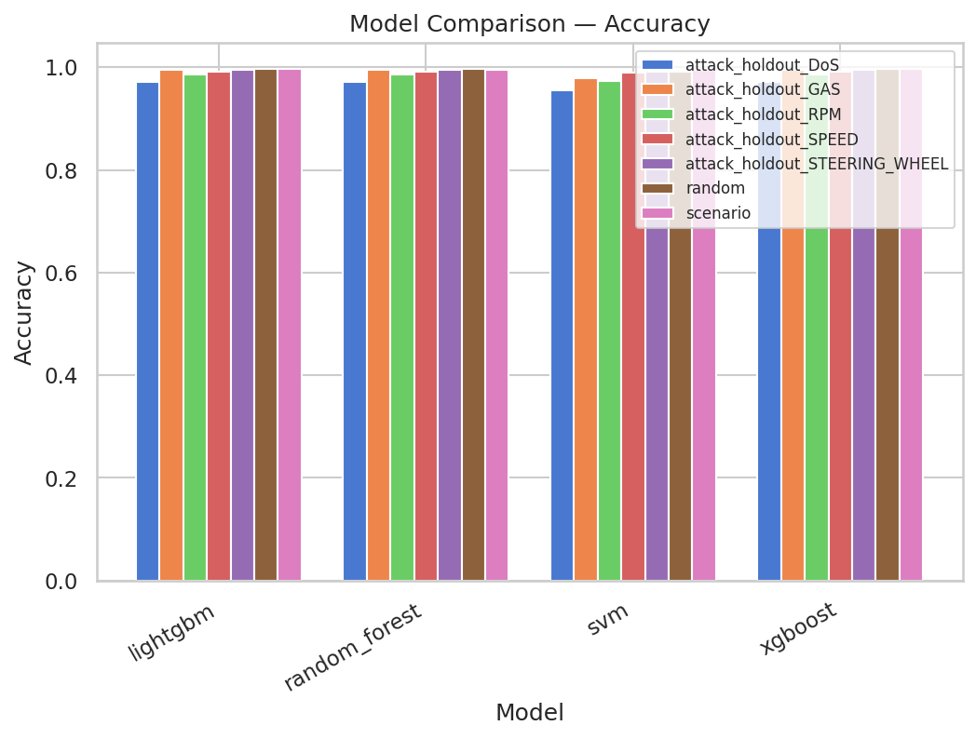
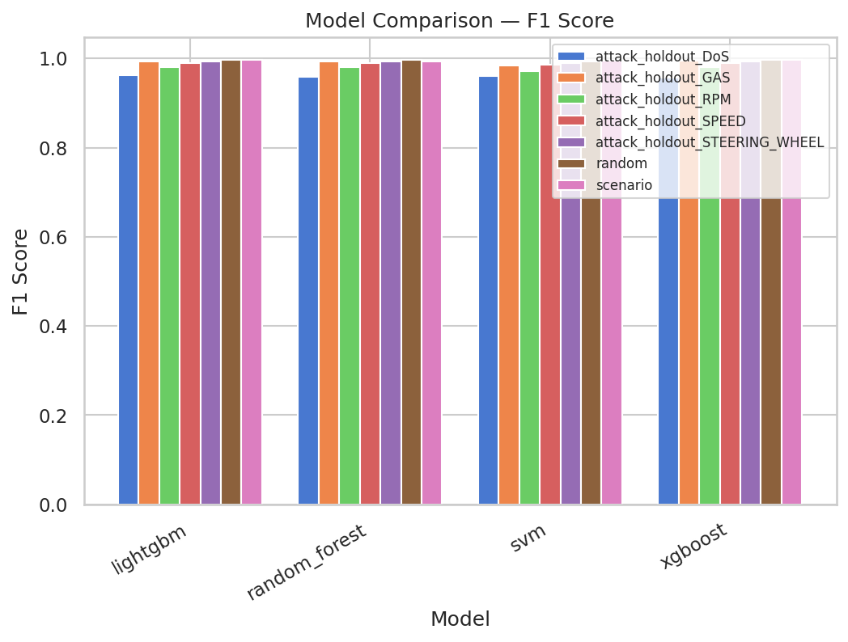
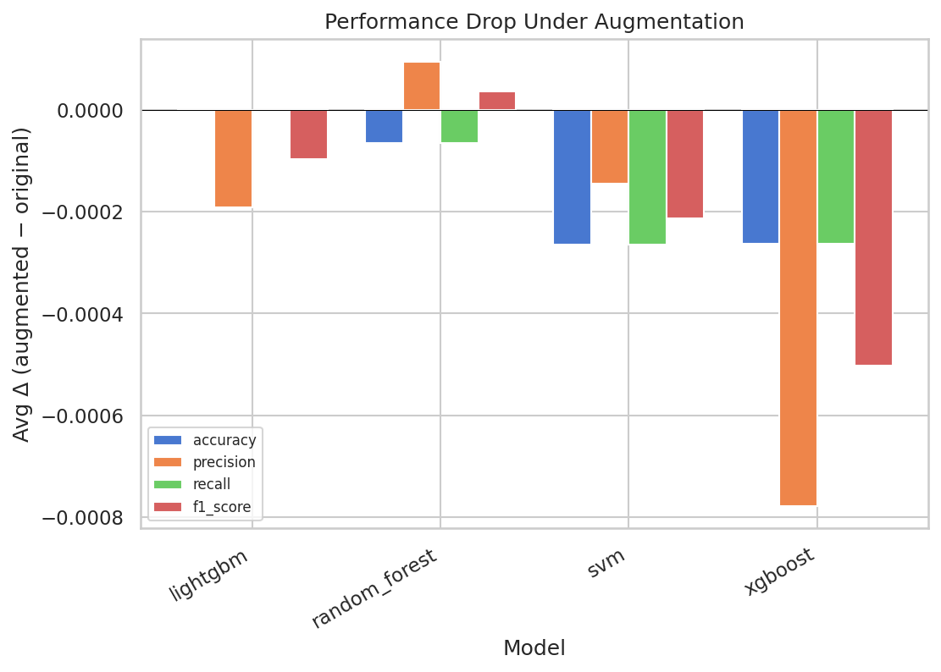
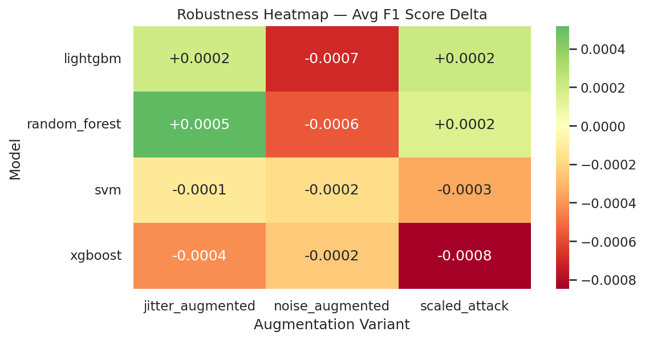
Work Done So Far: Key Results (Figures)
15 / 20

Slide 16
Remaining Work
1. Deep Learning Integration
High Priority
2. Sequence & Sliding-Window Features
High Priority
MLP, LSTM, and 1D-CNN architectures already scaffolded in src/deep_learning.py — need integration into main experiment runner for head-to-head comparison.
Implementing sliding-window aggregation across consecutive CAN frames — expected to improve DoS and RPM spoofing detection.
3. Cross-Dataset Validation
Medium Priority
4. Adversarial Robustness Evaluation
Medium Priority
Models trained on CICIoV2024 tested on Car-Hacking, OTIDS, and ROAD datasets to assess feature generalization across vehicle platforms.
Current augmentations simulate realistic noise. Next step: crafted adversarial CAN frames specifically designed to evade detection.
5. Feature Selection Benchmarking
Medium Priority
6. Final Report & Research Paper
Ongoing[High Priority]
MI, correlation filter, and PCA pipelines built in src/feature_selection.py — identify minimal feature set for embedded deployment.
Polish RESEARCH_PAPER.md for IEEE/ACM submission, finalize project report and documentation.
16 / 20

Slide 17
Scope
Technical Scope
Evaluates 4 classical ML classifiers (RF, SVM, XGBoost, LightGBM) across 7 split strategies and 3 augmentation variants = 112 fully executed experiments. Deep learning (MLP, LSTM, 1D-CNN) targeted for final phase. Framework is YAML-configurable and modular — new models, datasets, or augmentations can be added without restructuring the core pipeline.
Application Scope
All 4 models achieve sub-millisecond inference latency — directly applicable to on-board, real-time CAN bus monitoring in production vehicles. Attack-holdout evaluation specifically addresses novel/zero-day attacks post-deployment. Designed as a reusable community benchmark for standardized comparison.
Academic & Research Scope
Directly responds to standardization gaps identified by Rajapaksha et al. [4] and Verma et al. [18]. Novel contribution: augmentation-based robustness evaluation for CAN IDS — not present in prior work. Results contribute reproducible baselines; framework designed for open-source release.
Acknowledged Limitations
Post-deduplication dataset (3,588 samples) is small; rarest class (Spoofing-GAS, 25 samples) limits statistical confidence. Only frame-level features used — temporal/signal features may improve detection. Augmentations simulate noise but not adversarially crafted perturbations.
17 / 20

Slide 18
Conclusion
✅
Technical Feasibility Confirmed
Across 112 experiments, all 4 classifiers achieve F1 > 0.99 under standard protocols and sub-millisecond inference — comfortably within real-time CAN bus constraints.
⚠
The Zero-Day Challenge
Detection rates collapse for tree-based models on holdout attacks (XGBoost: 20% DoS, RF: 28%). SVM uniquely maintains 100% DR on DoS and GAS holdouts via smooth kernel boundaries — critical safety implication.
🛡
Robustness Validated
All models stable under realistic data variations — max F1 delta < 0.004 across 84 augmented experiments. SVM achieves lowest robustness score (0.000232), best for safety-critical environments.
★
Recommendation: Hybrid IDS Architecture
LightGBM as primary classifier (optimal accuracy, zero FPR, perfect DR on scenario evaluation) + SVM as secondary anomaly detector targeting novel/zero-day attacks that tree models miss.
18 / 20

Slide 19
References
CICIoV2024 Dataset & Surveys
ML-Based CAN IDS & Datasets
[1] E. C. P. Neto et al., CICIoV2024: Advancing Realistic IDS Approaches, IoT vol. 26, 2024.
[11] S. Tariq et al., CAN-ADF: CAN Attack Detection Framework, Comp. & Security vol. 94, 2020.
[2] H. Le & I. Alsmadi, Intrusion Detection for IoV CAN Bus Using ML, Future Internet 18(1), 2026.
[12] L. Yang et al., LCCDE: Ensemble Framework for IDS in IoV, IEEE GLOBECOM, 2022.
[3] N. F. Janbi, AI-Driven IDS in IoV: CICIoV2024 Insights, IJACSA 16(3), 2025.
[13] M. Nazeer et al., Hybrid XGBoost–DL for CAN Bus IDS, JESA, 2024.
[4] S. Rajapaksha et al., AI-Based IDS for In-Vehicle Networks: A Survey, ACM Comp. Surveys, 2023.
[14] C. Miller & C. Valasek, Remote Exploitation of Passenger Vehicle, Black Hat USA, 2015.
[5] Ö. Özdemir et al., Anomaly Detection in In-Vehicle Networks, arXiv:2409.07505, 2024.
[15] H. M. Song et al., Car-Hacking Dataset, IEEE DataPort, 2018.
[6] B. Lampe & W. Meng, DL-Based IDS in Automotive, Expert Systems vol. 221, 2023.
[16] H. Lee et al., OTIDS: IDS Dataset for In-Vehicle Network, 2017.
[7] In-vehicle IDS: Systematic Survey of DL Approaches, PeerJ Comp. Science, 2023.
[17] M. Hanselmann et al., CANet: Unsupervised IDS for CAN Bus, IEEE Access vol. 8, 2020.
[8] W. Wu et al., Deep Transfer Learning in IDS-IoV Review, CMC vol. 80, 2024.
[18] M. E. Verma et al., Comprehensive Guide to CAN IDS & ROAD Dataset, PLOS ONE, 2024.
[9] H. M. Song et al., In-vehicle IDS using deep CNN, Vehicular Comm. vol. 21, 2020.
[19] T. Chen & C. Guestrin, XGBoost: Scalable Tree Boosting System, KDD, 2016.
[10] M. D. Hossain et al., LSTM-based IDS for CAN bus, IEEE Access vol. 8, 2020.
[20] G. Ke et al., LightGBM: Highly Efficient Gradient Boosting, NeurIPS, 2017.
19 / 20

Slide 20
Thank You
Developing a Standardized and Reproducible
Evaluation Framework for IoV Intrusion Detection Using the CICIoV2024 Dataset
Manipal Institute of Technology, Manipal

