Slide 1

Visiting a new country?
Got stuck due the language barrier?

Slide 2

vTranslate
// Translate on the go

Slide 3
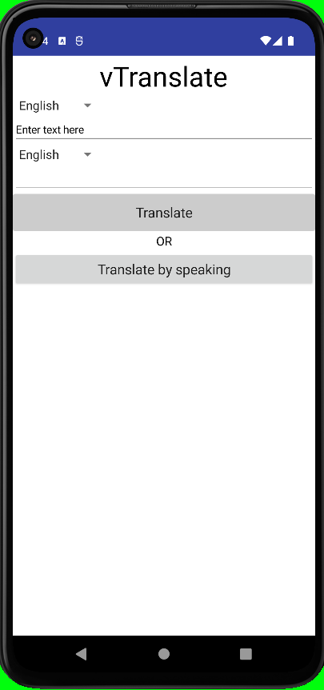
Simple
Accurate

Slide 4
Offline translation
Advert free

Slide 5

Download today!

