Slide 1


Slide 2


COMPANY DATABASE MANAGEMENT SYSTEM
Second Year Project Synopsis
Submitted by
ROLL | NAME
2301730252 | Aditya Goyal
2301730271 | Aarav
2301730272 | Mayank Garg
Industry Mentor: Mr. Rajesh Goyal
Faculty Mentor: Ms. Neetu Chauhan
Notes:
New Courses replaced with New Programmes

Slide 3

Project Overview
Centralized Data Systems: Establish company-wide web-based and back-end systems to track employee data — such as records, inventory, financial transactions, and payroll
Strong Database Management System (DBMS): A DBMS should be in place to provide integrity, security and efficient data operations (data entry, querying, updating, reporting).
Informed Decision Making: Deliver data insights in real time via a single and centralized platform to facilitate informed strategic decisions and strategic planning at business levels leading to improved overall business operational efficiency
Scalability & Performance Optimization: Ensuring the system can accommodate growing volumes of data and users and remains efficient and responsive as the company grows
PAGENO1.
Notes:
New Courses replaced with New Programmes

Slide 4
About the Problem
Data Inaccuracy and Fragmentation: A centralized database management system or central data source is still far away for many companies, and data is often fragmented in different departments and software bundles creating gaps that lead to data inaccuracies.
Another one is Security Vulnerabilities: To decentralized data storage, the risk of unauthorized access and data breaches increases, as sensitive information may be inadequately protected across multiple zones with sensitive information
Operational Inefficiencies: Data leading to time-consuming processes, reduced productivity, and increased potential for errors due to lack of integration and manual handling of the data.
Scalability Challenges — Without a solid system in place, horizontal scaling with growing choirs of data can result in performances issues and hindered project updates and data consistency.
Challenge of managing diverse data: A centralized Company Database Management System solves these challenges by bringing data together, enhancing security measures, streamlining operations, and providing scalability to grow alongside the company.
PAGENO2.
Notes:
New Courses replaced with New Programmes

Slide 5
Problem Statement
The absence of an organized and centralized database management system in an organization can be a hassle when it comes to managing vital data like employee records, inventory, transactions, payroll, etc. This leaves us waiting, guessing, and going through the eyes maintained by all this information sharing in the digital age.
Data is an important asset for any business and how to manage it properly. The inability to aggregate data from unique sources breeds errors, hinders operational efficiency, and muddles decision making. Moreover, it exposes sensitive data to potential breaches due to lack of data security and centralized access.
Centralize the Company Database Management System (CDMS) for improved data hands on, automation, accuracy and security in data handling. The potential for greater productivity, accelerated decision-making, and improved strategic planning is huge. It would also mitigate operational risks, ensure data integrity, and provide a scalable solution for future growth.
PAGENO3.
Notes:
New Courses replaced with New Programmes

Slide 6
Objectives
Centralized Information Management: Create a web-based interface to integrate all company data in one place, including employee records, inventory, financial transactions, and payroll.
Improved Data Integrity and Consistency: Put in processes to ensure that data across all departments is accurate and keeps up to date.
Implement Data Security Measures: Take all necessary steps to secure proprietary data from unauthorized access and potential breaches.
Operations Process: Automate regular tasks and processes to decrease human effort, lower errors, and boost performance.
Scalable System Architecture: It supports future business expansion by enabling easy integration of new data types, users and capabilities as the business grows.
PAGENO4.
Notes:
New Courses replaced with New Programmes

Slide 7
Methodology, Tools, and Techniques
Methodology:-
Agile Methodology: Deployed work cycles and feedback loops to increase agility.
Test-Driven Development (TDD) : Writing tests prior to code implementation to verify the functionality and minimize defects
Modular Design: broke the system down into independent modules which make it easier to maintain
Tools:-
Frontend: HTML CSS JavaScript React Js
Backend: Node. js, Express. js, RESTful APIs
Database: MySQL
Techniques:-
Continuous Integration/Continuous Deployment (CI/CD): Automation of testing and deployment for quick release cycles
Design Strategies to Improve User Experience Responsive Design Pillars of Good Web/UX Design Code Refactoring: Last a code structure for readability review making.
PAGENO5.
Notes:
New Courses replaced with New Programmes

Slide 8
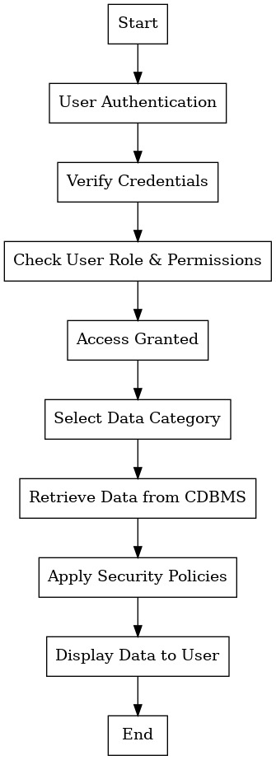
Methodology Flowchart
PAGENO6.
Notes:
New Courses replaced with New Programmes

Slide 9
Expected Results & Impact
The Company will provide a fully developed, web-based Company Database Management System (CDMS), which will include all core company data on one platform. It is going to aid data administration, enhance precision.
it will effectively solve the identified problem by centralizing fragmented data, automating processes, improving data security, and enabling real-time decision-making through better access to accurate information.
The deliverable will include a working model of the website, showcasing all core functionalities such as data entry, querying, reporting, and security protocols, ensuring it meets the company’s operational needs.
The project will contribute to the field by providing a practical solution for efficient data management in businesses, particularly in companies with growing data and complex operations. It will serve as a model for other organizations looking to streamline their internal systems.
Potential benefits include improved operational efficiency, enhanced decision-making, secure data handling, and better scalability, which can be implemented across industries that rely on data-driven operations. Researchers and industries will benefit from the system’s real-time insights, automation, and security features.
The future scope of this work includes extending the system’s capabilities to support machine learning models for predictive analytics, integration with other enterprise software, and further scaling to handle large volumes of data across multiple locations.
PAGENO7.
Notes:
New Courses replaced with New Programmes

Slide 10
References
Smith, J. (2021). Database Management Systems: Concepts, Design, and Applications. 3rd ed. Pearson Education.
Khan, A., & Sharma, R. (2020). An approach to centralized data management in organizations. International Journal of Computer Applications, 11(2), 45-53. https://doi.org/10.1109/IJCA2020.10257
W3Schools. (2024). HTML Tutorial. Retrieved from https://www.w3schools.com/html/
Mozilla Developer Network (MDN). (2024). JavaScript Documentation. Retrieved from https://developer.mozilla.org/en-US/docs/Web/JavaScript
Amazon Web Services (AWS). (2023). AWS Cloud Services Overview. Retrieved from https://aws.amazon.com/what-is-aws/
GitHub. (2023). Version Control with Git. Retrieved from https://git-scm.com/book/en/v2
MySQL Documentation. (2024). MySQL 8.0 Reference Manual. Retrieved from https://dev.mysql.com/doc/refman/8.0/en/
PAGENO8.
Notes:
New Courses replaced with New Programmes

Slide 11
THANK YOU

